Slide 1

Qt Learnings
By Girish Lande

Slide 2
Useful Links (Keep reading them whenever got time)
https://doc.qt.io/qt-5/qtquick-performance.html
https://doc.qt.io/qtcreator/creator-qml-performance-monitor.html
https://doc.qt.io/archives/4.6/model-view-creating-models.html
https://doc.qt.io/archives/4.6/model-view-programming.html

Slide 3
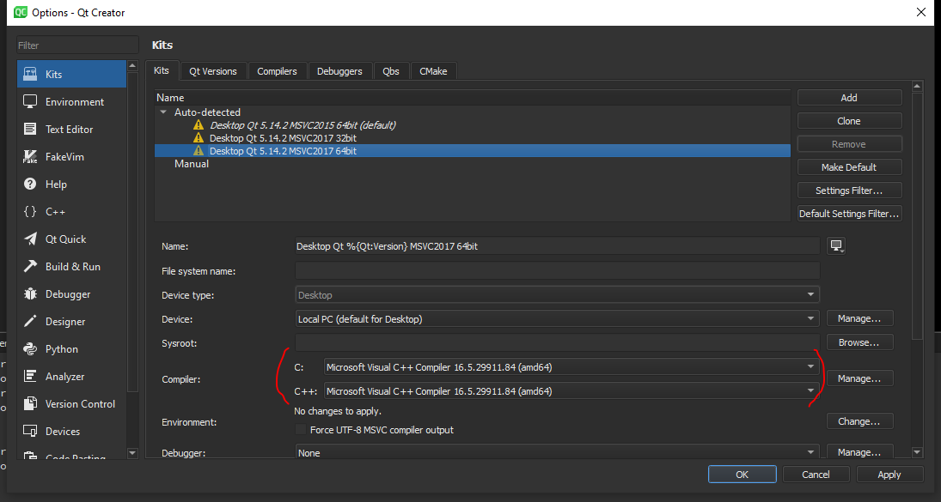
Visual Studio 2019 with Qt Creator as compiler
When using Visual studio 2019 for developing application using QT. Simply install QT opensource on your machine, Select MSVC 2017 64 in various options in QT installation. Once that is selected you can complete setup of QT.
Then Open Tools options and add a kit for visual studio.
Select settings as per following page.

Slide 4
qDebug() vs std::cout<<
In Qt project we often use qDebug() and rightly so.
Std::cout << “message” will send message to output stream but will not actually print on monitor.
Std::cout << std::flush is required to print message immediately. Otherwise you will see all messages printed at the end of program.
qDebug() on the other hand will output immediately and will also add newline feed.

Slide 5
How to check if connection is successful ?
Connect(sender,signal,receiver,slot) is successful or not ?
Use qDebug() << connect() to print. If connection is successful it will print true.

Slide 6
Connect using macros vs method address
Following are 2 methods to connect signals to slots in QT.
connect(this, &Student::mySignal, this, &Student::mySlot); // new method
connect(this, SIGNAL(mySignal()), this, SLOT(mySlot())); // Old method
IMP: Read https://wiki.qt.io/New_Signal_Slot_Syntax
Pros
Compile time check of the existence of the signals and slot, of the types, or if the Q_OBJECT is missing.
Argument can be by typedefs or with different namespace specifier, and it works.
Possibility to automatically cast the types if there is implicit conversion (e.g. from QString to QVariant)
It is possible to connect to any member function of QObject, not only slots.
Cons
More complicated syntax? (you need to specify the type of your object)
Very complicated syntax in cases of overloads? (see below)
Default arguments in slot is not supported anymore.

Slide 7
Always check return value of connect method (programmers should never ignore return values):
Instead of
connect(that, SIGNAL(mySignal(int)), this, SLOT(mySlot(int)));
always use something like
bool success = connect(that, SIGNAL(mySignal(int)), this, SLOT(mySlot(int)));
Q_ASSERT(success);
Or if you like throw an exception or implement full error handling. You may also use a macro like that:
#ifndef QT_NO_DEBUG
#define CHECK_TRUE(instruction) Q_ASSERT(instruction)
#else
#define CHECK_TRUE(instruction) (instruction)
#endif
CHECK_TRUE(connect(that, SIGNAL(mySignal(int)), this, SLOT(mySlot(int))));
You need an event loop for queued connections:
I.e. when ever you connect signals/slots of two objects owned by different threads (so called queued connections) you need to call exec(); in the slot's thread!
The event loop also needs to be actually served. Whenever the slot's thread is stuck in some kind of busy loop, queued connections are NOT executed!

Slide 8
Signals and Slots
You need register custom types for queued connections:
So when using custom types in queued connections you must register them for this purpose.
First declare the type using the following macro:
Q_DECLARE_METATYPE(MyType)
Then use one of the following calls:
qRegisterMetaType<MyTypedefType>("MyTypedefType"); // For typedef defined types
qRegisterMetaType<MyType>(); // For other types
Prefer new compile time syntax over old run-time checked syntax:
Instead of
connect(that, SIGNAL(mySignal(int)), this, SLOT(mySlot(int)));
use this syntax
connect(that, &ThatObject::mySignal, this, &ThisObject::mySlot));
which checks signal and slot during compile time and even does not need the destination being an actual slot.
If your signal is overloaded use the following syntax:
connect(that, static_cast<void (ThatObject::*)(int)> &ThatObject::mySignal), this, &ThisObject::mySlot); // <Qt5.7
connect(that, qOverload<int>::of(&ThatObject::mySignal), this, &ThisObject::mySlot); // >=Qt5.7 & C++11
connect(that, qOverload<int>(&ThatObject::mySignal), this, &ThisObject::mySlot); // >=Qt5.7 & C++14
Also do not mix const/non-const signals/slots for that syntax (normally signals and slots will be non-const).

Slide 9
Signals and Slots
Your classes need a Q_OBJECT macro:
In classes where you are using "signals" and "slots" specifications you need to add a Q_OBJECT macro like this:
class SomeClass
{
Q_OBJECT
signals:
void MySignal(int x);
};
class SomeMoreClass
{
Q_OBJECT
public slots:
void MySlot(int x);
};
This macro adds necessary meta information to the class.

Slide 10
Signals and Slots
Your objects must be alive:
As soon as either the sender object or the receiver object is destroyed, Qt automatically discards the connection. If the signal isn't emitted: Does the sender object still exist? If the slot isn't called: Does the receiver object still exist?
To check the lifetime of both objects use a debugger break point or some qDebug() output in the constructors/destructors.
It still does not work:
To do a very quick and dirty check of your connection emit the signal by your self using some dummy arguments and see if it is called:
connect(that, SIGNAL(mySignal(int)), this, SLOT(mySlot(int)));
emit that->mySignal(0); // Ugly, don't forget to remove it immediately
Finally of course it is possible that the signal simply is not emitted. If you followed the above rules, probably something is wrong in your program's logic. Read the documentation. Use the debugger. And if there is now other way, ask at stackoverflow.

Slide 11
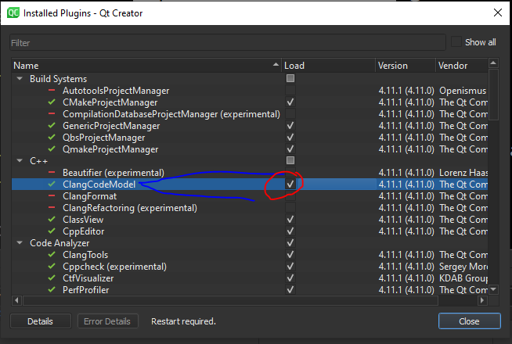
QT Creator intellisense not working ?
When using Visual studio compiler with QT Creator, if clicking on methods, class names doesn’t take you to their definition, then check plugin dialog and uncheck, ClangCodeModel.

Slide 12
Keep binding expressions as simple as possible. Avoid updating bound property when it's not necessary (triggering re-evaluation of binding expressions). See Property bindings for more details.
Prefer using concrete types instead of var. See Using var vs concrete types for details.
Avoid using massive JavaScript functions in qml. See JavaScript code fro details.
Prefer using simple Row, Column types instead if RowLayout, ColumLayout. If usage of Layout type is unavoidable read Layouts and Qt Quick Layouts overview
Use Loader for lazy instantiation. See Loader for details.
Almost all qml views should have data models. See Data Models, QAbstractItemModel subclass and qml ListModel
Don't use Qt.createComponent() and Qt.createQmlObject(). Everything that is described here: Dynamic object creation should be avoided.
Important QML Guidelines

Slide 13
Important QML Guidelines
Keep QML object attributes in the same order: https://doc.qt.io/qt-5.11/qml-codingconventions.html#qml-object-declarations
Qt qml documentation to read:
Qt Quick Best Practices
Performance Considerations And Suggestions
Integration QML and C++
Overview - QML and C++ Integration
Exposing Attributes of C++ Types to QML
Writing QML Extensions with C++
Data Type Conversion Between QML and C++
Open question 1: qml Instantiator vs Repeater vs Loader ???
Instantiator is a combination of Repeater and Loader. It's useful when you have a model that you use to create many objects dynamically. Also supports asynchronous loading.

Slide 14
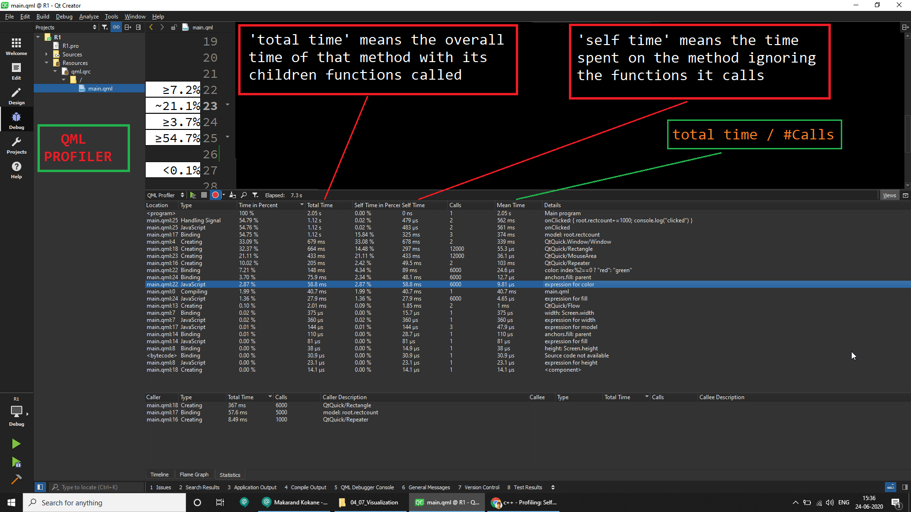

Slide 15
HOW To check time required to execute function
QElapsedTimer timer;
timer.start();
slowOperation(); // we want to measure the time of this slowOperation()
qDebug() << timer.elapsed();

Slide 16
Showing content of AbstractListModel without roles.
ListView {
anchors.centerIn: parent
width: 400
height: 400
model: studentmodel
delegate: Rectangle {
width: parent.width
height: 50
color: index%2==0?"red":"green"
Text {
anchors.centerIn: parent
font.pointSize: 16
text: model.display
}
}
}
model.display // model.data(index, Qt::DisplayRole) in c++
model.decoration // Qt::DecorationRole
model.edit // Qt::EditRole
model.toolTip // Qt::ToolTipRole

Slide 17
Showing how to use Array in QML
property var names: ["Girish","Ajit","Sachin","Suhas","Ramesh","Suresh"];
ListView {
anchors.top: b1.bottom
spacing: 10
width: 300
height: 400
model: names
delegate: Rectangle {
width: parent.width
height: 50
color: index%2==0?"green":"lightblue"
Text {
anchors.centerIn: parent
text: model.modelData
font.pointSize: 20
}
}
}

Slide 18
Accessing Model values of QML model in ListView
ListView {
spacing: 10
width: 400
height: 400
model: ListModel {
ListElement{name: qsTr(“Girish")}
ListElement{name: qsTr(“Ajit")}
ListElement{name: qsTr(“Suhas")}
}
delegate: Rectangle {
width: 200
height: 50
color: index%2?"lightgreen":"steelblue"
Text {
text: model.name
anchors.centerIn: parent
font.pointSize: 20
}
}
}

Slide 19
How to access element of model for given role?
ComboBox {
width: 200
height: 100
// model: 4
model: ListModel {
ListElement {name:"1"}
ListElement {name:"2"}
ListElement {name:"3"}
ListElement {name:"4"}
}
onCurrentIndexChanged: {
console.log(currentIndex+1);
console.log(model.get(currentIndex)["name"]);
}
}

Slide 20
Accept clicks from all mouse buttons(left, middle, right)
This is required*
MouseArea {
anchors.fill: parent
acceptedButtons: Qt.AllButtons;
onClicked: {
console.log("Mouse pressed")
if (mouse.button == Qt.MidButton) {
rect.color="red"
console.log("middle button")
} else if (mouse.button == Qt.RightButton) {
console.log("right button")
rect.color = "green"
} else if (mouse.button == Qt.LeftButton) {
console.log("left button")
rect.color = "blue"
}
}
}

Slide 21
Steps for Creating Deployment folder for QML application
1. Create your application (e.g D:\test\q1 )
2. Build your application in debug/release
3. It will create separate build folder (e.g D:\test\ .\build-q1-Desktop_Qt_5_14_2_MSVC2017_64bit-Debug
4. Create new folder for deployment (e.g D:\test\q1Distribution)
5. Fire following command in parent folder of source and build.
windeployqt <executable path> --dir <deployment folder path> --qmldir <qmlfiles path>
example
D:\test>windeployqt .\build-q1-Desktop_Qt_5_14_2_MSVC2017_64bit-Debug\debug\q1.exe
--dir D:\test\q1Distribution --qmldir D:\test\q1
windeployqt ./build-ecgSimulatorUI-Desktop_Qt_5_14_2_MSVC2017_64bit-Release\release\ecgSimulatorUI.exe --dir D:\test\ECGSimulatorUI --qmldir D:\ConsoleDevelopment\Tools\ecgSimulatorUI

Slide 22
windeployqt ./build-ecgSimulator-Desktop_Qt_5_14_2_MSVC2017_64bit-Release\release\ecgSimulator.exe --dir D:\test\ECGSimulatorCmd --qmldir D:\ConsoleDevelopment\Tools\ecgSimulator

Slide 23
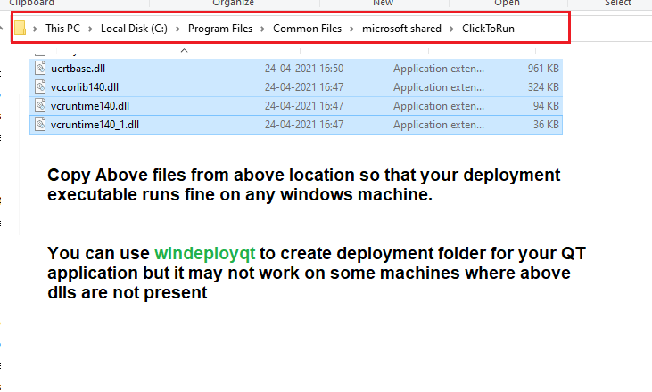
Required dlls for deployment folder to work

Slide 24
Painful error of “Dependent (that clearly exists) does not exist error when building Qt Creator project”
Add following line in .pro file which will convert all paths to absolute paths.
QMAKE_PROJECT_DEPTH = 0

Slide 25

How to Convert QT project(.pro) to Visual Studio Project
Simply fire following command inside QT project folder.
qmake -tp vc
Note : your environment variable PATH should store path to
cl.Exe of visual studio. For e.g
C:\Program Files (x86)\Microsoft Visual Studio\2019\Professional\VC\Tools\MSVC\14.20.27508\bin\Hostx64\x64

Slide 26
Dialog {
id: d1
onVisibleChanged: {
textitem.setMyFocus();
}
property alias textitem: myloader.item
Loader {
id: myloader
anchors.fill: parent
sourceComponent: Column {
function setMyFocus() {
mytext.forceActiveFocus();
}
Rectangle {
width: 200
height: 200
color: "red"
TextField {
id: mytext
anchors.centerIn: parent
}
}
}
}
}
Setting attributes on items inside loader object
In this example we are setting focus on the textbox which is part of dynamically loaded component inside loader.
Idea is to create alias for loader component.
And using the alias we can update property of component.

Slide 27
How to trigger a button click when the enter key is pressed in QML
Button {
id: _button
text: "Button"
function activate() { console.debug("Button activated"); }
onClicked: _button.activate()
Keys.onReturnPressed: _button.activate() // Enter key
Keys.onEnterPressed: _button.activate() // Numpad enter key
}

Slide 28
Use dynamic string in message
// Create a progress dialog.
QProgressDialog dialog;
dialog.setLabelText(QString("Progressing using %1 thread(s)...").arg(QThread::idealThreadCount()));
ui->label->setText(QString("Progressing at %1 percentage..").arg(QString::number(value)));

Slide 29
print to console when using Qt?
#include <QTextStream>
QTextStream out(stdout);
foreach(QString a, strings)
out << a << endl;

Slide 30
set color of text and background of a QLabel?
QPalette test_pallete;
test_pallete.setColor(QPalette::Window, Qt::white);
test_pallete.setColor(QPalette::WindowText, Qt::blue);
test_label->setAutoFillBackground(true);
test_label->setPalette(test_pallete);
test_label->setText("Hello World");

Slide 31
MultiThreading in QT
1. Derive your thread class from Qthread and override run() method.
2. Using thread pool. Derive your class from Qrunnable. Then use threadpool instance and
pass your class object to start() method to run your run() method in multithreading.
3. Using QtConcurrent() method.

Slide 32
Std output in QT Creator for debugging
If you are working on multiple qt creator projects then qDebug() stops working. In such cases you can use
Following functions. Add them in header and include that header.
QTextStream& qStdOut()
{
static QTextStream ts( stdout );
return ts;
}
void log(QString msg) {
qStdOut() << msg << flush;
}

Slide 33
Calling a function on Timer
When we call some function on a timer as follows
QTimer* t1 = new QTimer(this);
t1->setInterval(1000);
connect(t1,&QTimer::timeout,this,&Student::func1);
t1->start();
It uses different thread from main thread. BUT very importantly
Every call is done on the same thread.
Hence Even if your interval is set to 1000 ms it will not call function second time if first call is not done. This is very important to remember and crucial point.
This way you can call a function as fast as possible , say every 1 ms and don’t worry about the calls being pushed in the stack.

Slide 34
Q_OBJECT macro
Q_OBJECT macro is important.
This Creates test file test_moc.cpp
Without this file SIGNALS and SLOTS will not work
Qobject cannot be copied. It disables the copy operation. You must send Qobject by pointer or reference.

Slide 35
Signal and slots
Do not write implementation for signals.
Always public
Always defined
But Never implemented
SLOT
Can be public private or protected
Always defined and implemented
Should match the signature of the signal
You can call a slot like a normal function

Slide 36
Fuzzy compare in QT
Qt's qFuzzyCompare function is useful for approximate comparison of two float or double values. ... In this case, only if p1 and p2 are exactly equal the function will detect that and return true, but otherwise, if values are only approximately equal, it will return false

Slide 37
Using sender of the signal in slot() method
Void Server::onConnected() { QTCPSocket* socket = qobject_cast<QTcpSocket*>(sender());
// In above way we can get the pointer to the sender from the slot
}

