Slide 1

Qt Learnings
By Girish Lande

Slide 2
When using Visual studio 2019 for developing application using QT. Simply install QT opensource on your machine, Select MSVC 2017 64 in various options in QT installation. Once that is selected you can complete setup of QT.
Then Open Tools options and add a kit for visual studio.
Select settings as per following page.

Slide 3
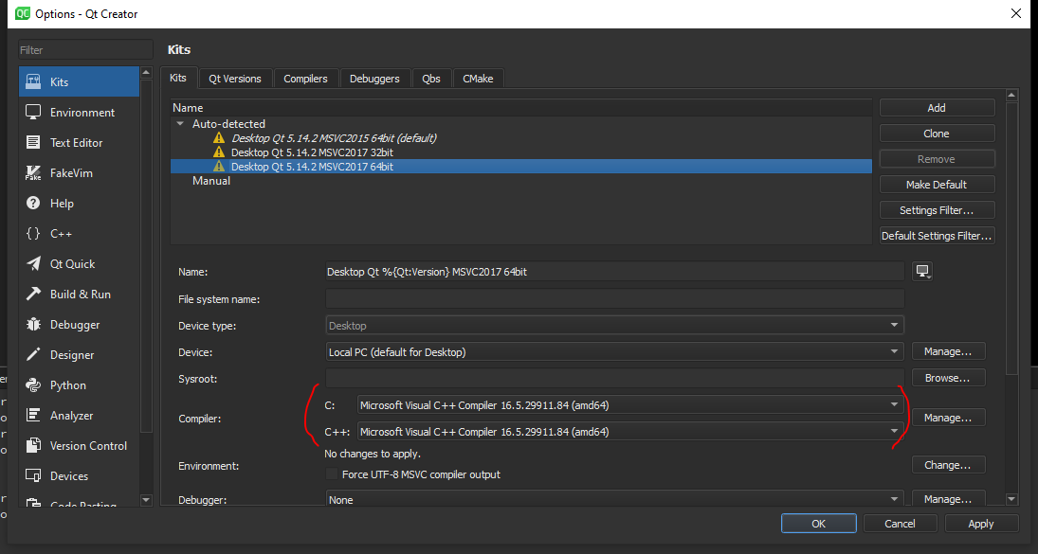

Slide 4
qDebug() vs std::cout<<
In Qt project we often use qDebug() and rightly so.
Std::cout << “message” will send message to output stream but will not actually print on monitor.
Std::cout << std::flush is required to print message immediately. Otherwise you will see all messages printed at the end of program.
qDebug() on the other hand will output immediately and will also add newline feed.

Slide 5
Connect using macros vs method address
Following are 2 methods to connect signals to slots in QT.
connect(this,&Student::mySignal,this,&Student::mySlot); // new method
connect(this,SIGNAL(mySignal()),this,SLOT(mySlot())); // Old method IMP: Read https://wiki.qt.io/New_Signal_Slot_Syntax
Pros
Compile time check of the existence of the signals and slot, of the types, or if the Q_OBJECT is missing.
Argument can be by typedefs or with different namespace specifier, and it works.
Possibility to automatically cast the types if there is implicit conversion (e.g. from QString to QVariant)
It is possible to connect to any member function of QObject, not only slots.
Cons
More complicated syntax? (you need to specify the type of your object)
Very complicated syntax in cases of overloads? (see below)
Default arguments in slot is not supported anymore.

