Slide 1

VTK Learnings
By Girish Lande

Slide 2
Previously the touch interactions in Qt worked for touchpad on MacOS, but not on Windows touchscreens. This commit adds support for multi-touch gestures on Windows touchscreens and fixes some errors in MacOS trackpad gestures.
List of gestures supported:
Tap
Tap And Hold
Pinch
Rotate
Pan
Swipe
Added new example QVTKTouchscreenRenderWindows to demonstrate the use of gesture events in a QVTKOpenGLNativeWidget. See demonstration video here: https://youtu.be/fpnqsDmJ0Y8
Implementation details:
Modified QVTKInteractorAdapter to invoke events using widget local coordinates
Qt coordinates are inconsistent between gestures, and even within the same gesture on different platforms (Windows touchscreen vs MacOS touchpad)
VTK expects the invoked events to be in the local coordinate frame
Updated vtkInteractorStyleMultiTouchCamera to utilize the updated events

Slide 3
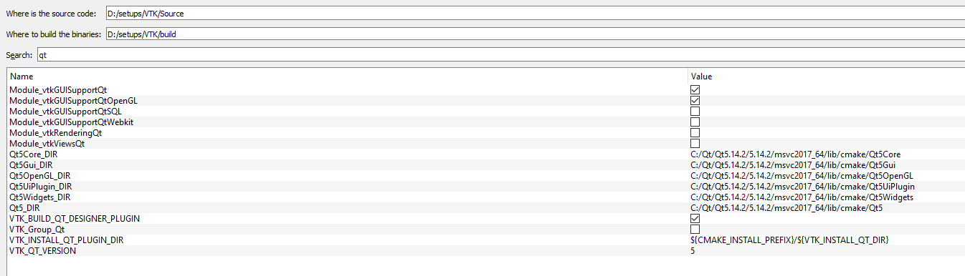
How to build vtk
Download vtk . Rename that folder to source. Create build folder. And install folder. Then use cmake to configure . Please refer to above settings for QT. Then configure project. Then Generate solution file. Now open that solution file in Visual studio and build. Building subproject “install” should create installation required things in given folder.

Slide 4
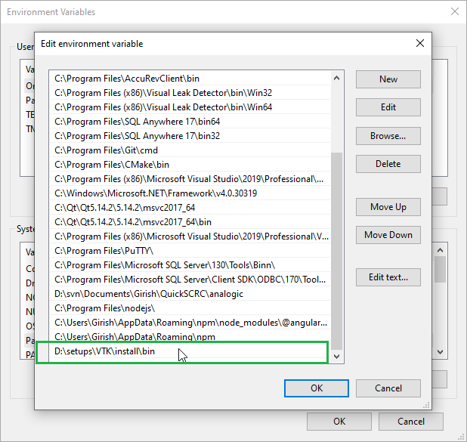
You don’t need to copy vtk dlls to the debug/release folder of your project
Simply add VTK installation folder bin path in your PATH environment variable in system environment variables. That’s why DLLS are called “shared” libraries. They get shared between the application

Slide 5
Template Project => 0VTK_QT_Template
Use this project and scripts in it for beginning any demo project for VTK

