Slide 1
Bezant Assignment
By Girishma Vandanapu

Slide 2
List of contents
Architecture
Flow diagram
Overview
Architecture deep dive and technological preferences
Technological preferences
Ingestion
Batch Ingestion
Real-time Ingestion
Data Processing
Data learnings
Data processing flow
Target Load- Data warehousing
Dimensions and Fact Tables
Data warehouse modelling
Process to load to dimensions and fact tables
Slow changing dimensions- issue 1
Slow changing dimensions- issue 2
References and links

Slide 3
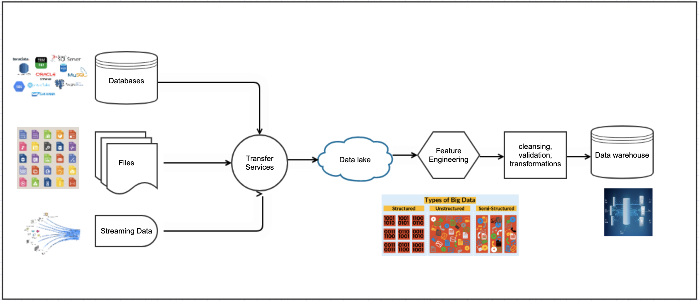
Architecture Flow Diagram

Slide 4
Architecture Overview
Data Lake
Input data can be structured/ unstructured/ semi-structured format
Input data can come from databases/ files/ real-time data streams
Data Warehouse
Target must have capability to analyse huge data
Data Lake House
Considering the product requirements ,the input data and target….. Data Lake House type of data pipeline fits well to this use case.
Target must provide faster read access
Target must be capable of organizing, storing huge historical data for the training of AI/ML models

Slide 5
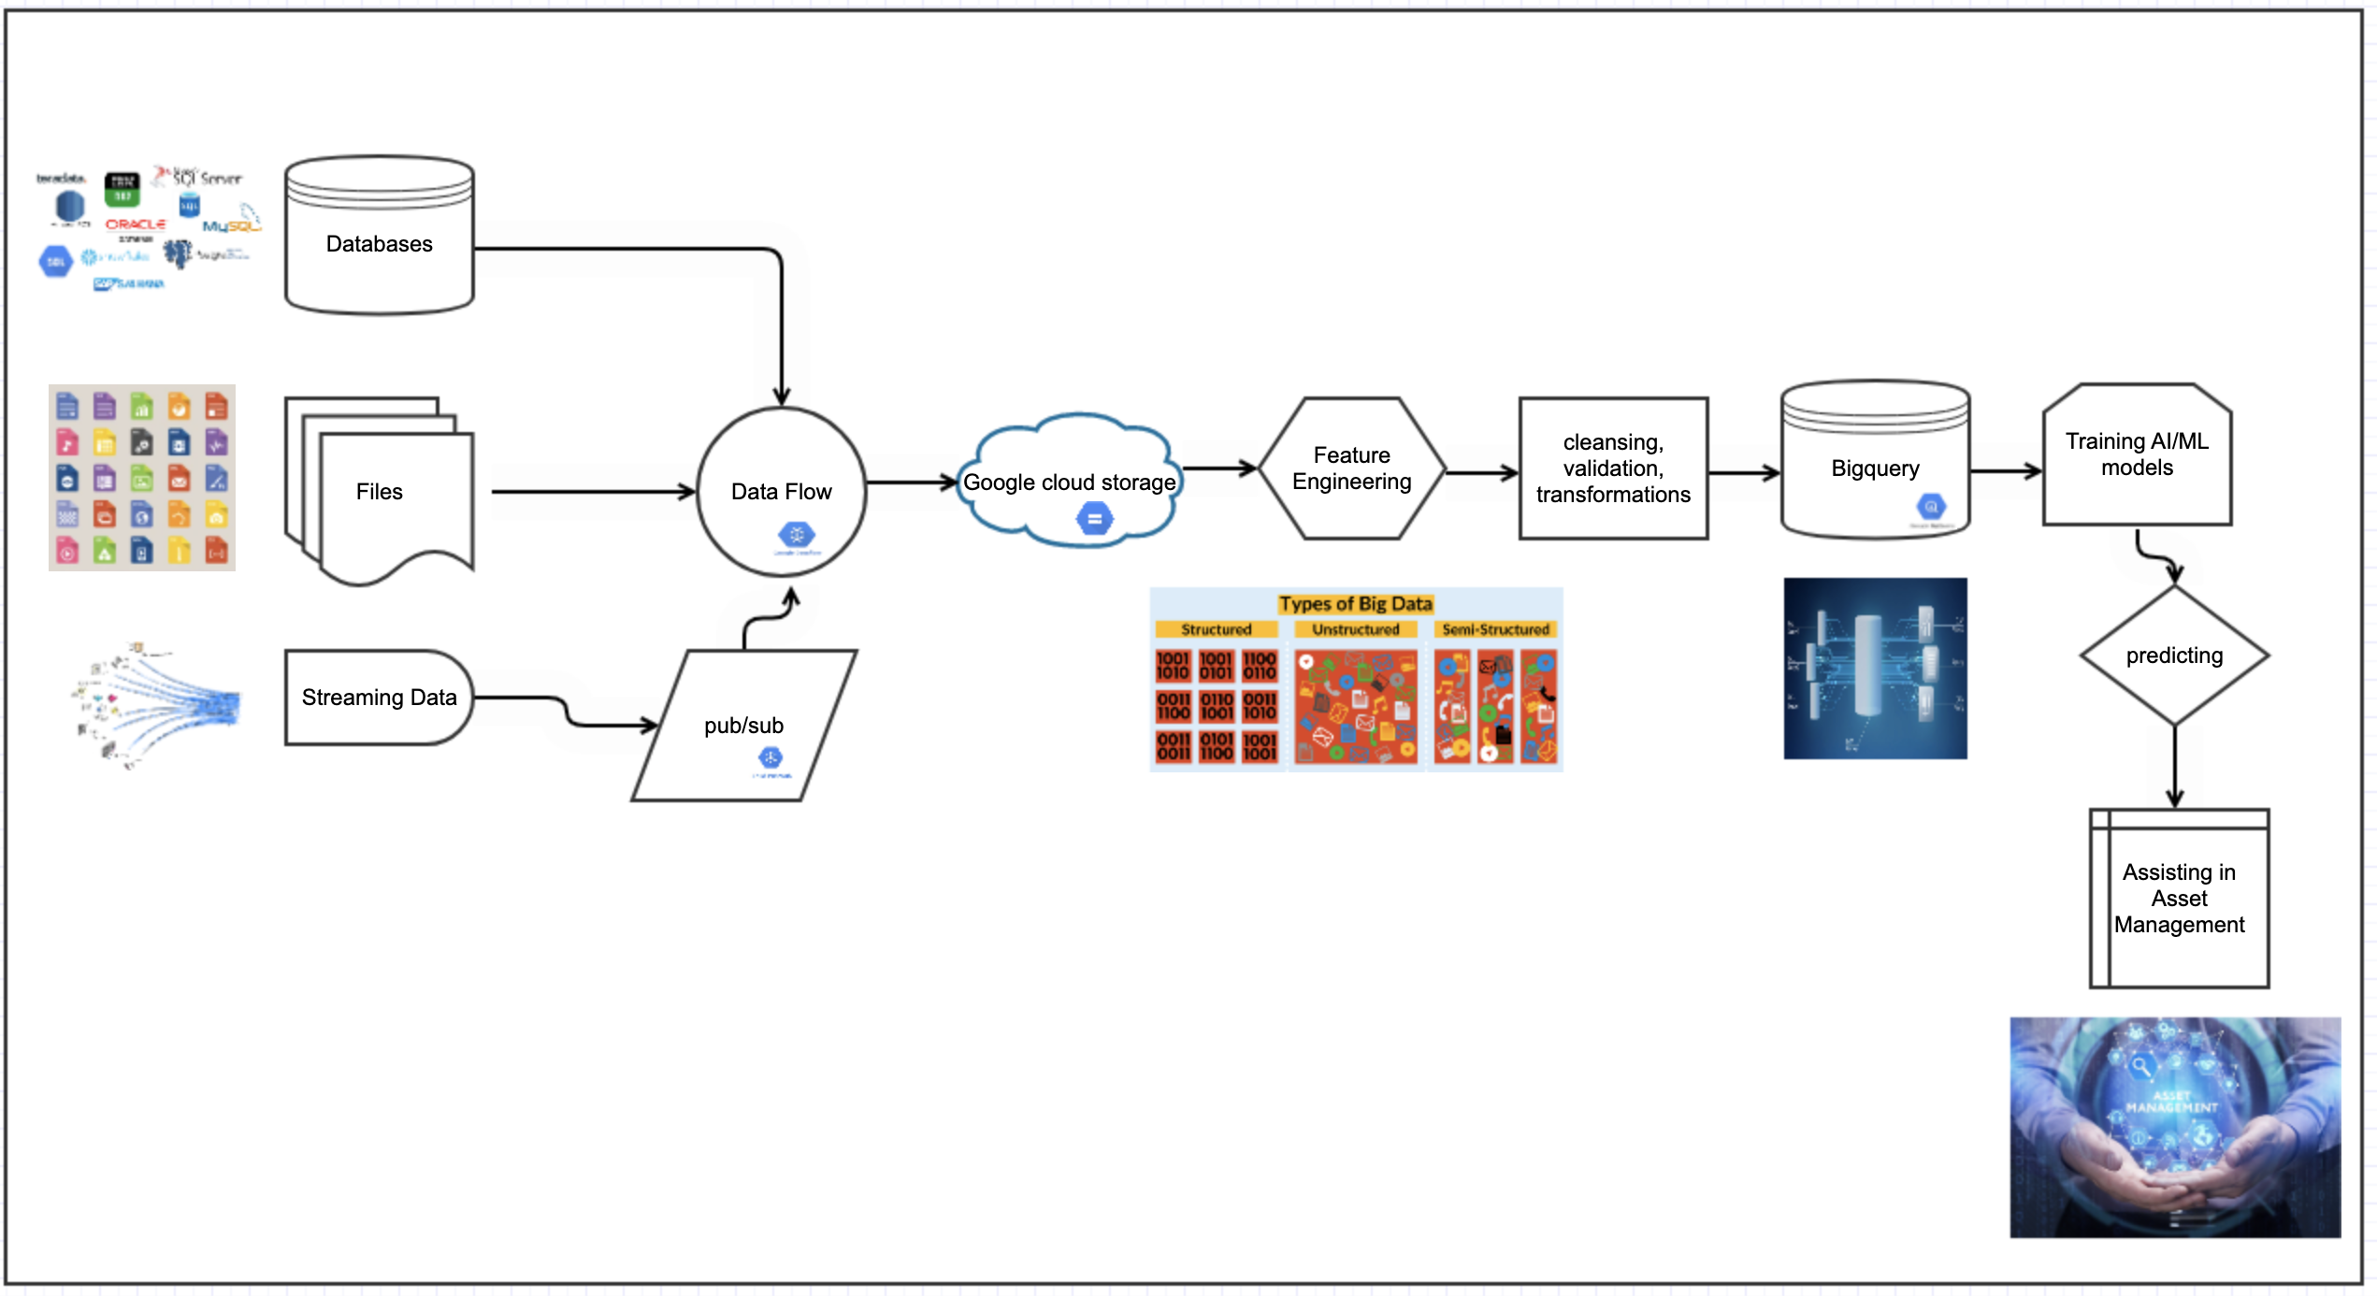
Architecture deep dive and technological preferences

Slide 6
Technology preferences
Dataflow
Helps in Extracting, transforming, loading huge data for both batch and real-time data
serverless architecture, fast and cost-effective service, easy pipeline building templates, etc.
Google Cloud Storage
Acts as a data lake and gives the flexibility to store structured, unstructured, semi-structured data.
Also helps in auto archiving, compressing, cleaning of historical, less often used data.
Google BigQuery
Helps to run analytics, train models on Huge data and provide faster insights
Serverless architecture, Acts as a Data warehouse and provides faster reads.
Pub/sub
Serverless architecture, decouples the producer and consumer by giving buffering/ queuing capability
Can help in retrieving data from multiple publishers on the topic of interest.
Consider storing the data in compressed formats like orc, parquet to minimize cost and improve performance.

Slide 7
Batch Ingestion
Historical Data Load
Historical load is done at the start of data pipeline building, this is one-time load of entire data present until that time.
Consider using the storage transfer services for this load.
Incremental Data Load
Incremental load can be intraday, daily, weekly, monthly, etc.. depending upon the frequency of the source data.
For loading Incremental data, state of data that is ingested has to be maintained after each run, else we might end loading entire data or duplicate data. In most cases state of data is stored in timestamp.
Also, sometimes the data arrives at source for current timestamp after the current time is passed, in such cases…consider using an extraction window.

Slide 8
Real-time Ingestion
Pub/sub
If the producer is producing data at faster pace compared to the consumer consuming pace, then there might be data loss. In such cases we need a system with buffering/queuing capability like pub/sub.
Also pub/sub helps in procuring data from multiple real-time sources on topics of our interest. Also it auto scales itself and it takes no much effort to setup due to it’s serverless architecture
Fault tolerance
If any of the micro-batch fails, then ingestion must start from the same place, there shouldn’t be any data loss or duplicates. So, ensure that checkpointing is properly done.
Checkpointing helps our application to be fault tolerant.

Slide 9
Data Processing
Data learnings –
It is telegram chat data from 2 telegram channels(directcrypto, yocrypto).
It has approximately 4 years data and around 1.2 lakh records per year.
There are around 17,000 users/groups.
The messages were about the directional bet advices of multiple currencies on multiple platforms, market trends, investors opinions, investors experiences, etc.
Found errors like - stop loss and profits incorrectly given for an entry price, some emojis, irrelevant text, nulls, text not having neither coin details nor platform details, generalized statements, alert texts, reactions to other messages, some outliers like 170% profit in 2 days.
Some of the critical data features - message_id, message_timestamp, trader_id, coin, long/short, leverage, current price, entry, profits/loss, stop loss, take_profit_level, isOverLeverageOk, trend(bull or bear), action_to_take(close or keep), period_to_invest, trading_platform, current_trade_status(closed/open), exit_price.

Slide 10
Data Processing Flow
Landing zone
Native zone
Staging zone
Data lands here and available temporarily for a few days.
Data in landing zone is compressed and stored in orc, parquet formats in this zone.
Entire data is available in this zone. This will act as source of truth for any information.
The native zone data goes through feature engineering, cleansing, validations, etc.
Then goes through schema transformations to load data into data warehouse.
Consumption Zone
Data is available in fact and dimension tables in a data warehouse
AI/ML models, reporting tools, users can consume the data from here.
Cleanup, archiving jobs will remove the data in certain intervals.
This data can reside in GCS.
This data can reside in GCS.
This data can reside in BigQuery.

Slide 11
Dimensions and Fact Tables
Modelling
After feature extraction, the next critical thing is to store the data in an organized way for analytics, reporting, ML models building , etc.
Fact
Fact table will contain all our KPI(key performance indicators), on which we can do some computations. Also, it contains the primary keys of dimension tables.
Dimension
Dimension tables as the name suggests will have dimensions on which we can group by the facts and do computations.
So, modelling the data warehouse well is very important. I have used star schema to model the data warehouse and divided the entire data into fact and dimension tables.

Slide 12
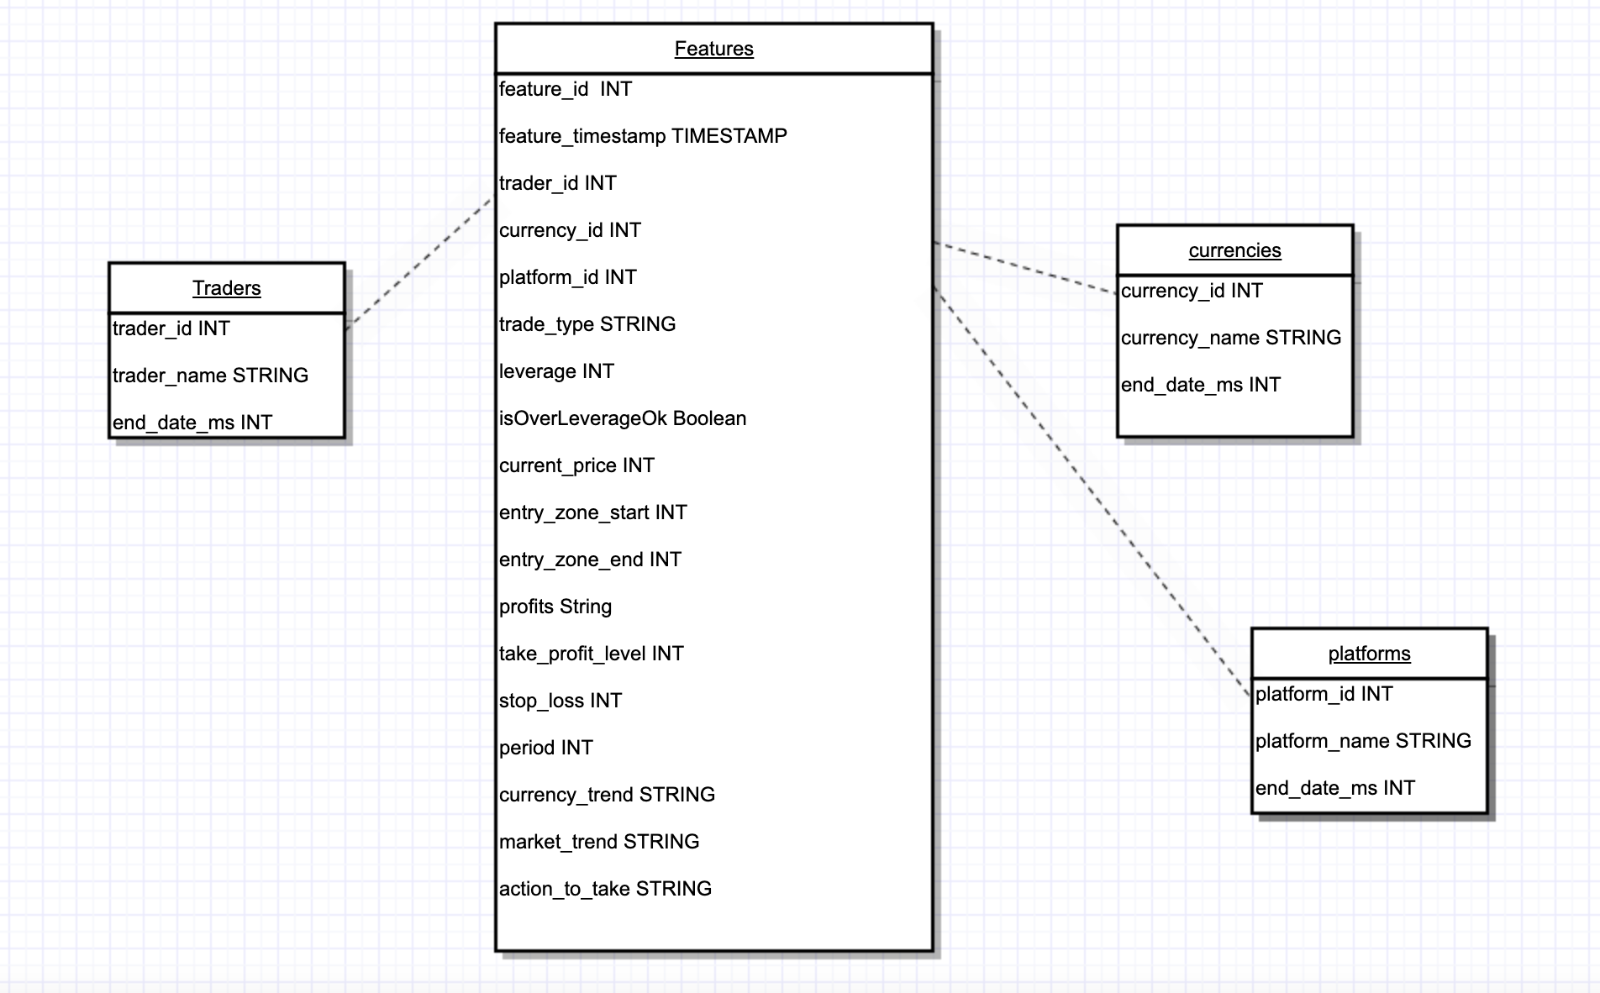
Data warehouse Modelling
dimension table
dimension table
dimension table
exit_price INT
fact table

Slide 13
Process to load the Dimensions and Fact tables
Read the source and dimensions data
Fetch the distinct dimensions present in the source but not in the dimension tables and persist into dimension tables with current epoch time as primary key as it indicated the valid from time.
Add the foreign keys (primary keys of dimension tables) columns to the source data with nulls in it.
Read the updated dimension tables and update the foreign keys in the source data.
Drop the columns which belongs to dimension tables in source data and persist source data into Fact table.

Slide 14
Slow changing dimensions- issue 1
scd issue
Dimensions data is not updated, inserted frequently as the dimensions change very rarely or slowly.
solution
There are scd1, 2, 3, 4, 6 to handle the same. Most of the data warehouses use scd 2. scd 2 helps to keep track of latest data and historical data and it fits well to our use case.
usage
In scd 2, dimension tables have valid from and valid to columns. I have considered the primary key column as valid from column. i.e: current epoch time. Valid to column will give the expiry, whenever there is an update, this can be loaded that time.
So, contemplating on the best ways to track historical and and the latest data is significant.

Slide 15
Slow changing dimensions- issue 2
Whenever there is fast changing fact and slow changing dimension, there can be issues.
If the dimension column values are null in the source, then it will get difficult to load data into data warehouse.
This issue can be handled in the below ways-
never process that fact
Park and retry
Insert a dummy value
Insert a row in dimension and update later

Slide 16
References and links
Github code - https://github.com/girishma18/crypto_asset_managemant_project
Analysis link- https://github.com/girishma18/crypto_asset_managemant_project/blob/main/analysis.txt

Slide 17
Thanks for Giving this Learning Opportunity

