Slide 1


INTERNATIONAL
INTERNATIONAL.COM
PERFORMANCE ASSURANCE STRATEGY
Proving S/4HANA, BTP and Central Finance at production load before go-live
Project NorthStar | October 2026 | Draft for VP IT and program leadership
CONFIDENTIAL AND PROPRIETARY TO INTERNATIONAL

Slide 2

EXECUTIVE SUMMARY
A ring-fenced, risk-based workstream can still prove the solution at load before Dec 15, if we decide by Oct 9
THE SITUATION
OUR ANSWER
WHAT WE NEED BY OCT 9
No plan, owner, budget or team for performance testing, while Mock-2 and SIT2 are distressed
10 weeks to tech go-live on Dec 15. UAT Oct 26 to Nov 20, cutover from Nov 23
Pre-prod is about 50% of PRD. Volumes and peak profiles are not yet known
Risk concentrates in the CFIN JE feed and trial balance match, VSM truck orders, billing with OneSource and DRC Mexico, VIM, and 168 BTP interfaces
Run performance assurance as its own workstream with a named owner and a dedicated team, separate from SIT2 and Mock staff
Risk-tiered scope: about 35 scripted end-to-end scenarios instead of several hundred bespoke tests
Start shift-left baselining in SIT2 this week. Most go-live performance defects are code, not hardware
Execute in a protected pre-prod window Nov 2 to Dec 4 and translate results with a three-class scaling model
Approve the workstream, the owner and the PwC change request
Fund a specialist performance team of about 6 people for 10 weeks
Reserve pre-prod Nov 2 to Dec 4 for performance cycles
Legacy and SaaS owners commit test capacity or accept stubs by Oct 16
Adopt the KPIs as a formal gate on Dec 4, feeding tech go-live readiness
2

Slide 3
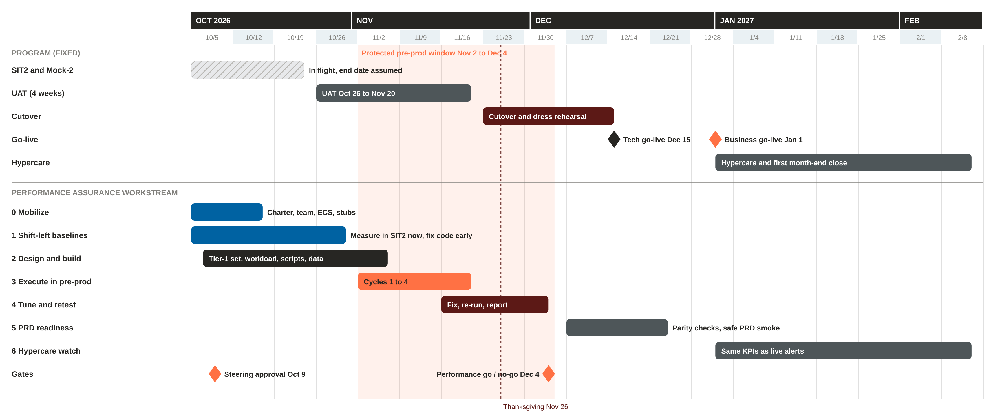
TEN WEEKS TO TECH GO-LIVE
Execution runs in parallel to UAT in a protected pre-prod window, ending with a performance gate on Dec 4
The cutover rehearsal from Nov 23 overlaps the retest window. Pre-prod sequencing must be decided now, not discovered in November.
3

Slide 4
THE SEVEN REQUIREMENTS, ANSWERED
Each requirement from the Oct 1 call has a concrete response, an owner and a ready-by date
# | Requirement raised | Our response | Owner | Ready by
1 | Specific tests for apps, integrations and batch | Risk-tiered catalog: about 35 Tier 1 scripted scenarios, about 70 Tier 2 component checks, telemetry for the rest. AI-assisted triage of the 168 interfaces, RICEFW list and Control-M export | INTL perf lead, PwC | Oct 16
2 | KPIs for each test | Standard KPI library by metric class, thresholds tuned per Tier 1 scenario and signed by process owners | PwC perf manager, process owners | Oct 23
3 | Environment to test in | Pre-prod (50% of PRD) with full Mock data volumes, protected Nov 2 to Dec 4. ECS refresh, config parity and snapshot restore points | Basis, SAP ECS | Oct 30
4 | Tooling over the environment | Keep NeoLoad. Add SAP-native ABAP and HANA analysis, Integration Suite monitoring, Cloud ALM and service virtualization stubs | Perf engineering | Oct 23
5 | Tests loaded with data and volumes | Workload model from legacy volumes, synthetic data factory, scripts parameterized for sequential and concurrent runs | Perf engineering, test data | Nov 2
6 | Near-production roles and integration security | Performance users cloned from production business roles, communication users with production-like authorizations, no SAP_ALL | Security and GRC | Oct 30
7 | Environment scaling estimates | ECS configuration sheet for pre-prod and PRD, a three-class scaling model, and a calibration run before cycle 1 | Basis, INTL perf lead | Nov 3
4

Slide 5
WHERE THE PERFORMANCE RISK LIVES
Working hypothesis until volumes are mined in week 1. Ratings drive the Tier 1 selection
Value stream | Volume | Complexity | Business impact | Novelty / known issues | Overall | Why
CFIN JE feed (Infor LN, DataStage, JDBC) and TB match | High | High | Very high | High | Very high | Month-end JE volume must post and reconcile inside the close calendar
OTC truck order (VSM / AVC, pricing, OneSource) | Medium | Very high | Very high | High | Very high | Complex configuration plus a synchronous tax call on every save
Billing, invoice outbound, DRC Mexico CFDI | High | High | Very high | High | Very high | Revenue and regulatory deadline. Chain of tax, forms, DRC and legacy
VIM vendor invoices (OCR, workflow, posting) | High | High | High | Very high | High | Already a known pain point. Workflow and background job load
BTP Integration Suite (168 interfaces) | High | Medium | High | High | High | Shared choke points: tenant limits, JMS, EOIO, Cloud Connector
Batch: Control-M, SOA, DataStage | High | High | High | Medium | High | Nightly and month-end windows across US and Mexico time zones
Warranty claims via Pega | Medium | Medium | High | High | High | Burst inbound claims, credit memo postings
Financial close and analytics | Medium | Medium | Very high | Medium | High | Heavy ACDOCA reads during the first close
Ariba indirect procurement | Medium | Low | Medium | Low | Medium | Standard integration, moderate volume
Fiori launchpad, login, roles | Medium | Low | Medium | Medium | Medium | Morning login storm, large role catalogs
5

Slide 6
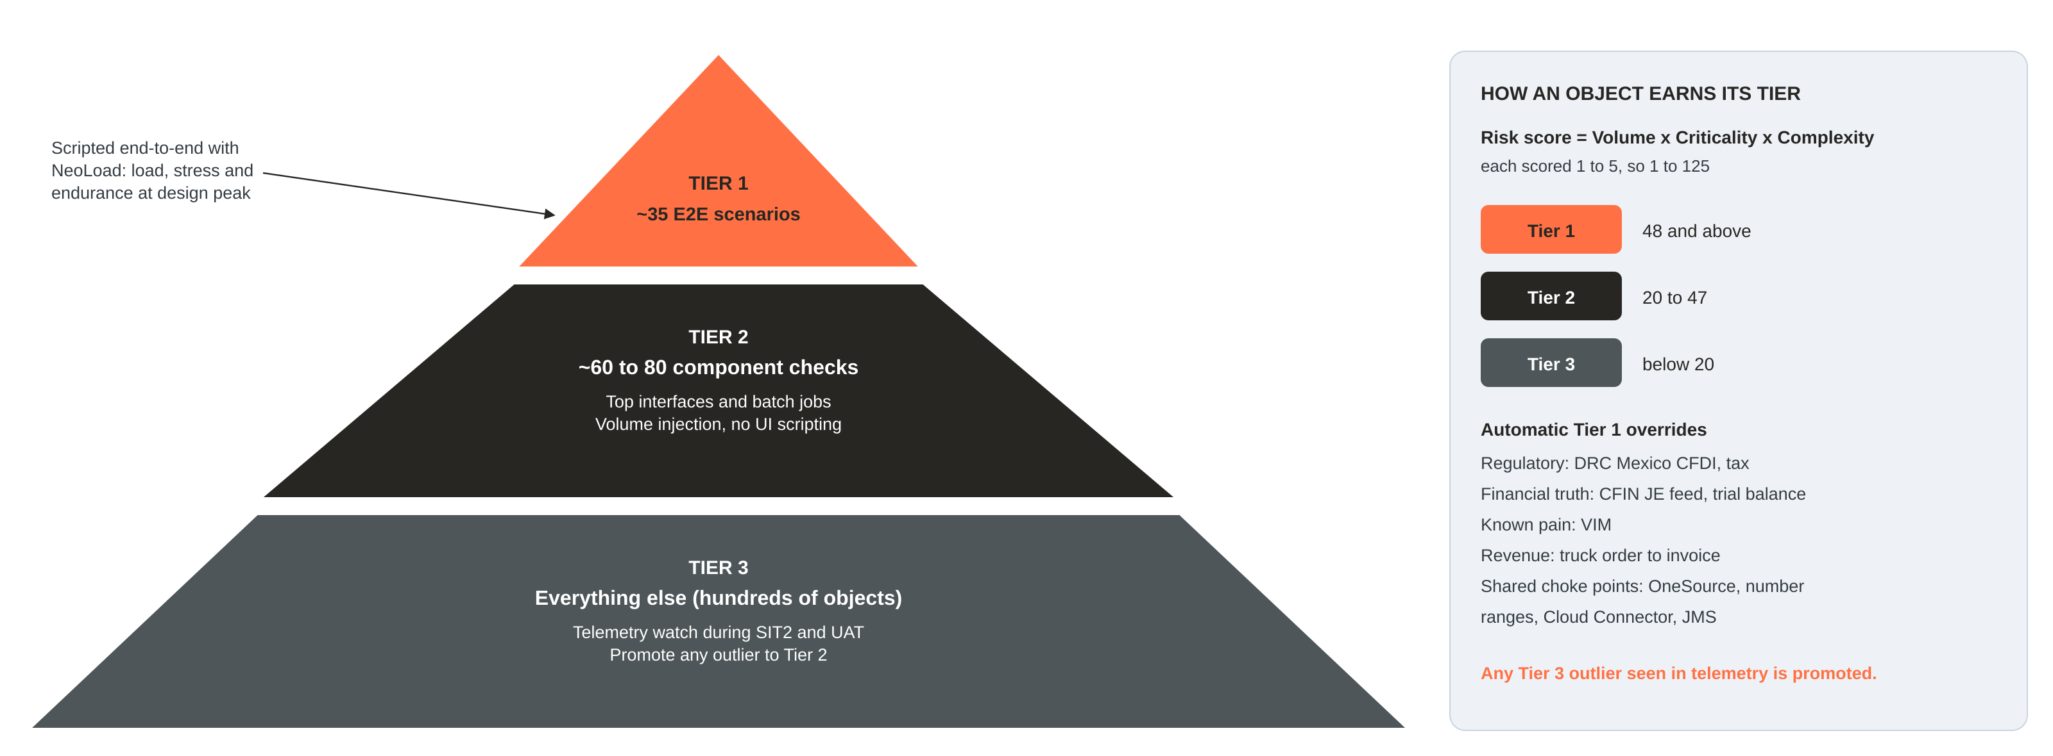
RISK-TIERED SCOPE
Test deeply where the risk is. Watch everything else with telemetry
How it works: every object in the interface list, RICEFW list, Fiori and T-code usage list and Control-M export gets a risk score. Tier 1 is scripted and load tested, Tier 2 gets volume injection without UI scripting, and Tier 3 is watched in SIT2 and UAT telemetry. This answers "several hundred tests" with defensible coverage instead of brute force.
6

Slide 7
THE TIER 1 SCENARIO SET: 35 END-TO-END FLOWS
Draft for the Oct 15 sign-off workshop. Full catalog with KPIs and scores is in the workbook
Order to cash and billing (8)
Central Finance and close (7)
P2P and VIM (6)
VSM truck order: configure, price, tax, save
Order change and reconfiguration
Inbound dealer and legacy orders via API
Delivery and goods issue
Billing run with OneSource and output
Invoice outbound to legacy apps
DRC Mexico CFDI to PAC and status back
Cash application and customer payments
Infor LN JE feed at month-end peak
AIF error reprocessing at volume
Trial balance match S/4 versus legacy
FX revaluation, depreciation, accruals
Financial statements and analytical apps
GL extracts to legacy and reporting
Period open and close steps
Ariba PO replication to S/4
Goods receipt and service entry
VIM OCR intake in bulk
VIM approval workflow, concurrent users
Invoice posting and 3-way match
Payment run and bank file
Warranty (3)
Integration and batch (6)
Platform and mixed load (5)
Pega claim inbound burst
Claim adjudication and credit memo batch
Claim status back to Pega
Top 20 iFlow mix at design peak
OneSource latency under concurrent load
Endpoint outage and backlog drain
Nightly Control-M critical path
Month-end batch chain
DataStage and SOA jobs alongside online
Morning login storm and launchpad
Integrated peak hour, all streams
Eight-hour soak
Stress to break point
Top heavy reports and CDS views
7

Slide 8
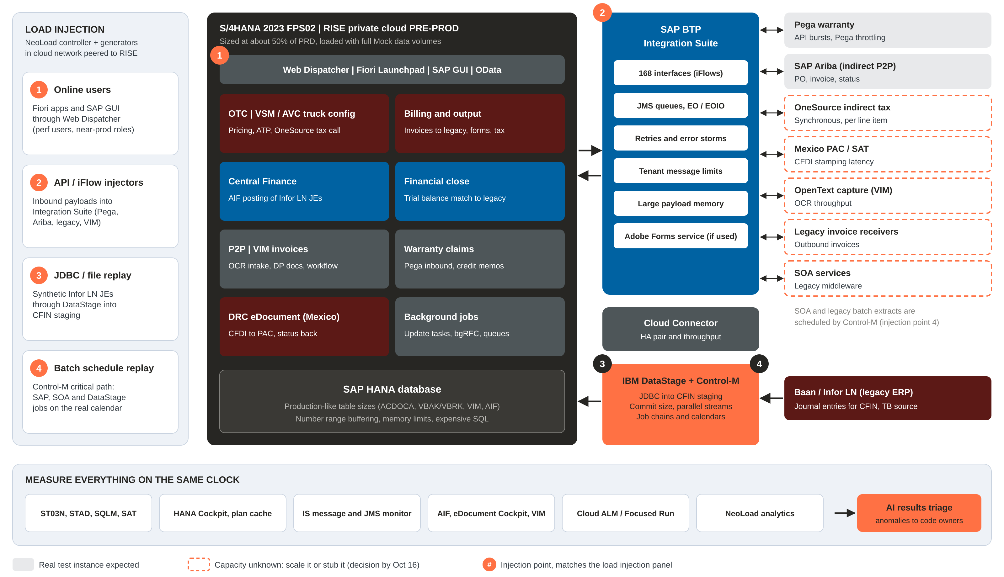
TEST ARCHITECTURE AND INJECTION POINTS
Four injection points, one measurement clock across S/4HANA, BTP, DataStage and the legacy endpoints
8

Slide 9
ENVIRONMENT STRATEGY
Pre-prod is the primary stage. Two fallbacks protect the gate if pre-prod time or capacity runs out
A
RECOMMENDED
READY-TO-TEST CHECKLIST
Protected pre-prod window
Full Mock data volumes, with table sizes checked against PRD projection
Transport and configuration parity with PRD
HANA parameters, work processes and number range buffering match PRD
Integration Suite test tenant and Cloud Connector set up like PRD
Performance users and roles cloned from production business roles
Stubs live for endpoints that cannot take load
Snapshot taken before each cycle, restore tested
Monitoring retention extended (ST03N, STAD, SQLM, IS logs)
ECS configuration sheet for pre-prod and PRD on file
Nov 2 to Dec 4 reserved for performance cycles. Shared with cutover rehearsal by agreed slots, nights and weekends
B
ADD-ON
ECS temporary app-tier upsize
Ask ECS to quote extra application servers for one cycle. Confirms class B scaling and narrows the forecast error
C
CONTINGENCY
PRD window before cutover
Only if pre-prod results are inconclusive. Full-size hardware, then snapshot restore. Needs ECS and cutover lead agreement
9

Slide 10
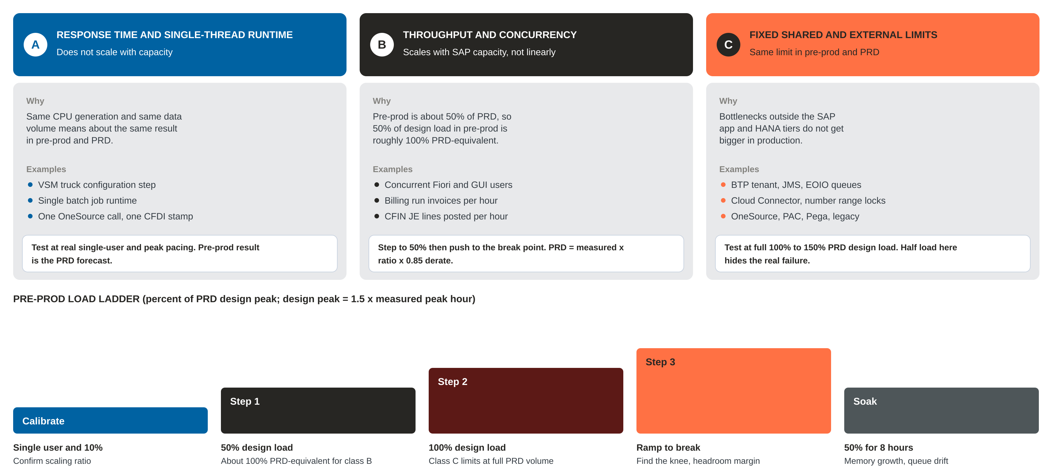
READING RESULTS FROM A 50% PRE-PROD
Not every metric doubles in production. Three classes, three translation rules
10

Slide 11
TOOLING: KEEP NEOLOAD, COMPLETE THE STACK
Switching load tools now would cost 3 to 4 weeks we do not have. The gaps are in monitoring, stubs and analysis
Layer | Tool | What it does for us
Load injection, UI | NeoLoad (licensed) | Fiori and OData, SAP GUI and web protocols. All Tier 1 user scripts
Load injection, non-UI | NeoLoad API tests or JMeter, DataStage replay jobs | iFlow payloads, JDBC JE volumes, file drops at design rate
Service virtualization | Mock iFlows on the BTP test tenant, or WireMock | Stand in for PAC, OneSource and legacy endpoints that cannot take load
ABAP and HANA analysis | ST03N, STAD, SQLM, SAT, ST05, HANA Cockpit, SQL plan cache | Find the expensive statement, the hot code path, the lock
Integration monitoring | Integration Suite monitor, JMS queues, Cloud Connector, AIF, eDocument Cockpit | Throughput, backlog, retries and error rates per interface
Observability and hypercare | SAP Cloud ALM or Focused Run, existing APM if licensed | Same dashboards and thresholds carry into hypercare
Results intelligence | AI-assisted analysis over exported metrics | Anomaly detection, triage to code owners, daily readout
Recommendation: keep NeoLoad for this go-live. It is licensed and covers the SAP protocols we need. Revisit the tool choice after hypercare, when the question becomes continuous performance regression for future releases rather than a ten-week sprint.
11

Slide 12
WORKLOAD MODEL AND TEST DATA
Peak is defined from evidence, not opinion. Data is production-shaped, not empty-system clean
1
2
3
4
Mine volumes
Find the peak
Add headroom
Build the mix
Infor LN JE counts, legacy orders and invoices, Ariba, Pega, Control-M history
Busiest hour of the busiest day: month-end days 1 to 3, billing cut-off, dealer order peaks
Design load = 1.5 x measured peak hour, plus 2027 growth
Little's Law turns hourly volume into virtual users and pacing per scenario
Test data: master data comes from the Mock-converted load so table sizes are realistic. Transactions are synthesized: balanced JEs that pass CFIN mapping, valid VSM configurations, CFDI-valid Mexican invoices, invoice images for VIM OCR, warranty claims. A pre-prod snapshot before each cycle lets us reset in hours, not days.
12

Slide 13
KPIS AND THE DEC 4 GO / NO-GO GATE
Proposed defaults. Process owners confirm thresholds per Tier 1 scenario by Oct 23
Class | KPI | Proposed threshold
Online, simple | Fiori or GUI step response, 90th percentile | 2 seconds or less
Online, complex | VSM configure, price and save; VIM approval | 5 seconds or less
Synchronous API | OneSource tax call, 95th percentile | 800 ms or less, no timeouts
Async interfaces | Sustained throughput versus design peak | 1.5 x peak, no backlog growth
Resilience | Backlog drain after a 1-hour endpoint outage | 60 minutes or less, zero loss
Central Finance | JE lines posted per hour; TB match | 1.5 x month-end peak; 100% match
Batch | Critical path versus batch window | Fits with 20% buffer
Platform | CPU, HANA memory, free dialog work processes | 70% / 80% / 20% free at PRD-equivalent
Endurance | Degradation over 8 hours | Under 10%, no memory growth
GO / NO-GO ON DEC 4
All severity 1 performance defects closed
At least 90% of Tier 1 scenarios meet KPI; the rest have a signed workaround and a hypercare monitor
Month-end CFIN volume posted and trial balance matched inside the close calendar
Batch critical path fits the window
No class C limit reached at full design load
Scaling forecast for PRD documented and accepted
13

Slide 14
WHERE INTELLIGENCE ACCELERATES THE WORK
AI shortens the slowest manual steps. People still own every decision and every sign-off
1
Inventory triage
2
Workload mining
3
Synthetic data factory
Read FSDs, the interface list, RICEFW and the Control-M export. Draft classification and risk scores for a two-hour validation workshop
Parse legacy GL counts, SOA and DataStage logs, and job history to find peak hours and arrival patterns
Generate balanced JEs, valid VSM configurations, CFDI-valid invoices, VIM invoice images and warranty claims
Weeks to days
Peak from evidence
Volume without PII
4
Script acceleration
5
Results triage
6
Daily readout
Draft API payloads from iFlow and OpenAPI specs, and suggest correlation and parameterization for NeoLoad scripts
Flag anomalies across ST03N, HANA and Integration Suite metrics, and route the expensive statement to its code owner
Auto-draft the daily executive status from test results and the defect log, reviewed by the performance lead
Faster Tier 1 build
Hours to root cause
Leaders stay informed
Also use what we already pay for: SAP Enterprise Support Going-Live Check (confirm entitlement), an ECS sizing review, and SAP Cloud ALM.
14

Slide 15
START THIS WEEK: THE FIRST TEN DAYS
None of these steps needs the test environment. All of them shorten the path to Nov 2
1
Name the owner
Oct 5
6
Pull legacy volumes
Oct 5 to 14
International performance lead and PwC counterpart
Infor LN GL, billing, Ariba, Pega and Control-M exports
2
Turn on telemetry in SIT2
Oct 5 to 9
7
AI triage of the inventory
Oct 7 to 14
ST03N and STAD retention, SQLM, HANA expensive statements, IS trace
168 interfaces, RICEFW, Fiori and T-code usage
3
Open ECS tickets
Oct 5
8
Call legacy owners
Oct 7 to 16
Pre-prod and PRD config sheet, refresh plan, snapshots, upsize quote
Scale or stub: OneSource, PAC, Pega, legacy receivers
4
Request Going-Live Check
Oct 5 to 9
9
Stand up NeoLoad
Oct 12 to 23
Confirm SAP Enterprise Support entitlement, book the analysis session
Controller, generators, network path to RISE, auth for perf users
5
Mine Mock-2 runtimes
Oct 5 to 16
10
Tier 1 sign-off workshop
Oct 15 to 16
CFIN posting rates, job runtimes, load durations
Risk scores, draft KPIs, owners per scenario
15

Slide 16
TEAM AND OPERATING MODEL
About 13 FTE at peak, mostly ring-fenced so SIT2 and Mock teams are not drained
Role | FTE | Source
International performance test lead (owner) | 1.0 | International
PwC performance test manager | 1.0 | PwC
Performance engineers (NeoLoad scripting, execution) | 4.0 | Specialist partner or offshore
Basis and HANA performance engineer | 1.0 | International or PwC, plus ECS
ABAP performance developers (fix team) | 2.0 | PwC
BTP Integration Suite engineer | 1.0 | Integration team
Test data engineer (synthetic data factory) | 1.0 | PwC or partner
DataStage and Control-M engineer | 0.5 | International
Functional SMEs: OTC/VSM, CFIN, P2P/VIM, warranty, tax | 1.25 | 5 x 25%, ring-fenced
Security and GRC | 0.25 | International
Legacy and SaaS owners | named | Infor LN, Pega, OneSource, PAC, OpenText, Ariba
CADENCE
Daily
15-minute stand-up during cycles
Twice weekly
Performance defect triage with dev leads
Weekly
30-minute readout to VP IT and program
Each cycle
Results pack with PRD forecast
Dec 4
Go / no-go into tech go-live readiness
Detailed RACI and plan are in the workbook.
16

Slide 17
RACI SUMMARY
R responsible, A accountable, C consulted, I informed. The workbook carries the RACI for all 44 plan activities
Activity | VP IT / steering | INTL perf lead | PwC perf mgr | Perf eng team | Basis / HANA | SAP ECS | BTP integr. | Func. SMEs | Legacy owners | Security / GRC
Charter, funding, decisions | A | R | C | I | I | I | I | I | I | I
Tier 1 scope and risk scoring | I | A | R | C | C |  | C | R | C
KPIs and acceptance criteria | C | A | R | C | C |  | C | R | I
Pre-prod readiness and parity | I | A | C | C | R | R | R |  |  | C
Perf users, roles, comm users |  | A | C | C | C |  | C |  |  | R
Workload model and volumes |  | A | R | R |  |  | C | C | R
Scripts, data, stubs |  | A | C | R |  |  | R | C | C
Test execution cycles | I | A | R | R | R | C | R | C | C
Tuning and code fixes | I | A | R | C | R | C | R | C | R
Go / no-go recommendation | A | R | R | C | C | I | C | C | I | I
17

Slide 18
TOP RISKS AND MITIGATIONS
Owned by the performance lead and reviewed at each weekly readout
Risk | Rating | Mitigation
Pre-prod contention with cutover rehearsal and UAT | High | Reserve Nov 2 to Dec 4 now. Slot nights and weekends. Option C as contingency
Team pulled into SIT2 and Mock-2 firefighting | High | Dedicated external performance team. SMEs ring-fenced at 25%
Volumes unknown today | High | Mine legacy data in week 1. Conservative 1.5x headroom, flagged as assumption
Legacy and SaaS endpoints cannot take load | High | Stub with mock iFlows. Separate low-rate contract test against the real endpoint
Fixes arrive too late to retest | High | Shift-left in SIT2. Twice-weekly triage. Priority transport lane for performance fixes
Pre-prod data not production-shaped | Medium | Refresh from Mock load. Check table sizes against PRD projection
Scaling misread leads to false confidence | Medium | Three-class model, ECS config sheet, calibration run, class C at full load
SSO blocks scripted performance users | Medium | Agree the authentication approach for performance users in week 2
Defect that cannot be fixed by Dec 15 | Medium | Pre-agreed workarounds (scheduling, parallelization) plus hypercare alerts
18

Slide 19
DECISIONS NEEDED BY OCT 9
Each week of delay comes straight out of the execution window
1
Stand up performance assurance as a funded workstream
Named International owner, PwC counterpart, change request approved
2
Bring in a specialist performance team of about 6 people
So SIT2, Mock-2 and UAT staff are not diverted
3
Reserve pre-prod Nov 2 to Dec 4
Agree slots with the cutover lead. Approve the Mock data refresh and snapshots through ECS
4
Direct legacy and SaaS owners to commit capacity or accept stubs by Oct 16
Infor LN, Pega, OneSource, Mexico PAC, OpenText, legacy receivers
5
Make the Dec 4 performance gate a formal input to tech go-live readiness
KPIs signed by process owners by Oct 23
19

Slide 20
APPENDIX: TECHNICAL HOTSPOTS TO PROBE FIRST
Architecture-level checks that most often decide SAP go-live performance. Each is a shift-left item in SIT2
Area | What to check
Number ranges | Buffering for FI, billing and eDocument numbers. Non-buffered or gapless ranges for Mexico serialize postings
OneSource | Synchronous call per item in order, billing and invoice verification. Connection pooling, timeouts, vendor rate limits
Billing chain | Billing run, then output forms, then DRC eDocument, then PAC. Throughput of the slowest link sets invoices per hour
CFIN via DataStage JDBC | Commit size, parallel streams, staging table indexes and locks, AIF parallel posting, recon report runtime
Integration Suite | Tenant message limits, JMS capacity, EOIO serialization, large payload memory, retry storms, Cloud Connector HA
VIM | OCR throughput, DP document jobs, workflow event queue, duplicate check, background job schedule
VSM and AVC | Model complexity, dependency evaluation, pricing condition volume, BOM explosion on save
Fiori and identity | Launchpad catalog size per role, OData batching, SSO for load users, Web Dispatcher limits
HANA | Table sizes from Mock data, ACDOCA reads, expensive statements, delta merge, memory allocation limit
Batch | Control-M concurrency versus background work processes, job classes, overlap with US and Mexico online peaks
20

