Slide 1
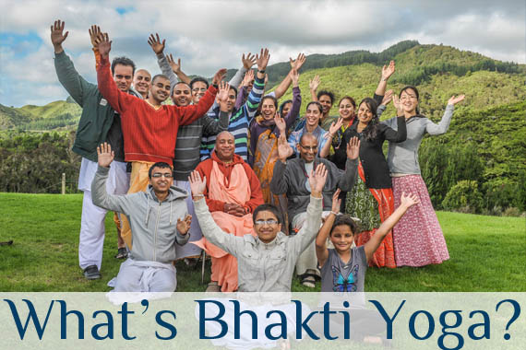

Slide 2
What is Bhakti Yoga
What is Bhakti?
LOVE
How does our typical love look like?
Interactive exercise:
Name few things for which our love lasts
0-1 year
Gadgets (apple watch, Xbox, laptop, etc.), teenage love, kids toys, dress, etc.
1-10 years
House, car, sometimes few neighbors, birthday/anniversary gifts, jewelry, sometimes spouse, etc.
Up to our lifetime
our body, Spouse, Parents, Kids, Friends, family, pets, plants, bank balance, mother nature, sometimes few neighbors, etc.
Multiple lifetimes
such a love is called bhakti
These are different shades or spectrum of our love – some of them short-term and some long-term but not forever permanent

Slide 3
What is Bhakti Yoga(contd.)
What is Bhakti? Primary/Secondary definitions.
A word in Sanskrit language
Pure love for the ultimate cause of all causes
Selfless love
Eternal love beyond our death, lifetime after lifetime
Unchanging love
Love that is ever-fresh
Love without motive of name, fame, money, power, etc.
Permanent feeling of love
Love that is not affected by circumstances
Favorable attitude to always please the beloved
Closest analogy of this world: Mother’s love for her child

Slide 4
What is Bhakti Yoga (contd.)
What is Yoga? Primary/Secondary definitions.
A word in Sanskrit language
Connecting to the ultimate cause
Union
Addition
To join
The word yoke came from yoga
Exercise
Nourishes body, mind and soul
Keeps body, mind and soul in equilibrium/harmony
That which gives peace within us and people around us
Wellness element
That which leads to liberation from miseries
That which gives happiness and ability to deal with adversities

Slide 5
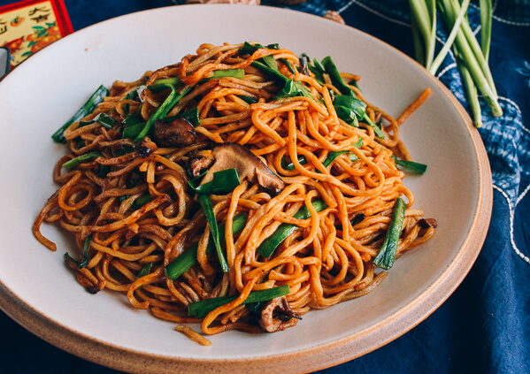
Final slide
Next class : Why do Bhakti yoga? The purpose of Bhakti yoga
Thank you, dinner time ☺

