Slide 1

Lending Club Case Study
Girish Satyam &
Ambar Ashish

Slide 2

Objective
The primary aim of this case study is to apply Exploratory Data Analysis (EDA) techniques to loan data obtained from a consumer finance company. The goal is to gain insights into the field of risk analytics within banking and financial services, as well as to comprehend the strategies for mitigating financial losses when lending to customers.
Through this case study, we will enhance our grasp of data visualizations and learn how various charts can facilitate a more comprehensive understanding of the data.
The business objective of this case study is to assist the company in uncovering the key factors that contribute to loan defaults. The company intends to utilize this knowledge to refine its portfolio management and risk assessment practices.
The main focus of this case study is to identify potentially high-risk loan applicants by employing EDA techniques.

Slide 3
Comprehension of the Business
When the company evaluates a loan application, it must decide whether to approve the loan based on the applicant's profile. This decision involves two types of risks: --
If the applicant is likely to repay the loan, rejecting the application means the company loses potential business.
If the applicant is unlikely to repay the loan, in other words, they are at risk of defaulting, approving the loan could result in a financial loss for the company.
This case study employs Exploratory Data Analysis (EDA) to investigate how the characteristics of both consumers and loans impact the likelihood of loan default.

Slide 4
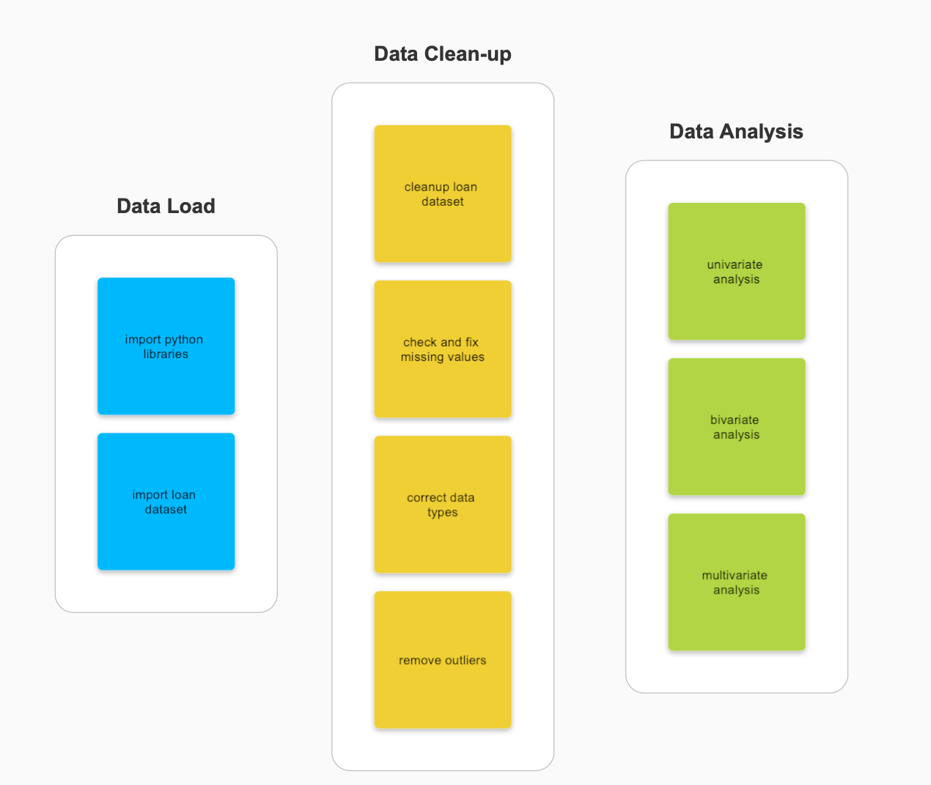
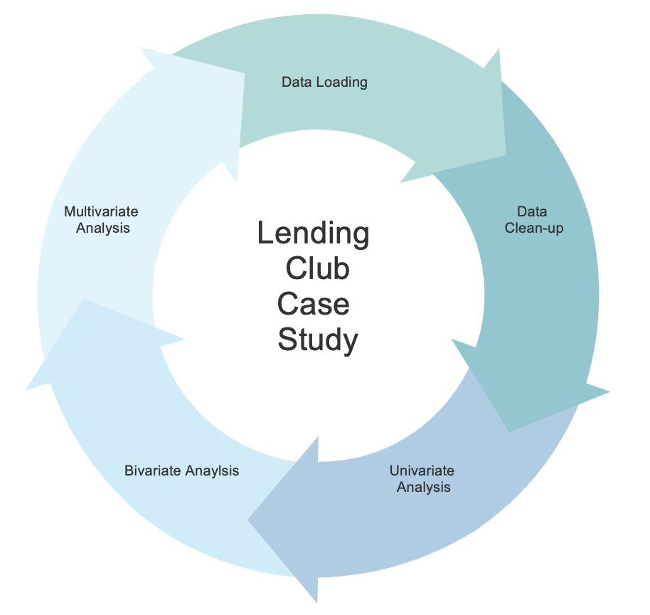
Data Cleanup and Preparation Steps/Process

Slide 5
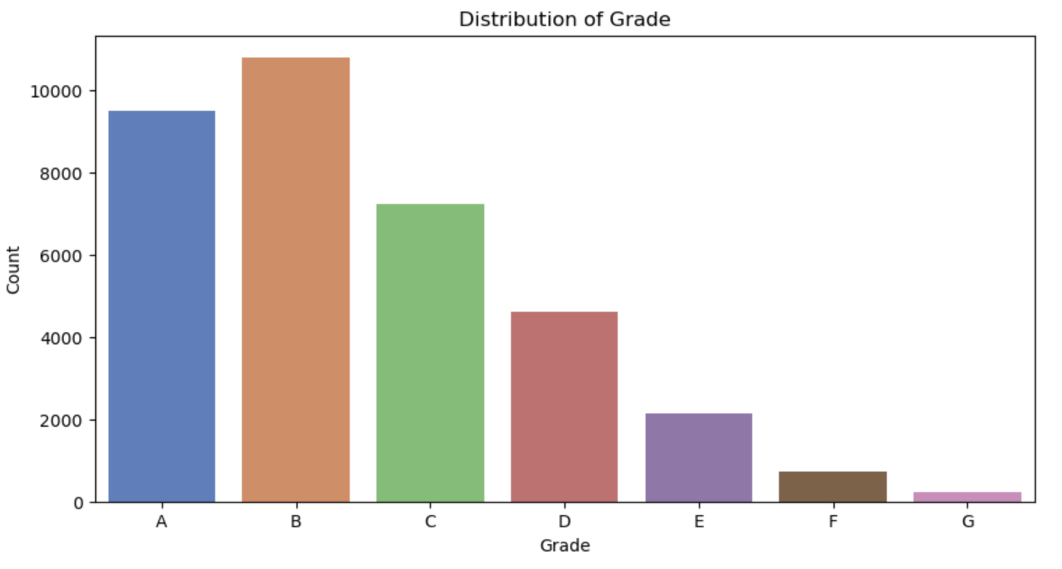
Loan Distribution against Grades
Observation:
A significant proportion of loans fall within categories A and B when compared to other grades, indicating that the majority of loans are of high quality or high-grade.

Slide 6
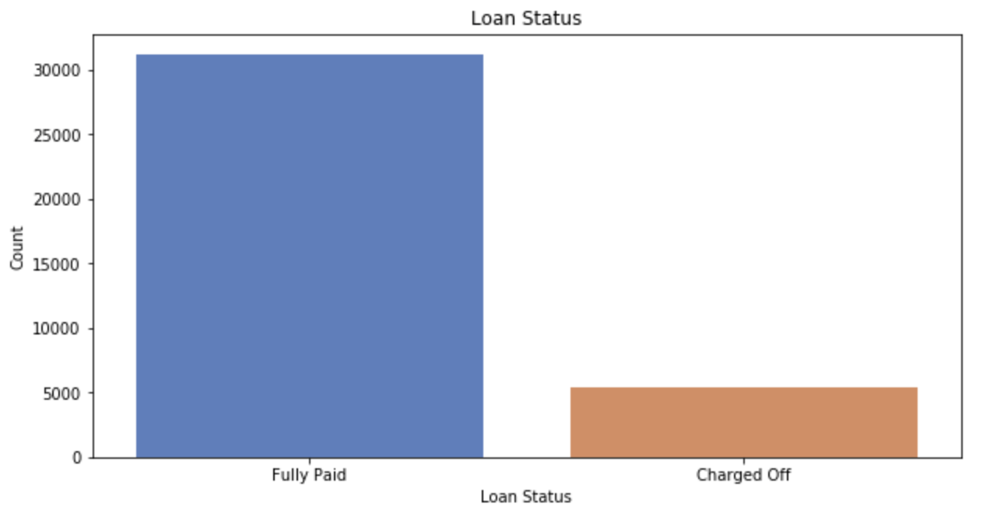
Loan Status
Observation:
Defaulted Loans (Charged Off) are low in number as compared to the Fully Paid loans.

Slide 7
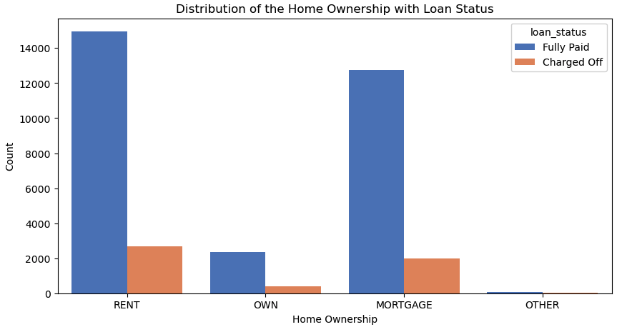
Home Ownership Vs Loan Status
Observation : Majority of borrowers don’t own any property & are either renting or have a mortgage. The percentage of loan defaulters is higher among borrowers with an existing "MORTGAGE."

Slide 8
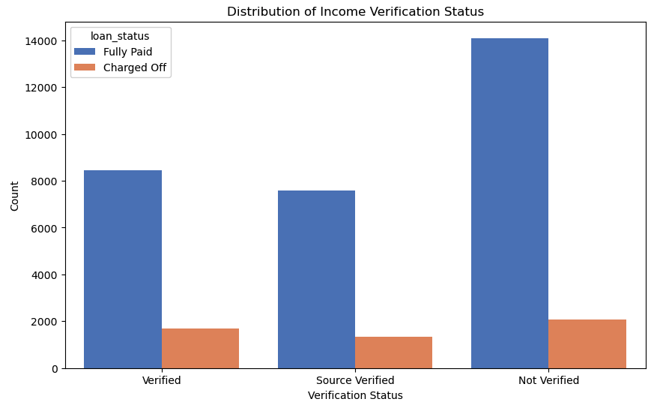
Income Verification Status Vs Loan Status
Observation : For Most of the borrowers the income status is not verified by consumer Finance Company.

Slide 9
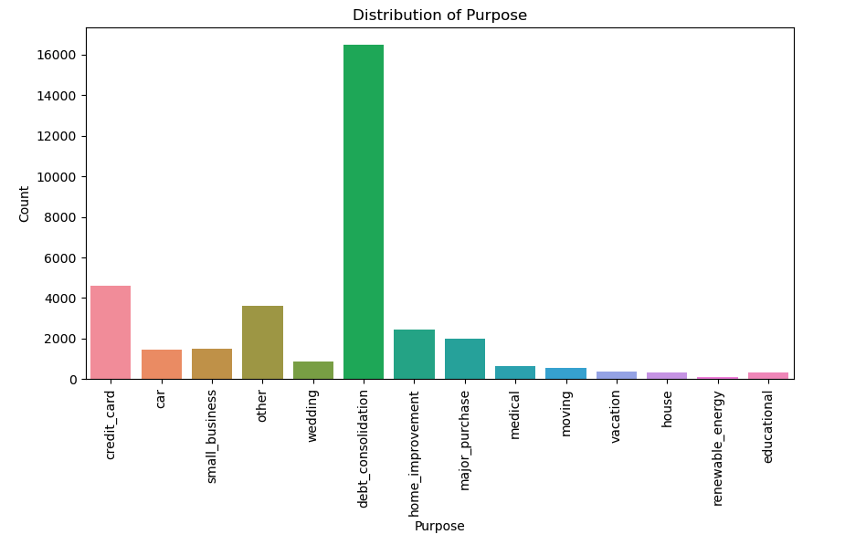
Purpose Vs Loan Status
Observation :The primary reason for borrowers taking out loans is debt consolidation, with credit card usage as the second most common purpose.

Slide 10
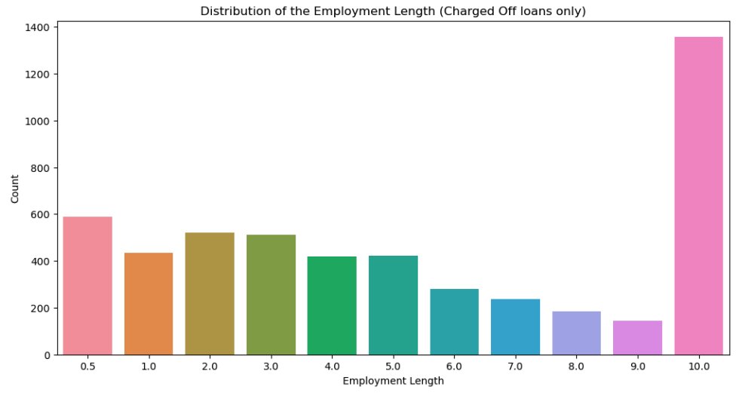
Employee Length Vs Loan Status
Observations :-
Most of the borrowers are having experience of 10+ years With consumer Finance Company.
Most of the defaulters are having experience of 10+ years With consumer Finance Company.

Slide 11
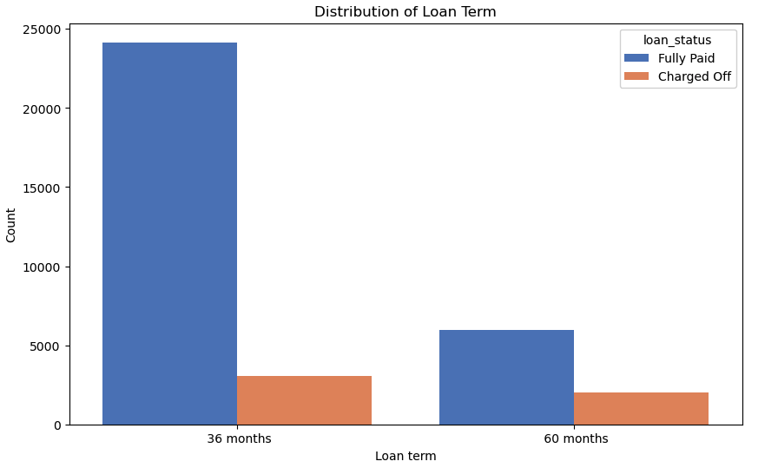
Loan Term Vs Loan Status
Observation : Majority of the loans are approved for a period of 36 months.

Slide 12
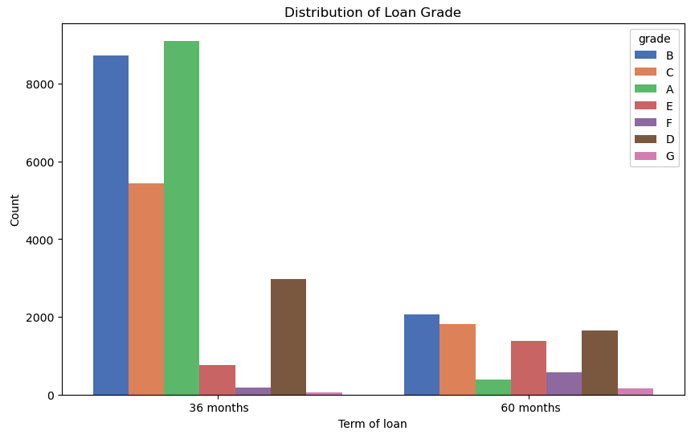
Loan Grade & Loan Term
Observation : The majority of 36-month loans are in grade A and B, while the majority of 60-month loans belong to grade B and C.

Slide 13
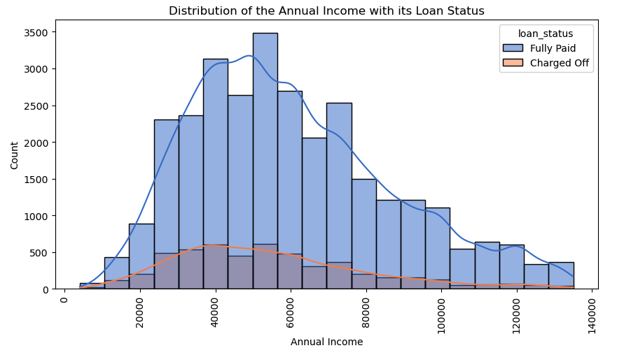
Annual Income with it’s Loan Status
Observation - The distribution of Annual Income exhibits characteristics of a left-skewed normal distribution, indicating that the majority of borrowers have relatively low annual incomes. Borrowers with annual incomes below 50,000 are at a higher likelihood of loan default.

Slide 14
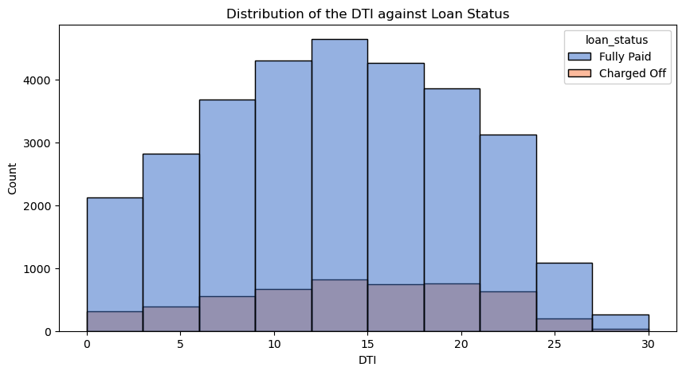
DTI against Loan Status
Observation : Analyzing the distribution, it is evident that a significant proportion of borrowers have a notably high debt-to-income ratio, primarily clustered within the 10-20 DTI ratio range.

Slide 15
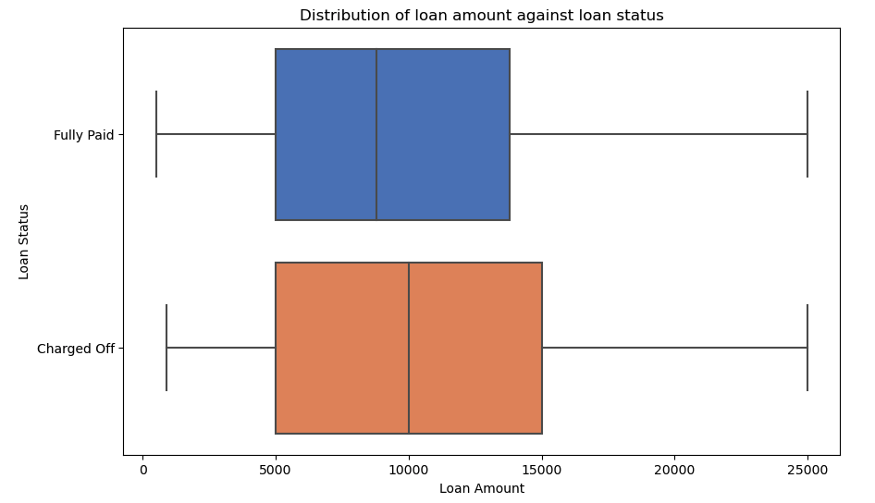
Loan Amount Vs Loan Status
Observation : The mean & 25th quantile is same for both Fully Paid and Charged Off loans.

Slide 16
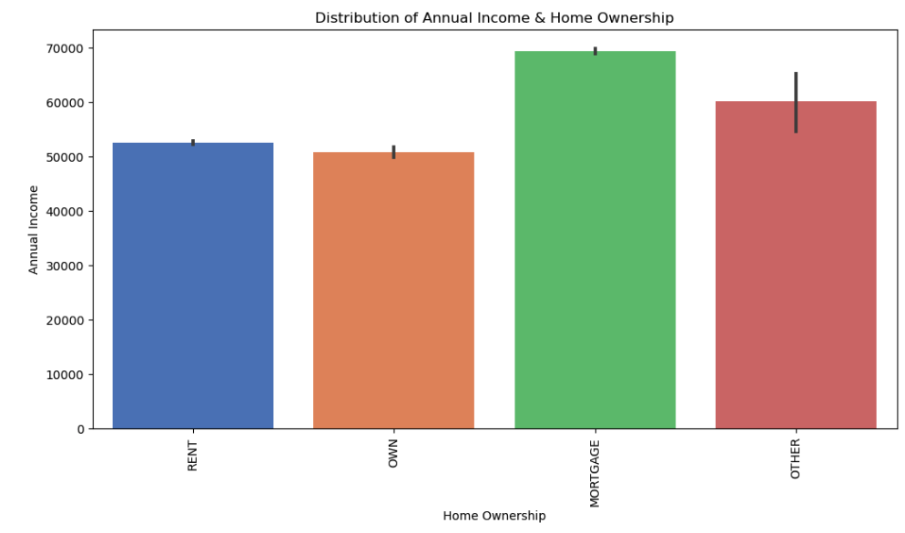
Annual Income & Home Ownership

Slide 17
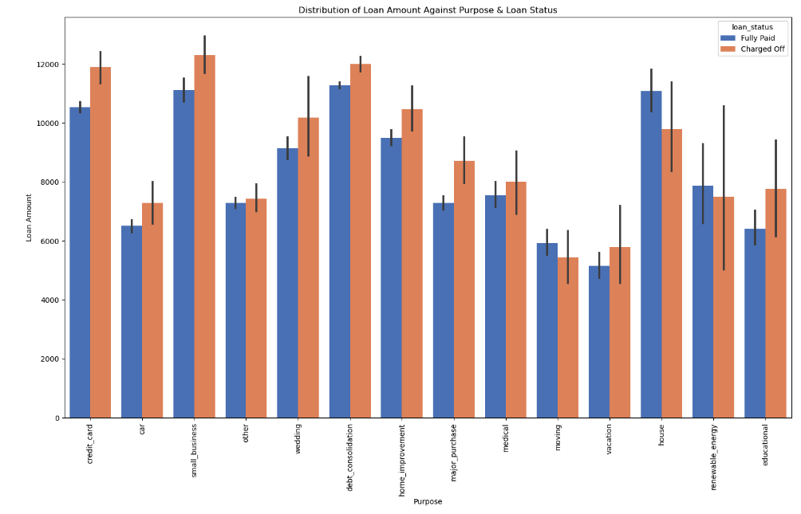
Loan Amount Against Purpose & Loan Status

Slide 18
Synopsis
Below are the observation with “Charged-Off” Loans & Loans are more likely to be defaulted in below cases :-
Applicants earning an annual income below 50000.
The loan amount is requested for an amount exceeding 10000.
Applicants who utilize the loan for purposes such as consolidating existing debts, launching a small business, paying off credit card balances, or making home improvements.
Applicants with a work history of over 10 years."
Applicants who are granted loans with an interest rate ranging from 13% to 17%
Applicants with debt-to-income ratios falling within the range of 12 to 15.
The applicant currently has an active "MORTGAGE" in progress.
The applicant has a work history of over 10 years, and the requested loan amount falls within the range of 12000 to 14000.

