Slide 1
Instructions for Cortex M4
Girish S Kumar
Notes:
Click to add notes

Slide 2
Instructions for ARM Cortex-M4
For any Processor to perform a task user has to give instructions
High level languages like C/C++ which are closer to English In such a case a compiler translates the high level instructions to a machine language
This kind of language is composed of binary code or machine code
sequence, like 01101110. The low-level language is a computer- or machine-dependent
language.

Slide 3
Assembly Language Work Flow
Assembly Language Instructions
Assembler
Machine Language Instructions

Slide 4
ARM Instructions set
ARM instructions are always 32 Bit
Op Code and data is contained in this
Op-Code 20 bits
Operands 12 bit
32 -Bits
Notes:
How presentation will benefit audience: Adult learners are more interested in a subject if they know how or why it is important to them.
Presenter’s level of expertise in the subject: Briefly state your credentials in this area, or explain why participants should listen to you.

Slide 5
ARM Thumb-2 Instructions
ARM developed two different instruction set architectures:
Traditional 32-bit instruction set (ARM Instructions)
16-bit instructions to improve the code Density (Thumb Instructions)
During 2003 ARM developed Thumb-2 technology This technology enables a mixture of 16-bit and 32-bit instructions to be executed within one operating state. All the ARM Cortex-M processors are based on Thumb-2 technology.

Slide 6
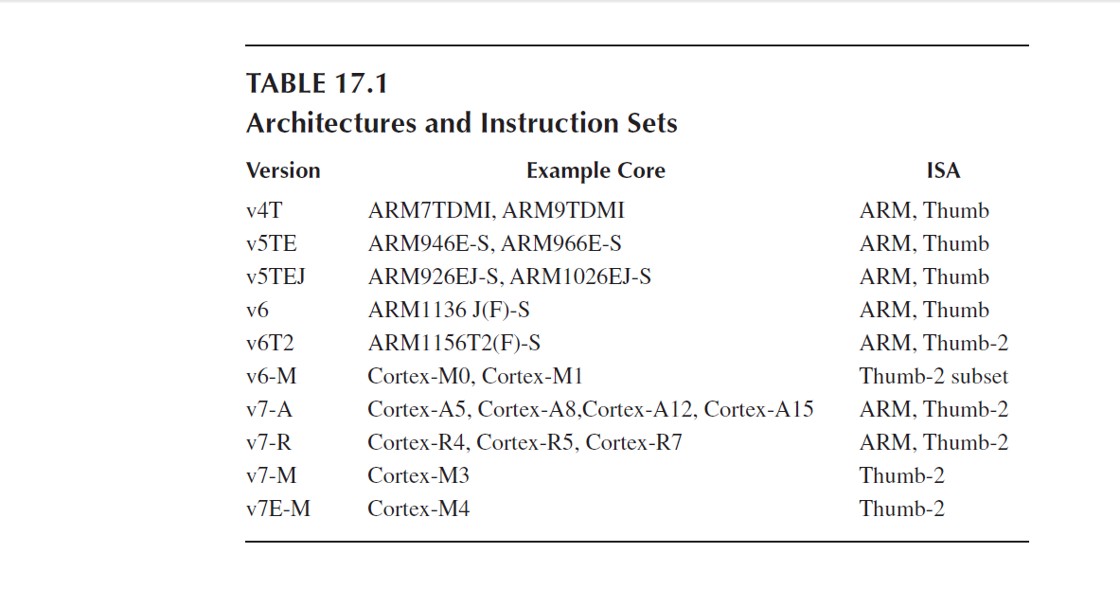

Slide 7
Cortex M4 Instructions Set
Cortex M4 has
203 Instructions in general category
65 instructions related to FPU
1. Data Moving Instructions
2. Arithmetic Instructions
3. Logic Instructions
4. Shift and Rotate Instructions
5. Data Conversion Instructions
6. Bit-Field Processing Instructions
7. Compare and Test Instructions
8. Program Flow Control Instructions
9. Saturation Instructions
10. Exception Related Instructions
11. Sleep Mode Instructions
12. Memory Barrier Instructions
13. Miscellaneous Instructions
14. Unsupported Instructions

Slide 8
Syntax of Assembly Language
1. Label field
2. Operation field
3. Operands field
4. Comment field
 | Label Field | Operation Field | Operands | Comments
Mandatory/Optional | Optional | Mandatory | Mandatory | Optional
Purpose | Identify a line for branching A label must be located at the first column & max 15 Chars Label must end with a : | Contains the Mnemonic like MOV, ADD | The operands field contains the data or an address for its corresponding instruction to be operated | To add documentation to your should be mentioned after a semicolon

Slide 9
Rules for third field Operands
For data processing instructions written for the ARM assembler, the first operand is the destination of the operation.
• For a memory read instruction,, the first operand is the destination register that data is to be loaded into.
• For a memory write instruction, the first operand is the source register that holds the data to be written into the memory.
• For a multiple load instruction, the register list which is the third operand is the destination operand that the data will be loaded into.
• For a multiple store instruction, the register list which is the third operand is the source operand that the stored data will be written into the memory.

Slide 10
Pseudo Instructions
For a assembler to convert Assembly language instructions to Machine language it needs additional information telling
Flash memory address where the instructions are stored
Data and constants a are stored
Reserved memory space
End point to users code
Such instructions for the assembler enabling it to generate machine code are called Pseudo instructions
Pseudo instruction are never converted into machine code, they are very assembler specific
Machine and assembly instructions are machine specific similarly pseudo instructions are assembler specific

Slide 11
Shifting Data
AREA appcode, CODE, READONLY
EXPORT __main
ENTRY
__main FUNCTION
MOV r0, #0x11 ; load initial value
LSL r1, r0, #1 ; shift 1 bit left
LSL r2, r1, #1 ; shift 1 bit left
stop B stop ; stop program
ENDFUNC
END
Notes:
Lesson descriptions should be brief.

Slide 12
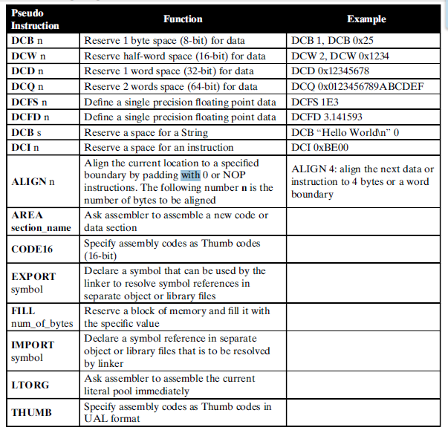
Popular pseudo
instructions used in
Cortex-M4 MCU

Slide 13
Swapping Registers
THUMB
AREA appcode, CODE, READONLY
EXPORT __main
ENTRY
__main FUNCTION
MOV r0, #0x100
MOV r1, #0x200
EOR r0, r0, r1 ; r0 XOR r1
EOR r1, r0, r1 ; r1 XOR r0
EOR r0, r0, r1 ; r0 XOR r1
stop B stop ; stop program
ENDFUNC
END
Notes:
Example objectives
At the end of this lesson, you will be able to:
Save files to the team Web server.
Move files to different locations on the team Web server.
Share files on the team Web server.

Slide 14
Factorial
THUMB
AREA factorial, CODE, READONLY
EXPORT __main
ENTRY
__main FUNCTION
MOV r6,#10 ; load n into r6
MOV r7,#1 ; if n = 0, at least n! = 1
loop CMP r6, #0
MULGT r7, r6, r7
SUBGT r6, r6, #1 ; decrement n
BGT loop ; do another mul if counter!= 0
stop B stop ; stop program
ENDFUNC
END

Slide 15



Cortex-M4 Addressing Modes

Slide 16
Seven Addressing Modes
1. Immediate Offset Addressing Mode
2. Register Offset Addressing Mode
3. PC-Relative Addressing Mode
4. Load and Store Multiple Registers Addressing Mode
5. PUSH and POP Register Addressing Mode
6. Load and Store Register Exclusive Addressing Mode
7. Inherent Addressing Mode

Slide 17
Immediate offset Addressing mode
Target address to do a LOAD or STORE is obtained by adding
an offset to a base address that is stored in a register.
The offset value can be positive or negative, any general-purpose register
R0 to R12 can be used to store the base address
1. Regular Immediate Offset Addressing Mode
2. Pre-Indexed Immediate Offset Addressing Mode
3. Post-Indexed Immediate Offset Addressing Mode
4. Regular Immediate Offset Addressing Mode with Unprivileged Access

Slide 18
Regular Immediate Offset Addressing Mode

Slide 19
Pre-Indexed Immediate Offset Addressing Mode

Slide 20
Post-Indexed Immediate Offset Addressing Mode

Slide 21
Regular Immediate Offset Addressing Mode with Unprivileged Access

Slide 22
PC-Relative Addressing Mode
he PC-relative addressing mode can be used to load a register with a value stored
in program memory a short distance away from the current instruction. It can be
seen as a special case of the "base plus offset" addressing mode, one that
selects the program counter (PC) as the "base register".
There are a few CPUs that support PC-relative data references.
Such CPUs include:
The x86-64 architecture and the 64-bit ARMv8-A architecture^{[10]} have PC-relative
addressing modes, called "RIP-relative" in x86-64 and "literal" in ARMv8-A.
The Motorola 6809, a very advanced 8-bits CPU designed in 1978, also supports
a PC-relative addressing mode.
When this addressing mode is used, the compiler typically places the constants in
a literal pool immediately before or immediately after the subroutine that uses
them, to prevent accidentally executing those constants as instructions.
TODO :
Find a assembly program which uses literal
Reword the slide

Slide 23
Floating Point Numbers

Slide 24
Floating point and integers Mix

Slide 25
Structure of Assembly Language Programs Assembler Rules and Directive

Slide 27
Load and Store
Instructions

Slide 29
Arithmetic Operations
Basics of DSP

Slide 31
Loops and Control Structures

