Slide 1
Introduction to ARM Processor
Girish S Kumar

Slide 2
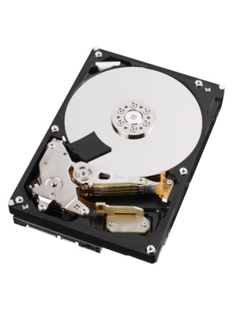


Primary Memory
(RAM)
Instruction
Data Address
Data
Secondary Memory
(Hard Disk)
CPU
Basic Computer Architecture

Slide 3
Two Popular Computer Architecture
Von Neumann Architecture
Data and Instructions are accessed by processor through the SAME BUS
Harvard Architecture
Data and Instructions are accessed by processor through Separate Buses

Slide 4
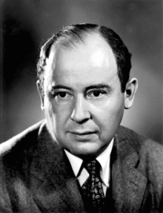
Von Neumann Architecture
Von Neuman architecture is also called Princeton Architecture was published in 1945 by Mathematician , physicist & Computer Scientist John von Neumann
Data & Instructions memory
Data & Instructions
CPU

Slide 5
Harvard Architecture
The Harvard architecture is a computer architecture with physically separate storage and signal pathways for instructions and data. The term originated from the Harvard Mark I relay-based computer, which stored instructions on punched tape (24 bits wide) and data in electro-mechanical counters.
Data
Memory
Instruction
Memory
Data
Instructions
CPU

Slide 6
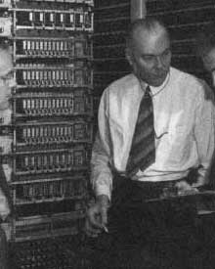
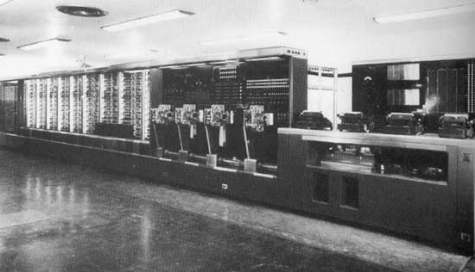
Some time in 1936 or possibly in early 1937, the Harvard physician Howard Aiken started to make plans about an automatic calculation machine. IBM agreed to construct for Harvard an automatic computing plant comprising machines for automatically carrying out a series of mathematical computations adaptable for the solution of problems in scientific fields, the machine was called ASCC (Automatic Sequence Controlled Calculator), but later on it became also known as Harvard Mark I.

Slide 7
Instruction Set Architecture
Instruction set architecture (ISA), is the part of the computer architecture related to programming, including the native data types, instructions, registers, addressing modes, memory architecture, interrupt and exception handling, and external I/O.
CISC
Where single instructions can execute several low-level operations (such as a load from memory, an arithmetic operation, and a memory store) or are capable of multi-step operations or addressing modes within single instructions.
Intel x86 Motorola 68K
RISC
A simplified instruction set provides higher performance also uses fewer cycles per instruction. Has specific instructions for data processing and moving data to and from memory
All ARM Series

Slide 8
HOW did ARM Series Evolved from early days

Slide 9
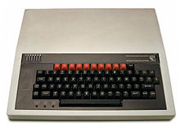
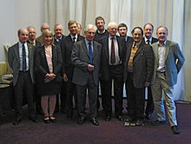
Acorn Computers Ltd.
Originally ARM Comes from Acorn Risk Machine
Acorn was Computer design company based out of UK who build one of the early personal computer called BBC Microcomputer based on a 8-Bit processor (1982)
By 1983, Engineers who build BBC Micro begin to think of next steps to build a successor to take their product to next level

Slide 10

What were the thoughts
Must deliver higher value that the existing BBC Micro
A 16 Bit CPU
With a good interrupt response may better than or comparable to that of 8-bit 6502, has to be identified ……..
MOS Technology, Inc. also known as CSG (Commodore Semiconductor Group), build 6502

Slide 11
What were the technical Challenges
All the 16 bit Microprocessors available in the market were CISC based and much slower than what they were looking for.
Instructions were complex and tool multiple cycles to complete
They long Interrupt latencies compared to 6508
It is not easy to build a new processor that can meet their expectations …….

Slide 12
They decided not to give up .. Instead they continued their search, started looking all the latest research happening, around world on processor design

Slide 13
They came across a processor designed by Post Graduate students at Berkley called RISC I.
It had very simple instructions and low interrupt latency
Students designed it in less than year
This was the starting point of ARM

Slide 14
Three main guiding principles they
Based on they started the design was
A Load and store Architecture
Fixed length instructions (32 Bit length)
3 Address Instruction format

Slide 15
1990 as Advanced RISC Machines Ltd.(ARM) , a joint venture of Apple Computer, Acorn Computer Group, and VLSI Technology.
In 1991, ARM introduced the ARM6 processor family,
and VLSI Technology became the initial licensee.
Today around 2 billion ARM based processors are shipped every year
ARM does not fabricate or sell any of these chips. Fabrication and selling by Semiconductor Companies who has partner with ARM. They design microprocessor, SoC and microcontrollers based on the design (IP) given by ARM
This is called Intellectual property licensing – a very successful and practical model in developing processor designs (Synthesizable core)

Slide 16
Developed
By ARM
Processor
Core
Debug
System
Developed
By ARM and
Semiconductor
Companies
Peripherals
Memory
Clock and Reset
I/O

Slide 17
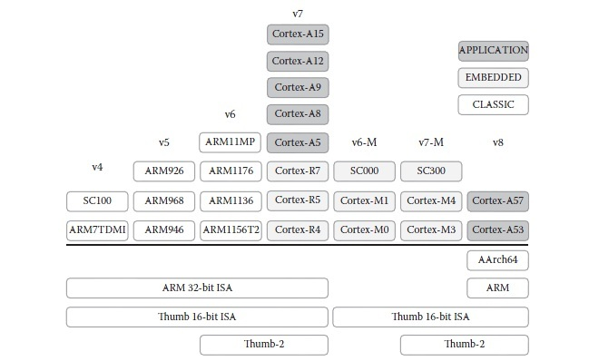

Slide 18
ARM Cortex Portfolio Today
CORTEX-R
CORTEX-A
CORTEX-M
Cortex-A73
Cortex-A72
Cortex-A57
Cortex-A53
Cortex-A35
Cortex-A17
Cortex-A15
Cortex-A9
Cortex-A8
Cortex-A7
Cortex-A5
Cortex-A5
Cortex-R8
Cortex-R7
Cortex-R5
Cortex-R4
Cortex-M0
Cortex-M0+
Cortex-M3
Cortex-M4
Cortex-M7
smallest/lowest power Optimized for discrete processing and microcontroller
Fast response Optimized for high-performance, hard real-time applications
Highest performance Optimized for rich operating systems

Slide 19
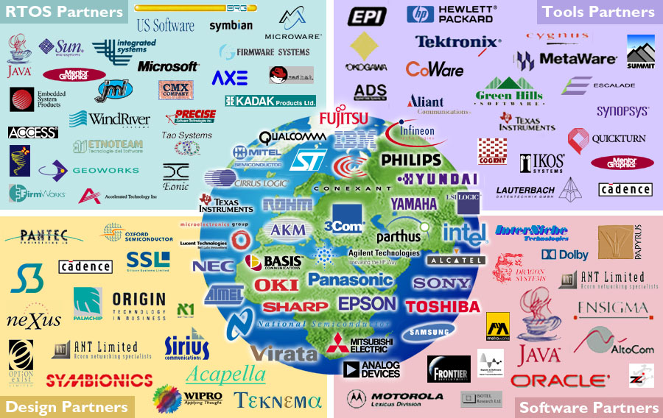

Slide 20
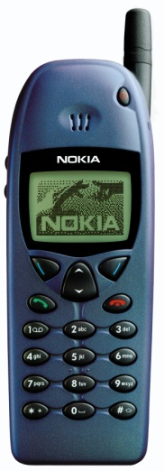
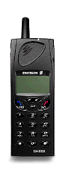
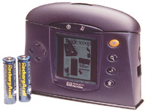
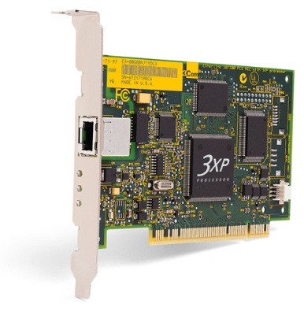

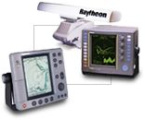
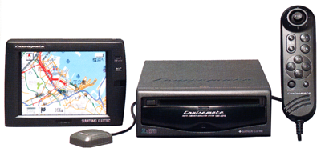
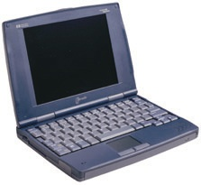
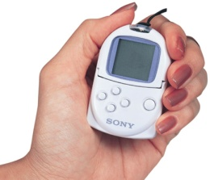
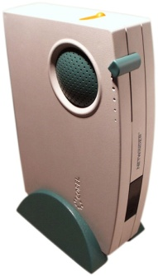

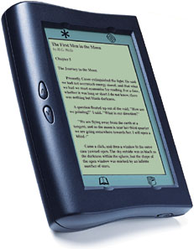
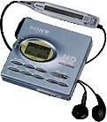

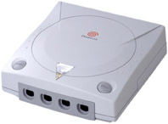
ARM Powered Products

Slide 21
Raspberry PI- ARM Cortex-A53
Samsung Galaxy Grand - 1.2 GHz dual core Cortex-A9 processor
Galaxy S4 1.6 GHz quad-core Cortex-A15 cluster and a 1.2 GHz quad-core Cortex-A7 cluster.
Galaxy duos 1.2 GHz dual core Cortex-A9
Nokia 3230 123 MHz 32-bit RISC CPU ARM-9

