Slide 1
ARM Architecture concepts
Girish S Kumar
ARM
Notes:
Presentation slide for courses, classes, lectures et al.

Slide 2
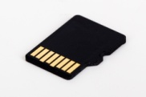
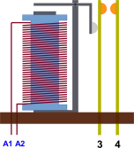

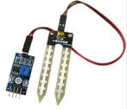


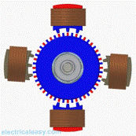
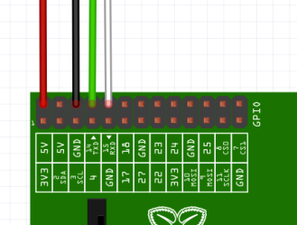


Primary Memory
(RAM)
Secondary Memory
Memory Card (16 GB, 32 GB etc)
Electromagnetic
Relay
Input
CPU
Touch
Screen
LCD (I/O)
Electric
Motor
Ports
Embedded Systems
Network Interface

Slide 3
Thoughts behind ARMs design
ARM aim was target for CPU small computers and embedded system
Main Requirements was
Low Power
Performance for Real Time applications
High Availability and Reliability ( 99.99% uptime)
Resilient to Fault Conditions
Able to handle extreme conditions of weather
conditions

Slide 4
How did ARM deviated from RISC
Variable cycle execution for certain instructions-Not every ARM instruction executes in a single
cycle. For example, load-store-multiple instructions vary in the number of execution cycles
depending upon the number of registers being transferred.
Inline barrel shifter leading to more complex instructions-
Supports 16 Bit Thumb instructions for better code density
Conditional execution-An instruction is only executed when a specific condition has been
satisfied. This feature improves performance and code density by reducing branch instructions.
Enhanced instructions-The enhanced digital signal processor (DSP) instructions were added to the
standard ARM instruction set to support fast 16 x 16-bit multiplier operations and saturation.
These instructions allow a faster-performing ARM processor in some cases to replace the
traditional combinations of a processor plus a DSP.

Slide 5
How did ARM different from x86
No | ARM | x86
1 | All ARM instructions works only on CPU Registers except Load and store | X86 instructions can work both on registers and memory
2 | ARM cores have a large number of general-purpose registers and many instructions execute in a single cycle. | X86 does not has similar numbers of general purpose registers
3 | Simpler architecture, leading to small silicon area and lots of power save features | X86 is not designed for low power in mind as it targeted only laptop, desktop and server markets
4 | Instructions top: ldrb r2, [r0, #1]! L drb r3, [r1, #1]! subs r2, r3, r2 Beq top /* branch(/jump) if result is zero */ | repe cmpsb

Slide 6
Key ARM architectural features
No | Feature | Description
1 | Load and Store Architecture | Only load and store instructions can access memory – Does not support memory to memory data processing operations. – Must move data values into registers before using them.
2 | Fixed length 32 bit instruction | All instructions are 32 Bit long, except Thumb, and give high code density
3 | 3 Address format instructions | All Instruction do have three operand expect MOV type
4 | Registers | Large number of General Purpose registers
5 | Pipe Line | Decoding done in three or more stages
6 | Reduced Die size and smaller processor | Lower power consumption, reduced manufacturing cost, suitable for handheld devices

Slide 7
ARM Instruction Types
Non | Type | Description
1 | Data Processing Instruction | ADD, SUB, AND, EOR ORR etc
2 | Data Transfer Instructions | ARM has three sets of instructions which interact with main memory. These are: – Single register data transfer (LDR/STR) – Block data transfer (LDM/STM) – Single Data Swap (SWP)
3 | Control Instruction | Branch Instructions Conditional branches Branch and Link Instructions Subroutine return I nstruction

Slide 8
ARM Programmers Mode ARM7TDMI
CPU Registers the basic storage area on processor
ARM7TDMI comes with (32 bit wide)
30 General Purpose registers
6 Status Registers
One Program Counter
Byte, or 8 bits
Halfword, or 16 bits
Word, or 32 bits
Data Types

Slide 9
Modes
User | Supervisor | Abort | Undefined | Interrupt | Fast Interrupt
R0 | R0 | R0 | R0 | R0 | R0
R1 | R1 | R1 | R1 | R1 | R1
R2 | R2 | R2 | R2 | R2 | R2
R3 | R3 | R3 | R3 | R3 | R3
R4 | R4 | R4 | R4 | R4 | R4
R5 | R5 | R5 | R5 | R5 | R5
R6 | R6 | R6 | R6 | R6 | R6
R7 | R7 | R7 | R7 | R7 | R7
R8 | R8 | R8 | R8 | R8 | R8
R9 | R9 | R9 | R9 | R9 | R9
R10 | R10 | R10 | R10 | R10 | R10
R11 | R11 | R11 | R11 | R11 | R11
R12 | R12 | R12 | R12 | R12 | R12
R13 (SP) | R13 | R13 | R13 | R13 | R13
R14(LR) | R14 | R14 | R14 | R14 | R14
PC | PC | PC | PC | PC | PC
CSPR | CSPR | CSPR | CSPR | CSPR | CSPR
 | SVSR_SVC | SPSR_ABORT | SPSR_UNDEF | SPSR_IRQ | SPSR_FIQ

Slide 10
No | Processor Mode | Description | Comment
1 | User | Almost all apps runs in this mode, OS task run in this mode – Read Access to Control field, RW to condition flags) | Non Privileged mode
2 | Supervisor | A privileged mode entered whenever the CPU is reset or when an SVC instruction is executed. | R3, R14 are banked
3 | System | System mode is the only privileged mode that is not entered by an exception. It can only be entered by executing an instruction that explicitly writes to the mode bits of the Current Program Status Register (CPSR). So ,the exception handlers modify the CPSR to enter System mode. | Uses the same register as in User mode
4 | FIQ | Fast interrupt high priority | Eg: Battery low R8-R14 is banked
5 | IRQ | Normal Interrupt mode | Eg: Keyboard , R3, R14 are banked
6 | Abort | When a non existing mem loc is accessed | R3, R14 are banked
7 | Undef | When and unknown instruction is executed | R3, R14 are banked

Slide 11
Current Program Status Register
The Current Program Status Register (CPSR) can be seen as the state of the
machine, It contains
Condition Code Flags
Interrupt Enable Flags
Current processor mode
Current State
All modes except User/System mode CPSR is saved
Question :Why is CPSR not save when User mode and System mode are entered ?
31 | 30 | 29 | 28 | 27 | ……. | 24 | .. | 19..16 | 9 | 8 | 7 | 6 | 5 | 4….0
N | Z | C | V |  |  | J |  |  |  | A | I | F | T | M[4:0]
Condition Flags
Interrupt Flags
Processor
Mode

Slide 12
31 | 30 | 29 | 28 | 27 | ……. | 24 | .. | 19..16 | 9 | 8 | 7 | 6 | 5 | 4….0
N | Z | C | V |  |  | J |  |  |  |  | I | F | T | M[4:0]
Disables IRQ
Disables FIQ
Signed Over flow
Unsigned with ADD Over flow
Disables imprecise abort
Set when result is ZERO
Processor mode
Is set to bit 31 of the result, so N is 1 if the signed value is negative
PSR | Mode
10000 | User
10001 | F!Q Mode
10010 | IRQ Mode
10011 | Supv. Mode
10111 | Abort Mode
11011 | Undefined mode
11111 | System Mode

Slide 13
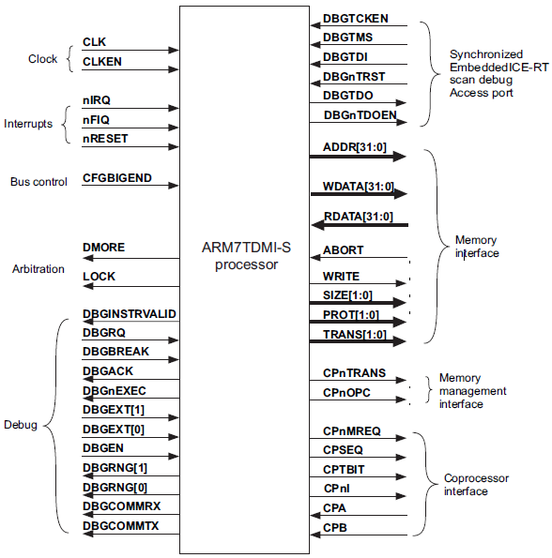
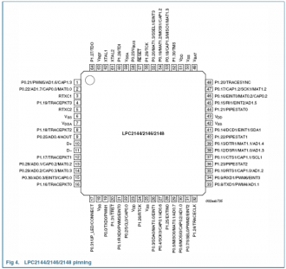
ARM7TDMI PIN diagram

Slide 14
ARM after RESET
After RESET is made low and made high the following steps
happens in the Processor
1. Enter Supervisor mode by Writing ----------- into CPSR -------- bits
2. Saves the values of R14 and CPSR into SPSR_SVC
3. Disables IRQ, FIQ interrupts by Setting I & F flags of CPSR
Clears the T bit in CPSR to run in ARM mode
Forces PC it fetch the next instruction from address 0x000000000

Slide 15
Exception Vector Table
Exception Type | Mode | Vector Address
Reset | SVC | 0x00000000
Undefined instruction | UNDEF | 0x00000004
Software intrrupt (SVC) | SVC | 0x00000008
Pre-fetch Abort | ABORT | 0x0000000C
Data Abort | ABORT | 0x00000010
IRQ | IRQ | 0x00000018
FIQ | FIQ | 0x0000001C
When an interrupt (IRQ) comes along, the Program Counter will be set to 0x18 and begin fetching instructions from there. The data at 0x18 will be instruction to
----------------------

Slide 16
Standard ARM 32 bit address space
A new activation frame is created here
Containing a back trace of local variable etc
Stack
Unused Space
Heap
Space allocated for malloc()
Static Data
Compiled Code

Slide 17
Mapping of a C program into Address space
#include <stdio.h>
int length= 2,;
Int breath = 5 ;
Int volume ;
Main()
{
inta,b ;
a = area(10);
b = volume(5) ;
}
Void area(into count)
{
count = count +1
}
Void volume(int height)
{
int v ;
v = length * breath *height
}
Stack
Stack
Unused Space
Heap
Static Data
Length & breath volume
Compiled Code

Slide 18
Big Endian – Little Endian
Address | Value
1000 | CD
1001 | 12
1002 | AB
1003 | 90
In little endian, you store the least significant byte in the smallest address. Here's how it would look:
Address | Value
1000 | 90
1001 | AB
1002 | 12
1003 | CD
In big endian, you store the most significant byte in the smallest address. Here's how it would look

Slide 19
Questions/Discussions
Notes:
An opportunity for questions and discussions.

