Slide 1
AMBA Architecture
Girish S Kumar

Slide 2
Flash Back….
Processor
Core
Debug
System
Peripherals
Memory
Clock and Reset
I/O

Slide 3
What is AMBA
The ARM AMBA (Advanced Microcontroller Bus Architecture) protocol is an open standard, on-chip interconnect specification for the connection and management of functional blocks in a System-on-Chip (SoC).
It facilitates right-first-time development of multi-processor designs with large numbers of controllers and peripherals. AMBA promotes design re-use by defining common interface standards for SoC modules.

Slide 4
What is AMBA
he AMBA specification standard is used for designing high-level embedded microcontrollers. AMBA’s major objective is to provide technology independence and to encourage modular system design. Furthermore, it strongly encourages the development of reusable peripheral devices while minimizing silicon infrastructure
It’s the interface every semiconductor vendor uses to “bolt” functional blocks together in their chip.

Slide 5
What does AMBA Consists of
Name | Acronym | Description
Advanced System Bus | ASB | Obsolete – Not used any more
Advanced Peripheral Bus | APB | Simple, easy, for your peripherals
Advanced High-Performance Bus | AHB | Used in CORTEX-M Designs
Advanced eXtensible Interface | AXI | The most widespread, now up to AXI4
Advanced Trace Bus | ATB | For moving trace data around the chip, see CoreSight
AXI Coherency Extensions | ACE | Used in smartphones, tablets, etc.
Coherent Hub Interface | CHI | The highest performance, used in networks and servers

Slide 6
Key features of AMBA
Flexibity: IP re-use requires a common standard while supporting a wide variety of SoCs with different power, performance and area requirements. With its ACE, AXI, AHB and APB interface protocols, AMBA 4 has the flexibility to match every requirement. With the AMBA 5 CHI interface Arm extends performance and scalability to many coherent processors.
Compatibility : It is a standard interface specification that ensures compatibility between IP components from different design teams or vendors. The AMBA specifications are available as both a written specification as well as a set of assertions that unambiguously define the interface protocol, thus ensuring this level of compatibility.
Wide Adoption: There is a large amount of IP available in the industry today. AMBA facilitates this IP and engineers across the globe have accepted it as a standard and use it daily. It is the most widely adopted industry standard for on-chip connectivity for IP products such as Memory Controllers, Interconnects, Trace solutions, GPUs, CPUs.
Support: The wide adoption of AMBA specifications throughout the semiconductor industry has driven a comprehensive market in third party IP products and tools to support the development of AMBA-based systems. The availability of SystemVerilog assertions for AMBA promotes this industry-wide participation.

Slide 7
What are assertions
An assertion is a boolean expression at a specific point in a program which will be true unless there is a bug in the program.

Slide 8
Discussion.
Suppose you are giving set of modules say HW or SW module which exchange data in real time and you are asked to define a set of interface and standards to interface them how will you go about ?

Slide 9
AMBA Bus Architecture
UART
TIMER
ARM Processor
High Bandwidth On chip RAM
B
R
I
D
G
E
High Bandwidth External Memory I/F
DMA Bus Master
Keypad
GPIO

Slide 10
AHB Advanced High Performance Bus

Slide 11
Advance High-Performance Bus
A typical AMBA AHB system design contains the following components:
• AHB Master : A bus master is able to initiate read and write operations by providing an address and control information. Only one bus master is allowed to actively use the bus at any one time.
• AHB Slave : A bus slave responds to a read or write operation within a given addressspace range. The bus slave signals back to the active master the success, failure or waiting of the data transfer.
• AHB Arbiter: The bus arbiter ensures that only one bus master at a time is allowed to initiate data transfers. Even though the arbitration protocol is fixed, any arbitration algorithm, such as highest priority or fair access can be implemented depending on the application requirements.
• AHB decoder :The AHB decoder is used to decode the address of each transfer and provide a select signal for the slave that is involved in the transfer.

Slide 12
AMBA AHB Signal list
Name | Source | Description
HCLK | Clock Source | Rising Edge of HCLK is used for all signal timings and bus tranfers/
HRESETn | Reset controller | A low signal will on this will reset the bus system
HADDR[31:0] Address bus | Master | The 32-bit system address bus.
HTRANS[1:0] Transfer Type | Master | Type of Transfer, Sequential, non sequential idle or busy
HWRITE Transfer Direction | Master | A high indicates a write transfer and low indicates a read transfer
HSIZE[2:0] Transfer Size | Master | Indicates the size of the transfer, Transfer size which is typically byte (8-bit), halfword (16-bit) or word (32-bit). The protocol allows for larger transfer sizes up to a maximum of 1024 bits
HBURST[2:0] Burst type | Master | Indicates if the transfer forms part a Burst type burst. Four, eight and sixteen beat bursts are supported and the burst may be either incrementing or wrapping

Slide 13
AMBA AHB Signal list
Name | Source | Description
HPROT[3:0] Protection Control | Master | The signals indicate if the transfer is an opcode fetch or data access, as well as if the transfer is a privileged mode access or user mode access. For bus masters with a memory management unit these signals also indicate whether the current access is cacheable or bufferable. The protection control signals Protection control provide additional information about a bus access and are primarily intended for use by any module that wishes to implement some level of protection.
HWDATA[31:0] Write Data bus | Master | The write data bus is used to Write data bus transfer data from the master to the bus slaves during write operations. A minimum data bus width of 32 bits. is recommended. However, this may easily be extended to allow for higher bandwidth operation.
HSELx Slave Select | Decoder | Each AHB slave has its own slave Slave select signal and this signal indicates that the current transfer is intended for the selected slave. This signal is simply a combinatorial decode of the address bus.

Slide 14
AMBA AHB Signal list
Name | Source | Description
HRDATA[31:0] | Slave | The read data bus is used to transfer Read data bus data from bus slaves to the bus master during read operations. A minimum data bus width of 32 bits is recommended. However, this may easily be extended to allow for higher bandwidth operation.
HREADY Transfer Done | Slave | When HIGH the HREADY signal Transfer done indicates that a transfer has finished on the bus. This signal may be driven LOW to extend a transfer. Note: Slaves on the bus require HREADY as both an input and an output signal.
HRESP[1:0] Transfer Response | Slave | The transfer response provides Transfer response additional information on the status of a transfer. Four different responses are provided, OKAY, ERROR, RETRY and SPLIT.

Slide 15
AMBA AHB Signal list for multiple bus master operation
Suffix x indicates the signal is from module X. For example there will be a number of
HBUSREQx signals in a system, such as HBUSREQarm, HBUSREQdma
Name | Source | Description
HBUSREQx Bus Request | Master | A signal from bus master x to the Bus request bus arbiter which indicates that the bus master requires the bus. There is an HBUSREQx signal for each bus master in the system, up to a maximum of 16 bus masters.
HLOCKx Locked Transfers | Master | When HIGH this signal indicates that Locked transfers the master requires locked access to the bus and no other master should be granted the bus until this signal is LOW
HGRANTx Bus Grant | Arbiter | This signal indicates that bus master Bus grant x is currently the highest priority master. Ownership of the address/control signals changes at the end of a transfer when HREADY is HIGH, so a master gets access to the bus when both HREADY and HGRANTx are HIGH.
HMASTER[3:0] Master Number | Arbiter | These signals from the arbiter Master number indicate which bus master is currently performing a transfer and is used by the slaves which support SPLIT transfers to determine which master is attempting an access. The timing of HMASTER is aligned with the timing of the address and control signals.
HMASTLOCK Locked sequence | Arbiter | Indicates that the current master is Locked sequence performing a locked sequence of transfers. This signal has the same timing as the HMASTER signal.
HSPLITx[15:0] Split completion request | Slave(SPILIT capable) | This 16-bit split bus is used by a Split completion request slave to indicate to the arbiter which bus masters should be allowed to reattempt a split transaction. Each bit of this split bus corresponds to a single bus master.

Slide 16
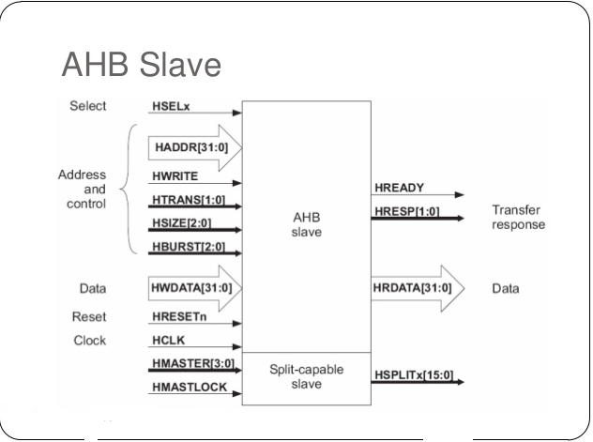

Slide 17
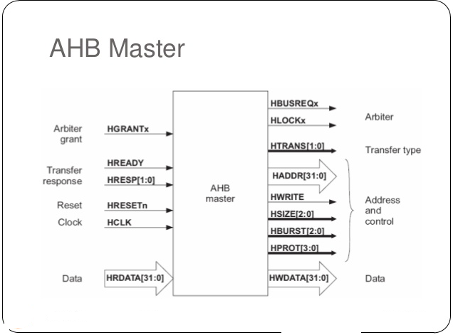

Slide 18
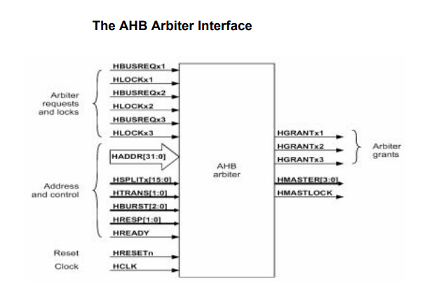

Slide 19
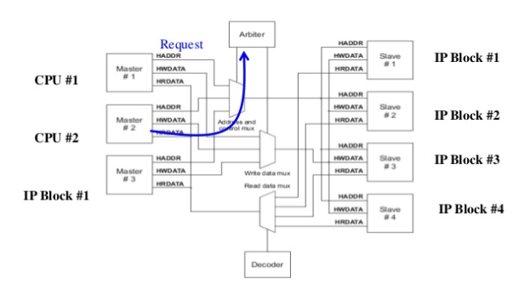
Request Grand Protocol

Slide 20
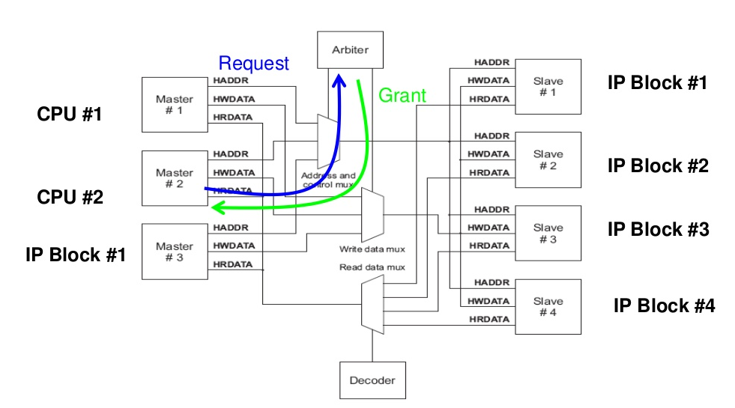
Request /Grant Protocol

Slide 21
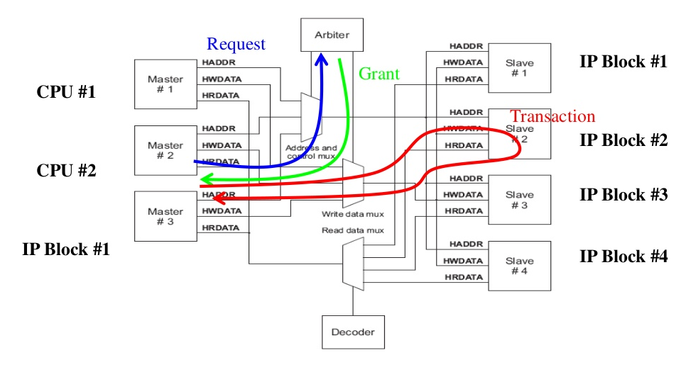
Request /Grant Protocol

Slide 22
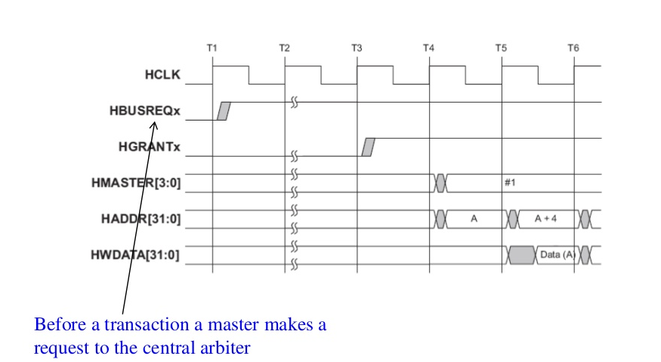
Request /Grant Protocol

Slide 23
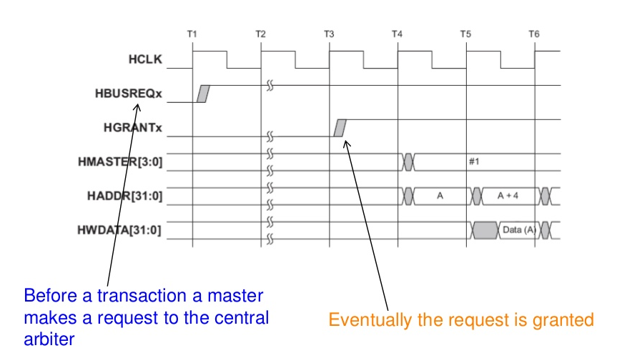
Request /Grant Protocol

Slide 24
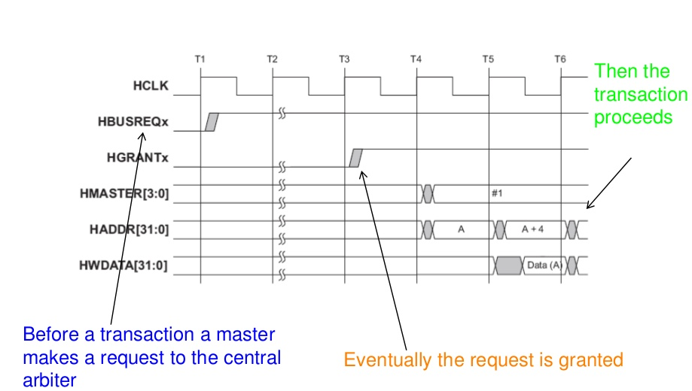
Request /Grant Protocol

Slide 25
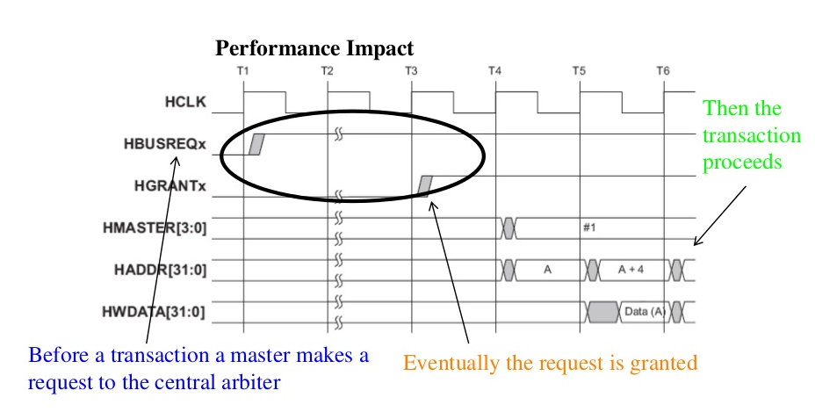
Request /Grant Protocol

Slide 26
Improving efficiency using pipelining
IF we can make the address of next transaction can be presented before the data from the current transaction is completed – We can improve the efficiency

Slide 27
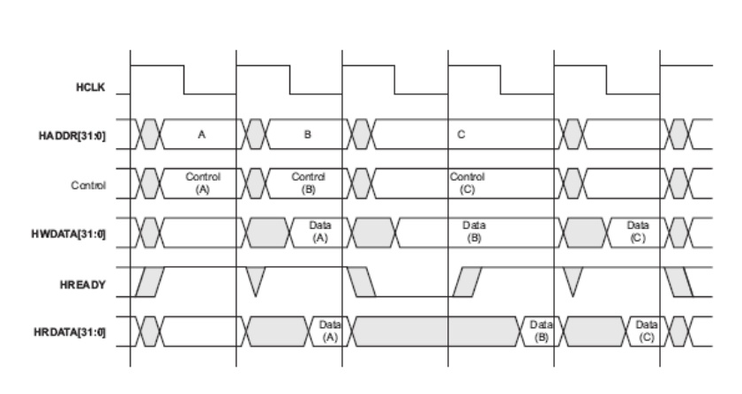

Slide 28
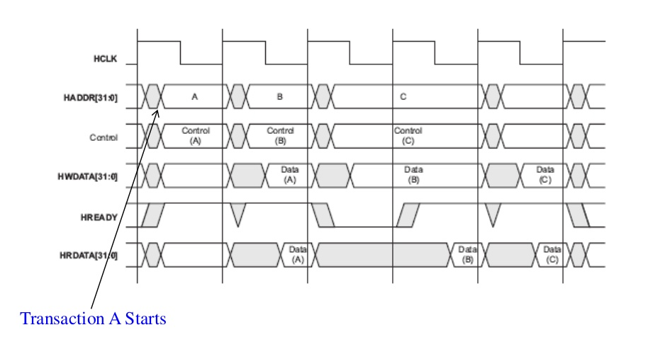

Slide 29
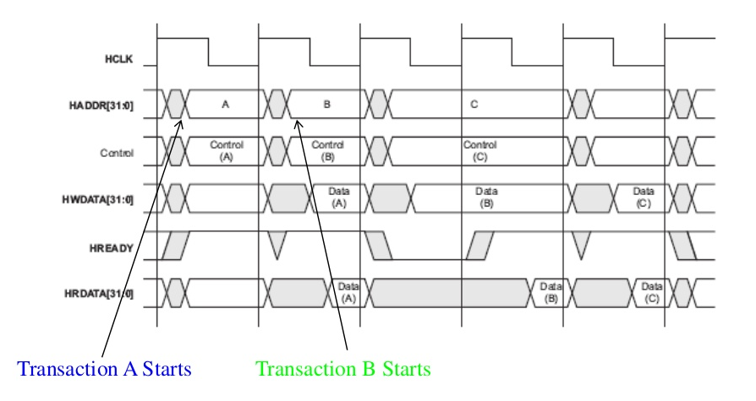

Slide 30
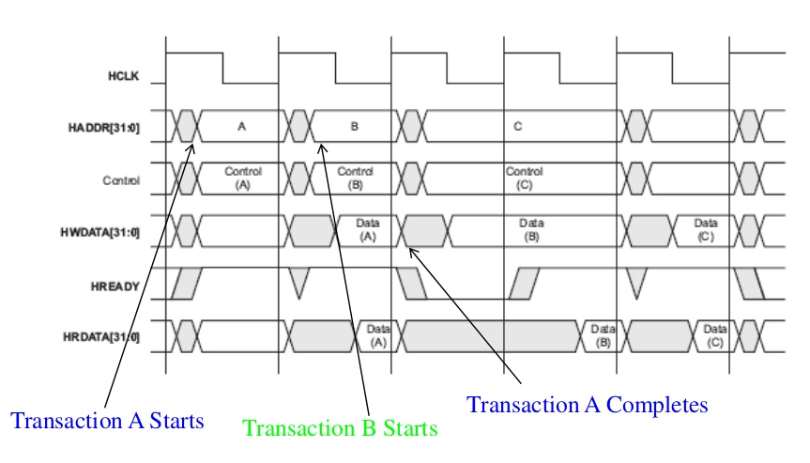

Slide 31
The Advanced Extensible interface (AXI)

Slide 32
What is AXI
We discussed about Advanced High-performance Bus (AHB) - This is used for connecting components that need higher bandwidth on a shared bus. These could be a internal memory or an external memory interface, DMA , DSP etc but the shared bus would limit the number of agents. higher bandwidth is possible through burst data transfers.
AXI (Advanced Extensible interface) protocol also was an enhancement from AHB
AXI is designed for high bandwidth and low latency interconnects. This is a point to point interconnect and overcomes the limitations of a shared bus protocol in terms of number of agents that can be connected. AXI supports multiple outstanding data transfers (pipe-lined), burst data transfers, separate read and write paths and supporting different bus widths.

Slide 33
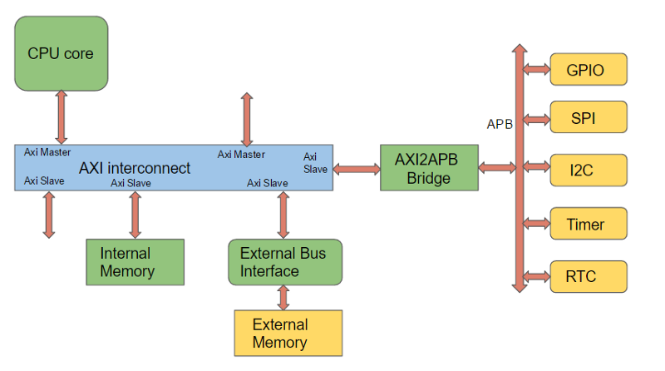
AXI Block Diagram

Slide 34
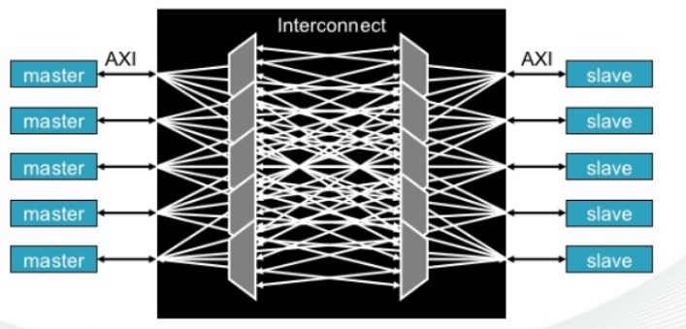
AXI Interconnect Cross bar switch

Slide 35
Key Features of AXI
AXI interconnect can be used to build an SOC with various functional blocks talking through a master-slave protocol.
The interconnect could be a custom crossbar or a switch design or even an off the shelve NOC (Network on Chip) IP that supports multiple AXI masters and slaves.
The AXI interconnect helps in scaling up connectivity for number of agents compared to previous AHB/ASB bus.
An AXI to APB bridge on one of the slave port is normally used to bridge communications to a set of peripherals shared on an APB bus.

Slide 36
AXI Stream
AXI-stream protocol is another flavor of the AXI protocol that supports only streaming of data from a master to a slave. There is no separate read/write channels in the stream protocol unlike a full AXI or AXI-lite as the intend is to only stream in one direction. Multiple streams of data can be transferred (even with interleaving) across a master and slave. This becomes useful in designs like video streaming applications.

Slide 37
ACE (AXI Coherency Protocol Extension)
Further evolution happened in the era of mobile and smartphones with SOCs having dual/quad/octa core processors with shared caches integrated and the need for hardware managed coherency across the memory subsystem. This lead to the introduction of ACE (AXI Coherency Protocol Extension) in AMBA revision 4.
In this, CPU cores with coherent caches getting integrated on a single chip. The ACE protocol extends the AXI read and write data channels by introducing separate snoop address, snoop data and snoop response channels. These extra channels provides mechanisms to implement a snoop based coherency protocol.

Slide 38
CHI —( Coherent Hub Interface)
With the arrival of high performance computing and data center , the computing environment became more hetrogenious
number of processor cores increased
Graphical processing units got integrated on SoC
DSP units got integrated on SoC
FPGAs, memory controllers and IO sub systems became a part of SoC
To take care of this CHI (Coherent Hub Interconnect) protocol was introduced as a re-design of the AXI/ACE protocol. The signal based AXI/ACE protocol was replaced with the new packet based CHI layered protocol that can scale very well for near term future.
The ACE protocol was developed as an extension to AXI to support coherent interconnects. The ACE protocol used a signal level communication between master/slave and hence the interconnects needed large number of wires with added channels for snoops and responses. This worked well for small coherent clusters with dual/quad core mobile SOC designs. With increasing number of coherent clusters on SOC along with other heterogeneous compute elements and memory controllers — the AMBA 5 revision introduced CHI protocol as a complete re-design of the ACE protocol. The CHI protocol uses a layered packet based communication protocol with protocol, link layer and physical layer implementation and also supports QoS based flow control and retry mechanisms.

