Slide 1
ARMv8 Archictecture
Girish S Kumar

Slide 2
ARMv8 is the first architecture series where 64 Bit instruction sets are introduced

Slide 3
Architecture terms in v8
AArch64 the ARMv8-A 64-bit execution state, that uses 31 64-bit general purpose registers (R0-R30), and a 64-bit program counter (PC), stack pointer (SP), and exception link registers(ELR). Provides 32 128-bit registers for SIMD vector and scalar floating-point support (V0-V31). A64 instructions have a fixed length of 32 bits and are always little-endian.
AArch32 is the ARMv8-A 32-bit execution state, that uses 13 32-bit general purpose registers (R0-R12), a 32-bit program counter (PC), stack pointer (SP), and link register (LR). Provides 32 64-bit registers for Advanced SIMD vector and scalar floating-point support. AArch32 execution state provides a choice of two instruction sets, A32 (ARM) and T32 (Thumb2). Operation in AArch32 state is compatible with ARMv7-A operation.
T32: 16-bit instructions are decompressed transparently to full 32-bit ARM instructions in real time without performance loss.Thumb-2 technology made Thumb a mixed (32- and 16-bit) length instruction set

Slide 4
ARM v8 features High level
64-Bit pointer and registers
Fixed length (32bit) instructions
Load/store architecture
Little endian (big endian possible)
31 general purpose registers and zero register
Unaligned access ok – Except of exclusive and ordered accessed

Slide 5
New Features
Load-acquire and store-release atomics
Crypto (AES and SHA) instructions
AdvSIMD usable for general purpose float math
Larger PC-relative addressing and branching
Literal pool access and most conditional branches are extended to ± 1MB, unconditional branches and calls to ±128MB
Non-temporal (cache skipping) load/store
Load/store of a non-contiguous pair of registers

Slide 6
New extensions provided with v8 arch
Jazelle is a Java hardware/software accelerator: “ARM Jazelle DBX (Direct Bytecode eXecution) technology for direct bytecode execution of Java”. On Sofware side: Jazelle MobileVM is a complete JVM which is Multi-tasking, engineered to provide high performance multi-tasking in a very small memory footprint
Floating Point: for floating point operations
NEON: the ARM SIMD 128 bit (Single instruction, multiple data) engine and DSP the SIMD 32bit engine useful to make linear algebra operations
Cryptographic Extension is an extension of the SIMD support and operates on the vector register file. It provides instructions for the acceleration of encryption and decryption to support the following: AES, SHA1, SHA2-256.
TrustZone: is a system-wide approach to security for a wide array of client and server computing platforms include payment protection technology, digital rights management, BYOD, and a host of secured enterprise solutions

Slide 7
New Extensions
Virtualization Extensions with the Large Physical Address Extension (LPAE) enable the efficient implementation of virtual machine hypervisors for ARM architecture compliant processors.
The visualization extensions provide the basis for ARM architecture compliant processors to address the needs of both client and server devices for the partitioning and management of complex software environments into virtual machines.
The Large Physical Address extension provides the means for each of the software environments to utilize efficiently the available physical memory when handling large amounts of data

Slide 8
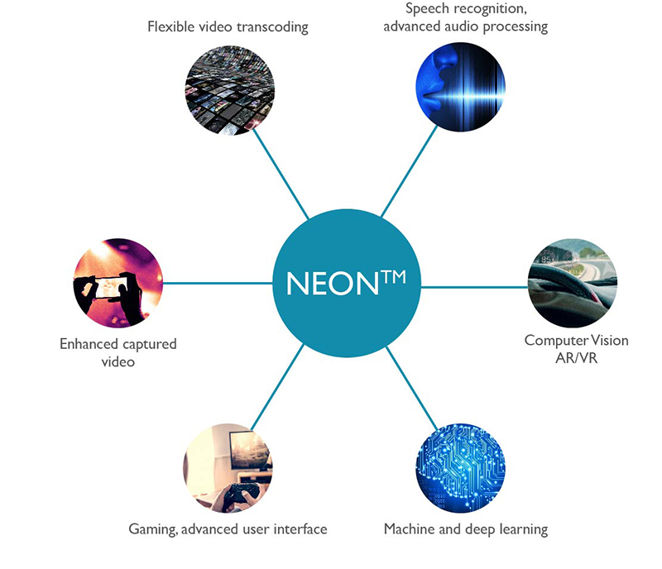
What is NEON SIMD
ARM NEON technology is an advanced SIMD (single instruction multiple data) architecture extension for the Arm Cortex-A series and Cortex-R52 processors.

Slide 9
NEON Technology
NEON technology was introduced to the Armv7-A and Armv7-R profiles. It is also now an extension to the Armv8-A and Armv8-R profiles. NEON technology is intended to improve the multimedia user experience by accelerating audio and video encoding/decoding, user interface, 2D/3D graphics or gaming. NEON can also accelerate signal processing algorithms and functions to speed up applications such as audio and video processing, voice and facial recognition, computer vision and deep learning.

Slide 10
One Step Deeper into NEON
The NEON technology is a packed SIMD architecture.
NEON registers are considered as vectors of elements of the same data type.
Multiple data types are supported by the technology.
The following table describes data types as supported by the architecture version.
 | Armv7-A/R | Armv8-A/R | Armv8-A
Floating Point
Integer

