Slide 1
Instructions for Cortex M4
Girish S Kumar
Notes:
Click to add notes

Slide 2
Instructions for ARM Cortex-M4
For any Processor to perform a task user has to give instructions
High level languages like C/C++ which are closer to English In such a case a compiler translates the high level instructions to a machine language
This kind of language is composed of binary code or machine code
sequence, like 01101110. The low-level language is a computer- or machine-dependent
language.

Slide 3
Assembly Language Work Flow
Assembly Language Instructions
Assembler
Machine Language Instructions

Slide 4
ARM Instructions set
ARM instructions are always 32 Bit
Op Code and data is contained in this
Op-Code 20 bits
Operands 12 bit
32 -Bits
Notes:
How presentation will benefit audience: Adult learners are more interested in a subject if they know how or why it is important to them.
Presenter’s level of expertise in the subject: Briefly state your credentials in this area, or explain why participants should listen to you.

Slide 5
ARM Thumb-2 Instructions
ARM developed two different instruction set architectures:
Traditional 32-bit instruction set (ARM Instructions)
16-bit instructions to improve the code Density (Thumb Instructions)
During 2003 ARM developed Thumb-2 technology This technology enables a mixture of 16-bit and 32-bit instructions to be executed within one operating state. All the ARM Cortex-M processors are based on Thumb-2 technology.

Slide 6
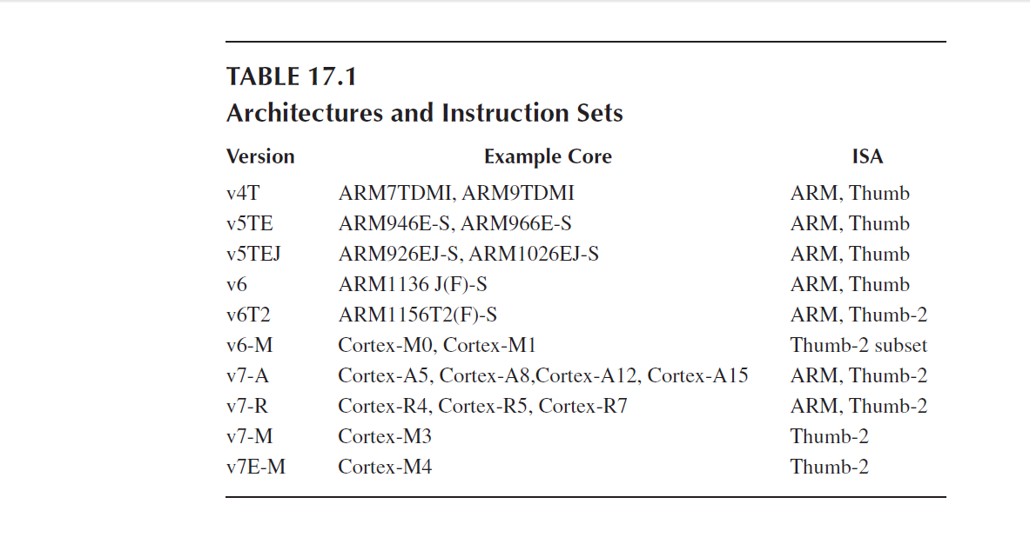

Slide 7
Cortex M4 Instructions Set
Cortex M4 has
203 Instructions in general category
65 instructions related to FPU
1. Data Moving Instructions
2. Arithmetic Instructions
3. Logic Instructions
4. Shift and Rotate Instructions
5. Data Conversion Instructions
6. Bit-Field Processing Instructions
7. Compare and Test Instructions
8. Program Flow Control Instructions
9. Saturation Instructions
10. Exception Related Instructions
11. Sleep Mode Instructions
12. Memory Barrier Instructions
13. Miscellaneous Instructions
14. Unsupported Instructions

Slide 8
Syntax of Assembly Language
1. Label field
2. Operation field
3. Operands field
4. Comment field
 | Label Field | Operation Field | Operands | Comments
Mandatory/Optional | Optional | Mandatory | Mandatory | Optional
Purpose | Identify a line for branching A label must be located at the first column & max 15 Chars Label must end with a : | Contains the Mnemonic like MOV, ADD | The operands field contains the data or an address for its corresponding instruction to be operated | To add documentation to your should be mentioned after a semicolon

Slide 9
Rules for third field Operands
For data processing instructions written for the ARM assembler, the first operand is the destination of the operation.
• For a memory read instruction,, the first operand is the destination register that data is to be loaded into.
• For a memory write instruction, the first operand is the source register that holds the data to be written into the memory.
• For a multiple load instruction, the register list which is the third operand is the destination operand that the data will be loaded into.
• For a multiple store instruction, the register list which is the third operand is the source operand that the stored data will be written into the memory.

Slide 10
Pseudo Instructions
For a assembler to convert Assembly language instructions to Machine language it needs additional information telling
Flash memory address where the instructions are stored
Data and constants a are stored
Reserved memory space
End point to users code
Such instructions for the assembler enabling it to generate machine code are called Pseudo instructions
Pseudo instruction are never converted into machine code, they are very assembler specific
Machine and assembly instructions are machine specific similarly pseudo instructions are assembler specific

Slide 11
Shifting Data
AREA appcode, CODE, READONLY
EXPORT __main
ENTRY
__main FUNCTION
MOV r0, #0x11 ; load initial value
LSL r1, r0, #1 ; shift 1 bit left
LSL r2, r1, #1 ; shift 1 bit left
stop B stop ; stop program
ENDFUNC
END
Notes:
Lesson descriptions should be brief.

Slide 12
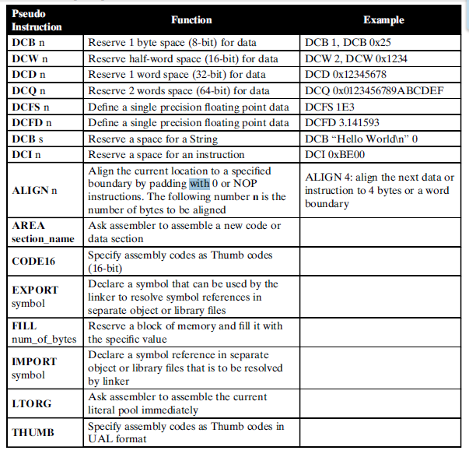
Popular pseudo
instructions used in
Cortex-M4 MCU

Slide 13
Swapping Registers
THUMB
AREA appcode, CODE, READONLY
EXPORT __main
ENTRY
__main FUNCTION
MOV r0, #0x100
MOV r1, #0x200
EOR r0, r0, r1 ; r0 XOR r1
EOR r1, r0, r1 ; r1 XOR r0
EOR r0, r0, r1 ; r0 XOR r1
stop B stop ; stop program
ENDFUNC
END
Notes:
Example objectives
At the end of this lesson, you will be able to:
Save files to the team Web server.
Move files to different locations on the team Web server.
Share files on the team Web server.

Slide 14
Factorial
THUMB
AREA factorial, CODE, READONLY
EXPORT __main
ENTRY
__main FUNCTION
MOV r6,#10 ; load n into r6
MOV r7,#1 ; if n = 0, at least n! = 1
loop CMP r6, #0
MULGT r7, r6, r7
SUBGT r6, r6, #1 ; decrement n
BGT loop ; do another mul if counter!= 0
stop B stop ; stop program
ENDFUNC
END

Slide 15



Cortex-M4 Addressing Modes

Slide 16
Seven Addressing Modes
1. Immediate Offset Addressing Mode
2. Register Offset Addressing Mode
3. PC-Relative Addressing Mode
4. Load and Store Multiple Registers Addressing Mode
5. PUSH and POP Register Addressing Mode
6. Load and Store Register Exclusive Addressing Mode
7. Inherent Addressing Mode

Slide 17
Immediate offset Addressing mode
Target address to do a memory operation LOAD or STORE is obtained by
adding an offset to a base address that is stored in a register.
The offset value can be positive or negative, any general-purpose register
R0 to R12 can be used to store the base address.
Memory
Address | Data
0x01003 | 0x4573
0x01004 | 0x6789
0x01005 | 0x4128
Base address Register
Any one from (R0-R12)
+
Offset

Slide 18
Variations of Offset Addressing
1. Regular Immediate Offset Addressing Mode
2. Pre-Indexed Immediate Offset Addressing Mode
3. Post-Indexed Immediate Offset Addressing Mode
4. Regular Immediate Offset Addressing Mode with
Unprivileged Access

Slide 19
Regular Immediate Offset Addressing Mode
MOV R2, 0x00340
LDRB R0, [R2, #0x5]
In this mode, the offset is an immediate number and the
content of the register R2 keeps unchanged after the execution
of this instruction.
The range of the offset depends on the operation mode used in
the instruction. For the regular Immediate Offset mode, the offset
is ranged -255 to 4095.
The square bracket [ ] covering the R2 and an Offset indicates that
the combination of the content of the R2 and the Offset is a
valid memory address.

Slide 20
Example of Shifting Data with Regular Immediate Offset Addressing Mode
AREA appcode, CODE, READONLY
EXPORT __main
ENTRY
__main FUNCTION
MOV R2, #0x20000000 ; Base Address
LDR R0, [R2, #0x5] ; 0x5 is the offset
LSL r1, r0, #1 ; shift 1 bit left
LSL r2, r1, #1 ; shift 1 bit left
stop B stop ; stop program
ENDFUNC
END

Slide 21
Load Instruction
LDR{type} Rd, [Rn, {#Offset}]
Base Register
Size and Type of
Data Loaded
Destination Register
Instruction | Size & type
LDR | 32 Bit
LDRB | Unsigned byte
LDRH | Unsigned half word (16 bits)
LDRSB | Signed byte
LDRSH | Signed Half Word

Slide 22
Pre-Indexed Immediate Offset Addressing Mode
LDR{type} Rd, [Rn, {#Offset}]!
The target memory address is first calculated by adding the content of the
register Rn and the Offset (Pre-Indexed).
2. Then the data item stored in that target address will be loaded into the
destination register Rd The effective target address is written back into Rn
The difference between this mode and the Regular immediate offset mode
is that the content of the register Rn is modified after running this instruction

Slide 23
Example of Shifting Data with Pre-index Offset Addressing Mode
AREA appcode, CODE, READONLY
EXPORT __main
ENTRY
__main FUNCTION
MOV R2, #0x20000000 ; Base Address
LDRB R0, [R2, #0x5]! ; 0x5 is the offset
LSL r1, r0, #1 ; shift 1 bit left
LSL r2, r1, #1 ; shift 1 bit left
stop B stop ; stop program
ENDFUNC
END

Slide 24
Post-Indexed Immediate Offset Addressing Mode
LDR{type} Rd, [Rn], {#Offset}
In this mode target memory address is directly obtained from the register Rn without
using the Offset value.
Then use this address as the target memory address to access the memory to
perform either loading or storing operations.
After the instruction is executed, a combination of the content of the register Rn
and the offset is performed, and this sum is sent back to the register Rn.
This means that the content of the register Rn is modified or changed after (post)
this mode’s instruction is executed.

Slide 25
Example of Shifting Data with Pre-index Offset Addressing Mode
AREA appcode, CODE, READONLY
EXPORT __main
ENTRY
__main FUNCTION
MOV R2, #0x20000000 ; Base Address
LDRB R0, [R2], #0x5 ; 0x5 is the offset
LSL r1, r0, #1 ; shift 1 bit left
LSL r2, r1, #1 ; shift 1 bit left
stop B stop ; stop program
ENDFUNC
END

Slide 26
Regular Immediate Offset Addressing Mode with Unprivileged Access
LDR{type}T Rd, [Rn,{#Offset}]
Eg: LDRBT R0, [R2, #0x5];
These load and store instructions perform the same function as the Regular Immediate
Offset Addressing Mode did.
The difference is that these instructions have only unprivileged access even when
used in the privileged software.
When used in the unprivileged software, these instructions perform exactly the same
function as regular memory access instructions with immediate offset.

Slide 27
Store Instruction
STR {type} Rs, [Rn, {#Offset}]
Base Register
Size and Type of
Data Loaded
Data Source Register
Instruction | Size & type
STR | 32 Bit
STRB | Unsigned byte
STRH | Unsigned half word (16 bits)
Addressing mode works the same in LOAD and STORE Instructions

Slide 28
PC-Relative Addressing Mode

Slide 29
PC-Relative Addressing Mode
The PC-relative addressing mode can be used to load a register with a value stored
in program memory a short distance away from the current instruction. It can be
seen as a special case of the "base plus offset" addressing mode, one that
selects the program counter (PC) as the "base register".
There are a few CPUs that support PC-relative data references.
Such CPUs include:
Intel Architecture
ARM Architecture
Motorola 68000 Series
When this addressing mode is used, the compiler typically places the constants in
a literal pool immediately before or immediately after the subroutine that uses
them, to prevent accidentally executing those constants as instructions.
TODO :
Find a assembly program which uses literal
Reword the slide

Slide 30
Loading Constants in Registers
Easiest way to load a constant to Register is to use LDR as pseudo instruction
LDR <Register Name> , = <Numeric Constant>
Eg:
LDR R8, =0x20000040
When assembler sees this pseudo instruction it creates MOV instruction to do so. But assembler creates Literal Pools to store constants and this will be located somewhere close to the instructions in the memory. The compiler knows where the literals so to access the literals it generates an address relative to Program Counter (Says PC + 4 or PC =2 etc). But the problem with this approach is the value offset (what we add to PC) cannot be more that 12 bits, in ARM this offset is limited to 12 Bits., that is max (4KB) So in program which is long enough such that the Literal Pool is kept far away more that 4KB will have a problem
Note : 2 ^ 12 = 4096 4096/1024 = 4

Slide 31
How do we solve this
We solve this using an assembler directive LTORG. The LTORG instructs assembler to create the Literal Pool closes to where it is mentioned in this case the Literal pool will be created between the sub-routine
AREA appcode, CODE, READONLY
EXPORT __main
ENTRY
__main FUNCTION
BL func1 ; call first subroutine
BL func2 ; call second subroutine
stop B stop ; terminate the program
; Subroutine func1 begins
func1 LDR r0, =42 ; => MOV r0, #42
LDR r1, =0x12345678 ; => LDR r1, [PC, #N]
; where N = offset to literal pool 1
LDR r2, =0xFFFFFFFF ; => MVN r2, #0
BX lr ; return from subroutine
LTORG ; literal pool 1 has 0x12345678
; Subroutine func2 begins
func2 LDR.W r3, =0x12345678 ; => LDR r3, [PC, #N]
; N = offset back to literal pool 1
;LDR r4, =0x98765432 ; if this is uncommented, it fails.
; Literal pool 2 is out of reach!
BX lr ; return from subroutine
BigTable
SPACE 4200 ; clears 4200 bytes of memory,
; starting here
ENDFUNC
END

Slide 32
Disassembly Window
0x00000108 F000F803 BL.W 0x00000112
0x0000010C F000F80A BL.W 0x00000124
0x00000110 E7FE B 0x00000110
0x00000112 F04F002A MOV r0,#0x2A
0x00000116 4902 LDR r1,[pc,#8] ; @0x00000120
0x00000118 F04F32FF MOV r2,#0xFFFFFFFF
0x0000011C 4770 BX lr
0x0000011E 0000 DCW 0x0000
0x00000120 5678 DCW 0x5678
0x00000122 1234 DCW 0x1234
0x00000124 F85F3008 LDR.W r3,[pc,#-8] ; @0x00000120
0x00000128 4770 BX lr

Slide 33
4. Load and Store Multiple Registers Addressing Mode
What do we do if want to Load or Store a list of memory location to or from
Registers ? We use LDR and STR instructions in a loop, but ARM provides
Instructions to do this – so it more efficient that using loops
LDM{mode} Rn{!}, {reglist};
Eg: LDM R0!, {R1, R2, R3};
STM{mode} Rn{!}, {reglist};
Eg: STMDB R1!, {R3–R6, R11, R12};

Slide 34
LOAD MULTPILE Locations to Registers
Mode mean :
IA: Increment the target address After the Load or Store operation
DB: Decrement the target address Before the Load or Store operation
LDM{mode} Rn{!}, {reglist};
Name of the Register which contains the starting address from where the load instruction should start
List of Register to which the data from memory should be loaded
Value Last address from where Load was done + 1 will be written to Rn

Slide 35
STORE MULTPILE Locations to Registers
Mode mean :
IA: Increment the target address After the Load or Store operation
DB: Decrement the target address Before the Load or Store operation
STM{mode} Rn{!}, {reglist};
Name of the Register which contains the starting address from where the load instruction should start
List of Register to which the data from memory should be loaded
Value Last address from where Load was done + 1 will be written to Rn

Slide 36
Limitations
The register Rn cannot be PC.
• The reglist cannot contain SP.
• In any STM instruction, the reglist cannot contain PC.
• In any LDM instruction, the reglist cannot contain PC if it contains LR.
• The reglist must not contain Rn if you specify the write back suffix
when PC is in the reglist in an LDM instruction:
• Bit[0] of the value loaded to the PC must be 1 for correct execution, and a branch occurs to this half word-aligned address.
• If the instruction is conditional, it must be the last instruction in the IT block.

Slide 37
Exercise
Can you Think of writing a small program using ARM Assembly instructions using
STM and LDM and its variations which will implement
Full ascending stack
Full descending stack

Slide 38
PUSH and POP Register Addressing Mode

Slide 39
Stack Operations
In the Cortex-M4 memory system, the stack uses a full-descending operation mode.
Stack pointer SP points to the bottom or the largest address of the stack area at the beginning or after the system is reset.
After each PUSH operation, the processor first decrements the Stack pointer (SP) by 4, and then it stores the data (32-bit) in the memory location pointed by SP.
In a POP operation, the data of the memory location pointed by SP is read, and then the SP is incremented by 4.

Slide 40
How does PUSH and POP works.
Initially the Stack Pointer register SP is initialized to point to the bottom of the stack by
assigning 0x20007FFF to the SP.
2. After some pushing and popping operations, some data items are pushed
into the stack space the SP now points to the current address 0x20007000
where some data are stored.
3. Before performing the PUSH operation, the content on the SP will be first
decreased by 4 to adjust the SP to point to a new address 0x20006FFC to reserve
4 contiguous bytes to store a 32-bit data or instruction.
4. Then the PUSH instruction is executed to push 4 bytes, MSB, MS, LS, and
LSB, into the stack area starting from the lower address 0x20006FFC which is
pointed by the SP.
5. When the PUSH operation is done, the SP points to the Most Significant Byte
(MSB) with the lower address 0x20006FFC. When the next PUSH operation is
executed, first the SP performs another 4 operation, and it follows the same
operational procedure as above to push another data or instruction into the stack
space.

Slide 41
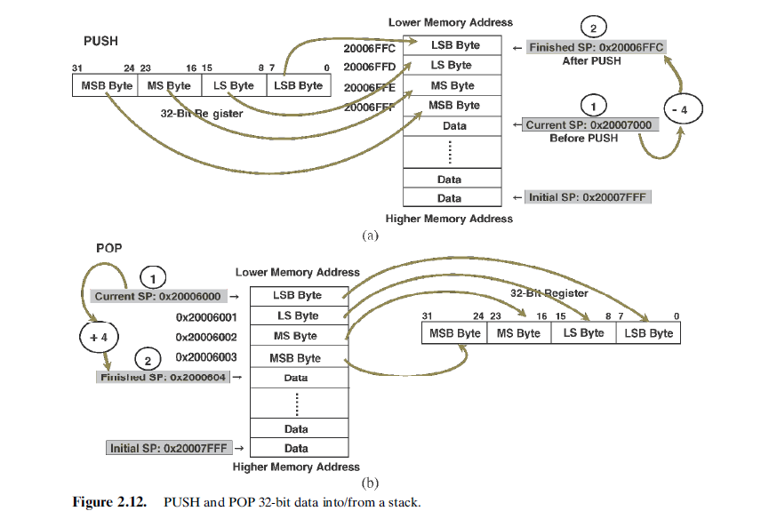

Slide 42
PUSH and POP instruction
PUSH Instruction is very similar to STMDB
POP is very similar to LDMIA
PUSH { list of registers to push to stack };
Example : PUSH {R0, R3–R5, R9};
POP {list of registers to push to stack};
Example POP {R2, R3};
Restrictions with PUSH and POP
The <List of registers> in PUSH or POP cannot contain SP.
• For the PUSH instruction, the <List of registers> cannot contain PC.
• For the POP instruction, the <List of registers> cannot contain PC if it contains LR.

Slide 43
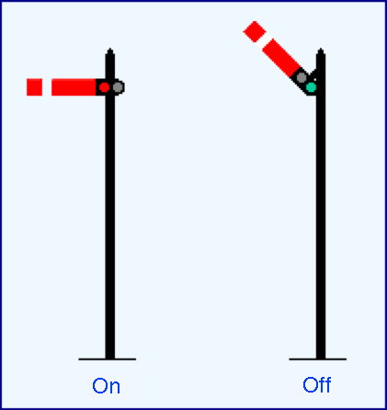
Semaphore in ARM Assembly ?

Slide 44
Exclusive Access to Resources
Let us say we have small device say a printer or something like that connected to a ARM processor Board .. This is memory mapped device
Multiple points, try too access this device. At a time we only one thread can access this device – how do we control this ? In high level language we have Semophore API. In Assembly ARM support this by providing two instructions LDREX STREX for accessing memory.
When we execute LDREX R0, [R1, #0x12]; The memory location with address R1 + 0x12 is read to R0 and the location is “Locked” so that no entity can access it.
When we do a STREX Rd, Rt, [Rn, #Offset]; data in Rt will be written to the address [Rn + Offset], and Rd will have the return status and ”lock” will be released.

Slide 45
Inherent Addressing Mode
Inherent Addressing Mode means that both operands are registers and all
operational data are located inside registers without needing to access the memory space.
Most Arithmetic and Logic as well as Shift and Rotate instructions use this addressing mode, such as the instructions ADD

Slide 46
Floating Point Numbers

Slide 47
Floating point and integers Mix

Slide 48
Structure of Assembly Language Programs Assembler Rules and Directive

Slide 50
Load and Store
Instructions

Slide 52
Arithmetic Operations
Basics of DSP

Slide 54
Loops and Control Structures

Slide 65
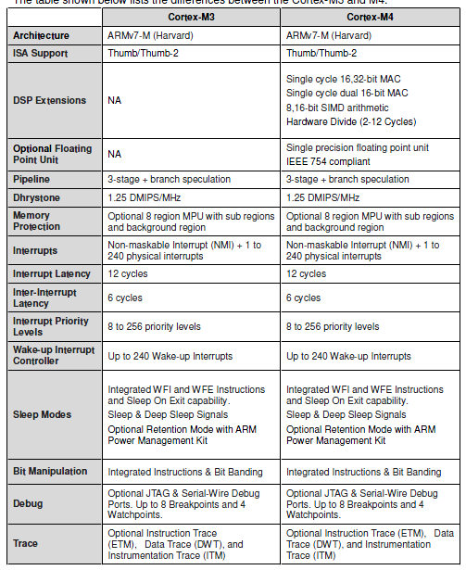
Cortex-M3 and M4

