Slide 1
Cortex M4 Exception Handling
Girish S Kumar

Slide 2
Cortex-M4 Block Diagram
ARM Cortex-M4 Microprocessor
Nested Vector
Interrupt
Controller
(NVIC)
Optional FPU
Optional
WIC
Optional
Embedded
Trace Macrocell
Processor core
Optional
Debug
Access Port
Optional Memory
protection unit
Optional Serial
Wire Viewer
Optional
Flash
patch
Optional
Data
watchpoints
Bus matrix
Code interface
SRAM and
peripheral interface

Slide 3
What are Interrupts and Exceptions
In an application it is necessary to stop the execution of the current set of programmed instructions and execute sets of instructions to handle special conditions,
Data received from network
A connection request from Blue Tooth headset
An incoming call indication on your mobile phone while a video clip is being played
To handle such situations processor put the execution of current set of instruction to hold and executes a different set (small set) of “pre-programmed” instructions
These requests, called Exceptions or interrupts, they are asynchronous nature. The set of pre-programmed instructions are called Interrupt Service Routines
After an exception/ interrupt service routine is executed , the main program resumes as if there had been no interruption. – This is very important aspect of Interrupt/Exception processing
In Cortex –M4 context there is a slight difference between Exceptions and Interrupts ,

Slide 4
What is difference between Exceptions and Interrupts
Exceptions
Exceptions are created within the CPU/Processor generated by an event, such as the system fault event and other system mis-operation, they have higher priority than others
Division by ZERO is a very good example where an exception is created
Interrupts
Interrupts are generated by an event from an internal peripheral (storage) or external peripherals like Blue tooth devices, keyboards they have lower priority when compared with Exceptions
Question : On a mobile phone, while running image editing two events happens almost at the same time, a division by zero and incoming call request, which one the phone should give priority ? Which is an exception and which is interrupt.

Slide 5
How Interrupts/Exceptions are processed
An exception or interrupt is first created by an exception/interrupt source and an interruptservice- request is sent to the Cortex-M4 CPU.
2. Based on the mask register’s content (PRIMASK) and the interrupt priority level (BASEPRI), CPU will determine whether to response or process the interrupt request.
3. If the interrupt request is accepted, the associated hardware will provide interrupt-related information, such as the interrupt source number and related Interrupt Service Routine (ISR) entry point, in a Vector Table.
4. Before the control can be transferred to the ISR, all related registers, including R0R3,
R12, LR, PSR, and PC, are pushed into the stack to reserve their contents. During this
protection process, all other interrupts or exceptions are masked or disabled to avoid any
data to be lost.

Slide 6
5. Then the control will be directed to the entry point (entry address of the ISR) stored in the
Vector Table to run the ISR to perform the required interrupt service. During this process, all other interrupts and exceptions are unmasked or enabled to allow higher-level-priority interrupts or exceptions to be requested and responded.
6. After the ISR is done and before the control can be transferred back to the main program,
(a) all other interrupts or exceptions are masked or disabled to avoid any data to be lost and,
(b) all related registers protected in step 4, including the PC, will be recovered by popping them back to the related registers.
7. Then the control can be directed to the main program to continue executing the normal
application codes based on the old PC content. At this time, all interrupts and exceptions are unmasked or enabled to allow any interrupt or exception to be requested and responded.

Slide 7
Nested Interrupt Vector control
External Peripherals
Internal Peripherals
NVIC
ARM Cortex
Processor
1
2
3
IRQs
IO PORT
Exceptions
IO PORT

Slide 8
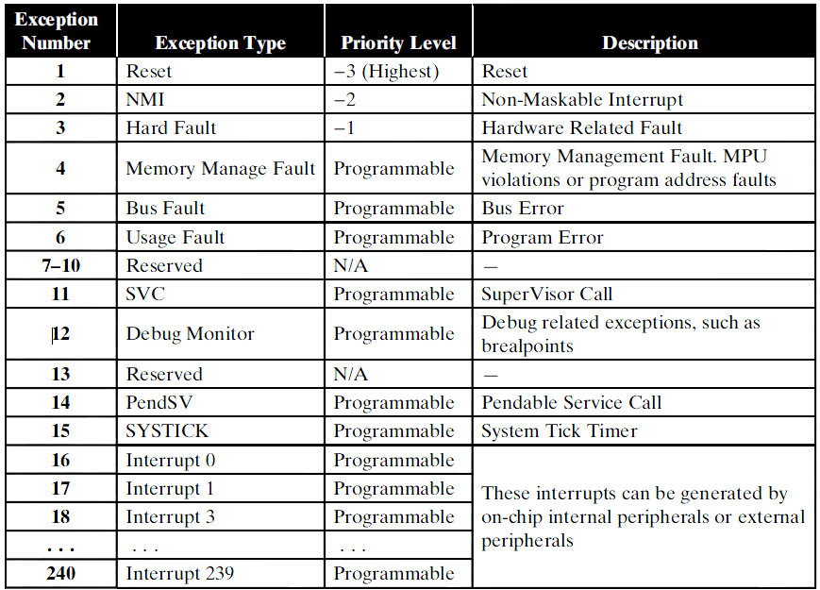
Exception and Interrupt types in the Cortex-M4 system

Slide 9
Exception and Interrupt types in the Cortex-M4 system
PSR
PRIMASK
FAULTMASK
BASEPRI
CONTROL
Cortex M4 define 15 exceptions which are numbered from 1 to 15 the table
The exceptions with number greater than 15 till 240 are called Interrupts
The smaller the number, the higher the priority level whether it is a exception or interrupt
First three in table Reset, NMI, and Hard Fault, have fixed priority levels as –ve numbers. Negative numbers means exceptions cannot be masked or disabled by
using PRIMASK register, and they have the highest priority level and must be handled first if they are coming.
For exception 4 onwards the priority levels for all exceptions and interrupts can be programmed to the different priority levels based priority given to peripheral devices (Eg: Keyboards, Sensors, Relay, display etc)
These exceptions and interrupts can be masked or disabled by using PRIMASK register in your application programs.

Slide 10
How are exception programmed
All exceptions and interrupts in the Cortex-M4are Handled by theNVIC.
The NVIC provides a group of programmable registers to manage exceptions and interrupts
There is module called System Control Block (SCB) which assists NVIC to manage exceptions and interrupts.
The registers in NVIC and SCB are used for programming Execptions and interrupts
The special registers such as PRIMASK, FAULTMASK, and BASEPRI, also provide mask, unmask, and priority level selections for most exceptions and interrupts to support their processing.

Slide 11
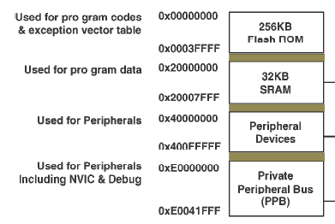
Where is NVIC located
NVIC and SCB are located in the
System Control Space (SCS) at the on-chip memory map with a memory range of
0xE000E0000xE000EFFF.

Slide 12
Processor Modes
Cortex –M4 has two modes
Thread Mode
Handler mode
Processor Mode | What happens in this mode
Thread mode | All User Application executes in this mode, when processor is RESET and completes the reset process, it automatically comes to Thread mode
Handler mode | All Exceptions are handled in this mode, once the exception handling is completed it goes back to thread mode

Slide 13
Processor Mode and Privileges
Privileged
User
Privileges
Processor mode
Use of this mode:
Exception Handling
Stack : Main
Handler
mode
Use of this mode:
Applications use this mode
Under special conditions
Stack : Main or process
Use of this mode:
Applications will be in this mode most of the time
Stack : Main or process
Thread
mode
Thread
mode
Privileged
User

Slide 14
Transition between modes
Thread mode
Handler mode
Switching to Handler Mode
For Exception handling
P
Exit from Exception
P
Transition through
Control Register
Switching to Handler Mode
For Exception handling
U
Exit from Exception

Slide 15
PSR
CONTROL Register
PRIMASK
FAULTMASK
BASEPRI
The CONTROL is a 32 bit register, that controls the
Which stack used at a given time
When the processor is in Thread mode it decides the privilege level
Indicates whether the Floating point Unit is active
CONTROL
BITS | Name | Function
31 …… 3 Bits | No name | Reserved
2 | FPCA | 0 = no floating-point context active 1 = floating-point context active.
1 | SPSEL | 0 = MSP is the current stack pointer 1 = PSP is the current stack pointer.
0 | nPRIV | Defines the Thread mode privilege level: 0 = privileged 1 = unprivileged.

Slide 16
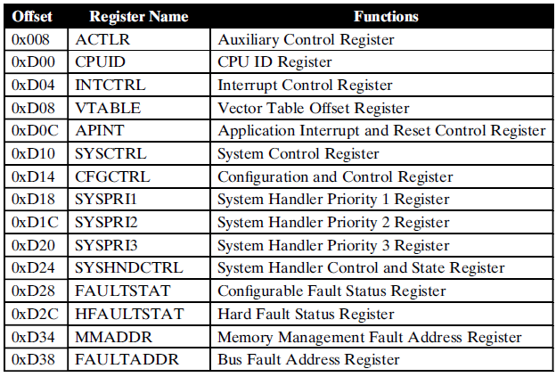
System Control Block
The System Control Block (SCB) provides system controls and implementation information, including configuration, control, and reporting of the system exceptions. These controls and implementations are performed via 15 control registers,

Slide 17
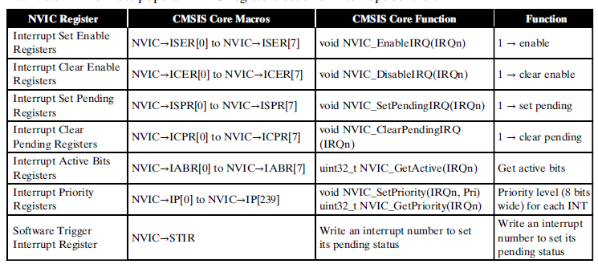
NVIC Registers

Slide 18
Sample Exception Handler
#include "TM4C123GH6PM.h“
int div(int lho, int rho)
{
return lho/rho;
}
void printMsg(const char * Msg)
{
while (*Msg != '\0'){
ITM_SendChar(*Msg);
++Msg;
}
}
void HardFault_Handler(void)
{
printMsg("In Hard Fault Handler\n");
while(1);
}

Slide 19
int main(void)
{
int x ;
int y ;
int z ;
char message[10];
SCB->CCR |= 0x10; //Enabling the Configuration Control Block in SCB
x = 10;
y = 20;
z = div(x, y);
sprintf (message,"Value of z = %d \n",z);
printMsg (message);
//Doing division by zero to create exception
y=0 ;
z = div(x, y);
}

Slide 20
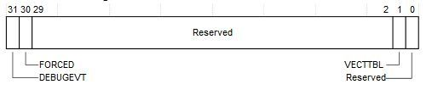
Root Causing the Fault
Now that we had found hard fault we need to find out what caused the fault for this we use register HardFault Status Register (SCB->HFSR)
For this we examine HFSR bit configuration,
If FORCED bit is set to 1, the HardFault handler must read Configurable Fault Status Register (SCB->CFSR) registers to find the root cause of the fault.

Slide 21
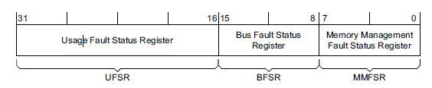
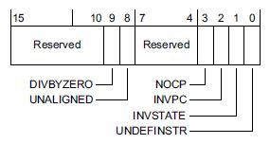
Configurable Fault Status Register

