Slide 1
KEIL Development Environment
Girish S Kumar
Notes:
Click to add notes

Slide 2
Topics
KEIL Overview
What is KEIL for Cortex-M family
Structure of a KEIL MDK project
Simulator
Simulator Capabilities
μVision5 Debug Architecture
Trace Capabilities
Logic Analyzer

Slide 3
What is KEIL
The Keil MDK is a comprehensive software development environment for
ARM -based microcontrollers.
This has two parts, MDK core and Soft ware Pack
MDK Core Contains
UI and Editor for editing programs
C/C++ Compiler
Pack Installer
Debugger with Trace Function
Software Pack
Device Drivers for SPI, USB and Ethernet
The Cortex Microcontroller Software Interface Standard ( CMSIS) support,
Which includes CMSIS-CORE, CMSIS-DSP, and CMSIS-RTOS
MDK Middleware support
Example programs
Notes:
How presentation will benefit audience: Adult learners are more interested in a subject if they know how or why it is important to them.
Presenter’s level of expertise in the subject: Briefly state your credentials in this area, or explain why participants should listen to you.

Slide 4
What is KEIL for Cortex-M family
1. μVision5 Integrated Development Environment (IDE): Provides a GUI with all
general required development tools, such as debugger and simulation environment.
2. ARM Compilation Tools: These tools include C/C++ Compiler, ARM Assembler,
Linker, and other utilities.
3. Debugger: Provides debug functions for ARM microcontroller programs.
4. Simulator: Provides simulation environment to enable users to build and run program
without any real hardware.
5. Keil RTX Real-Time Operating System Kernel: Provides a real operating system
kernel.
6. TCP/IP Networking Suite: Offers multiple protocols and various applications.
7. USB Device and USB Host stacks: These are provided with standard driver classes.

Slide 5
8. ULINKpro: This enables on-the-fly analysis of running applications and records every executed Cortex-M instruction.
9. Complete Code Coverage: Information about your program’s execution.
10. Execution Profiler and Performance Analyzer: These enable program
optimization.
11. CMSIS Cortex Microcontroller Software Interface Standard: Compliant.
12. Reference start-up codes: These are for about 1000 microcontrollers.
13. Flash Programming Algorithms.
14. Program examples

Slide 6
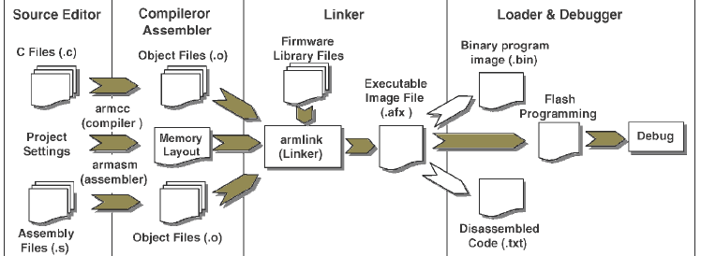
Structure of a MDK project

Slide 7
Simulator
The μVision5 Debugger can be configured as a Simulator or as a Target Debugger
The Simulator is a software-only product that simulates most features of a
microcontroller
Test and debug your application
Simulates peripherals serial port, external I/O, timers, and interrupts.
Simulates up to 4GB of memory from which specific areas can be
mapped for reading, writing, executing, or a combination of these
When debugging your program, op-codes are interpreted and executed as their
corresponding instructions would be. Can view program disassembly in mixed
mode or in assembly code.
All registers and flags are updated as each instruction executes., affected
registers are highlighted.
Instruction timings are accurately simulated so you can easily determine how long a
function or module takes to execute. Timing is cycle-accurate for deterministic parts.

Slide 8
Simulator Capabilities
μVision5 configures the Simulator based on device selected and selects the appropriate instruction set, timing, and peripherals. The μVision5 Simulator has the following capabilities:
Runs programs using the ARM7TM, ARM9TM, Thumb, Thumb2, (instr)
Is cycle-accurate and correctly simulates instructions and on-chip peripheral timing, where possible.
Simulates on-chip peripherals of ARM7TM, ARM9TM, and Cortex-Mx
Can provide external stimulus using the debugger C script language.
The μVision5 Debugger provides complete instruction set simulation for all ARM7TM, ARM9TM, Cortex-M3, devices.

Slide 9
μVision5 Debug Architecture

Slide 10
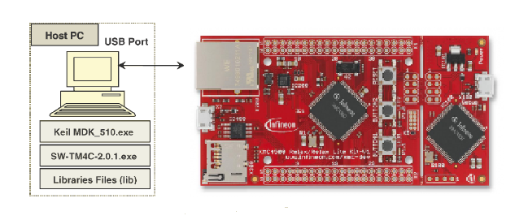
Supports simulation & debugging on a laptop using a target h/w
Features
Breakpoints,
Watch windows, and
Execution control
Trace capture,
Execution profiler,
Code coverage,
Logic analyzer.

Slide 11
The ARM debugger is composed of two elements:
The hardware (Debug Adapter)
Software (Debug Adapter Driver).
Protocols are developed to meet the needs of different debug processes.
JTAG (Join Test Action Group). JTAG is the industry-standard interface used
to download and debug programs on a target processor, as well as many other
functions
SWD: (Serial Wire Debug). The Serial Wire Debug mode is an alternative to the
standard JTAG interface.

Slide 12
Trace Capabilities
Why do we need Trace ?
Normal Debugging features which had discussed has limitations when we have to
debug time critical applications like robots, motor control, communication systems etc
This is because breakpoints and single stepping commands change the dynamic
behavior of the system.
How trace solves the problem ?
Instead of Stopping the program live information about what is happening is streamed live from the processor to a external device (Laptop etc)
DataWatchpoints can record memory accesses with data value and program address and, optionally, stop program execution.
Exception-Trace outputs details about interrupts and exceptions.
Instrumented Trace communicates program events and enables printf-style debug
messages and the RTOS Event Viewer.
Instruction Trace streams the complete program execution for recording and analysis.

Slide 13
On some microcontrollers, the trace information can be stored on an on-chip
Trace Buffer that can be read using the standard debug interface. The Cortex-
M4 has an optional Embedded Trace Buffer (ETB) that stores all trace data
described above.

Slide 14
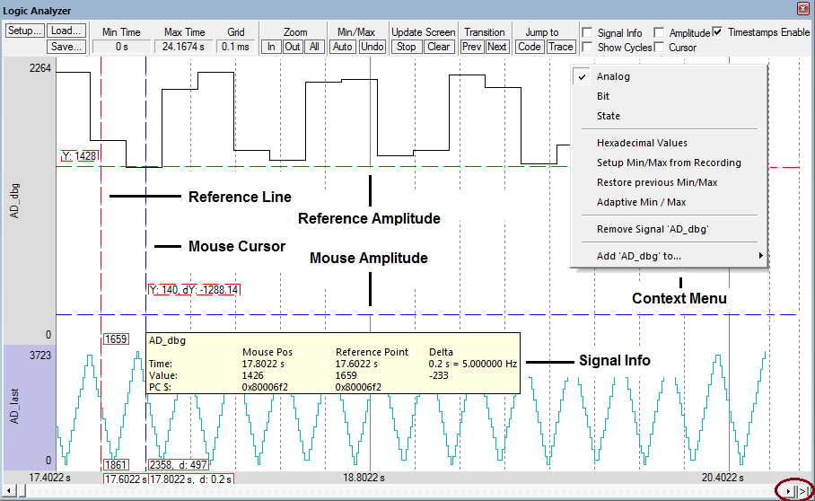
Logic Analyzer
The Logic Analyzer is a graphical analysis tool that shows value changes of variables . These elements can be specified by the user, but are subject to restrictions. As a consequence, not every variable can be shown.

Slide 15
The Logic Analyzer can record changes of:
Global program variables, including struct members.
VTREGs that represent I/O pins of the microcontroller.
Peripheral registers that are triggered by external or internal events, but with the restrictions outlined below.
The Logic Analyzer cannot record changes of:
Automatic variables defined inside a function Automatic variables are located on the stack or in overlayable memory regions. It is not possible to record changes of dynamic memory locations.
CPU registers CPU registers cannot be triggered with read or write breakpoints. Therefore, such changes cannot be recorded.
Peripheral registers that represent timer registers Increments of timers (or similar peripherals) are not simulated. Instead, the timing of events that are triggered by a timer, is calculated. Therefore, it is not possible to view timer increments.
I/O pins of communication peripherals I/O pin toggling of UART, CAN, SPI, or I²C communication peripherals is not simulated. It is assumed that the timing of communication streams behaves according to the specifications. Instead, the I/O stream is represented by VTREGs.
Memory BUS signals µVision simulates a CPU including memory areas, but it does not simulate the Memory BUS signals (data BUS, address BUS, and control lines like RD, WR, ALE). Therefore, it is not possible to view memory BUS signals with the Logic Analyzer.

