Slide 1
Cortex M4
Girish S Kumar
Notes:
Click to add notes

Slide 2
Cortex M4 General View
A 32 Bit microcontroller
It is designed to achieve
High code density,
Fast interrupt response times
Signal processing Algorithms
IEEE floating-point units
Real time Operating System support
Advance Trace Capabilities
Notes:
How presentation will benefit audience: Adult learners are more interested in a subject if they know how or why it is important to them.
Presenter’s level of expertise in the subject: Briefly state your credentials in this area, or explain why participants should listen to you.

Slide 3
Cortex-M4 Details
A 32 Bit microcontroller
Can handle 32 bit, 16 bit and 8 –bit data effectively
Cortex-M4 does not include any memory but provides interfaces to external Flash and SRAMs
32 bit address bus lets us address 4GB of Memory
Different regions are created memory space to store system instructions and data, users instructions, data, and mapped peripheral device registers and related interfaces.
Cortex -M4 internally uses a 32 But bus based on AMBA standard, Advanced Microcontroller Bus Architecture
The main bus interface between the MCU and external components is the Advanced Highperformance Bus (AHB), which provides interfaces for memory and system bus as well as for peripheral devices.
A Nested Vectored Interrupt Controller (NVIC) is used to provide all supports and managements to the interrupts

Slide 4
Cortex M4 - Architecture
Programmer View
Memory architecture.
Nested Vectored Interrupt Control.
Debug architecture.

Slide 5
Processor Modes
Cortex –M4 has two modes
Thread Mode
Handler mode
Processor Mode | What happens in this mode
Thread mode | All User Application executes in this mode, when processor is RESET and completes the reset process, it automatically comes to Thread mode
Handler mode | All Exceptions are handled in this mode, once the exception handling is completed it goes back to thread mode

Slide 6
Privileges in Mode
 | Privilege Mode | What can a program do in the mode
1 | Privileged mode | No Restrictions – Full access to everything
2 | Unprivileged mode | A program in this mode has limited access the xPSR register or it flags through MRS and MSR instructions Cannot access system timer, Nested Vectored Interrupt Controller (NVIC) , system control block May have restricted access to memory or peripherals.
Notes:
Lesson descriptions should be brief.

Slide 7
Processor Mode and Privileges
Privileged
User
Privileges
Processor mode
Use of this mode:
Exception Handling
Stack : Main
Handler
mode
Use of this mode:
Applications use this mode
Under special conditions
Stack : Main or process
Use of this mode:
Applications will be in this mode most of the time
Stack : Main or process
Thread
mode
Thread
mode
Privileged
User
Notes:
Example objectives
At the end of this lesson, you will be able to:
Save files to the team Web server.
Move files to different locations on the team Web server.
Share files on the team Web server.

Slide 8
Registers in Cortex-M4

Slide 9
R0
R1
R2
R3
R4
Low Registers
R5
General
Purpose
Registers
R6
R7
R8
R9
R10
High Registers
R11
R12
Special Purpose Registers
R13(SP)
MSP
PSP
PSR
Program Status Register
R14 (LR)
Banked Version
PRIMASK
R15(PC)
FAULTMASK
Exception Register
BASEPRI
CONTROL
Control Register

Slide 10
Stacks in ARM processor

Slide 11
Types of Stack
Ascending Stack:
In a push the stack pointer is incremented, i.e the stack grows towards higher address.
Descending Stack:
In a push the stack pointer is decremented, i.e the stack grows towards lower address.
Ascending Empty stack
Stack pointer points to the location in which the next item will be stored. A push will store the value, and increment the stack pointer.
Ascending Full Stack
Stack pointer points to the location in which the last item was stored. A push will increment the stack pointer and store the value.
Descending Empty stack
Stack pointer points to the location in which the next item will be stored. A push will store the value, and increment the stack pointer.
Full stack
Descending Full Stack
Stack pointer points to the location in which the last item was stored. A push will increment the stack pointer and store the value

Slide 12
Stack on Cortex M4
Main Stack
Process stack
R13(SP)
MSP
PSP
The Cortex M4 uses a full descending stack. This means the stack pointer holds the
address of the last stacked item in memory.
The processor implements two stacks, the main stack and the process stack, with a pointer for each held in independent registers,
Processor Mode | Used to execute | Privilege level | STACK USED
Thread | Applications | Privileged or Un privileged | Process stack or Main stack Based on CONTROL Register
Handler | Exceptions | Always Privileged | Main Stack

Slide 13
PSR
CONTROL Register
PRIMASK
FAULTMASK
BASEPRI
The CONTROL is a 32 bit register, that controls the
Which stack used at a given time
When the processor is in Thread mode it decides the privilege level
Indicates whether the Floating point Unit is active
CONTROL
BITS | Name | Function
31 …… 3 Bits | No name | Reserved
2 | FPCA | 0 = no floating-point context active 1 = floating-point context active.
1 | SPSEL | 0 = MSP is the current stack pointer 1 = PSP is the current stack pointer.
0 | nPRIV | Defines the Thread mode privilege level: 0 = privileged 1 = unprivileged.

Slide 14
PSR
Program Status Register (PSR) Cortex M4
PRIMASK
FAULTMASK
BASEPRI
CONTROL
4 Bits
31 | 30 | 29 | 28 | 27 | 26 | 25 | 24 | 23 | 20 | 19 | 16 | 15 | 10 | 9 | 8 | 7 | 6 | 5 | 4 | 3 | 2 | 1 | 0
N | Z | C | V | Q |  |  |  |  |  | G.. | ..E
 |  |  |  |  |  | ICI/IT |  | T |  |  |  | ICI/IT
 |  |  |  |  |  |  |  |  |  |  |  |  |  |  |  | ISR NUMBER
APSR
EPSR
IPSR

Slide 15
APSR Bit assignments
The APSR contains the status flags (N, C, V, and Z), the Greater Than or Equal flags (used by the SEL instruction), and an additional “sticky” Q flag used in saturation arithmetic, where sticky in this case means that the bit can only be cleared by explicitly writing a zero to it.
BITS | NAME | FUNCTION
31 | N | Negative Flag
30 | Z | Zero Flag
29 | C | Carry or Borrow Flag
28 | V | Overflow Flag
27 | Q | DSP Overflow and Saturation Flag
26:20 | - | Reserved
19:16 | GE[3:0] | Greater than or Equal flags for SEL instruction
15:0 | - | Reserved
Application Program Status Register (APSR),

Slide 16
SEL Instruction
The SEL instruction:
1. Reads the value of each bit of APSR.GE.
2. Depending on the value of APSR.GE, assigns the destination register the value of
either the first or second operand register.
Examples
SADD16 R0, R1, R2 ; Set GE bits based on result
SEL R1, R0, R3 ; Select bytes from R0 or R3 and assign to to R1, based on GE.

Slide 17
Interrupt Program Status Register (IPSR)
IPSR contains only an exception number that is used in handling faults and other types of exceptions.
BITS | NAME | FUNCTION
[31:9] | - | Reserved
[8:0] | ISR NUMBER | This is the number of the current exception: 0 = Thread mode 1 = Reserved 2 = NMI 3 = HardFault 4 = MemManage 5 = BusFault 6 = UsageFault 7-10 = Reserved 11 = SVCall 12 = Reserved for Debug 13 = Reserved 14 = PendSV 15 = SysTick 16 = IRQ0. . . . n+15 = IRQ(n-1)a

Slide 18
Execution Program Status Register (EPSR)
Two fields contain the IF-THEN instruction status bits overlapped with the
Interrupt-Continuable Instruction (ICI) bits, PLUS the Thumb (T) bit
BITS | NAME | FUNCTION
[31:27] | - | Reserved
[26:25], [15:10] | ICI | Interruptible-continuable instruction bits
[26:25], [15:10] | IT | Indicates the execution state bits of the IT instruction. (To be discussed Later)
[24] | T | Thumb state bit. (To be discussed Later)
[23:16] | - | Reserved
[9:0] | - | Reserved

Slide 19
What are Interruptible-continuable instructions
When an interrupt occurs during the execution of an LDM, STM, PUSH, or POP instruction, and when
an FPU is implemented an VLDM, VSTM, VPUSH, or VPOP instruction, the processor:
• stops the load multiple or store multiple instruction operation temporarily
• stores the next register operand in the multiple operation to EPSR bits[15:12].
After servicing the interrupt, the processor:
• returns to the register pointed to by bits[15:12]
• resumes execution of the multiple load or store instruction.
When the EPSR holds ICI execution state, bits[26:25,11:10] are zero.

Slide 20
Exception Registers Cortex M4
PSR
PRIMASK
FAULTMASK
BASEPRI
CONTROL

Slide 21
PRIMASK
PSR
PRIMASK
FAULTMASK
BASEPRI
The PRIMASK register prevents activation of all exceptions with configurable priority.
CONTROL
BIT | NAME | FUNCTION
[31:1] | - | Reserved
0 | PRIMASK | 0 = no effect 1 = prevents the activation of all exceptions with configurable priority

Slide 22
FAULT MASK
PSR
PRIMASK
FAULTMASK
BASEPRI
The FAULTMASK register prevents activation of all exceptions except for Non-Maskable Interrupt (NMI).
CONTROL
BIT | NAME | FUNCTION
[31:1] | - | Reserved
0 | FAULTMASK | 0 = no effect 1 = prevents the activation of all exceptions except for NMI.

Slide 23
PSR
BASEPRI
PRIMASK
FAULTMASK
BASEPRI
The BASEPRI register defines the minimum priority for exception processing. When BASEPRI is set to a nonzero value, it prevents the activation of all exceptions with the same or lower priority level as the BASEPRI value
CONTROL
BIT | NAME | FUNCTION
[31:1] | - | Reserved
0 | FAULTMASK | Priority mask bits: 0x00 = no effect Nonzero = defines the base priority for exception processing. The processor does not process any exception with a priority value greater than or equal to BASEPRI.

Slide 24
Register Summary
Name | Type | Required Privilege
[R0-R12] | RW | Either
MSP | RW | Privileged
PSP | RW | Either
LR | RW | Either
PC | RW | Either
PSR | RW | Privileged
APSR | RW | Either
IPSR | RO | Privileged
EPSR | RO | Privileged
PRIMASK | RW | Privileged
FAULTMASK | RW | Privileged
BASEPRI | RW | Privileged
CONTROL | RW | Privileged

Slide 25
What is IEEE Single Precision and Double Precision ?
The IEEE single precision floating point standard representation requires a 32 bit word
which may be represented as numbered from 0 to 31, left to right.
The 0th is the sign bit, S,
the next eight bits [1:8] are the exponent bits, 'E', and
the final 23 bits are the fraction 'F':
The IEEE double precision floating point standard representation requires a 64 bit word
which may be represented as numbered from 0 to 63, left to right.
The first bit is the sign bit, S,
The next eleven bits are the exponent bits, 'E', and
The final 52 bits are the fraction 'F':

Slide 26
Floating Point Processing
R0
S0
D0
R1
S1
R2
S2
D1
R3
Low Registers
S3
R4
R5
General
Purpose
Registers
R6
R7
R8
S30
D15
R9
S31
R10
High Registers
R11
R12
Special Purpose Registers
R13(SP)
MSP
PSP
PSR
Program Status Register
R14 (LR)
Banked Version
PRIMASK
R15(PC)
FAULTMASK
Exception Register
32 single-precision floating-point registers (s0–s31) or 16 double-precision
registers (d0–d15) or a mix
BASEPRI
CONTROL
Control Register

Slide 27
Cortex M4 - Architecture
Programmer View
Memory architecture.
Nested Vectored Interrupt Control.
Debug architecture.

Slide 28
Memory Architecture
The maximum searchable memory capacity in the Cortex -M4 system can be up to
4 GB. The bus interface between the MCU and external memory is the
Advanced High-performance Bus (AHB), which provides interfaces and connections to
various 32/16/8-bit memory devices.
To make memory access more effective he entire 4GB memory space is divided into
the different regions ith the help of the multiple bus interfaces processor can access
different memory regions, such as from the CODE region stored program codes to
DATA region in the SRAM or peripheral regions, simultaneously or at the same time
In the ARM Cortex-M4 MCU, an optional unit, Memory Protection Unit (MPU), is
provided to enable users to access different memory regions with certain permissions. The MPU is a programmable unit that defines access permissions for different regions. The MPU supports eight programmable regions. (Implementation Specific)

Slide 29
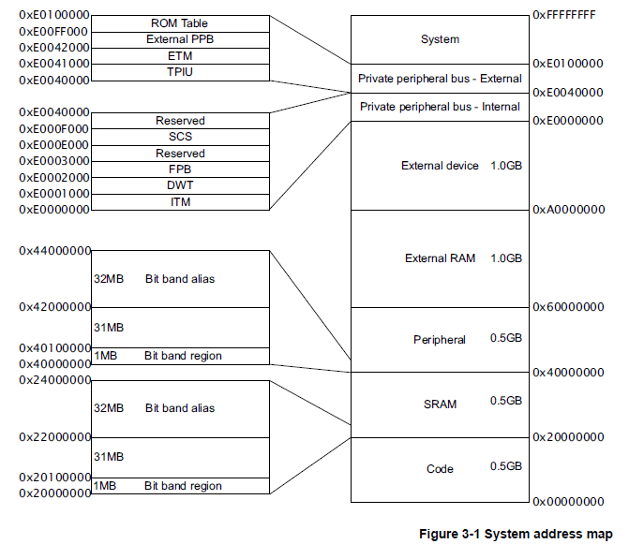
Memory Map

Slide 30
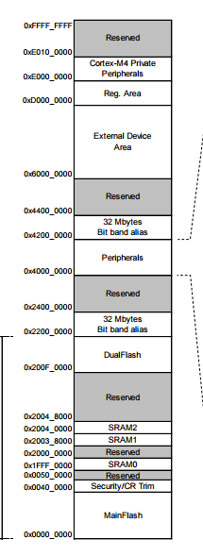

Slide 31
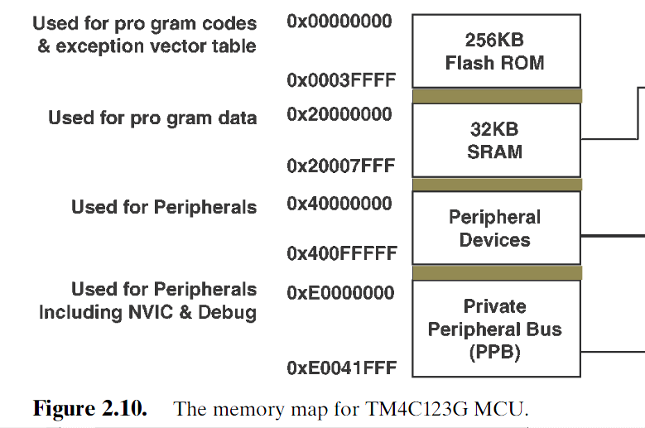

Slide 32
Cortex M4 - Architecture
Programmer View
Memory architecture.
Nested Vectored Interrupt Control.
Debug architecture.

Slide 33
Nested Vectored Interrupt Control.
The Nested Vectored Interrupt Controller (NVIC is used to handle and pre-process all exceptions and interrupts, including makeable and unmask able interrupts,
An exception or interrupt is first created by an interrupt source and sent to processor
Based on the mask register’s content and the interrupt priority level, CPU will
determine whether to response or process the interrupt request.
If the interrupt request is accepted, the associated hardware will provide
interrupt related information, such as the interrupt source and related Interrupt
Service Routine (ISR) entry point, in a Vector Table format.
4. Before the control can be transferred to the ISR, all related registers are pushed
into the stack to reserve their contents
5. Then the control will be directed to the entry point (entry address of the ISR) to
run the ISR to perform the required interrupt service.

Slide 34
Nested Vectored Interrupt Control.
5. After the ISR is done and before the control can be transferred back to the main Program
6. All related registers pushed on to start , including the PC, are recovered by popping them back to the related registers
7. Then the control can be directed to the main program to continue executing the normal application codes based on the old PC content.

Slide 35
Cortex M4 - Architecture
Programmer View
Memory architecture.
Nested Vectored Interrupt Control.
Debug architecture.

Slide 36
Debug Architecture
In theARM Cortex-M4 system, two types of interfaces to understand
“WHAT IS HAPPENING INSIDE”
Debug
Trace.
The debug interface to perform the debug functions,
Run Control of the processor allowing you to start and stop programs
Single Step one source or assembler line
Set breakpoints while the processor is running
Read/write memory contents and peripheral registers on-the-fly
Program internal and external Flash memory
The trace interface is to collect dynamic information from the CPU as the
system is running,
Data,
Event,
profiling or complete details of a user’s application program.

Slide 37
KEIL Real-Time Trace and Analysis
All Cortex-M3 and Cortex-M4 devices provide data and event trace.
Trace Window - Displays program flow by capturing timestamps, PC samples, exceptions, and Read/Write accesses.
Debug Viewer - Displays the printf-style output of the Instrumented Trace (ITM) in a terminal window.
Exceptions window - Displays statistical information about program exceptions and interrupts.
Event Counters - Display real-time values of specific event counters providing performance indications.
Logic Analyzer - Graphically displays variable changes in captured data trace.
RTX Event Viewer - display RTX Kernel task switching events and statistics on a time scale.

Slide 38
Vector Table
The Cortex-M4 vector table is probably one of the larger departures from all previous ARM processor designs. Returning to the idea that addresses are stored in the vector table, rather than instructions,
Exception Type | Exception No | Address
(Top of Stack) | ------------ | 0x00000000
Reset | 1 | 0x00000004
NMI | 2 | 0x00000008
Hard Fault | 3 | 0x0000000C
Memory management fault | 4 | 0x00000010
Bus Fault | 5 | 0x00000014
Usage Fault | 6 | 0x00000018
SV Call | 11 | 0x0000002c
Debug monitor | 12 | 0x00000030
Pend SV | 14 | 0x00000038
Sys Tick | 15 | 0x0000003c
Interrupts | 16 and above | 0x00000040 and above

Slide 39
Nested interrupt vector Controller
The NVIC supports nesting (stacking) of interrupts, allowing an interrupt to be
serviced earlier by exerting higher priority. It also supports dynamic reprioritisation
of interrupts. Priority levels can be changed by software during run time. Interrupts
that are being serviced are blocked from further activation until the interrupt service
routine is completed, so their priority can be changed without risk of accidental
re-entry.

Slide 40
References
1. http://stackoverflow.com/questions/801117/whats-the-difference-between-a-single-precision-and-double-precision-floating-p\
2. NIVC :http://wiki.csie.ncku.edu.tw/embedded/arm-exceptions.pdf

