Slide 1
Instructions for Cortex M4
Girish S Kumar
Notes:
Click to add notes

Slide 2
Thumb-2 Instructions set
ARM instructions are always 32 Bit
Op Code and data is contained in this
To improve Code density ARM came out 16 bit
instructions which are a subset
Cortex M4 does not support ARM 32 bit instructions
Support only Thumb-2 – A combination of 32 bit
and 16 bit instructions
Notes:
How presentation will benefit audience: Adult learners are more interested in a subject if they know how or why it is important to them.
Presenter’s level of expertise in the subject: Briefly state your credentials in this area, or explain why participants should listen to you.

Slide 3
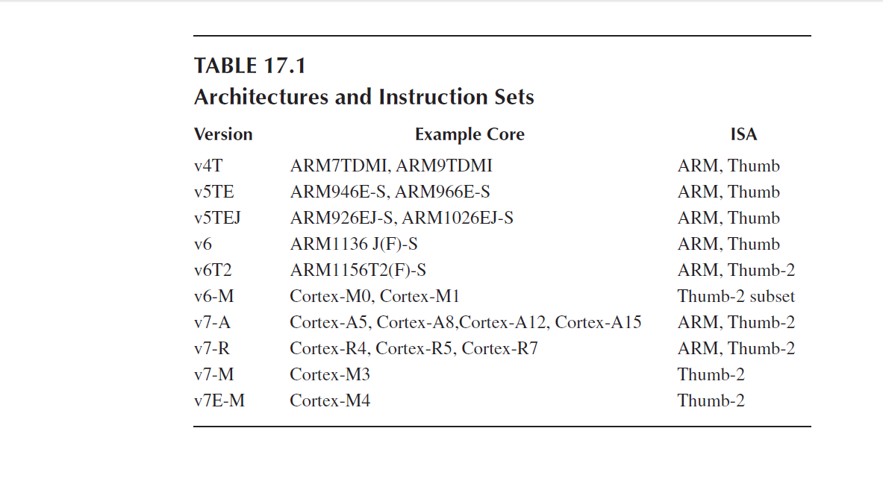

Slide 4
Shifting Data
PRESERVE8
THUMB
AREA appcode, CODE, READONLY
EXPORT __main
ENTRY
__main FUNCTION
MOV r0, #0x11 ; load initial value
LSL r1, r0, #1 ; shift 1 bit left
LSL r2, r1, #1 ; shift 1 bit left
stop B stop ; stop program
ENDFUNC
END
Notes:
Lesson descriptions should be brief.

Slide 5
Swapping Registers
PRESERVE8
THUMB
AREA appcode, CODE, READONLY
EXPORT __main
ENTRY
__main FUNCTION
MOV r0, #0x100
MOV r1, #0x200
EOR r0, r0, r1 ; r0 XOR r1
EOR r1, r0, r1 ; r1 XOR r0
EOR r0, r0, r1 ; r0 XOR r1
stop B stop ; stop program
ENDFUNC
END
Notes:
Example objectives
At the end of this lesson, you will be able to:
Save files to the team Web server.
Move files to different locations on the team Web server.
Share files on the team Web server.

Slide 6
Factorial
PRESERVE8
THUMB
AREA factorial, CODE, READONLY
EXPORT __main
ENTRY
__main FUNCTION
MOV r6,#10 ; load n into r6
MOV r7,#1 ; if n = 0, at least n! = 1
loop CMP r6, #0
MULGT r7, r6, r7
SUBGT r6, r6, #1 ; decrement n
BGT loop ; do another mul if counter!= 0
stop B stop ; stop program
ENDFUNC
END

Slide 7
Floating Point Numbers

Slide 8
Floating point and integers Mix

Slide 9
Structure of Assembly Language Programs Assembler Rules and Directive

Slide 11
Load and Store
Instructions

Slide 13
Arithmetic Operations
Basics of DSP

Slide 15
Loops and Control Structures

