Slide 1
Introduction to ARM Processor
Girish S Kumar

Slide 2
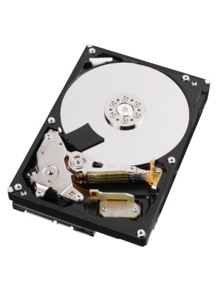


Primary Memory
(RAM)
Instruction
Data Address
Data
Secondary Memory
(Hard Disk)
CPU
Basic Computer Architecture

Slide 3
Two Popular Computer Architecture
Von Neumann Architecture
Data and Instructions are accessed by processor through the SAME BUS
Harvard Architecture
Data and Instructions are accessed by processor through Separate Buses

Slide 4
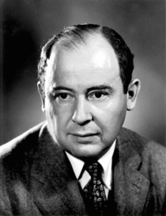
Von Neumann Architecture
Von Neuman architecture is also called Princeton Architecture was published in 1945 by Mathematician , physicist & Computer Scientist John von Neumann
Data & Instructions memory
Data & Instructions
CPU

Slide 5
Harvard Architecture
The Harvard architecture is a computer architecture with physically separate storage and signal pathways for instructions and data. The term originated from the Harvard Mark I relay-based computer, which stored instructions on punched tape (24 bits wide) and data in electro-mechanical counters.
Data
Memory
Instruction
Memory
Data
Instructions
CPU

Slide 6
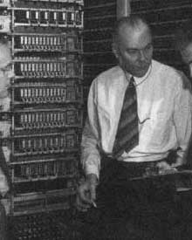
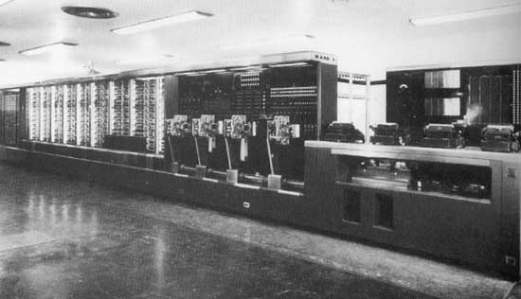
Some time in 1936 or possibly in early 1937, the Harvard physician Howard Aiken started to make plans about an automatic calculation machine. IBM agreed to construct for Harvard an automatic computing plant comprising machines for automatically carrying out a series of mathematical computations adaptable for the solution of problems in scientific fields, the machine was called ASCC (Automatic Sequence Controlled Calculator), but later on it became also known as Harvard Mark I.

Slide 7
Instruction Set Architecture
Instruction set architecture (ISA), is the part of the computer architecture related to programming, including the native data types, instructions, registers, addressing modes, memory architecture, interrupt and exception handling, and external I/O.
CISC
Where single instructions can execute several low-level operations (such as a load from memory, an arithmetic operation, and a memory store) or are capable of multi-step operations or addressing modes within single instructions.
Intel x86 Motorola 68K
RISC
A simplified instruction set provides higher performance also uses fewer cycles per instruction. Has specific instructions for data processing and moving data to and from memory
All ARM Series

Slide 8
HOW did ARM Series Evolved from early days

Slide 9
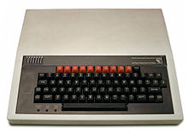
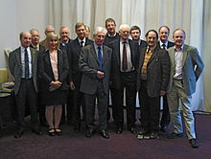
Acorn Computers Ltd.
Originally ARM Comes from Acorn Risk Machine
Acorn was Computer design company based out of UK who build one of the early personal computer called BBC Microcomputer based on a 8-Bit processor (1982)
By 1983, Engineers who build BBC Micro begin to think of next steps to build a successor to take their product to next level

Slide 10

What were the thoughts
Must deliver higher value that the existing BBC Micro
A 16 Bit CPU
With a good interrupt response may better than or comparable to that of 8-bit 6502, has to be identified ……..
MOS Technology, Inc. also known as CSG (Commodore Semiconductor Group), build 6502

Slide 11
What were the technical Challenges
All the 16 bit Microprocessors available in the market were CISC based and much slower than what they were looking for.
Instructions were complex and tool multiple cycles to complete
They long Interrupt latencies compared to 6508
It is not easy to build a new processor that can meet their expectations …….

Slide 12
They decided not to give up .. Instead they continued their search, started looking all the latest research happening, around world on processor design

Slide 13
They came across a processor designed by Post Graduate students at Berkley called RISC I.
It had very simple instructions and low interrupt latency
Students designed it in less than year
This was the starting point of ARM

Slide 14
Three main guiding principles they
Based on they started the design was
A Load and store Architecture
Fixed length instructions (32 Bit length)
3 Address Instruction format

Slide 15
Two Address Instructions
MOV R1, R0
ADD R1, R2
MOV R2, R3
ADD R2, R5
MUL R1, R2
MOV R3, R1
LDR R0 , =0xE000Ed88
STR r1, r[0]
Three Address Instructions
ADD R1, R0, R1
ADD R2, R3,R4
MUL R5, R1, R2

Slide 16
1990 as Advanced RISC Machines Ltd.(ARM) , a joint venture of Apple Computer, Acorn Computer Group, and VLSI Technology.
In 1991, ARM introduced the ARM6 processor family,
and VLSI Technology became the initial licensee.
Today around 2 billion ARM based processors are shipped every year
ARM does not fabricate or sell any of these chips. Fabrication and selling by Semiconductor Companies who has partner with ARM. They design microprocessor, SoC and microcontrollers based on the design (IP) given by ARM
This is called Intellectual property licensing – a very successful and practical model in developing processor designs (Synthesizable core)

Slide 17
Developed
By ARM
Processor
Core
Debug
System
Developed
By ARM and
Semiconductor
Companies
Peripherals
Memory
Clock and Reset
I/O

Slide 18
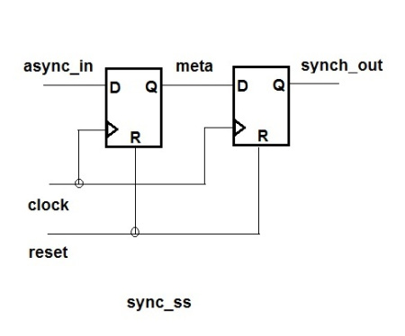
module sync_ss (clk, async_in, reset);
input clk, async_in, reset;
output synch_out;
always @(posedge clk)
if (reset)
meta <= 1’b0;
sync_out <= 1’b0;
else
meta <= async_in;
sync_out <= meta;
endmodule
Verilog Synthesizer

Slide 19

What is a synthesizable core ?
In Electronics a semiconductor intellectual property core, IP core, or IP block is a reusable unit of logic, cell, or integrated circuit layout design that is the intellectual property of a company
IP cores may be licensed to another company or can be owned and used by the owner itself. The term is derived from the licensing of the patent and/or source code copyright that exist in the design.
IP cores are used as the building blocks within ASICs, FPGA or Soc designs
Soft IP | IP cores are typically offered as synthesizable RTL. Synthesizable cores are delivered in a hardware description language such as Verilog
Hard IP | Hard cores, by the nature of their low-level representation, offer better predictability of chip performance in terms of timing performance and area. Eg: Analog and mixed-signal logic are generally defined as a lower-level

Slide 20
IP Vendors
Processor | Memory I/F | D/A and A/D | On-chip SRAMs | Peripherals
Altera - Nios II | Actel | S3 Group | ARM | Eureka Technology
ARM - ARM | Altera | Cadence Design Systems | ChipStart | Digital Blocks, Inc.
Cambridge Consultants - | ARM | Cosmic Circuits | Dolphin Integration
Cortus | Barco Silex | Dolphin Integration | M31 Technology
CEVA, Inc. - | Cadence Design Systems (through acquisition of Denali Software) | Omniphy | MoSys, Inc.
Digital Blocks, Inc. - 8051 with Standard and Configurable Peripherals | Eureka Technology |  | Synopsys
Dolphin Integration - 8051, 80251 | Faraday Technology |  | eSilicon
EnSilica - eSi-RISC | Lattice Semiconductor
Freescale and others - ColdFire
IBM and others -

Slide 21
What is a Debug Architecture ?
ln modern ARM processors include hardware debugging facilities, allowing software debuggers to perform operations such as halting, stepping, and break pointing of code starting from reset. These facilities are built using JTAG support (Joint Test Action Group (JTAG) is an electronics industry association formed in 1985 for developing a method of verifying designs and testing printed circuit boards after manufacture
)
TheARM architecture defines basic debug facilities at an architectural level. These include breakpoints, watchpoints and instruction execution in a "Debug Mode
. Both "halt mode" and "monitor" mode debugging are supported. The actual transport mechanism used to access the debug facilities is not architecturally specified, but implementations generally include JTAG support.
There is a separate ARM "CoreSight" debug architecture,

Slide 22
Due to the different requirements of embedded systems, ARM had split the processor cores into three distinct families,
where the end application now determines both the nature and the design of the processors, but all of them go by
the trade name of Cortex.
The Cortex-A, Cortex-R, and Cortex-M families continue to add new processors each year, generally based on performance requirements as well as the type of end application the cores are likely to execute

Slide 23
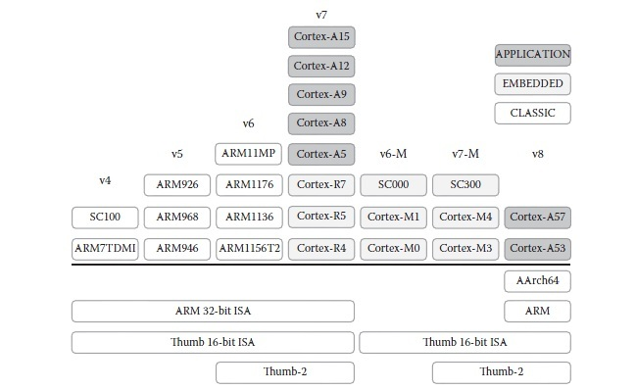

Slide 24
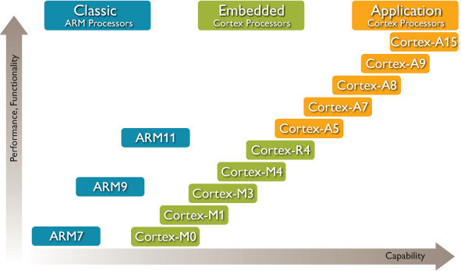

Slide 25
Series | Uses | Processor | Instruction Set Arch
Cortex –A | Feature phone (non smart phone) | CortexA5 | ARMv7A
 | Entertainment in a car (Video player + music) | Cortex A15 (TI OMAP) | ARMv7A
 | Raspberry Pi-1 | ARM1176JZF-S BCM 2835 (32 bit) | ARMv6A
 | Raspberry Pi-2 | Cortex-A7 cluster. Quad-core BCM 2836 (32 bit) | ARMv7A
 | Raspberry Pi-3 | Cortex A53 Quad Core BCM2837 (64 bit) | ARMv8A

Slide 26
Series | Uses | Processor | Instruction Set Arch
Cortex –R | Smallest Cortex-R processor Digi cams, Hard disk controllers wireless base band | Cortex-R4 TI (RM4, TMS570) | Armv7-R
 | Cloud storage, Industrial and automotive (Used in is commonly used in high-volume, deeply embedded SoC applications, such as Industrial, automotive, Mass Storage | Cortex-R5 Scaleo OLEA Texas Instruments RM57 Xilinx ZynqMP | Armv7-R
 | High performance, high energy efficiency, real-time responsiveness, advanced features Wireless Modem, Network Routers, Industrial, Automative Storage | Cortex-R7 | Armv7-R
 | The Cortex-R8 processor has the highest performance in its class of real-time processors. All the the above uses with better performance | Cortex-R8 | Armv7-R
 | Extended safety features, high performance, and hard real-time determinism. Used for Robotics, health care, building automation, Industrial and automotive | Cortex-R52 | Armv8-R
Designed for high performance hard real-time and safety critical applications.

Slide 27
Series | Uses | Processor | Instruction Set Arch
Cortex –M | All small embedded system controllers starting with home appliances to industrial control | Cortex-M0 | ARMv6-M
 |  | Cortex-M0+
 |  | Cortex-M1
 |  | Cortex-M3 | ARMv7-M
 |  | Cortex-M4 | ARMv7E-M
 |  | Cortex-M7
 |  | Cortex-M23 | ARMv8-M
 |  | Cortex-M33

Slide 28
A system on a chip or system on chip (SoC or SOC) is an integrated circuit (IC) that integrates all components of a computer or other electronic system into a single chip. It may contain digital, analog, mixed-signal, and often radio-frequency functions—all on a single chip substrate. SoCs are very common in the mobile computing market because of their low power-consumption. A typical application is in the area of embedded systems.

Slide 29
A typical SoC consists of:
A microcontroller, microprocessor or digital signal processor (DSP) core – multiprocessor SoCs (MPSoC) having more than one processor core
memory blocks including a selection of ROM, RAM, EEPROM and flash memory timing sources including oscillators and phase-locked loops peripherals including counter-timers, real-time timers and power-on reset generators external interfaces, including industry standards such as USB, FireWire, Ethernet, USART, SPI
analog interfaces including ADCs and DACs
voltage regulators and power management circuits

Slide 30
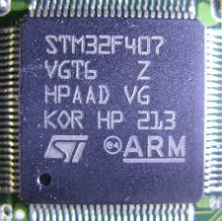
ARM SoC build by ST Microelectronics

Slide 31
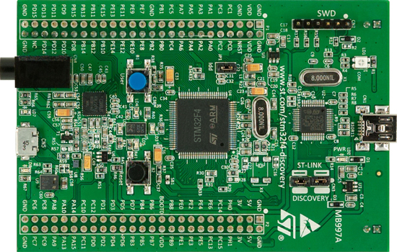
A computer build using STMF32VG704

Slide 32


Slide 33
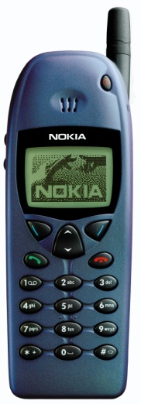
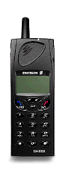
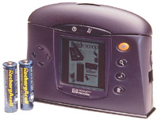
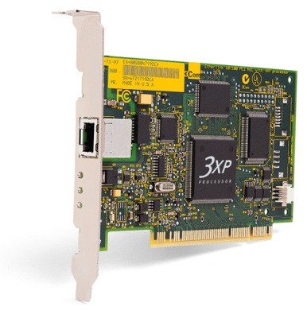
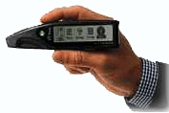
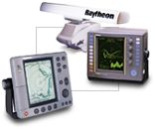
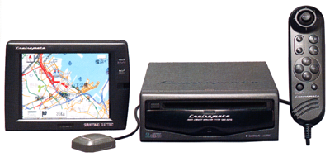
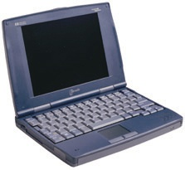

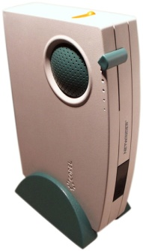

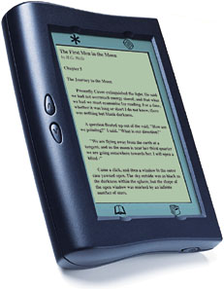
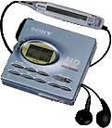

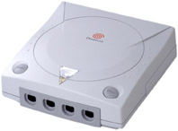
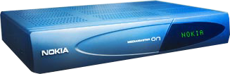
ARM Powered Products

Slide 34
ARMv8 is the first architecture series where 64 Bit instruction sets are introduced

Slide 35
ARM v8 features High level
64-Bit pointer and registers
Fixed length (32bit) instructions
Load/store architecture
Little endian (big endian possible)
31 general purpose registers and zero register

Slide 36
New extensions provided with v8 arch
Jazelle is a Java hardware/software accelerator: “ARM Jazelle DBX (Direct Bytecode eXecution) technology for direct bytecode execution of Java”. On Sofware side: Jazelle MobileVM is a complete JVM which is Multi-tasking, engineered to provide high performance multi-tasking in a very small memory footprint
Floating Point: for floating point operations
NEON: the ARM SIMD 128 bit (Single instruction, multiple data) engine and DSP the SIMD 32bit engine useful to make linear algebra operations
Cryptographic Extension is an extension of the SIMD support and operates on the vector register file. It provides instructions for the acceleration of encryption and decryption to support the following: AES, SHA1, SHA2-256.
Trust Zone: is a system-wide approach to security for a wide array of client and server computing platforms include payment protection technology, digital rights management, BYOD, and a host of secured enterprise solutions

Slide 37
New extensions provided with v8 arch
Virtualization Extensions with the Large Physical Address Extension (LPAE) enable the efficient implementation of virtual machine hypervisors for ARM architecture compliant processors.
The visualization extensions provide the basis for ARM architecture compliant processors to address the needs of both client and server devices for the partitioning and management of complex software environments into virtual machines.
The Large Physical Address extension provides the means for each of the software environments to utilize efficiently the available physical memory when handling large amounts of data

Slide 38
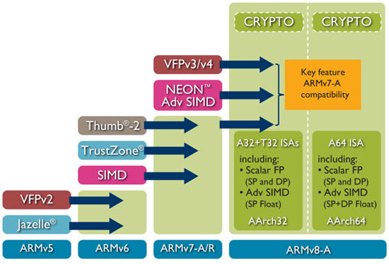

Slide 39
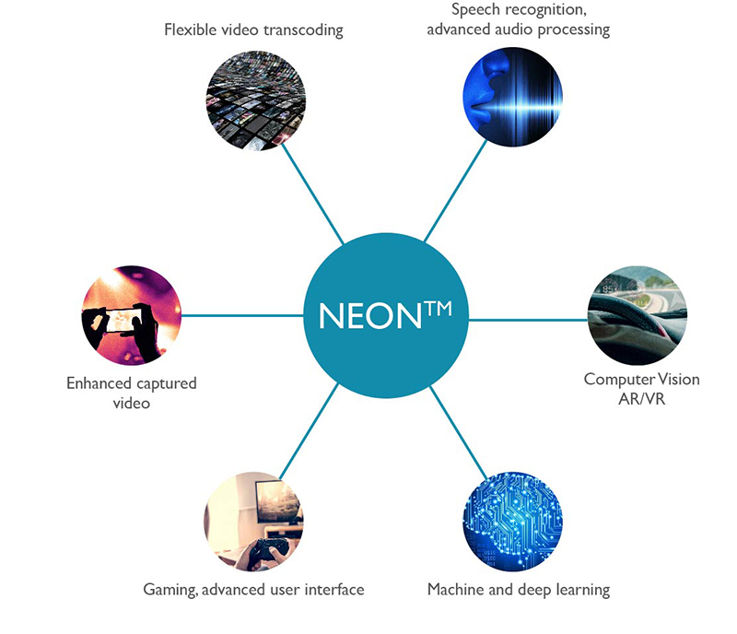
What is NEON SIMD
ARM NEON technology is an advanced SIMD (single instruction multiple data) architecture extension for the Arm Cortex-A series and Cortex-R52 processors.

Slide 40
ARM Cortex-M Series Family
Processor | ARM Architecture | Core Architecture | Thumb® | Thumb®-2 | Hardware Multiply | Hardware Divide | Saturated Math | DSP Extensions | Floating Point
Cortex-M0 | ARMv6-M | Von Neumann |  | Subset | 1 or 32 cycle | No | No | Software | No
Cortex-M0+ | ARMv6-M | Von Neumann | Most | Subset | 1 or 32 cycle | No | No | Software | No
Cortex-M1 | ARMv6-M | Von Neumann | Most | Subset | 3 or 33 cycle | No | No | Software | No
Cortex-M3 | ARMv7-M | Harvard | Entire | Entire | 1 cycle | Yes | Yes | Software | No
Cortex-M4 | ARMv7E-M | Harvard | Entire | Entire | 1 cycle | Yes | Yes | Hardware | Optional

Slide 41
ARM7TDMI Data path
Instructions
Memory
Memory Read
Memory Write
Instruction Decoder
Register File R0 – R15
R15
PC
MAC
Rm
Rn
Barrel Shifter
ALU
R15 Update
Rd : Result
Addr Register
Incrementer
32 –Bit address

Slide 42
What is a Barrel Shifter
A barrel shifter is a combinational logic circuit with N data inputs, N data outputs, and a set of control inputs that specify how to shift the data between input and output.
N inputs
Controls
N outputs

