Slide 1

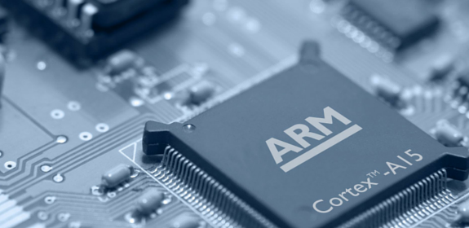
An Overview of our training on
Embedded System and Internet of Things

Slide 2
Embedded Systems and IoT Training Overview
VLSIGuru Institute offers a 16 weeks /100 hours training in Embedded systems covering all important aspects of Embedded system software design and IoT, through Lectures which involves Technical discussions, Hand-on exercises, Projects, Assignments. Mock interviews and model tests etc.

Slide 3
What are the objective of this course
Develop sound knowledge about Embedded system and IoT.
Understand the components of a Embedded system
To develop knowledge and skills that need to build embedded system software.
Develop skills to understand sensor and actuators
Develop sound knowledge of C and good programming skills, so that students can use this as a base and develop skills on any other computer language which is needed for embedded systems.

Slide 4
Target Audience
Students doing Master level courses, interested in learning embedded system and doing IoT projects as a part of their course work.
Fresh graduates with engineering background who would like to augment their knowledge on IoT and embedded system with hand-on practice.
Employed Software and Hardware professionals seeking new career opportunities in Embedded System or IoT.
Faculty/Staff from engineering and scientific institutions who is interesting in learning about Embedded systems and IoT.

Slide 5
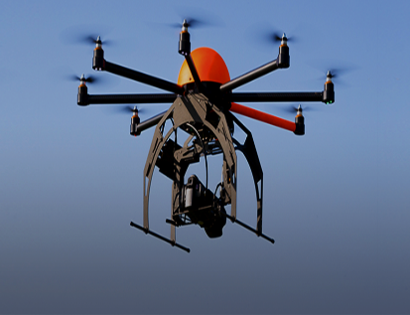

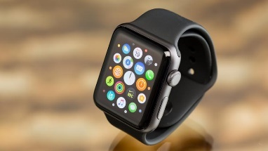
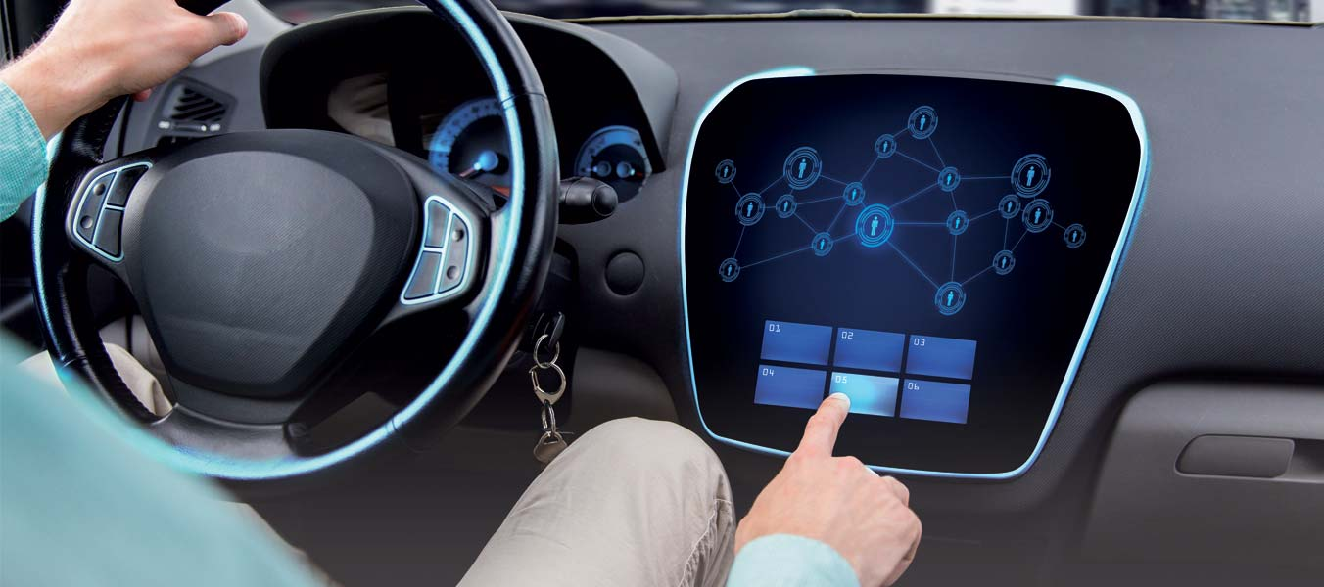
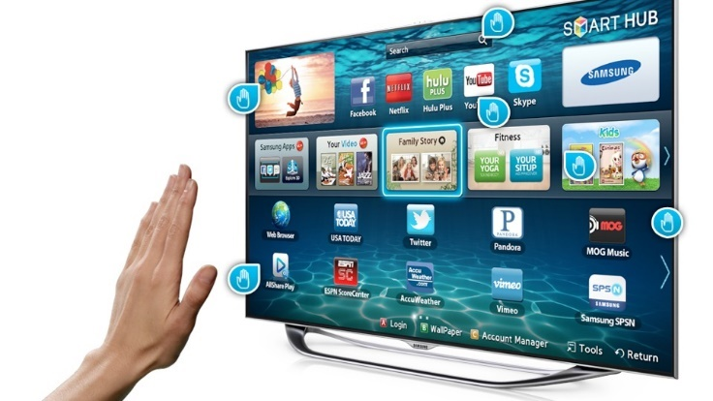

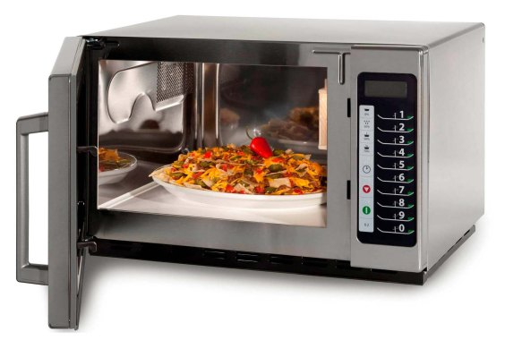
What is an embedded System
When a computer becomes a part of another large system or when computer becomes one of the components of a system we call it as:
Embedded Computer or Embedded system
Laptops, Desktop and servers are not embedded computers.
Computers fixed inside
Automobiles,
Microware oven,
Smart Watches,
Smart phones,
Robots,
Drones,
Smart TVs
Manufacturing Equipment
Washing Machines
Fridges
Digital Camera
Aeronautics

Slide 6
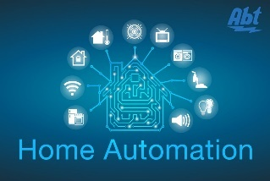


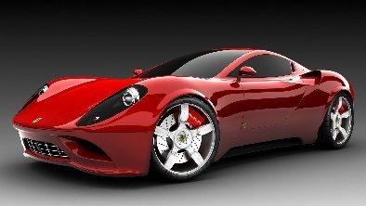
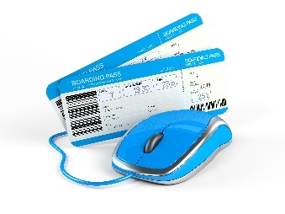


What is the future of embedded system ?
Computers are evolving everyday, and same with Embedded computers too.
IoT devices
Internet Connected Devices
Home based devices
Hospitals &
health care unit
Space and Defence units
Manufacturing Units
Banks and Insurance Companies
Automobiles, Airlines & Aeronautics

Slide 7
The future …..
It is expected by 2020,
IoT
market spending will be of the size
of Three Trillion
Dollars
Source: Gartner (January 2017)
http://www.gartner.com/newsroom/id/3598917

Slide 8
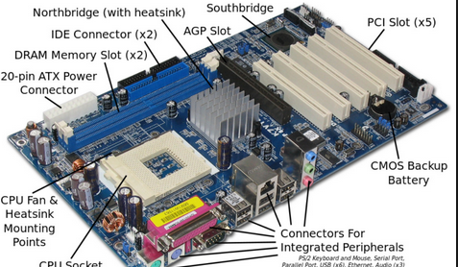
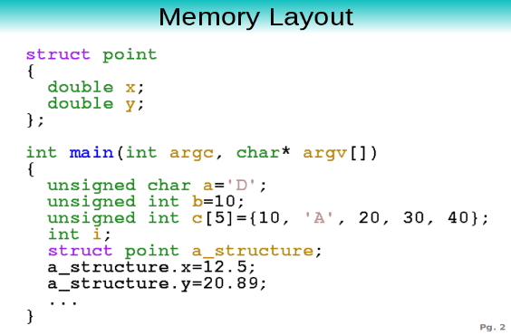
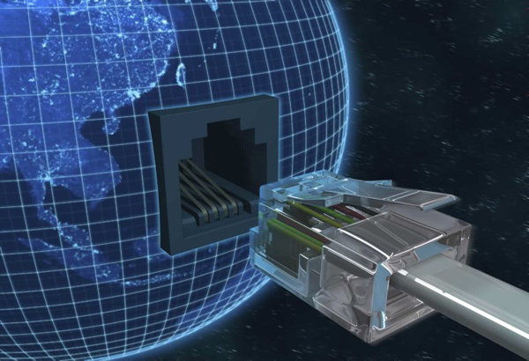
Key components of an Embedded system
Components of a Modern Embedded
System
Hardware
Software
Internet
Connectivity

Slide 9
Development of an embedded system
Embedded Hard ware suppliers
ST Micro electronics, Broadcom,
Raspberry-Pi Foundation
Provides the needed hardware boards
With in build networking capabilities
Software Engineers with Embedded
Systems knowledge develops this
Software engineers develop software with
Networking capabilities or that can talk to
Other computers over internet

Slide 10
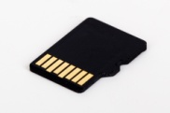
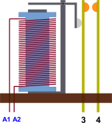

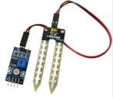
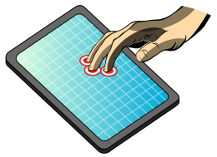

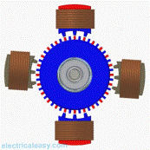
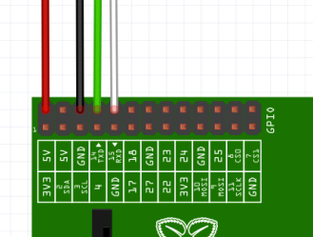


Architecture of an Embedded system
Primary Memory
(RAM)
Secondary Memory
Memory Card (16 GB, 32 GB etc)
Electromagnetic
Relay
Input
CPU
Touch
Screen
LCD (I/O)
Electric
Motor
Ports
Embedded
Network Interface

Slide 11
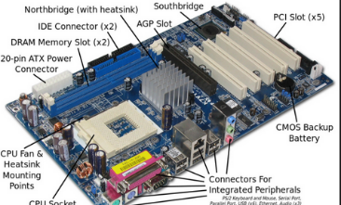
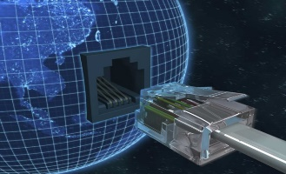
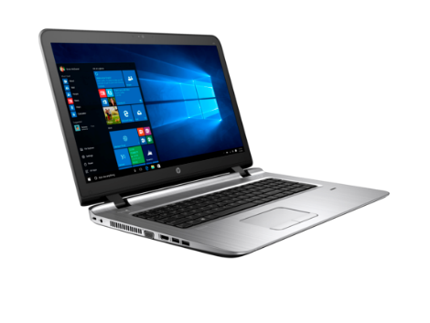
Embedded System Software development Ecosystem
Embedded Hardware
Software Development Tools
Compliers
Assemblers
Debugger
Simulators
Interpreter
Sensor
Simulator
Test Bench

Slide 12
How are sensor and actuators integrated
Embedded
Computer
Sensors send data to
computer using various
protocols, just like key
board uses USB in case
of a desktop, sensors
using I2C, SPI, UART
etc to send data to Computer

Slide 13
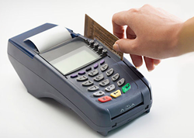


Embedded systems and Internet
With the evolution of Internet, desktop computer and not stand alone devices instead they are connected to internet just like that almost every embedded computers are also connected to internet one way or other.
Software that runs on a embedded computer need to communicate with other computers and exchange data.
This is good example of connected device/computer, or Internet of Things (IoT)
Software engineers working on Embedded system need to know network programming so that they can develop network based application on Embedded Devices. This is exactly what is covered under the topic of IoT.

Slide 14


What about Hardware Knowledge ?
To what extend an embedded
Software engineer should know
About computer hardware ?
Basic knowledge to
Understand the hardware
board, Processor , memory map,
Ports etc is enough to start with
However, Circuit level or chip level
Knowledge is not required

Slide 15

Taking these facts about an
Embedded system, we had
Designed the course contents and
Structure for you.

Slide 16
Course Overview
Overview of Embedded System
Refresher on Analog and Digital system
Architecture of Embedded and Desktop based system
Operating System Fundamentals
Basic Concepts of Compilers, Assemblers and Interpreters
How to compile a small C-program on Embedded system
C-Programming Fundamentals
Data Structures in C and its application
Case studies in C Programming.
Introduction of Object Oriented programming & C++
Real Time Operating Systems
Programming with Python.
Protocols for Communication with peripherals
Sensors and Actuators
Internet of Things (IoT) and computer networking.
Interfacing embedded system with sensor and actuators
ARM Processor Fundamentals based on –Cortex M series.

Slide 17
ARM processor fundamentals
Basic Concepts of ARM Processor
Difference between various ARM cores like A –series R series M –series
Programmer view of Cortex-M4 which is widely used in embedded system
Memory Model of Cortex M4
Instruction Set Architecture of Cortex –M4
Hands-on with ARM
Comparison of Cortex M4 and Cortex A53.
Architecture of a embedded computer designed using ARM based CPU.

