Slide 1
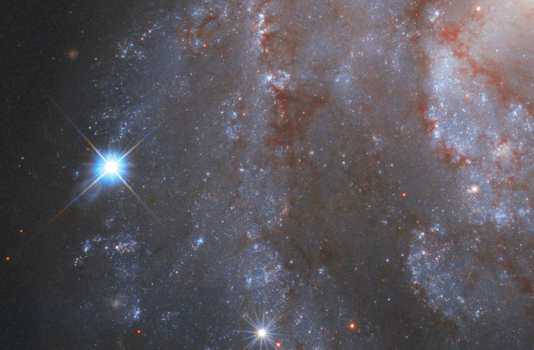
Stargazing and Astronomy

Slide 2
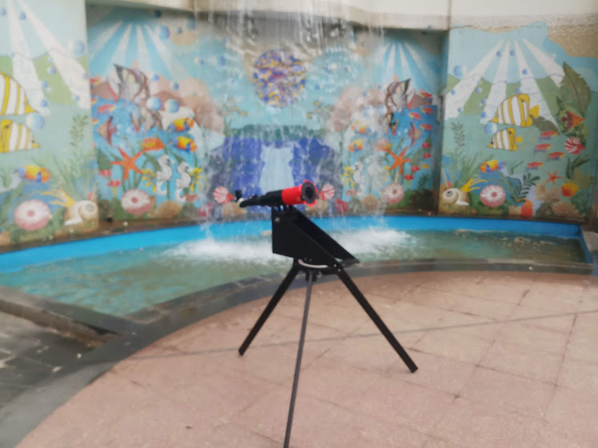
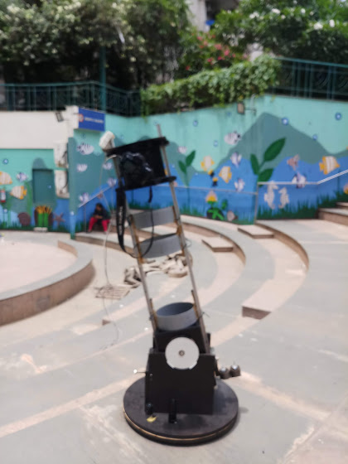
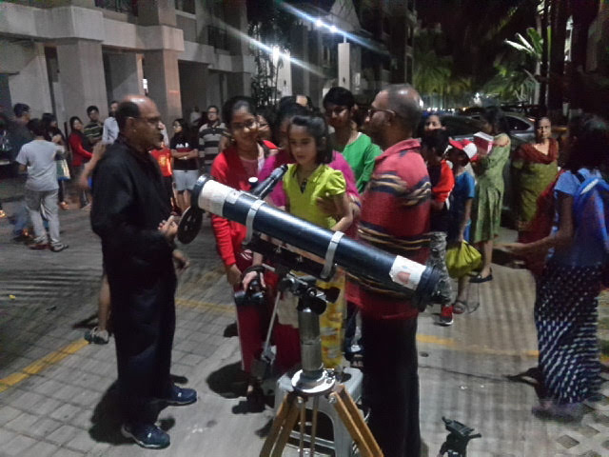
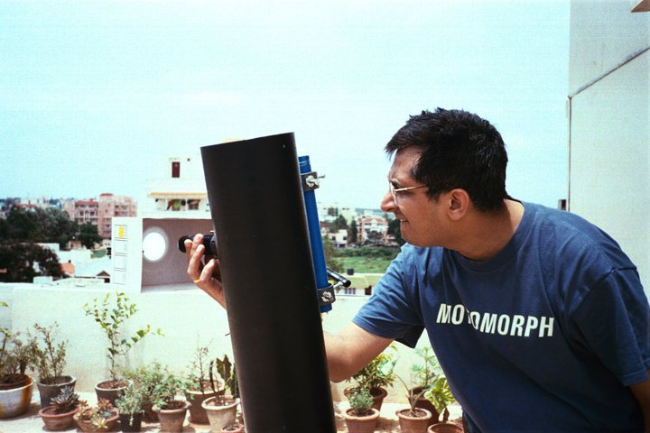
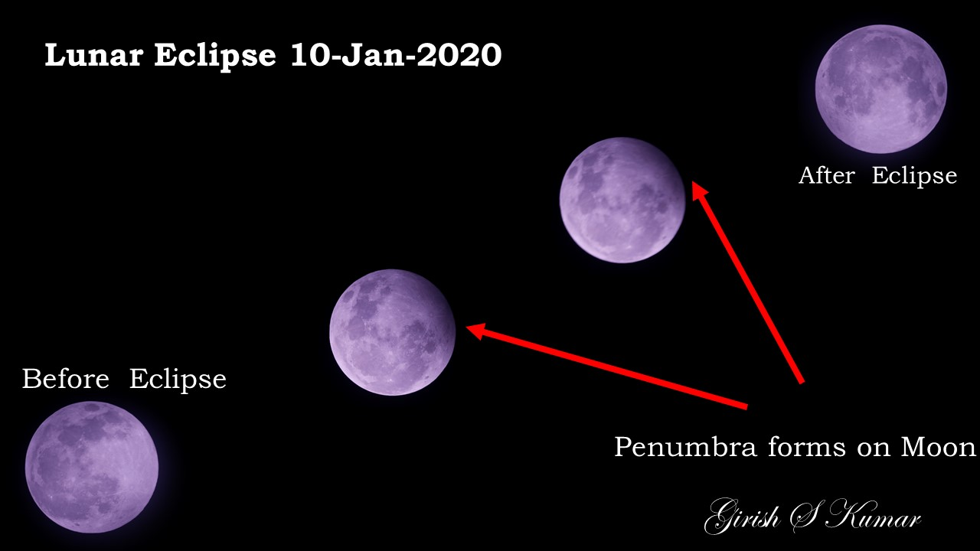
About Me
My facebook Page: https://www.facebook.com/kumarsgk/
My Linkedin profile: https://www.linkedin.com/in/girishskumar/

Slide 3
Motivation ?
Nothing but
Curiosity

Slide 4
How did I start with Astronomy ?
There were many drivers
Navigation based on Stars
Halley’s Comet in 1986
To See the surface of moon
Question about origin of Universe

Slide 5
Today we will learn about…
How I started astronomy
How does one start with astronomy
Naked eye astronomy
Binocular astronomy
Constellations
Zodiacs
Galaxies
What did Galileo do
Telescope astronomy
Practical uses of astronomy
Radio astronomy
Day time astronomy

Slide 6
What I do NOT plan to cover
X Aliens and Alien Spaceship
X Extra Terrestrial Life & Intelligence
X Theoretical Physics / Astronomy/Science
X Science Fiction books and stories
X Philosophical Discussions, Debates, Quiz about Astronomy and Physics

Slide 7
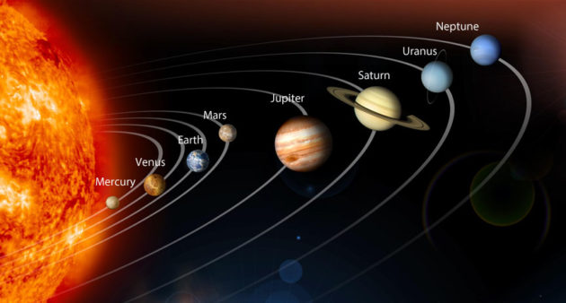
How does one start with Astronomy ?
Where does one start from ?

Slide 8
Universe is an Ocean with no borders… Spread out into infinite space .. No beginning …….No ends …
So there is no correct or wrong answer for this question
You start from a point…. Where you mind craves for….

Slide 9


What kind of equipment & tool do I need, to start with ?
A Curious Mind
Determination
A pair of eyes

Slide 10
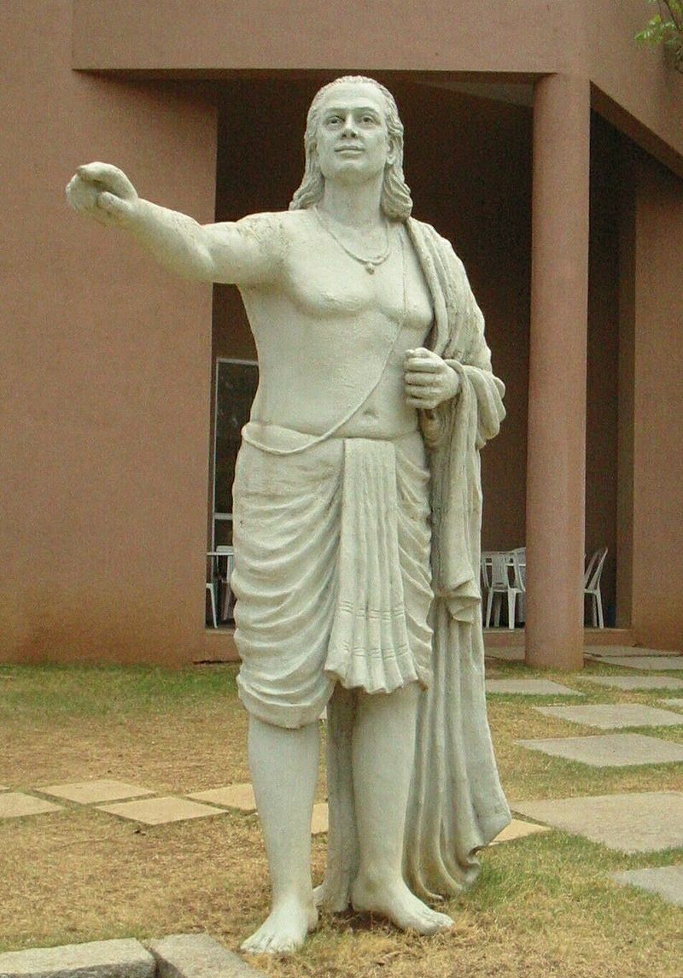
Aryabhata(476–550 CE) was the first of the Indian mathematician-astronomers from the classical age of Indian mathematics and Indian astronomy.
Mathematics
Place value system and zero
Approximation of π
Trigonometry
Indeterminate equations
Algebra, Linear Equations
Astronomy
Motions of the solar system
Eclipses
Sidereal periods
Heliocentrism

Slide 11
Naked eye Astronomy
Did with naked Eye alone
NO | Name | Period | Contribution
1 | Aryabhata | 476–550 CE | Aryabhata explicitly mentioned that the earth rotates about its axis, thereby causing what appears to be an apparent westward motion of the stars.
2 | Varāhamihira | 505 CE | Varāhamihira was an astronomer and mathematician who studied and Indian astronomy as well as the many principles of Greek, Egyptian, and Roman astronomical sciences.
3 | Bhāskara I | 629CE | Planetary longitudes, heliacal rising and setting of the planets, conjunctions among the planets and stars, solar and lunar eclipses, and the phases of the Moon are among the topics Bhaskara discusses in his astronomical treatises.
4 | Brahmagupta | 598–668 CE | calculated the instantaneous motion of a planet, gave correct equations for parallax, and some information related to the computation of eclipses. – In addition Gravity too

Slide 12
How do we do naked eye astronomy ?
Find an dark open area where you get maximum view into sky like a
Beach
Near a lake
Desert
River sides
Open terraces (far away for urban areas)
You need a dark sky … with less electric lights around (Light pollution)
Switch off all lights around (keep your eyes away from mobiles etc)
Look up ward towards sky (arm chair, or flat bed etc)
Close your eye for a minute or two (So your eyes are dark adapted)
Now open your eye and look at the stars… you will see stars showing up one by one …
In 5 minutes you will sky is filled with thousands of stars…
The more you look at sky without looking at any bright objects like lamps/moon etc.
You will start discovering more and more stars … one meteor occasionally ..
Compare with the print out of the star chart from internet .. Without anyone help you will able to see patterns what you see in star charts.
You can see Planets, starts, galaxies constellations, meteors, comets and many sky objects…

Slide 13
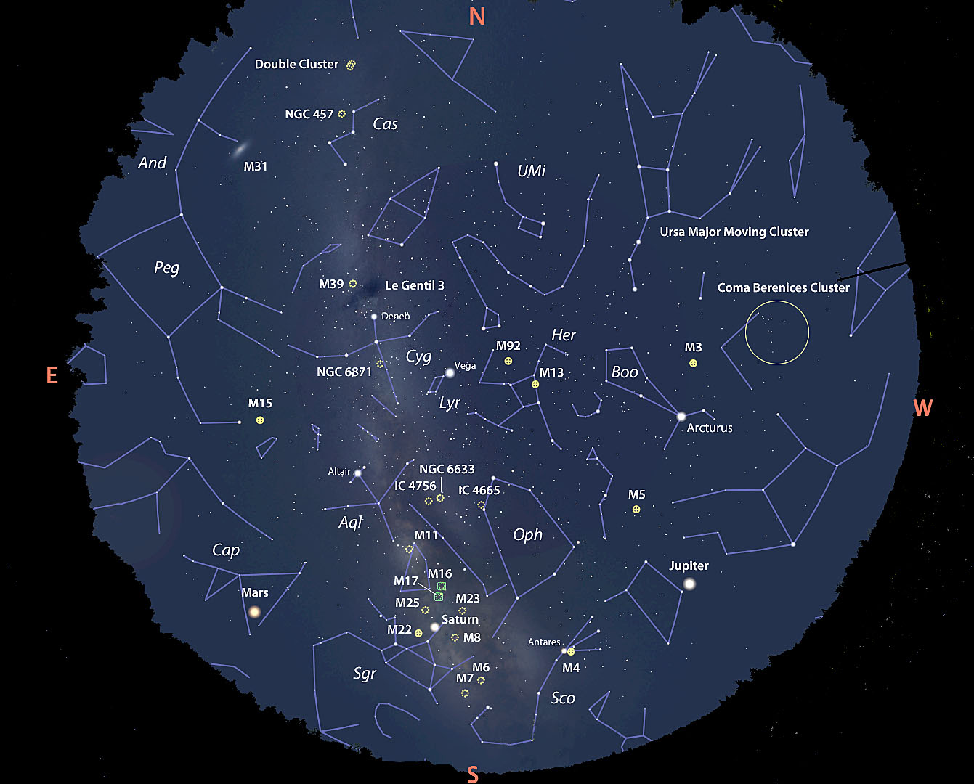

Slide 14
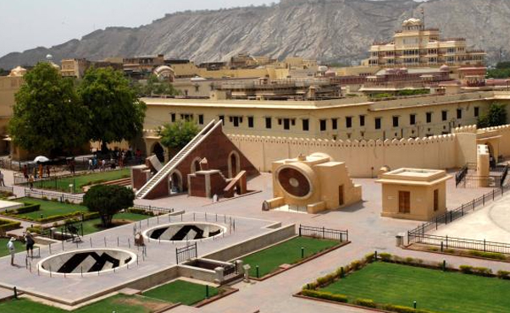
Equipment for naked eye photography
Jantar Mantar (1718) , situated at Jaipur, is the largest stone observatory in the globe. Jantar Mantar is one of the five astronomical observatories constructed by the founder of Jaipur- Maharaja Jai Singh. The name 'Jantar Mantar' is taken from the Yantra Manta, a Sanskrit word that refers to instruments and formulae. With so many instruments, the entire observatory extends to a land stretch of 18700 metres. Interestingly, some of the instruments available here are amongst the largest

Slide 15
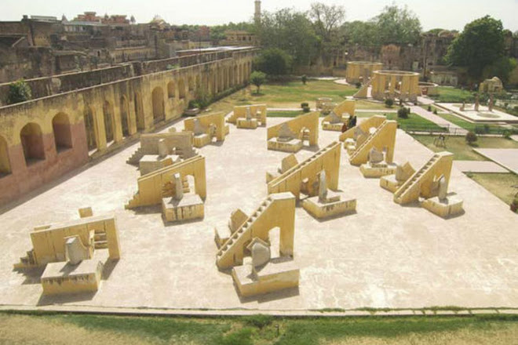
26.9124° N, 75.7873° E

Slide 16
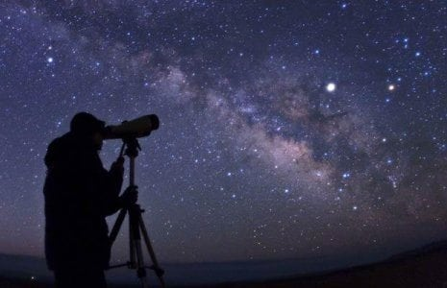
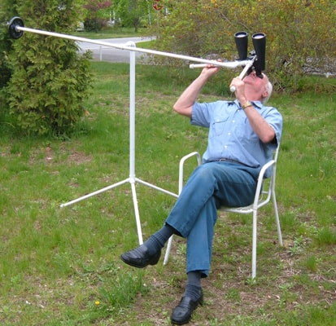
Binocular Astronomy
A Binocular shows more details and faint objects which otherwise cannot be seen with naked eye.
Binocular Very easy to use and portable device.
A 3D view of the sky is visible
Some Bigger once can give you the feeling of looking through the window of space ship

Slide 17
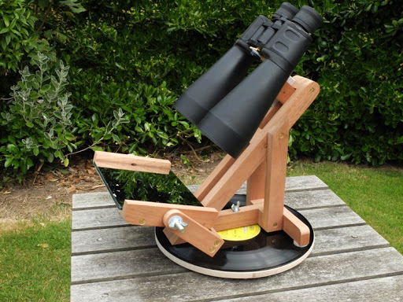
A Simple Binocular mount which you can make

Slide 18
Constellations

Slide 19
What are constellations ?
No one knows who defined or saw the constellations. Ancient civilizations, like the Mayans, Indian drew their own star maps of the skies with their constellations.
A constellation is a group of stars which make up imaginary outline or pattern in the night sky . Usually they are said to represent an animal, some person or creature in a shape. When seen, the group of stars seem to make a pattern.
Ptolemy48 constellations are still recognized by the IAU today, and the rest of the constellations were added later

Slide 20
What is the use of the these constellation definitions
A general list of 88 constellations was produced for the International Astronomical Union in 1922.^{[4]} It is roughly based on the traditional Greek constellations listed by Ptolemy in his Almagest in the 2nd century and Aratus' work Phenomena, with early modern modifications and additions
Constellations are useful in tracking artificial Satellites and in assisting astronomers and navigators to locate certain stars.
Constellation can be seen as specific area in sky … or sky is broken into 88 specific regions where you can see a particular pattern of stars.
88 Officially Recognized Constellations (nasa.gov)

Slide 21
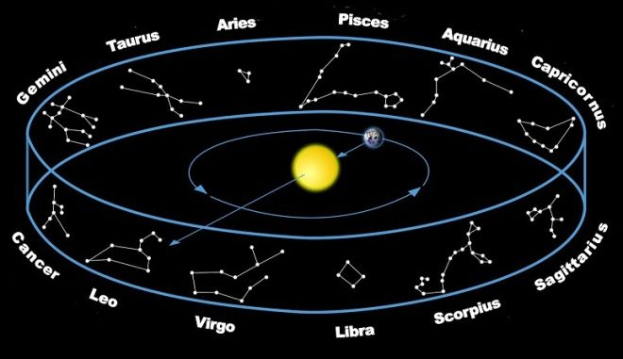
What are Zodiacs
Aries, Taurus, Gemini, Cancer, Leo, Virgo, Libra, Scorpius, Sagittarius, Capricornus, Aquarius and Pisces – Are know as the Zodicas or Zodic constellations
Zodiac constellations are constellations that lie along the plane of the ecliptic. The ecliptic, or the apparent path of the Sun, is defined by the circular path of the Sun across the sky, as seen from Earth. In other words, the Sun appears to pass through these constellations over the course of a year.
The passage of the Sun through the zodiac is a cycle that was used by ancient cultures to determine the time of year. Most of the planets in the solar system have orbits that take them near the ecliptic plane, within about 8 degrees above or below.

Slide 22
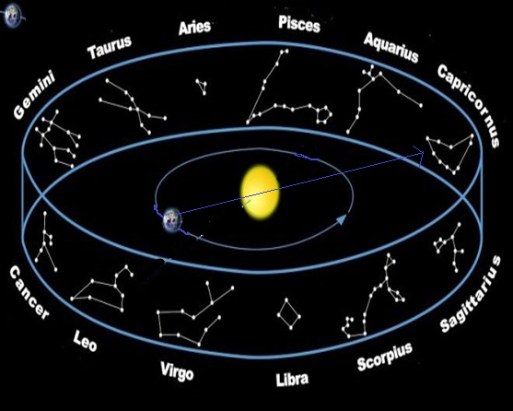

Slide 23
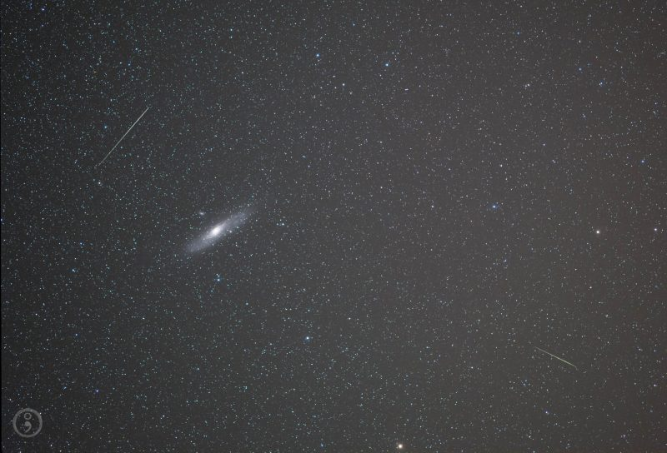
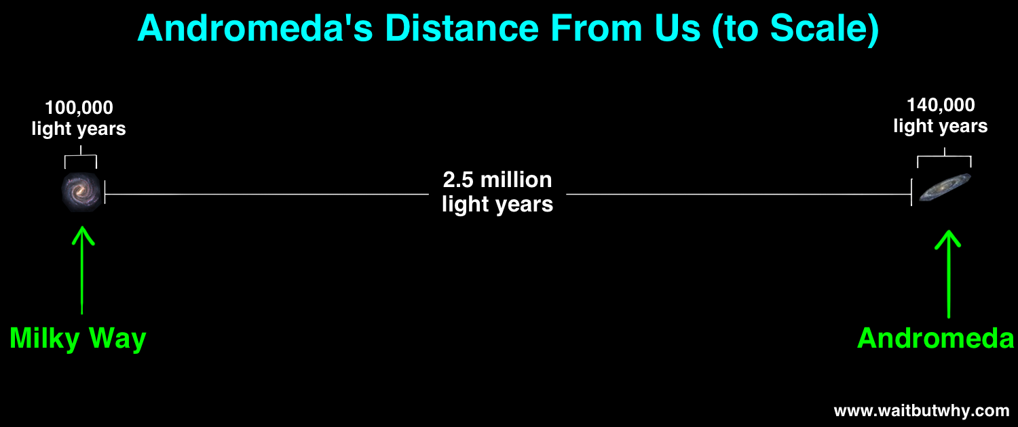
Galaxies

Slide 24
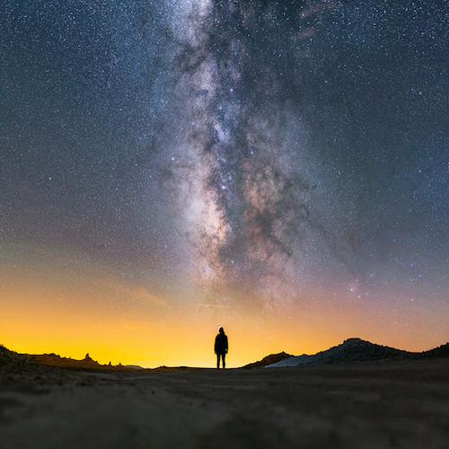
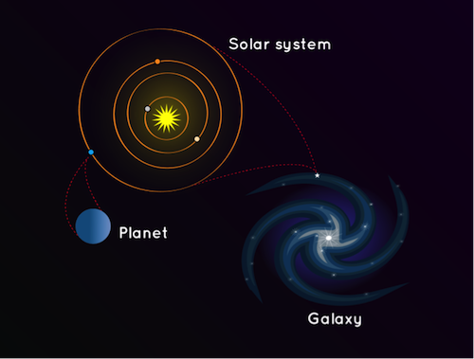
Galaxies
A galaxy is a huge collection of gas, dust, and billions of stars and their solar systems, all held together by gravity. Nearly all large galaxies are thought to also contain supermassive black holes at their centers. In our own galaxy, the Milky Way, the sun is just one of about 100 to 400 billion stars that spin around Sagittarius A*, a supermassive black hole that contains as much mass as four million suns.

Slide 25
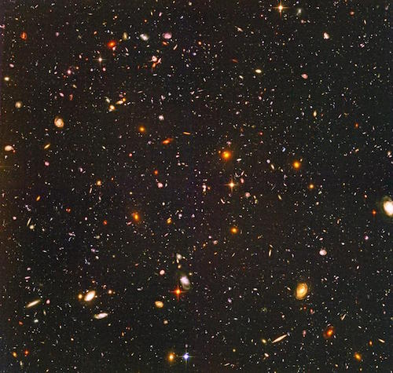
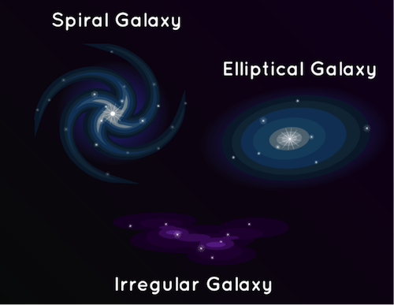
Some galaxies are spiral-shaped like ours. They have curved arms that make it look like a pinwheel. Other galaxies are smooth and oval shaped. They’re called elliptical galaxies. And there are also galaxies that aren’t spirals or ovals. They have irregular shapes and look like blobs. The light that we see from each of these galaxies comes from the stars inside it.
There are many galaxies besides ours, though. There are so many, we can’t even count them all yet! The Hubble Space Telescope looked at a small patch of space for 12 days and found 10,000 galaxies, of all sizes, shapes, and colors. Some scientists think there could be as many as one hundred billion galaxies in the universe.

Slide 26
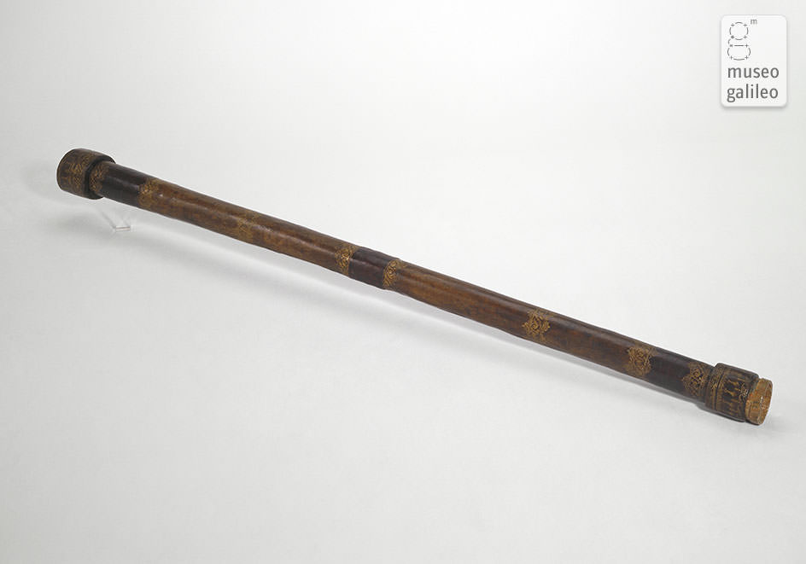
What did Galileo do ?
Some time in 1610 … (400 year back)
Galielo took two lenses a convex lens and a concave lens... He kept one behind the other and adjusted the distance between the two and look through them….. Alternatively Surprisingly when he held the concave lens closer to one eye and looked, the objects which are far away looked closer and bigger… this is how first telescope was invented ….
Even today …. This is the method … used for making telescope except that the materials used has changed
On January 7th, 1610, he turned his new 30 power telescope towards Jupiter, and found three small, bright “stars” near the planet.

Slide 27
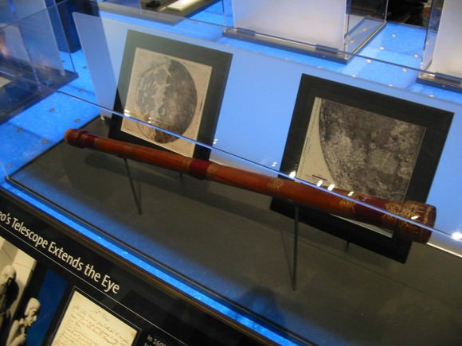
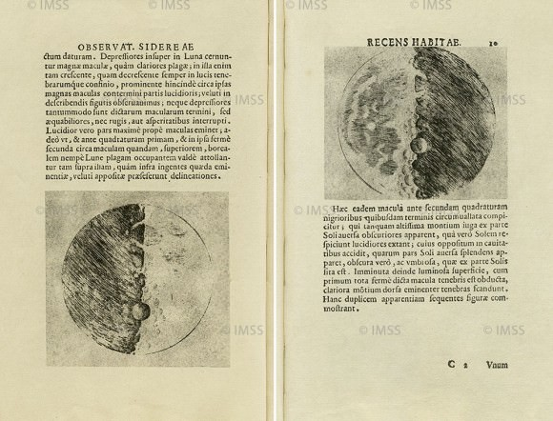

Slide 28
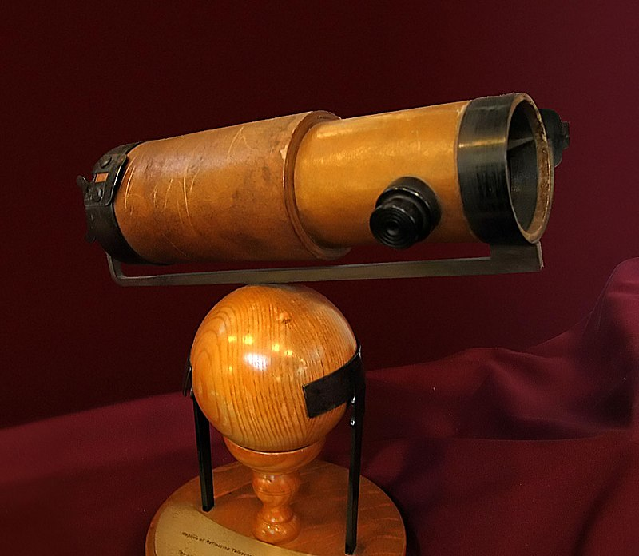
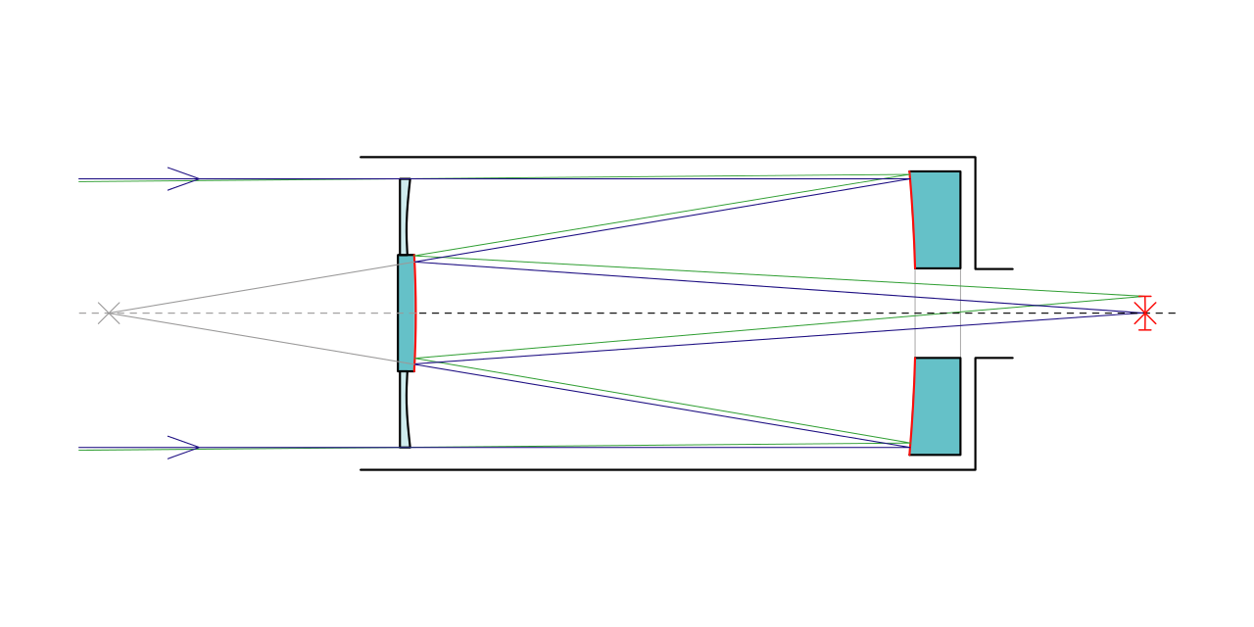

Telescope Astronomy
Invention of Telescope in 1610 has changed the way we looks at stars and planets… Objects which are far away can be seen with more clarity and details. Telescope underwent many modifications but the basic design remains the same
Newtonian Telescope
Schmidt–Cassegrain telescope

Slide 29
How you can build a telescope of you own
Two magnifying glasses - perhaps 30 cm Focal length and another one 5 cm focal length.
A cardboard tube - paper towel roll or gift-wrapping paper roll (it helps if it is long)
Duct tape
Scissors
A ruler, yard stick, or tape measure
Sheet of printed paper - newspaper or magazine will do

Slide 30
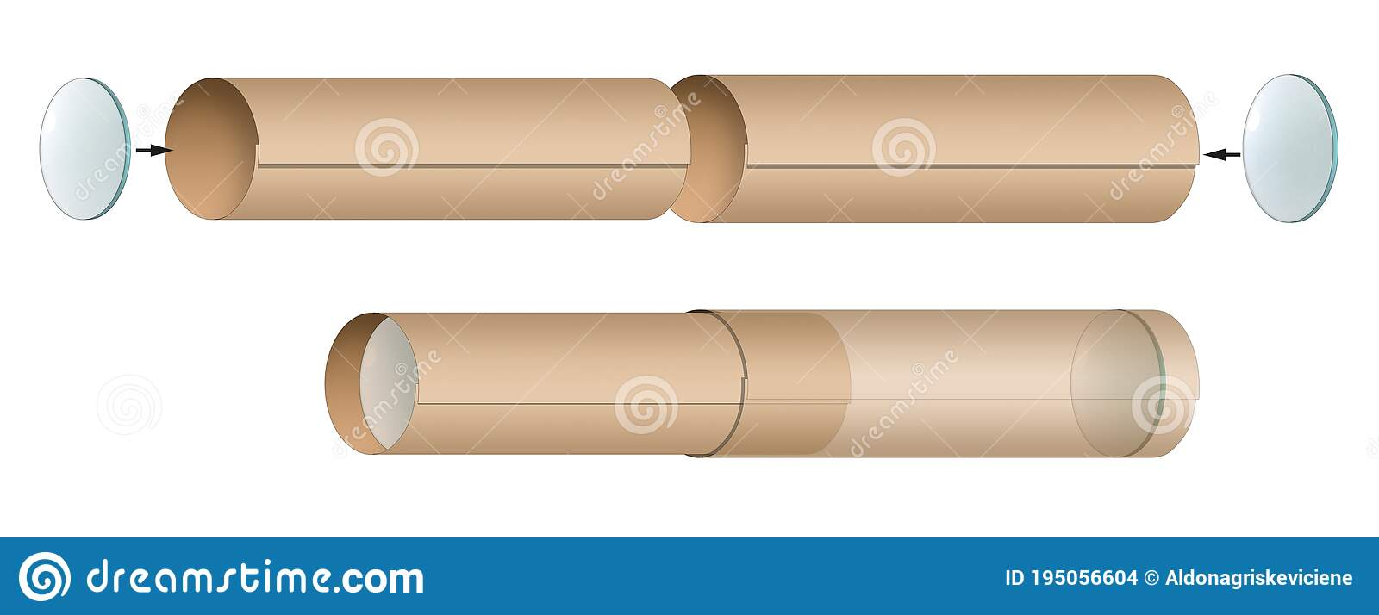

Slide 31
How you can get your way through the sky

Slide 32

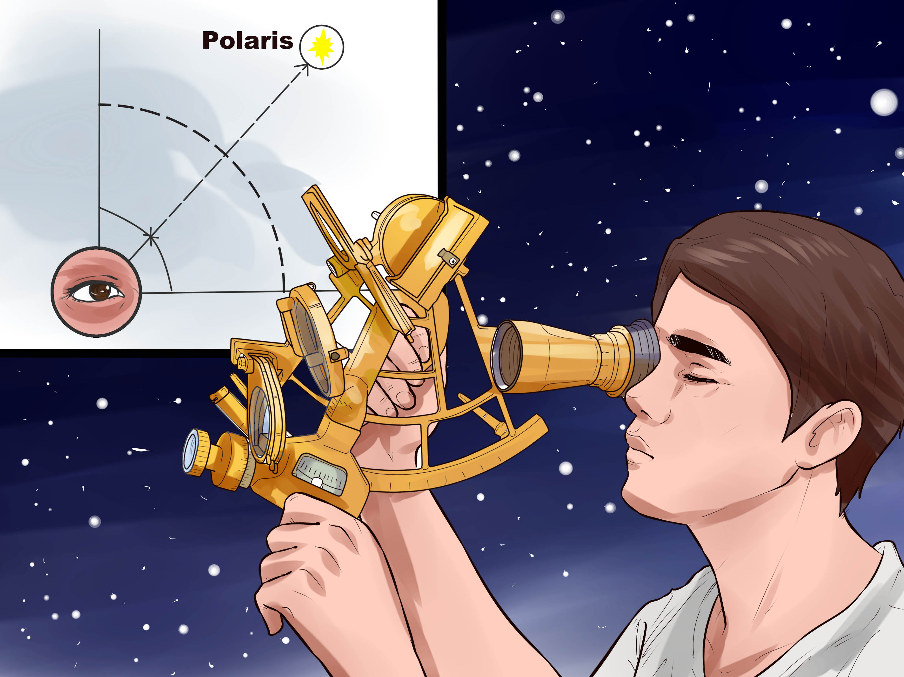

Practical Application of Astronomy

Slide 33
Radio Astronomy

Slide 34
Day time Astronomy

