Slide 1
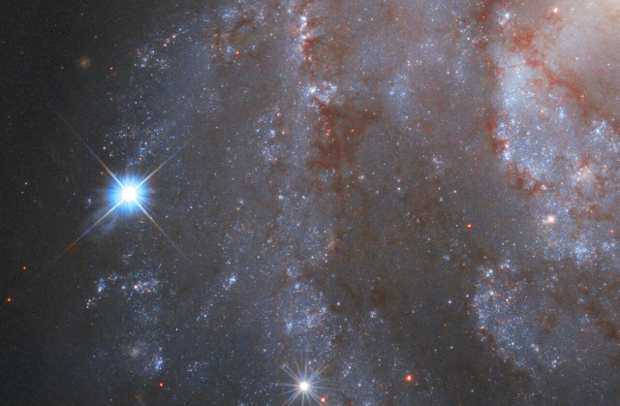
Stargazing and Astronomy

Slide 2
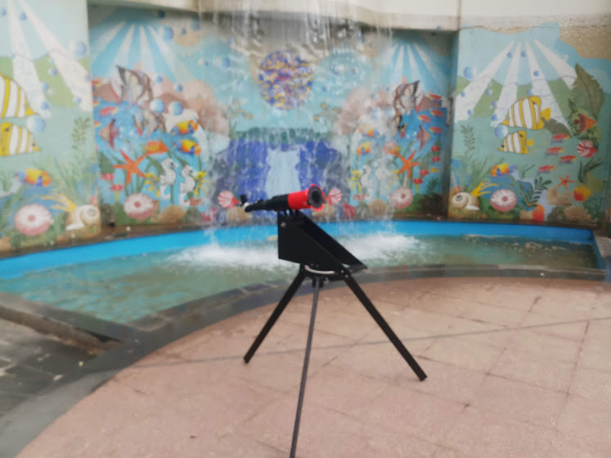
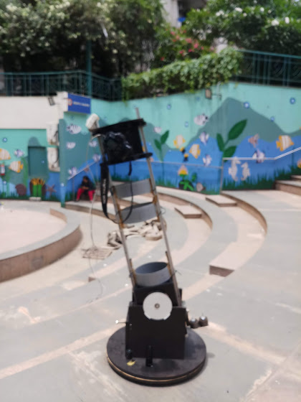
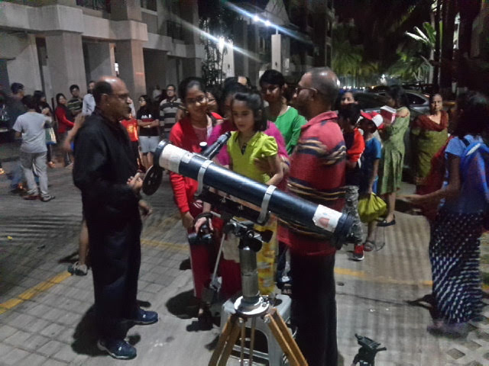
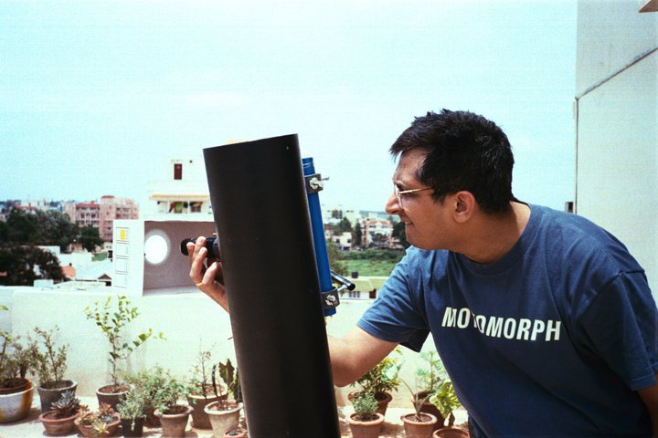
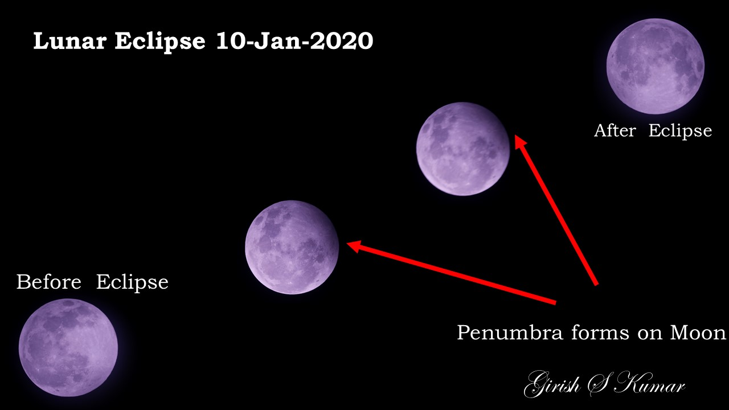
Introduction
My facebook Page: https://www.facebook.com/kumarsgk/
My Linkedin profile: https://www.linkedin.com/in/girishskumar/

Slide 3
Motivation ?
Nothing but
Curiosity

Slide 4
How did I start with Astronomy ?
There were many drivers
Navigation based on Stars
Halley’s Comet in 1986
See the surface of moon
Question about origin of Universe

Slide 5
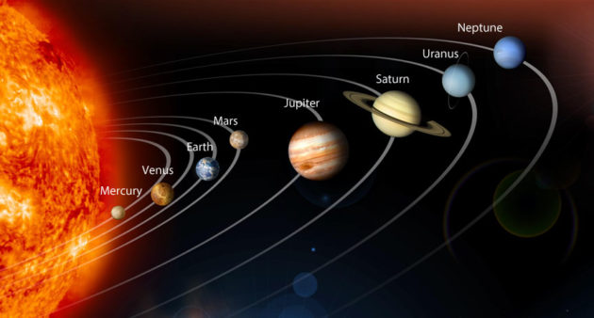
How do one start with Astronomy ?
Where do one start from ?

Slide 6
Universe is an Ocean with no borders… Spread out into infinite space .. No beginning …….No ends …
So there is no correct or wrong answer for this question
You start from a point…. Where you mind craves for….

Slide 7
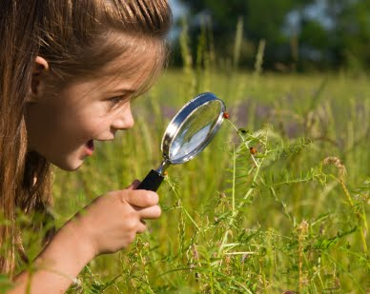

What kind of equipment & tool do I need, to start with ?
A Curious Mind
Determination
A pair of eyes

Slide 8
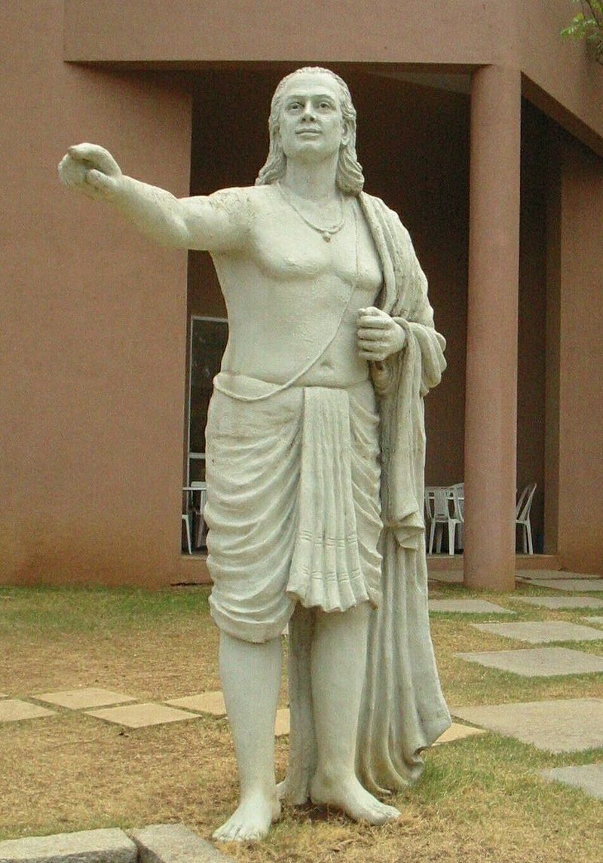
Aryabhata(476–550 CE) was the first of the Indian mathematician-astronomers from the classical age of Indian mathematics and Indian astronomy.
Mathematics
Place value system and zero
Approximation of π
Trigonometry
Indeterminate equations
Algebra, Linear Equations
Astronomy
Motions of the solar system
Eclipses
Sidereal periods
Heliocentrism

Slide 9
Naked eye Astronomy
Did with naked Eye alone
NO | Name | Period | Contribution
1 | Aryabhata | 476–550 CE | Aryabhata explicitly mentioned that the earth rotates about its axis, thereby causing what appears to be an apparent westward motion of the stars.
2 | Varāhamihira | 505 CE | Varāhamihira was an astronomer and mathematician who studied and Indian astronomy as well as the many principles of Greek, Egyptian, and Roman astronomical sciences.
3 | Bhāskara I | 629CE | Planetary longitudes, heliacal rising and setting of the planets, conjunctions among the planets and stars, solar and lunar eclipses, and the phases of the Moon are among the topics Bhaskara discusses in his astronomical treatises.
4 | Brahmagupta | 598–668 CE | calculated the instantaneous motion of a planet, gave correct equations for parallax, and some information related to the computation of eclipses. – In addition Gravity too

Slide 10
How do we do naked eye astronomy ?
Find an dark open area where you get maximum view into sky
Beach
Near a lake
Desert
River sides
Open terraces (far away for urban areas)
You need a dark sky … with less electric lights around (Light pollution)
Switch off all lights around (keep your eyes away from mobiles etc)
Look up ward towards sky (arm chair, or flat bed etc)
Close your eye for a minute or two (So your eyes are dark adapted)
Now open your eye and look at the stars… you will see stars showing up one by one …
In 5 minutes you will sky is filled with thousands of stars…
The more you look at sky without looking at any bright objects like lamps/moon etc.
You will start discovering more and more stars … one meteor occasionally ..
Compare with the print out of the star chart from internet .. Without anyone help you will able to see patterns what you see in star charts.
You can see Planets, starts, galaxies constellations, meteors, comets and many sky objects…

Slide 11
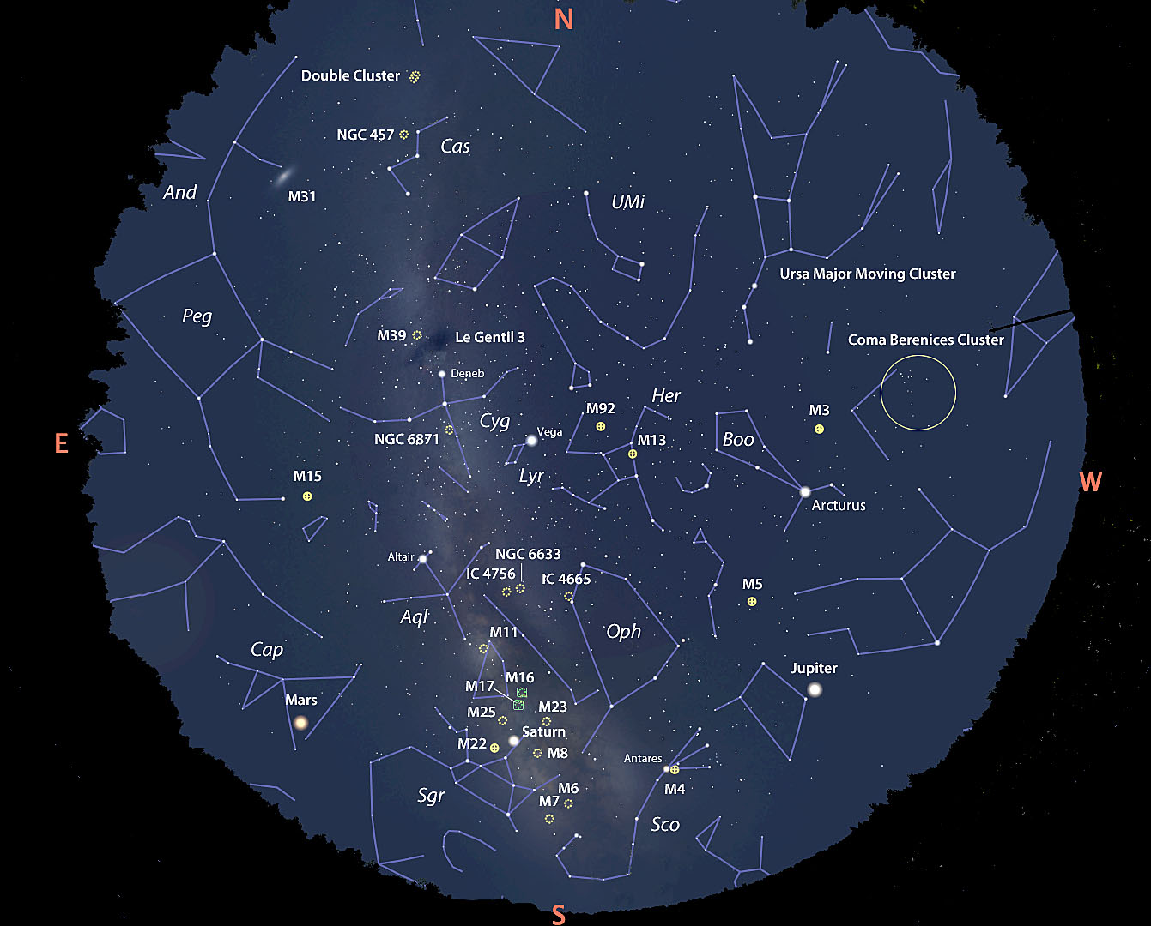

Slide 12
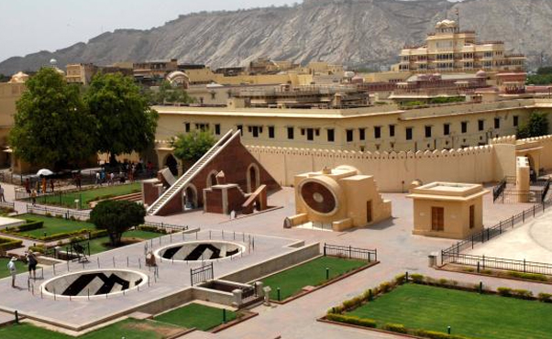
Equipment for naked eye photography
Jantar Mantar (1718) , situated at Jaipur, is the largest stone observatory in the globe. Jantar Mantar is one of the five astronomical observatories constructed by the founder of Jaipur- Maharaja Jai Singh. The name 'Jantar Mantar' is taken from the Yantra Manta, a Sanskrit word that refers to instruments and formulae. With so many instruments, the entire observatory extends to a land stretch of 18700 metres. Interestingly, some of the instruments available here are amongst the largest

Slide 13
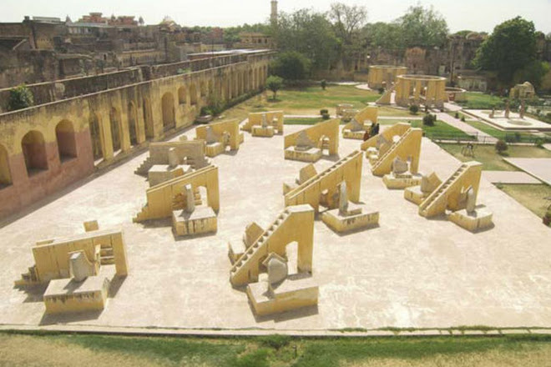
26.9124° N, 75.7873° E

Slide 14
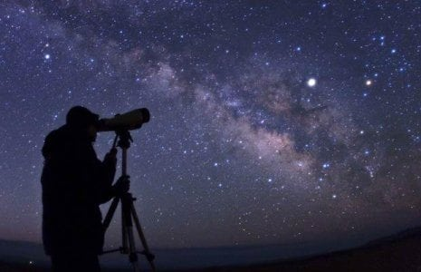
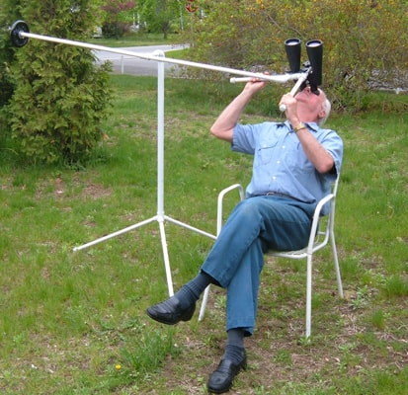
Binocular Astronomy
A Binocular shows more details and faint objects which otherwise cannot be seen with naked eye.
Binocular Very easy to use and portable device.
3D view of the sky is visible
Some Bigger once can give you the feeling of looking through the window of space ship

Slide 15
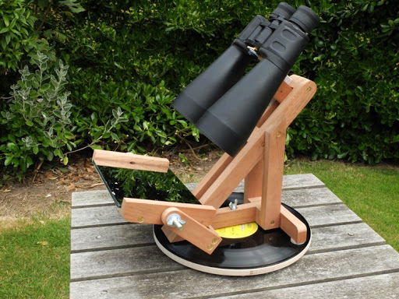
A Simple Binocular mount you can make

Slide 16
What are constellations

Slide 17
What are Zodiacs

Slide 18
Galaxies

Slide 19
What did Galileo did ?

Slide 20
Telescope Astronomy

Slide 21
Radio Astronomy

Slide 22
Day time Astronomy

