Slide 1
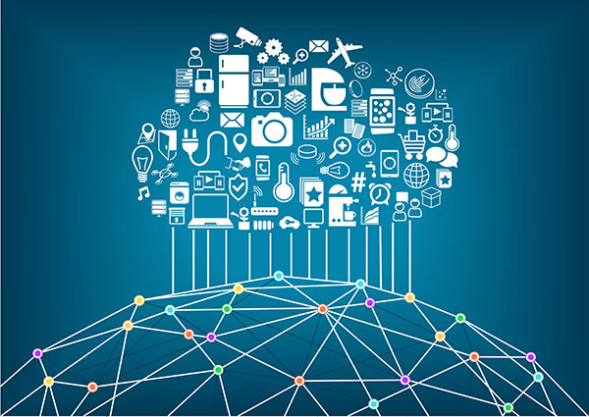
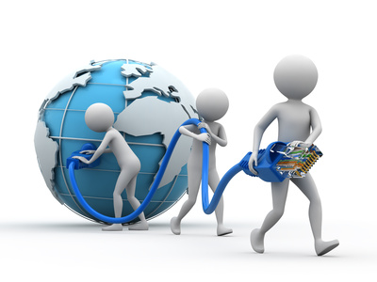

Internet of Things

Slide 2



Slide 3
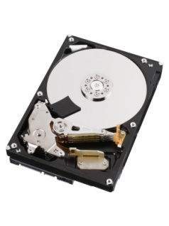



What are the parts of a Basic Computer?
Primary Memory
(RAM)
Input
Instruction
Data Address
Data
Secondary Memory
(Hard Disk)
CPU

Slide 4

What is IoT
A collection of electronic devices designed with built-in internet connectivity, so that they can be monitored, controlled and linked over the Internet via a mobile app or through a laptop or some internet device.
For those Electronic devices designed without built-in internet connectivity, we can extend its capability to have connectivity to the internet either via a cable or through wireless.

Slide 5

How did this term IoT evolved
Kevin Ashton is known for coining the term "the Internet of Things" to describe a system where the Internet is connected to the physical world via a large number of sensors

Slide 6


What all devices, can come under IoT ?
Let us discuss

Slide 7
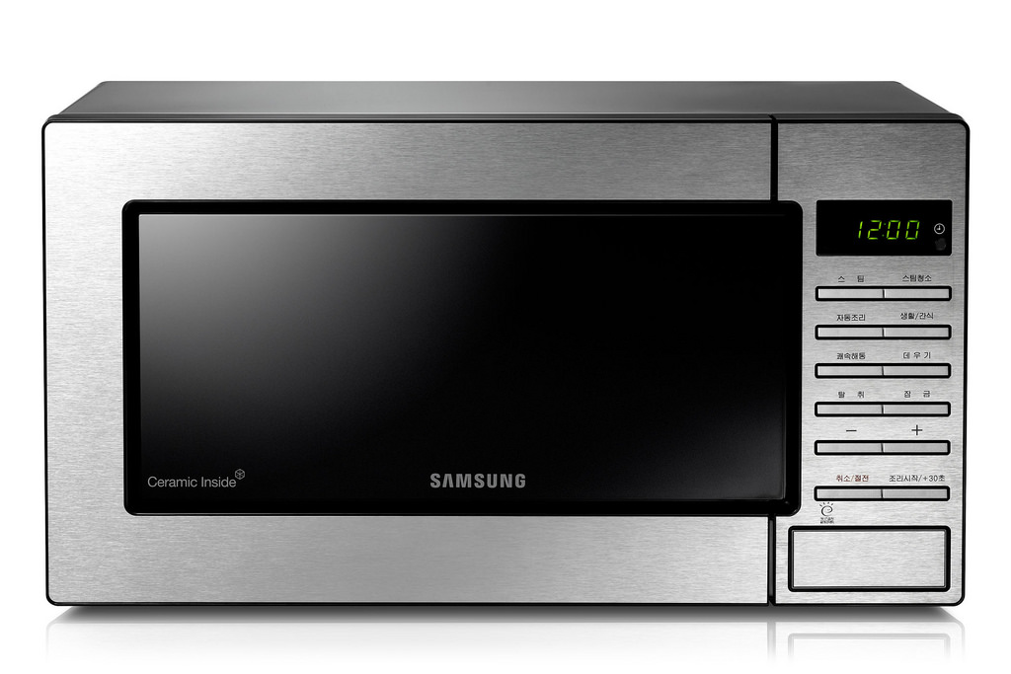
Is this Microwave Oven a IoT Device?

Slide 8


Do we get any benefit by making this water pump IoT Enabled?
Let us discuss

Slide 9
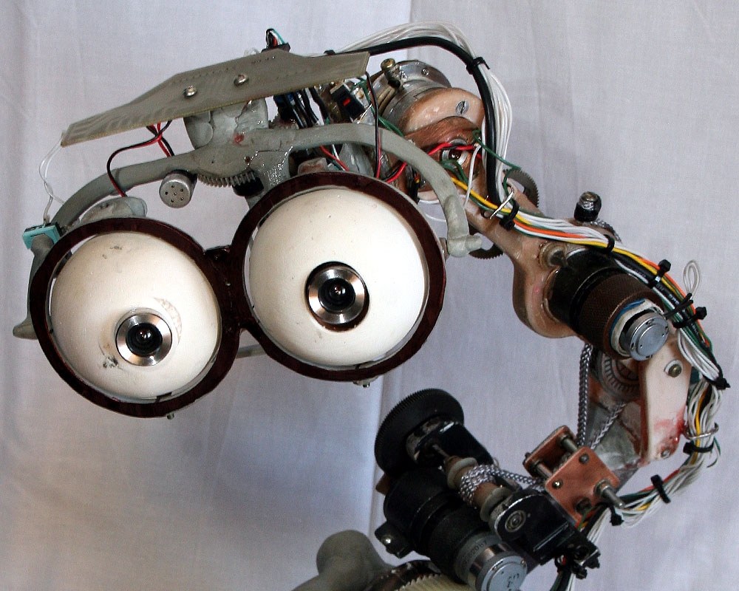
Sensors
What are the different sensors we can think off for IoT?
Write the name of few sensors you can think of

Slide 10


What else do you need to make a IoT Device
Think

Slide 11
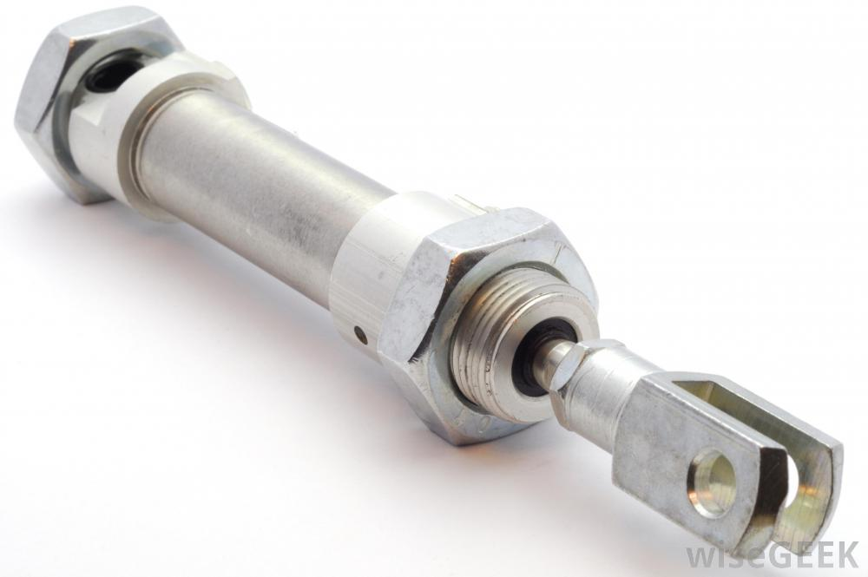
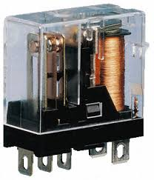
We need something called actuator to convert electrical signals into action

Slide 12
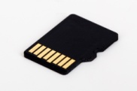
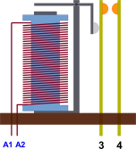

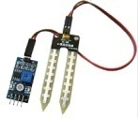
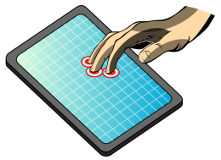

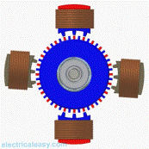
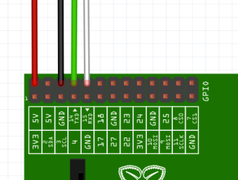


How does a computer used for IoT Look like?
Primary Memory
(RAM)
Secondary Memory
Memory Card (16 GB, 32 GB etc)
Electromagnetic
Relay
Input
CPU
Touch
Screen
LCD (I/O)
Electric
Motor
Ports
Network Interface
12

Slide 13
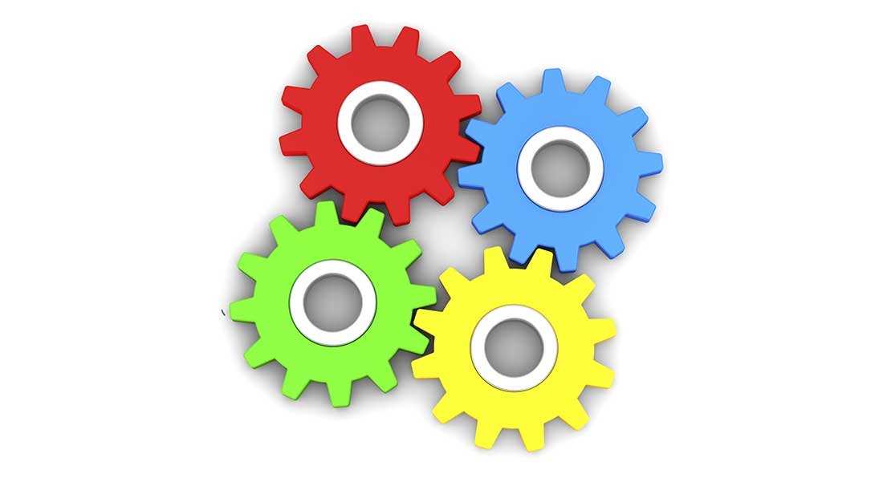
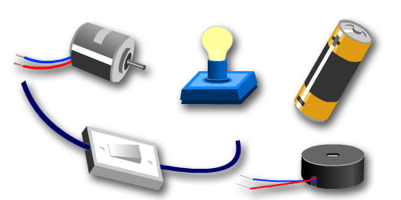
What is an embedded Computer?
An Electrical system Where Computers are components

Slide 14
When an embedded Computer is given access to Internet, the whole system becomes an IoT device

Slide 15
Let us discuss
Can you list a few IoT devices you had come across

Slide 16
How do we build a device with IoT Enabled
Think

Slide 17
What are the different components of an End to End IoT solution
What is an end to end Solution?

Slide 18

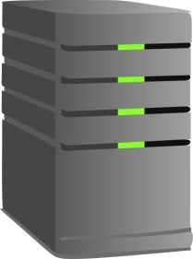

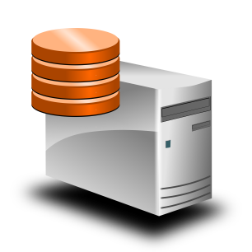
End to End IoT solution ?
End to End IoT has four layers
IoT device which has sensors Actuators
Connectivity (Internet)
Processing
Storage.
Processing
Internet
IoT device which has sensors Actuators
Storage

Slide 19
What benefit do we get out of IoT
IoT is a means for achieving automation through the internet
Jobs which are done manually like:
Data collection from remote equipments
Controlling equipments located at remote locations
Monitoring equipments at remote location
Doing maintenance of equipments at remote locations
Online Tracking and collection of performance data

Slide 20
Why Internet was Chosen ?
Internet

Slide 21
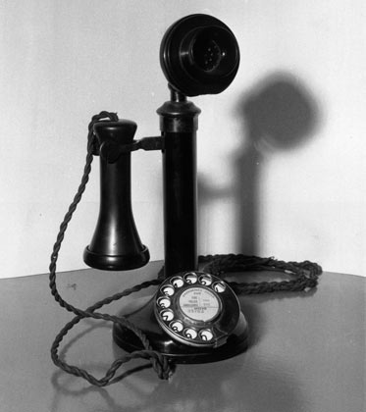
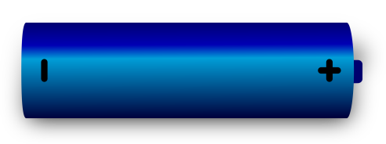
What was earlier mode of communication ?
Microphone
Headset
Simple Circuit Switched Telephony could provide reliable Real time Communication
But it came with its own limitations

Slide 22
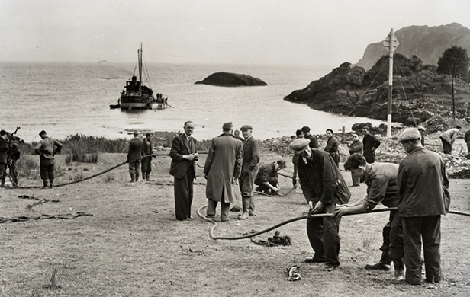
Trans Atlantic Cable

Slide 23
Pros and cons of Circuit Switched
Pros | Cons
The major advantage of circuit switching is that it has a predictable performance that can be guaranteed. Once the circuit has been established, the communication is typically error-free and relatively fast. | The disadvantage of circuit switching is that it requires an initial channel set up that is usually time-consuming
Easy to implement | Needs a dedicated “Connection” between the two points, which gets under utilized when not used.
 | During failure, it is not possible to establish alternative routes. Frequency of failures and down time is very high

Slide 24


Slide 25
Evolution of Packet switching
Packet switching is a digital networking communications method that groups all transmitted data into suitably sized blocks, called packets, which are transmitted via a medium like copper wire or RF signals .
Since the fault tolerance of Circuit Switched network was very poor, as solution 1950s, American computer scientist Paul Baran developed the concept Distributed Adaptive Message Block Switching which provided a much better fault tolerant system
In a packet switched network, data is transmitted in the form of packet with a “From” and “To” Address, just like a Postal Letter. Such mechanism ensured that a channel is occupied , only during the transmission of the packet, and upon completion of the transmission the channel is made available for the transfer of other traffic[]
Fault Tolerance was given such a importance, so that a packet switched network could withstand a Nuclear Attack

Slide 26
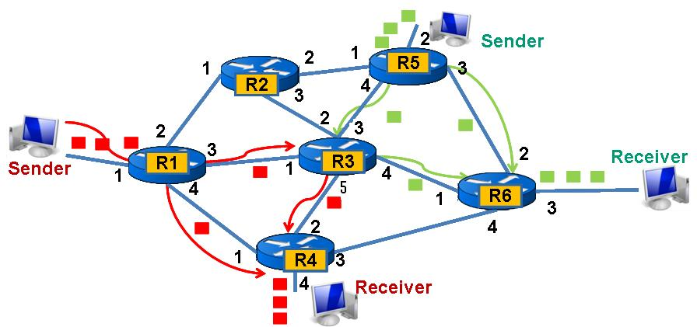

Slide 27
Advantages of Packet switching
Efficient use of Network with better utilization
Easily get around broken bits or packets.
Packet switching can support high data transmission rates
All the packets not follow same route in Packet Switching, this enables fault tolerance

Slide 28
Internet
Is a
Packet switched network

Slide 29
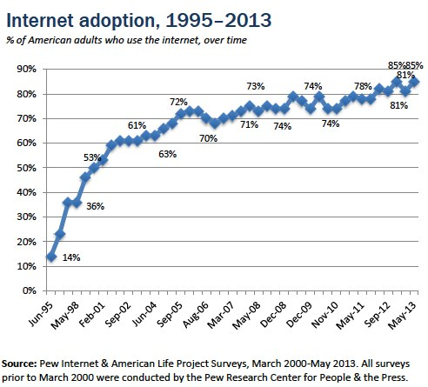
What does this graph indicates ?

Slide 30

Why there is too much hype about IoT
In future communication is not limited to Human to Human Information exchanges.
It is going to be many folds
Human to Human
Human to Machine
Machine to Human
Machine to Machine
Plants to Machine
Machine to Plants
Plants to Human and back ……
Internet is going to be the medium for all these kind of communication

Slide 31
What are the IoT platforms.
No | Name | Description
1 | Raspberry Pi | A credit card sized open source computer which runs on linux platform. It uses a ARM Cortex -8 CPU.This board features USB ports for keyboard and mouse, a HDMI port for display and an Ethernet port for wired internet connectivity
2 | Arduino | Arduino is an open-source small computer based on easy-to-use hardware and software, and does not need an Operating system
3 | Beaglebone Black: | low-cost development platform built around ARM Cortex A8 processor. It runs on Linux environment just like the Raspberry Pi.
4 | Intel Edison: | is a tiny computer featuring a Intel Atom CPU and 32 bit Intel Quark microcontroller. This tiny board carries all Wi-Fi and bluetooth modules for connectivity and thus requires no external modules to do so

Slide 32
No | Software Platform | API exposed for integration | Protocols supported | Type of analytics supported
1 | ThingWorx - MDM IoT Platform | REST API | MQTT, AMQP, XMPP, CoAP, DDS, WebSockets | Predictive analytics(ThingWorx Machine Learning), Real-time analytics (ParStream DB)
2 | IBM IoT Foundation Device Cloud | REST APIand Real TIME API | MQTT, HTTPS | Real-time analytics (IBM IoT Real-Time Insights)
3 | AWS IoT platform | REST API | MQTT, HTTP1.1 | Real-time analytics
4 | Bosch IoT Suite - MDM IoT Platform | REST API | MQTT, CoAP, AMQP,STOMP | No published
5 | Ericsson Device Connection Platform (DCP) - MDM IoT Platform | REST API | CoAP | Not Published

Slide 33
No | Protocol | Description
1 | MDM | Mobile Device Management
2 | MQTT | Message Queue Telemetry Transport : MQTT is a machine-to-machine (M2M)/"Internet of Things" connectivity protocol.
3 | CoAP | The Constrained Application Protocol (CoAP) is a specialized web transfer protocol for use with constrained nodes and constrained networks in the Internet of Things. The protocol is designed for machine-to-machine (M2M) applications such as smart energy and building automation.”
4 | AMQP | The Advanced Message Queuing Protocol (AMQP) is an open standard application layer protocol for message-oriented middleware.
5 | STOMP | Simple (or Streaming) Text Oriented Message Protocol (STOMP)is a simple text-based protocol, designed for working with message-oriented middleware (MOM). It provides an interoperable wire format that allows STOMP clients
6 | XMPP | Extensible Messaging and Presence Protocol (XMPP) is a communications protocol for message-oriented middleware based on XML (Extensible Markup Language)

