Slide 1
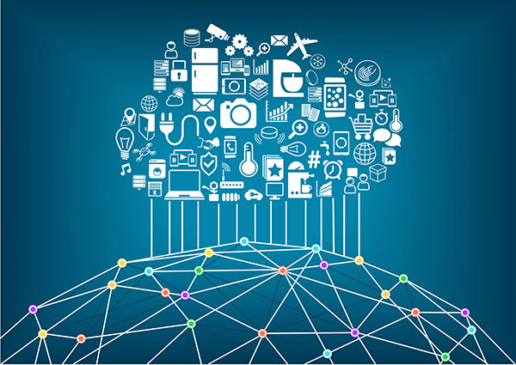
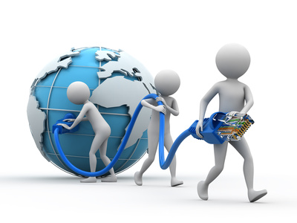
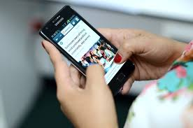
Internet of Things

Slide 2



Slide 3
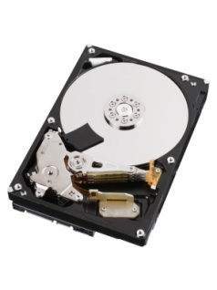



What are the parts of a Basic Computer?
Primary Memory
(RAM)
Input
Instruction
Data Address
Data
Secondary Memory
(Hard Disk)
CPU

Slide 4

What is IoT
A collection of electronic devices designed with built-in internet connectivity, so that they can be monitored, controlled and linked over the Internet via a mobile app or through a laptop or some internet device.
For those Electronic devices designed without built-in internet connectivity, we can extend its capability to have connectivity to the internet either via a cable or through wireless.

Slide 5
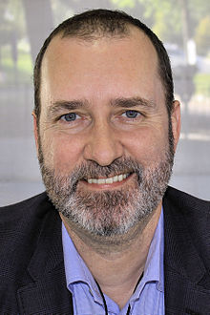
How did this term IoT evolved
Kevin Ashton is known for coining the term "the Internet of Things" to describe a system where the Internet is connected to the physical world via a large number of sensors

Slide 6


What all devices, can come under IoT ?
Let us discuss

Slide 7
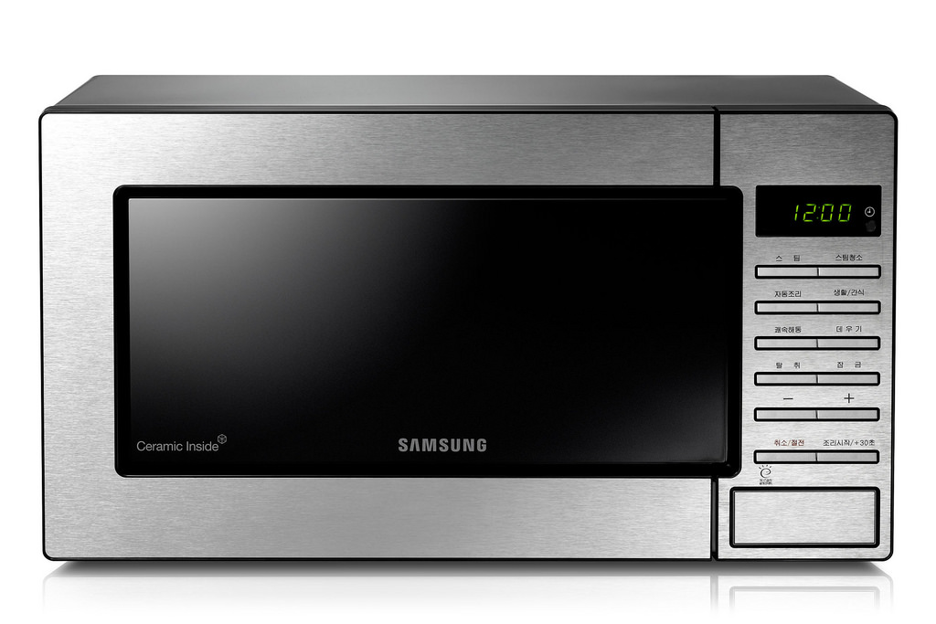
Is this Microwave Oven a IoT Device?

Slide 8


Do we get any benefit by making this water pump IoT Enabled?
Let us discuss

Slide 9
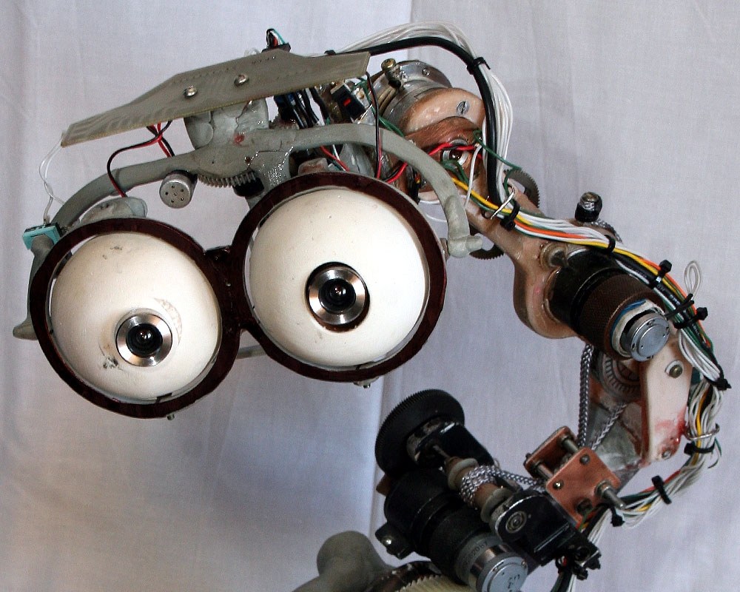
Sensors
What are the different sensors we can think off for IoT?
Write the name of few sensors you can think of

Slide 10


What else do you need to make a IoT Device
Think

Slide 11
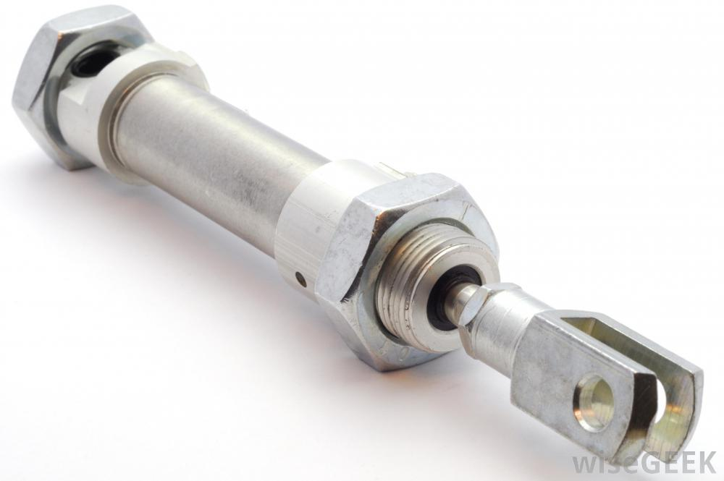
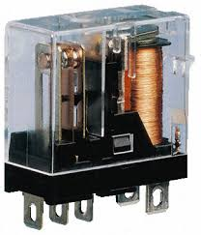
We need something called actuator to convert electrical signals into action

Slide 12
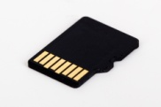
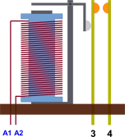

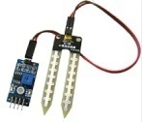
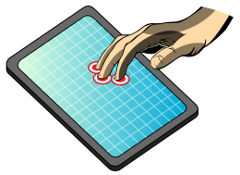

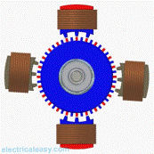
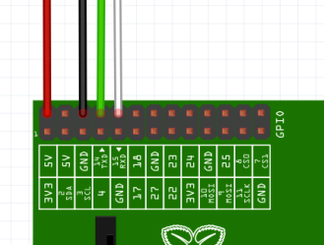


How does a computer used for IoT Look like?
Primary Memory
(RAM)
Secondary Memory
Memory Card (16 GB, 32 GB etc)
Electromagnetic
Relay
Input
CPU
Touch
Screen
LCD (I/O)
Electric
Motor
Ports
Network Interface
12

Slide 13
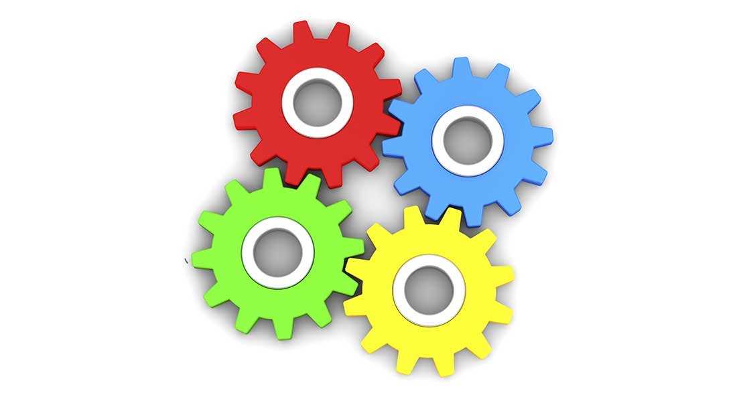
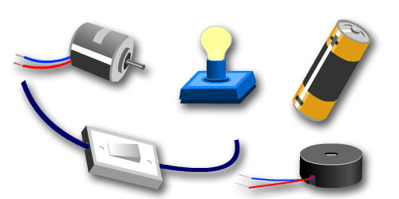
What is an embedded Computer?
An Electrical system Where Computers are components

Slide 14
When an embedded Computer is given access to Internet, the whole system becomes an IoT device

Slide 15
Let us discuss
Can you list a few IoT devices you had come across

Slide 16
How do we build a device with IoT Enabled
Think

Slide 17
What are the different components of an End to End IoT solution
What is an end to end Solution?

Slide 18

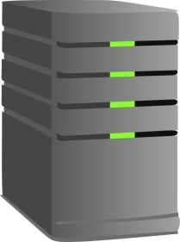
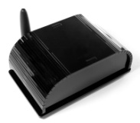
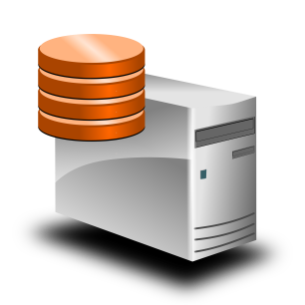
End to End IoT solution ?
End to End IoT has four layers
IoT device which has sensors Actuators
Connectivity (Internet)
Processing
Storage.
Processing
Internet
IoT device which has sensors Actuators
Storage

Slide 19
What benefit do we get out of IoT
IoT is a means for achieving automation through the internet
Jobs which are done manually like:
Data collection from remote equipments
Controlling equipments located at remote locations
Monitoring equipments at remote location
Doing maintenance of equipments at remote locations
Online Tracking and collection of performance data

Slide 20
Why Internet was Chosen ?
Internet

Slide 21
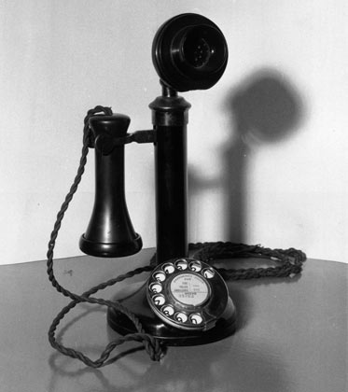
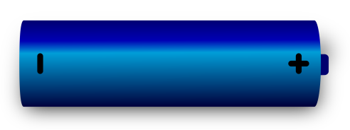
What was earlier mode of communication ?
Microphone
Headset
Simple Circuit Switched Telephony could provide reliable Real time Communication
But it came with its own limitations

Slide 22
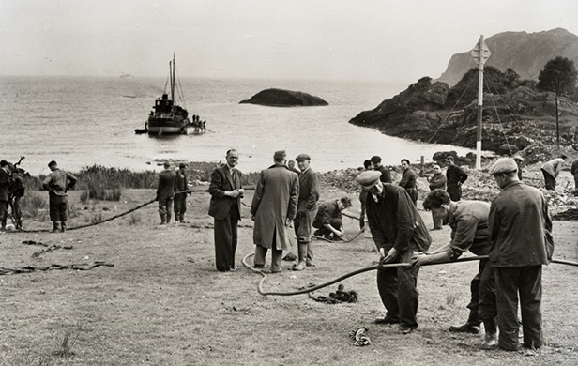
Trans Atlantic Cable

Slide 23
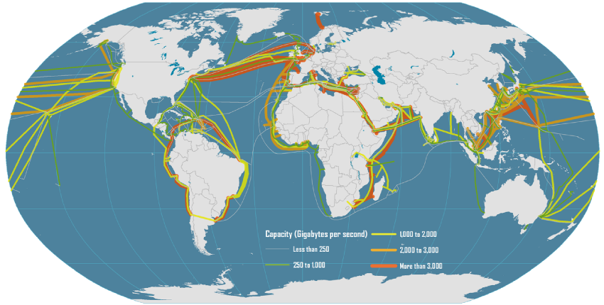

Slide 24
Pros and cons of Circuit Switched
Pros | Cons
The major advantage of circuit switching is that it has a predictable performance that can be guaranteed. Once the circuit has been established, the communication is typically error-free and relatively fast. | The disadvantage of circuit switching is that it requires an initial channel set up that is usually time-consuming
Easy to implement | Needs a dedicated “Connection” between the two points, which gets under utilized when not used.
 | During failure, it is not possible to establish alternative routes. Frequency of failures and down time is very high

Slide 25


Slide 26
Evolution of Packet switching
Packet switching is a digital networking communications method that groups all transmitted data into suitably sized blocks, called packets, which are transmitted via a medium like copper wire or RF signals .
Since the fault tolerance of Circuit Switched network was very poor, as solution 1950s, American computer scientist Paul Baran developed the concept Distributed Adaptive Message Block Switching which provided a much better fault tolerant system
In a packet switched network, data is transmitted in the form of packet with a “From” and “To” Address, just like a Postal Letter. Such mechanism ensured that a channel is occupied , only during the transmission of the packet, and upon completion of the transmission the channel is made available for the transfer of other traffic[]
Fault Tolerance was given such a importance, so that a packet switched network could withstand a Nuclear Attack

Slide 27
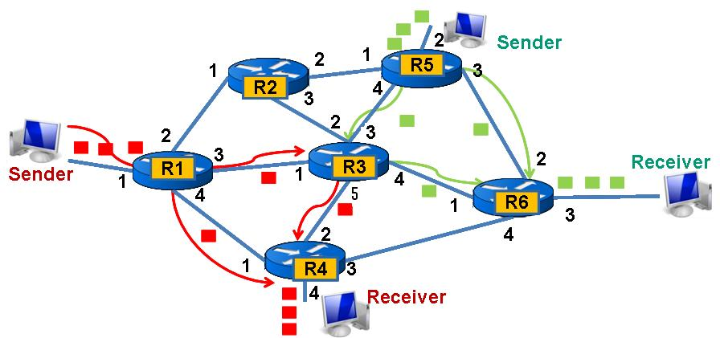

Slide 28
Advantages of Packet switching
Efficient use of Network with better utilization
Easily get around broken bits or packets.
Packet switching can support high data transmission rates
All the packets not follow same route in Packet Switching, this enables fault tolerance

Slide 29
Internet
Is a
Packet switched network

Slide 30
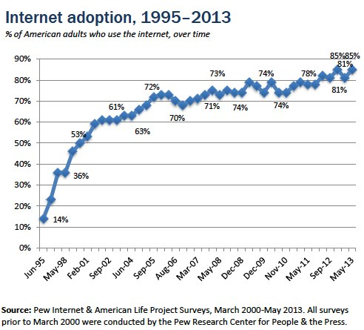
What does this graph indicates ?

Slide 31

Why there is too much hype about IoT
In future communication is not limited to Human to Human Information exchanges.
It is going to be many folds
Human to Human
Human to Machine
Machine to Human
Machine to Machine
Plants to Machine
Machine to Plants
Plants to Human and back ……
Internet is going to be the medium for all these kind of communication

Slide 32
What are the IoT platforms.
No | Name | Description
1 | Raspberry Pi | A credit card sized open source computer which runs on linux platform. It uses a ARM Cortex -8 CPU.This board features USB ports for keyboard and mouse, a HDMI port for display and an Ethernet port for wired internet connectivity
2 | Arduino | Arduino is an open-source small computer based on easy-to-use hardware and software, and does not need an Operating system
3 | Beaglebone Black: | low-cost development platform built around ARM Cortex A8 processor. It runs on Linux environment just like the Raspberry Pi.
4 | Intel Edison: | is a tiny computer featuring a Intel Atom CPU and 32 bit Intel Quark microcontroller. This tiny board carries all Wi-Fi and bluetooth modules for connectivity and thus requires no external modules to do so

Slide 33
No | Software Platform | API exposed for integration | Protocols supported | Type of analytics supported
1 | ThingWorx - MDM IoT Platform | REST API | MQTT, AMQP, XMPP, CoAP, DDS, WebSockets | Predictive analytics(ThingWorx Machine Learning), Real-time analytics (ParStream DB)
2 | IBM IoT Foundation Device Cloud | REST APIand Real TIME API | MQTT, HTTPS | Real-time analytics (IBM IoT Real-Time Insights)
3 | AWS IoT platform | REST API | MQTT, HTTP1.1 | Real-time analytics
4 | Bosch IoT Suite - MDM IoT Platform | REST API | MQTT, CoAP, AMQP,STOMP | No published
5 | Ericsson Device Connection Platform (DCP) - MDM IoT Platform | REST API | CoAP | Not Published

Slide 34
No | Protocol | Description
1 | MDM | Mobile Device Management
2 | MQTT | Message Queue Telemetry Transport : MQTT is a machine-to-machine (M2M)/"Internet of Things" connectivity protocol.
3 | CoAP | The Constrained Application Protocol (CoAP) is a specialized web transfer protocol for use with constrained nodes and constrained networks in the Internet of Things. The protocol is designed for machine-to-machine (M2M) applications such as smart energy and building automation.”
4 | AMQP | The Advanced Message Queuing Protocol (AMQP) is an open standard application layer protocol for message-oriented middleware.
5 | STOMP | Simple (or Streaming) Text Oriented Message Protocol (STOMP)is a simple text-based protocol, designed for working with message-oriented middleware (MOM). It provides an interoperable wire format that allows STOMP clients
6 | XMPP | Extensible Messaging and Presence Protocol (XMPP) is a communications protocol for message-oriented middleware based on XML (Extensible Markup Language)

Slide 35
How is a computer Network Build ?

Slide 36
What is an IP Address ?

Slide 37
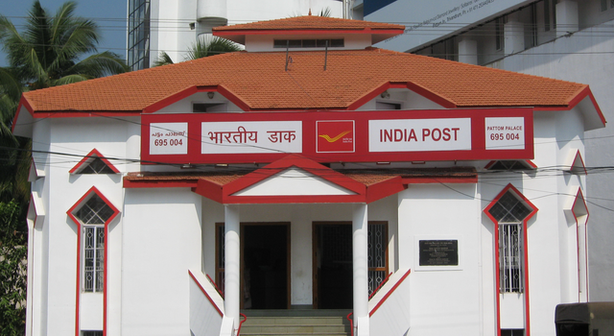

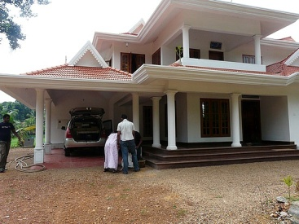
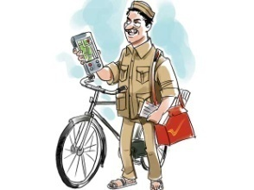

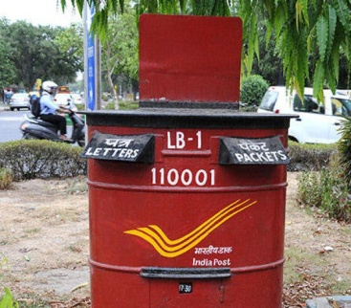

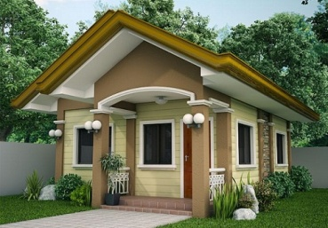

How does letter addressed to you through India Post reaches your home ?

Slide 38
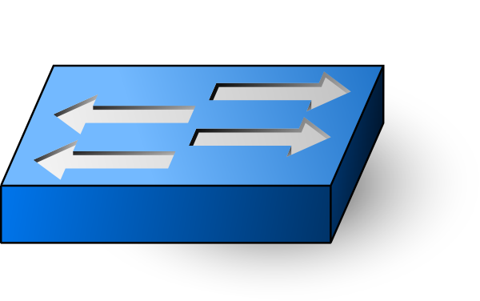
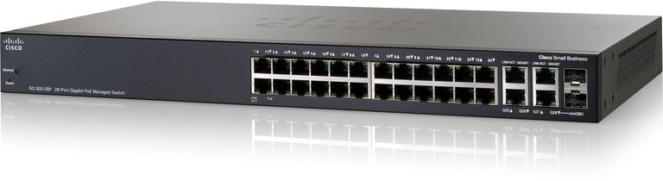
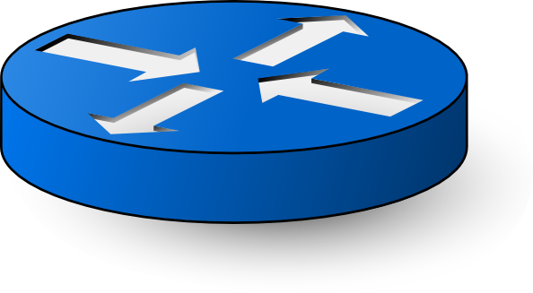
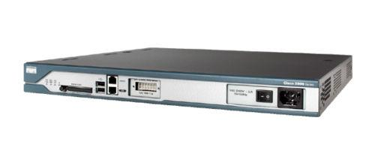
Switch
Router

Slide 39
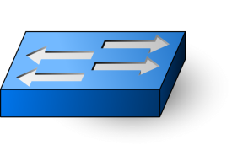

A typical network

Slide 40
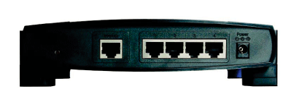
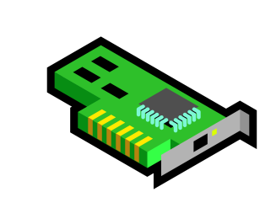
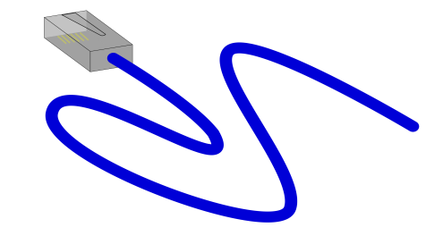

A Router with a Ethernet interface Router acts like an intersection in the highway with signboards
162.129.XXX.XXX
Default Gateway
162.140.XXX.XXX
162.110.XXX.XXX

Slide 41

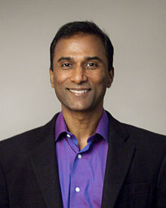
What was the earliest successful application of Internet ?
V. A. Shiva Ayyadurai is an Indian-born American scientist and entrepreneur. Ayyadurai is notable for his controversial claim to be the "inventor of email". His claim is based on the electronic mail software he wrote as a New Jersey high school student at the age of 14, in the late 1970s, which he called EMAIL.
Source: https://en.wikipedia.org/wiki/Shiva_Ayyadurai

Slide 42
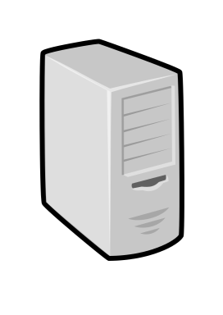
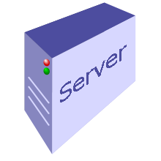
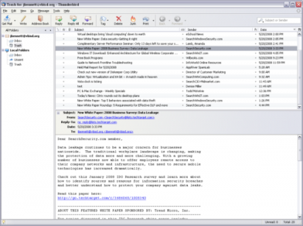
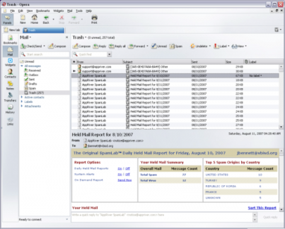
How does a simple Email work ?
Your email server (sreeni@vlsiguru.com)
Recipient-email(anil@vxworks.com)
Internet

Slide 43






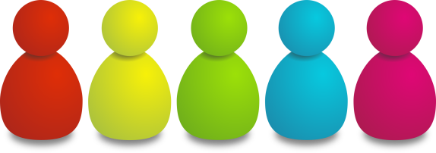
How does a simple Email work ?
Internet

Slide 44
X-Apparently-To: girish_kumar@yahoo.com; Wed, 26 Apr 2017 10:21:36 +0000
Return-Path: <vlsigurutraining@gmail.com>
Received-SPF: pass (domain of gmail.com designates 209.85.218.65 as permitted sender)
X-YMailISG: F5ZotccWLDt_Ka_GP7tH0Kqrk4crIDzljBWNzXRiBoffoABz
c0bQXpnN9_YAWIxav6g_S8jbR4EWTOrbpHU-
X-Originating-IP: [209.85.218.65]
Authentication-Results: mta1572.mail.ne1.yahoo.com from=gmail.com; domainkeys=neutral (no sig); from=gmail.com; dkim=pass (ok)
Received: from 127.0.0.1 (EHLO mail-oi0-f65.google.com) (209.85.218.65)
by mta1572.mail.ne1.yahoo.com with SMTPS; Wed, 26 Apr 2017 10:21:35 +0000
Received: by mail-oi0-f65.google.com with SMTP id y11so41102743oie.1
for <girish_kumar@yahoo.com>; Wed, 26 Apr 2017 03:21:35 -0700 (PDT)
DKIM-Signature: v=1; a=rsa-sha256; c=relaxed/relaxed;
d=gmail.com; s=20161025;
h=mime-version:from:date:message-id:subject:to;
bh=FvrDsxjbexpsN1E0l5LxR8aRS1Jb2Dw2d/kvsJwec74=;
b=kjRKCoqrQ+yLCgJhPD007AJtoq+/r57egC9Rqzvr0DsUX/YViah29y8/p8sPFA1L/z
............................................==
X-Google-DKIM-Signature: v=1; a=rsa-sha256; c=relaxed/relaxed;
d=1e100.net; s=20161025;
h=x-gm-message-state:mime-version:from:date:message-id:subject:to;
bh=FvrDsxjbexpsN1E0l5LxR8aRS1Jb2Dw2d/kvsJwec74=;
b=czTL8PTJhTIyFuDwVjaEDcBl4Yh89LxHas0TlKqZ1xwsOrVQ6kiaFvSCVwNm8Sq62N
.........................................................

Slide 45
X-Gm-Message-State: AN3rC/434Ib/DzF/NF6/ykaFE8MAZQPaQFe/jH9mA1XhPlMmfudPXPn2
n8j31uBkonJH284zsORsHfL9njAC4g==
X-Received: by 10.157.23.40 with SMTP id i40mr1201966ota.168.1493202094828;
Wed, 26 Apr 2017 03:21:34 -0700 (PDT)
MIME-Version: 1.0
Received: by 10.182.217.66 with HTTP; Wed, 26 Apr 2017 03:21:34 -0700 (PDT)
From: VLSIGuru Institute <vlsigurutraining@gmail.com>
Date: Wed, 26 Apr 2017 15:51:34 +0530
Message-ID: <CAM16T-bqxiXo31HFwFum2zaCDyt1QgUdEi2ZGja3Y66=jLnEZg@mail.gmail.com>
Subject: Embedded Systems and IOT 4 Day Workshop | 29/Apr, 8:30AM | Hands on projects
To: undisclosed-recipients:;
Content-Type: multipart/related; boundary=f4030437a2b0717791054e0f34e8
Bcc: girish_kumar@yahoo.com
Content-Length: 108946
--f4030437a2b0717791054e0f34e8
Content-Type: multipart/alternative; boundary=f4030437a2b071778d054e0f34e7
--f4030437a2b071778d054e0f34e7
Content-Type: text/plain; charset=UTF-8

Slide 46
Hi All,
VLSIGuru Institute is offering a *4 Day's workshop on Embedded Systems and
IOT* starting *29/Apr*, scheduled over 2 weekends. Course involve multiple
hands on projects and is being offered by a visiting faculty of IIIT
Bangalore.
Below is more details.

Slide 47
Client Server Computing
In client server computing paradigm
Instead of a single computer doing all the work the functionality is broken into three layer and done at different computer hardware. This enables, sharing of resource across multiple users. The layers which are broken down are
User interaction module -Which is called the Client
The computing module where all the processing takes place called – Client
The computer hardware where storage is attached – Called the storage server

Slide 48
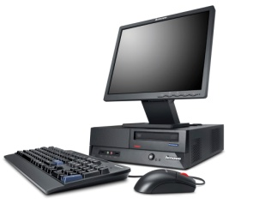


Client Server Computing
This piece does storage
This piece does computing
Interacts with user collect input – perform display and send data to computing module

Slide 49
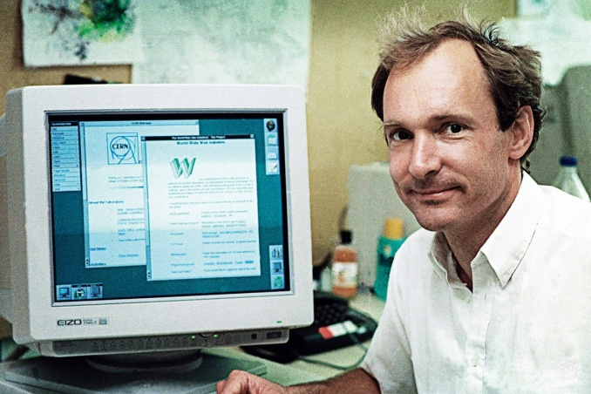
How did the concept of Web Came into existence
Though email was widely used to send and receive message, it was limited to one-to-one message and to messages addressed to a group. This did not resolve the need to information sharing with a wider audience without any limitation
A London based computer British computer scientist.Sir Tim Berners-Lee is the inventor of World Wide Web. The problem he faced while working as a scientist was sharing of information across the team members. Tim thought of a way to solve this problem and that was WWW.
By October of 1990, Tim had written the three fundamental technologies that remain the foundation of today’s web (and which you may have seen appear on parts of your web browser):
HTML: HyperText Markup Language. The markup (formatting) language for the web.
URI: Uniform Resource Identifier. A kind of “address” that is unique and used to identify to each resource on the web. It is also commonly called a URL.
HTTP: Hypertext Transfer Protocol

Slide 50
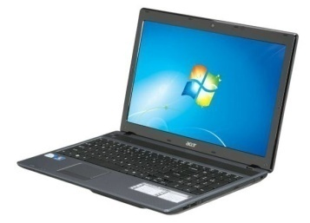
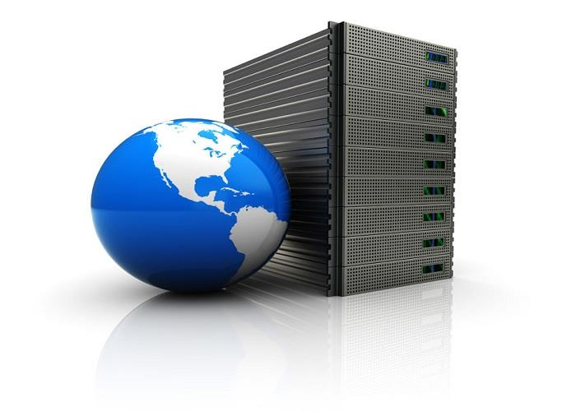
How is information exchanged between a Web Browser and Web Server
HTTP/1.1 200 OK Date: Mon, 27 Jul 2009 12:28:53 GMT Server: Apache/2.2.14 (Win32) Last-Modified: Wed, 22 Jul 2009 19:15:56 GMT Content-Length: 88 Content-Type: text/html Connection: Closed
<html>
<body>
<h1>Hello,World!</h1>
</body>
</html>
Internet
GET http://www.cnn.com HTTP/1.1

Slide 51
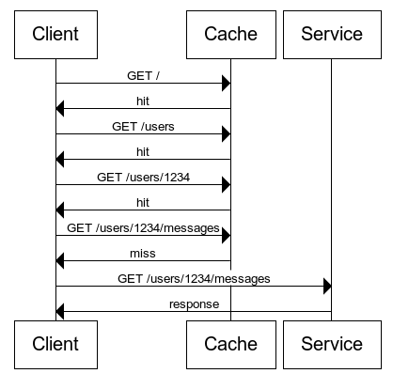

Slide 52
How is security implemented in Web Services

Slide 53
Types of Packet switched networks
Packet Switched
Connection Oriented (Virtual Circuit)
Connection less or (datagram)
TCP
X.25
Frame Relay
Multiprotocol Label Switching
IP
UDP
Ethernet

Slide 54
Types of Packet Switched network
Connection Less Mode : Each packet will have the complete addressing information. Each packet is routed individually, this will result in different paths and out-of-order delivery. Each packet will have
Destination address
Source address
Port numbers
Connection-oriented For a setup phase is included in each involved node before any packet is transmitted to establish the parameters of communication. The packets include a connection identifier rather than address information and are negotiated between endpoints so that they are delivered in order and with error checking.
Unlike Connection less, address information is only transferred to each node during the connection set-up phase, when the route to the destination is discovered and an entry is added to the switching table in each network node through which the connection passes.

Slide 55
How it is implemented
Your application server.c or client.c
Application Layer
Application Layer
Presentation Layer
Socket Interface
fd = socket(……)
Session Layer
Transport Layer
TCP or UDP
Network Layer
IP Layer
Data Link Layer
Ethernet Layer
Ethernet Drivers and Card
Physical Layer
Physical Layer
Cables

