Slide 1
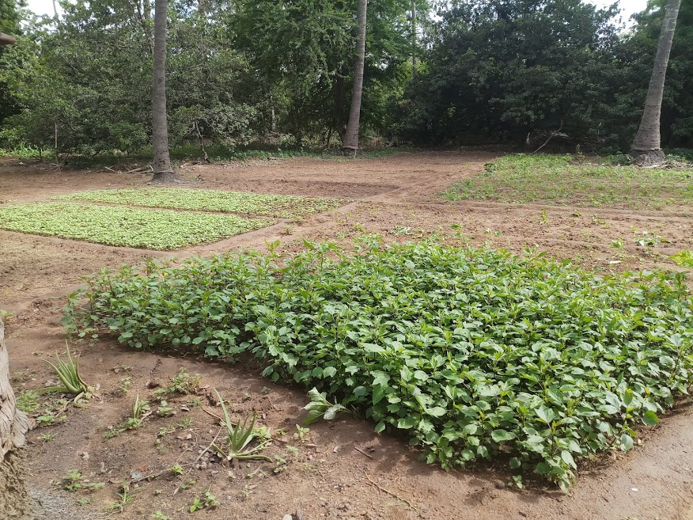
Dilemma of a modern day farmer

Slide 2
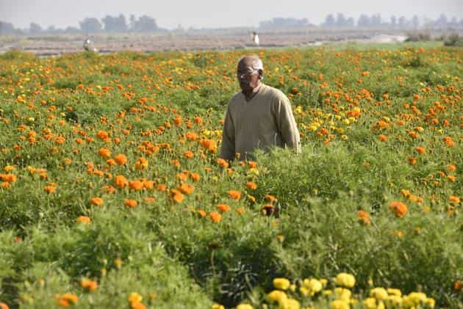
Knowledgeable and talented people who understand the science of agriculture is getting into farming

Slide 3
Modern Day Farmer
Entrepreneurs are getting into Farming.
Farming is just another source of Income for them.
They have to manage multiple farms at different locations
Different business at the same time along with farms.
Human Labor is no more an option.
Need to track the changes in farms closely cant afford a mistake that can result in loss of crops
Changing weather patterns
Non availability of water suitable for farming
Response of crops to climate changes
Response of crops to fertilizer
Handling pests and wild animals
Physical presence in the farms a challenge.
Security in farms spreading over large areas
Need to go with more and more automation for everything (starting with ploughing, sowing to harvesting)

Slide 4
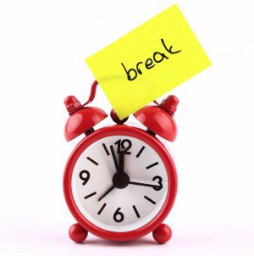
Pumping water is a basic need and our solution will be not of much help to farmer.
?
Can we list the reason why the existing solution is not feasible for framer

Slide 5
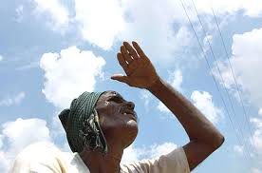
Basic problem with remote controlled pump
Is the pump actually pumping water
Is the water reaching the farms
Is the pump pumping enough water to farms
What is the temperature of the pump (is it getting heated up)
Is the pump working normally without any mechanical issues
What is the power consumed by pump
Is water in the storage/well enough to start the pump
Should we pump water periodically ? Or only when it is needed ?
What is the weather in the farm. (Temperature, Humidity and wind)
Is there a potential chance of rain any time soon ?
How is the soil, does it have enough water content or it is getting dry ?
How is the power situation in farm, are there are any power failures
Are there any intruders (wild animals pest etc)
Pollution in the farms
……………………
……………………………

Slide 6
How the solution should looks like ?

Slide 7
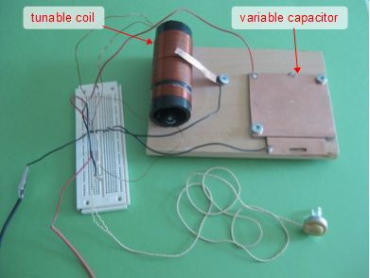
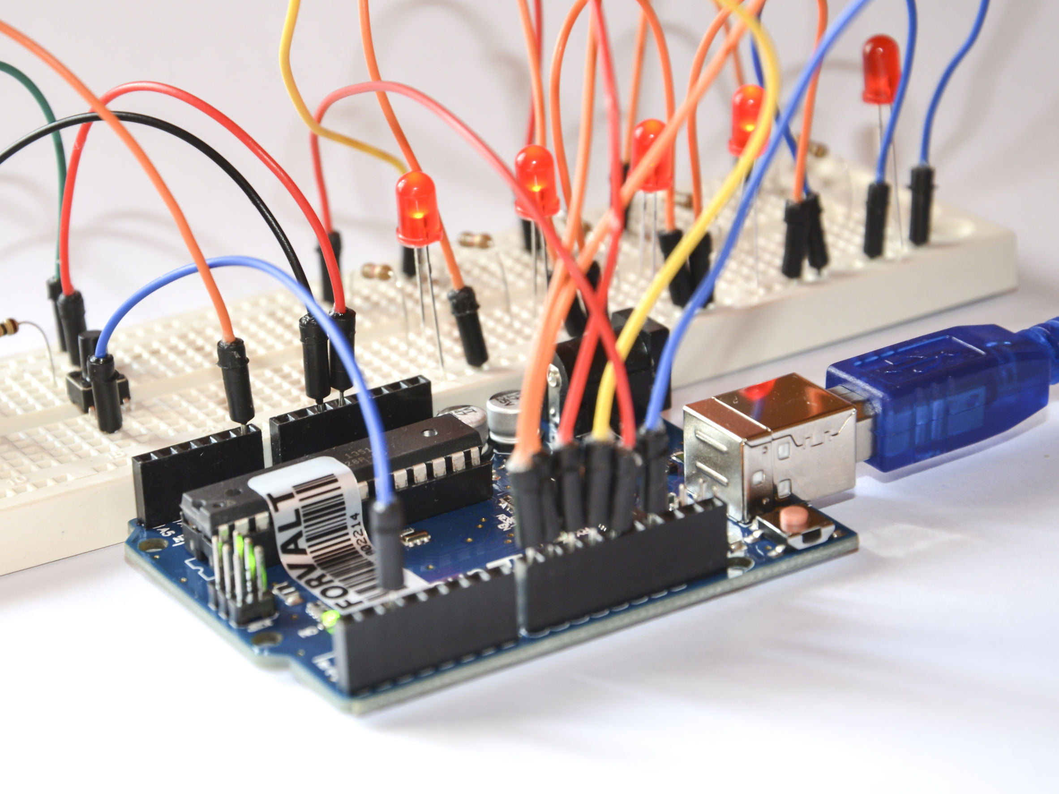
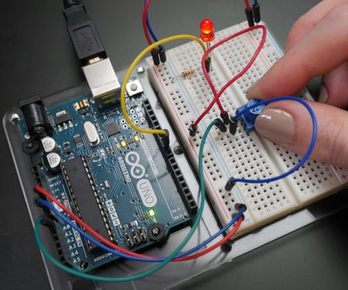
IT cannot be a DIY Solution or a prototype

Slide 8
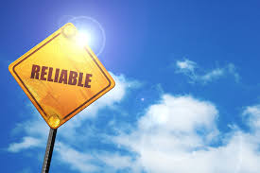
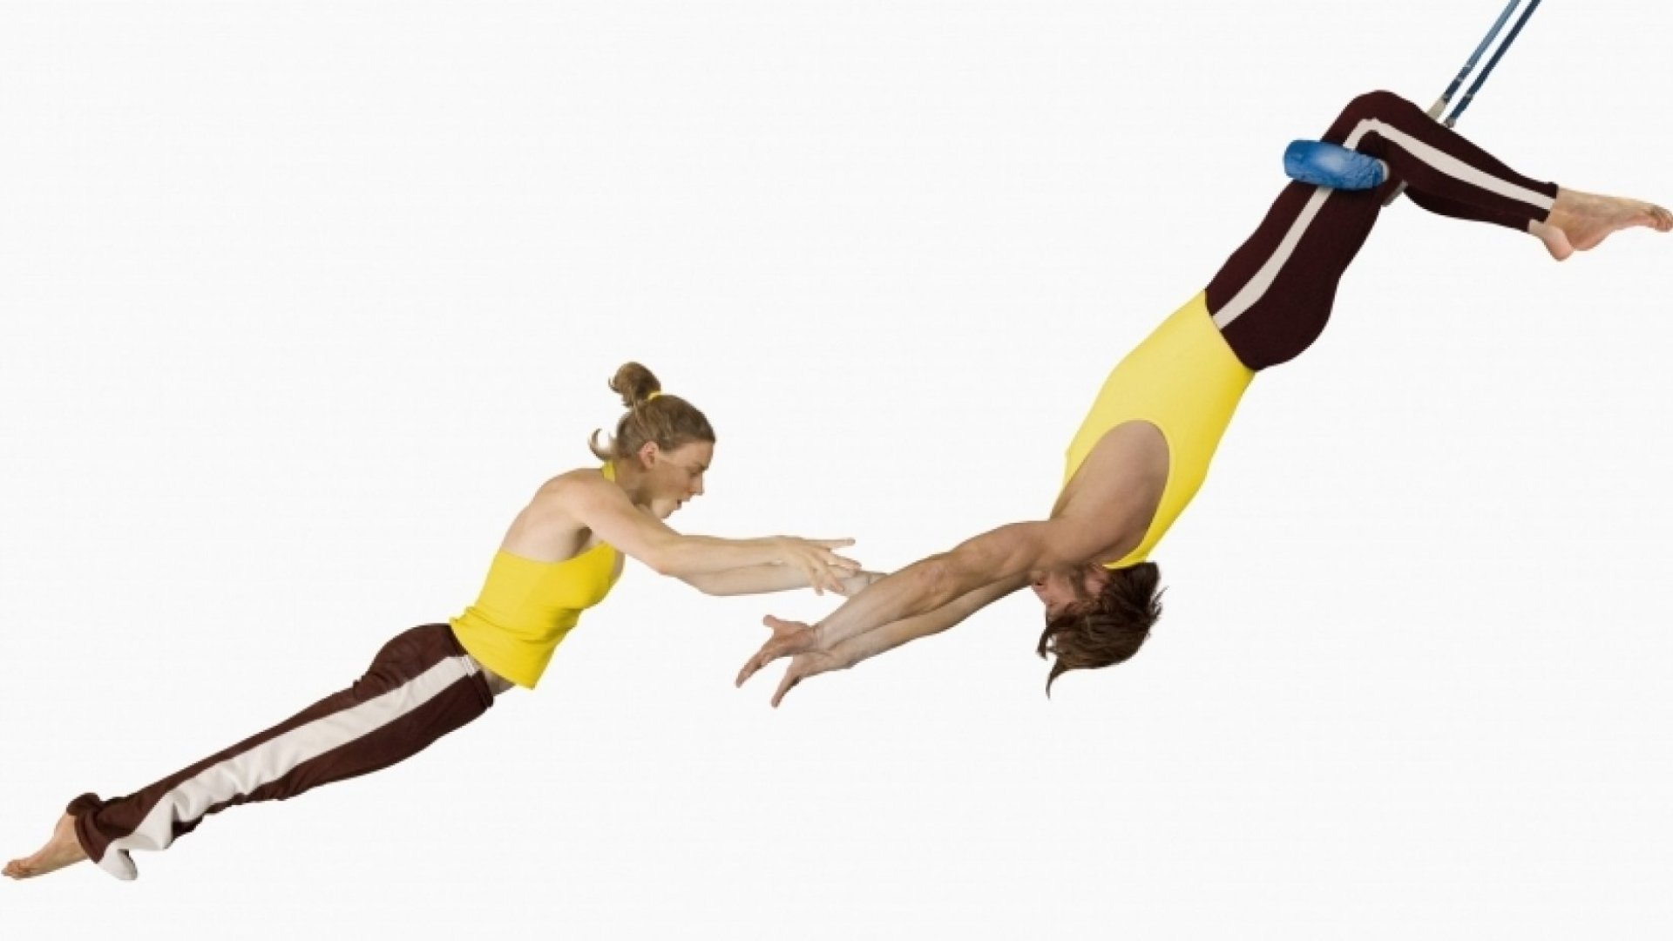

It has to be

Slide 9
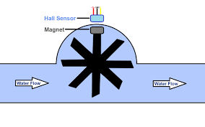
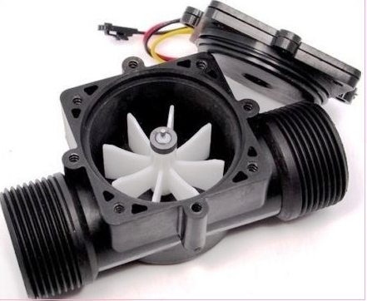
Is the pump pumping enough water ?.
Each time when the magnet a passes near the Hall effect sensor, the sensor produces an electric pulse.
No of pulses is proportional to the volume of water/fluid flowing through the pipe.
We cut the pipe and insert it into the pipe which carries water..
All we need to do is just count the no of pulses per minute which give is the flow.

Slide 10
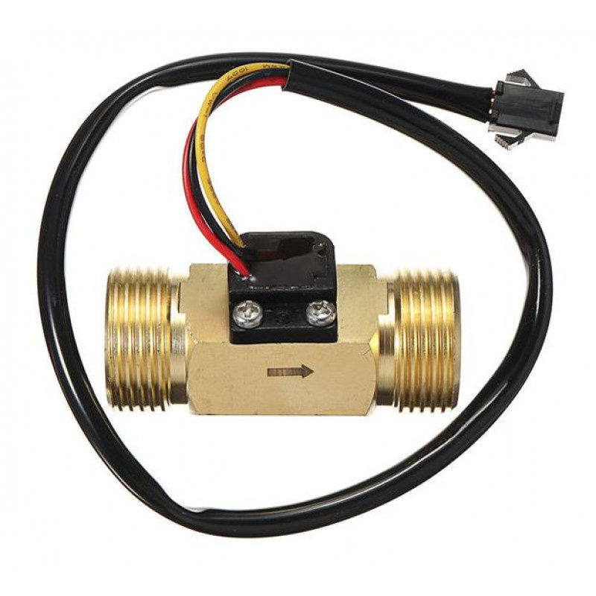

Slide 11
How do we interface this Sensor with ESP32
In the previous code we discussed, all we need to do is : Just add the following routine connect the sensors
data pin to GPIO 4 and power up the sensor
const int inputPIN = 4 ; //GPIO 4
void ICACHE_RAM_ATTR pin_ISR()
{
ticks++;
}
attachInterrupt(digitalPinToInterrupt(inputPIN), pin_ISR, RISING);
All we need to do is periodically take the value in global variable ticks and calculate the volume through put and reset the variable ticks.

Slide 12
Let us Review the Code

Slide 13
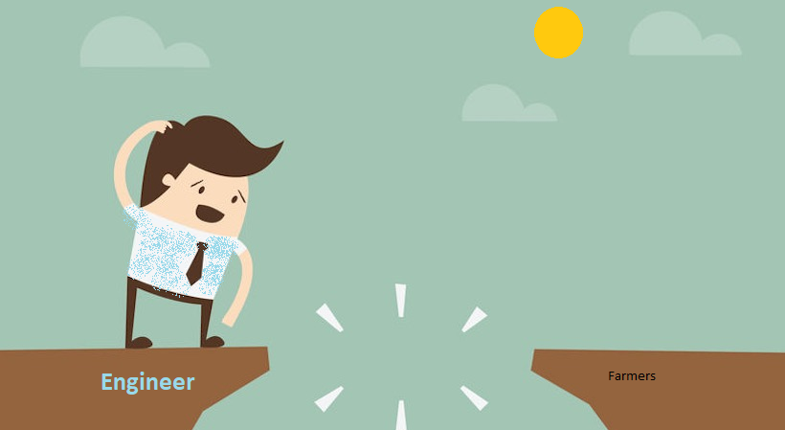
There are few problems with this approach

Slide 14
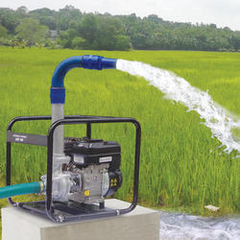
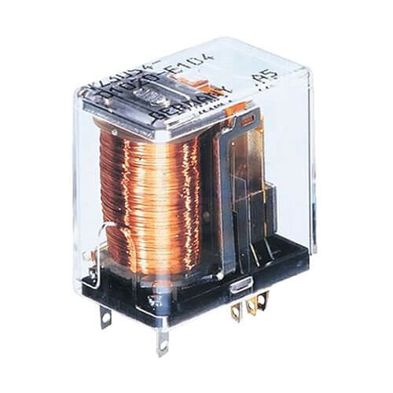
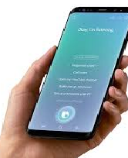
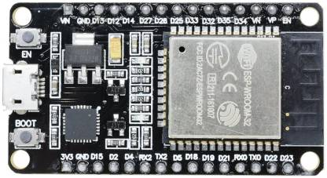
We all use Internet provided by local ISP
Farm Network (ISP-1)
(wifi at Farm)
Home network (ISP-2)
(Wifi at home)
Public
Internet

Slide 15
Instantaneous data is not enough
Instantaneous data is not always sufficient
  What was the max and min temperature for the last 10 days
  Is the mean temperature changing ?
  Is humidity dropping compared to last 10 days ?
  What the pattern on rail fall during the last 10 days ?
  How is soil retaining moisture in the last one month
  Water levels in local well/ponds
  Has the pH level of soil changed after the use of fertilizers.
We need access to historic data to make decisions

Slide 16
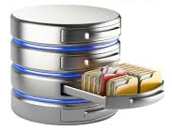
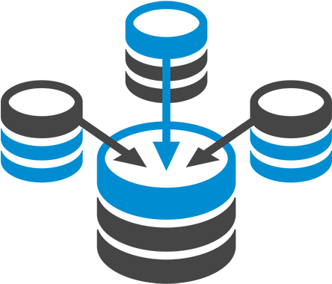

We need to store data with time stamps in a database
We need to have multiple database
Different types of data need to be stored
Data need to be retrieved
Presented to the farmer in a usable way
Affordable and Deployable

Slide 17
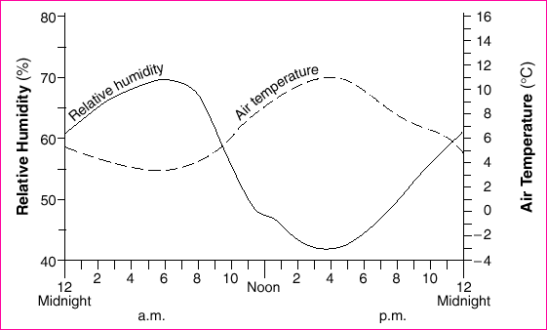

Slide 18
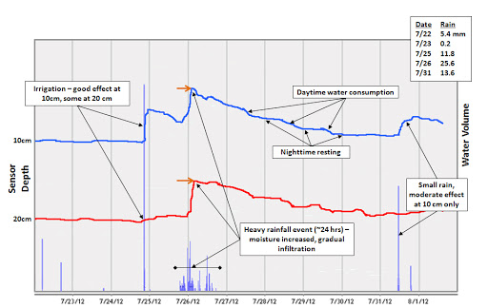

Slide 19
Presenting the data to farmer is a
Very critical aspect.
Design Thinking comes
into picture

Slide 20
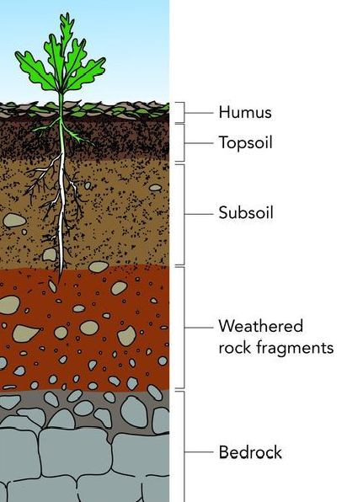
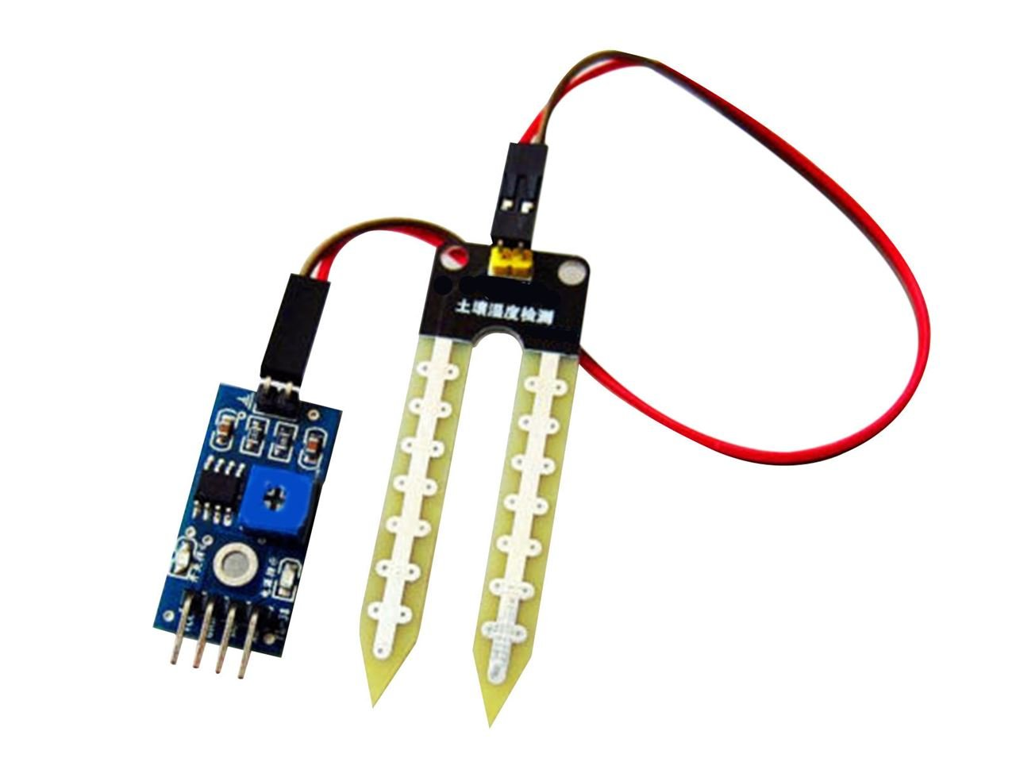
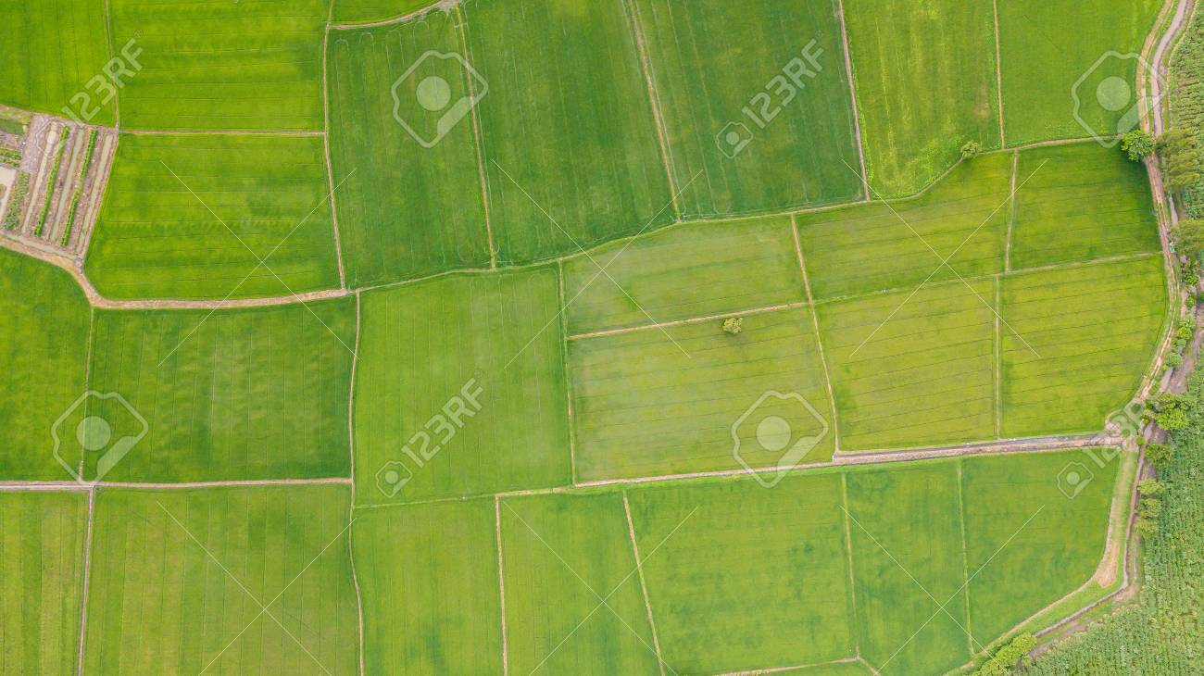
0
1
2
3
4

Slide 21
Necessity it he mother of Invention

Slide 22
This is what leads us to the need of an
IoT platform

Slide 23
Visualization or other front end
Present the information
Store Data
Data bases
Collect Data
Sensors
Level -1

Slide 24
Visualization or other front end
Present the information
Analyze data
Python
Store Data
Data bases
Collect Data
Sensors
Level -2

Slide 25
Optimize your operations
Analyze data
Collect Data
Metrices
Level -3

