Slide 1
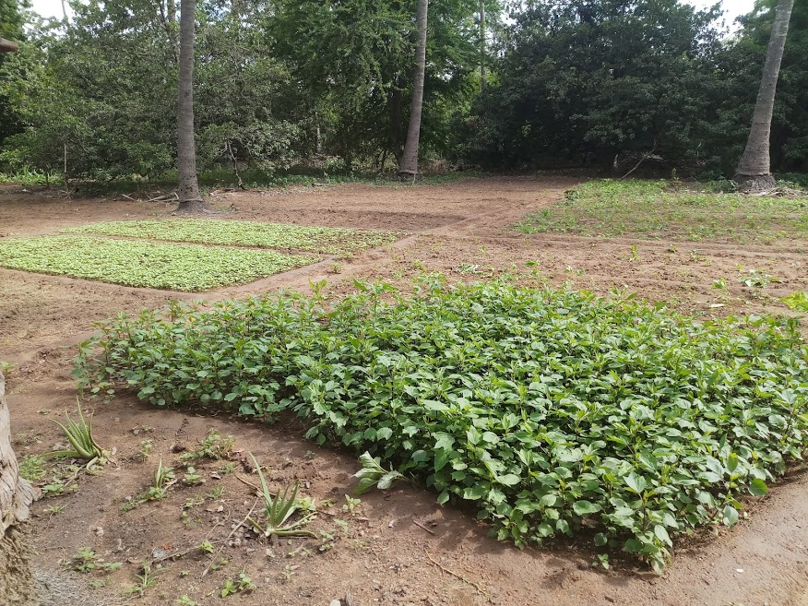
Dilemma of a modern day farmer

Slide 2
Modern Day Farmer
Framers are getting into entrepreneur mode
Farming is just another source of Income.
They have to manage multiple farms at different locations
Different business at the same time along with farms.
Human Labor is no more an option.
Need to track the changes in farms closely cant afford a mistake that can result in loss of crops
Changing weather patterns
Non availability of water suitable for farming
Response of crops to climate changes
Response of crops to fertilizer
Handling pests and wild animals
Physical presence in the farms a challenge.
Security in farms spreading over large areas
Need to go with more and more automation for everything (starting with ploughing, sowing to harvesting)

Slide 3

Pumping water is a basic need and our solution will be not of much help to farmer.
Can we list the reason why the existing solution is not feasible for framer

Slide 4

Basic problem with remote controlled pump
Is the pump actually pumping water
Is the water reaching the farms
Is the pump pumping enough water to farms
What is the temperature of the pump (is it getting heated up)
Is the pump working normally without any mechanical issues
What is the power consumed by pump
Is water in the storage/well enough to start the pump
Should we pump water periodically ? Or only when it is needed ?
What is the weather in the farm. (Temperature, Humidity and wind)
Is there a potential chance of rain any time soon ?
How is the soil, does it have enough water content or it is getting dry ?
How is the power situation in farm, are there are any power failures
Are there any intruders (wild animals pest etc)
Pollution in the farms
……………………
……………………………

Slide 5
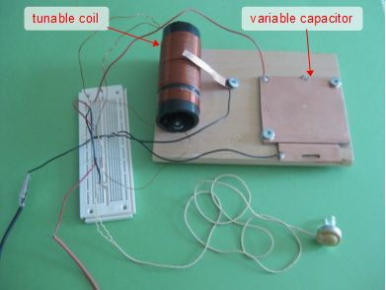
IT cannot be a DIY Solution or a prototype

Slide 6

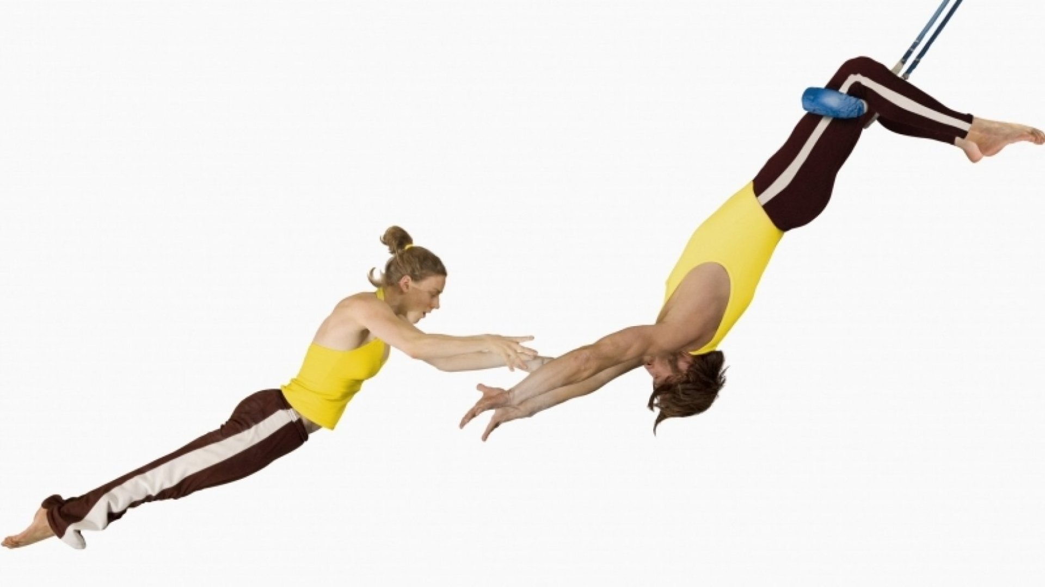
It has to be

Slide 7
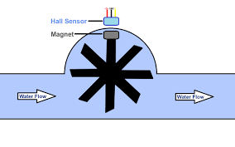
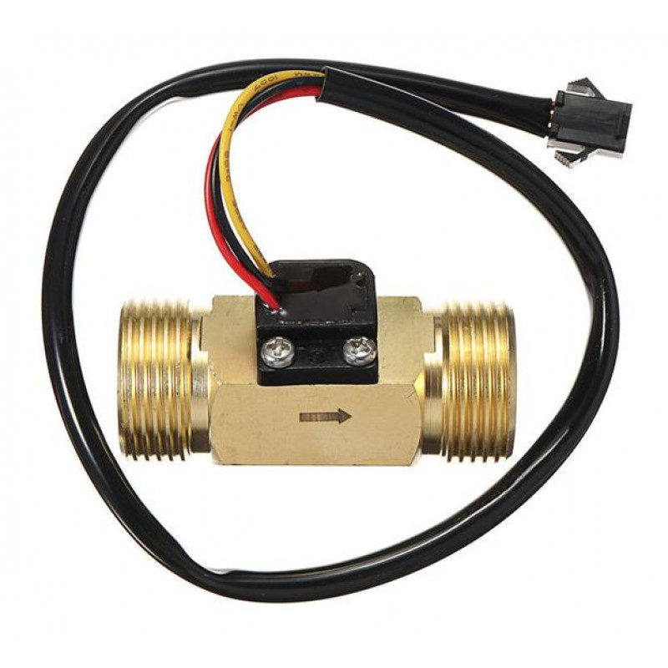
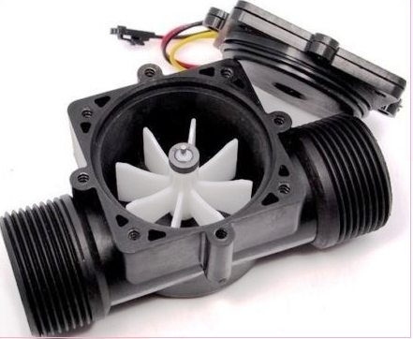
Is the pump pumping enough water ?.
Each time when the magnet a passes near the Hall effect sensor, the sensor produces an electric pulse.
No of pulses is proportional to the volume of water/fluid flowing through the pipe.
We cut the pipe and insert it into the pipe which carries water..
All we need to do is just count the no of pulses per minute which give is the flow.

Slide 8
How do we interface this Sensor with ESP32
In the previous code we discussed, all we need to do is : Just add the following routine connect the sensors
data pin to GPIO 4 and power up the sensor
const int inputPIN = 4 ; //GPIO 4
void ICACHE_RAM_ATTR pin_ISR()
{
ticks++;
}
attachInterrupt(digitalPinToInterrupt(inputPIN), pin_ISR, RISING);
All we need to do is periodically take the value in global variable ticks and calculate the volume through put and reset the variable ticks.

Slide 9
Let us Review the Code

