Slide 1
Introduction to Sensors & Actuators for IoT

Slide 2
What are sensors
A Sensor is a device that detect a change in the surrounding and transform it into another form (Say into an electrical pulse, or an action). However it should in no way impact the environment and change the change the process which is causing the temperature
A sensor can be electronic, mechanical, electrical or anything…

Slide 3
what are sensor for IoT
A Sensor that can measure the change in environment and transform into electrical signal that represent the measurement.
Example:
A temperature sensor can measure the current temperature in the room. Or the temperature of the liquid in which it is dipped or Temperature of the surface which is in contact.
A Sensor is a device that detect a change in the surrounding and transform it into another form (Say into an electrical pulse, or an action). However a sensor should in no way impact the environment and change or influence the process which is causing the change.

Slide 4
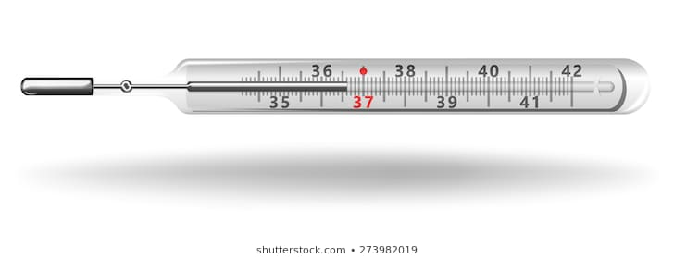
Let us take the design of simple temperature sensor take the discussion forward

Slide 5
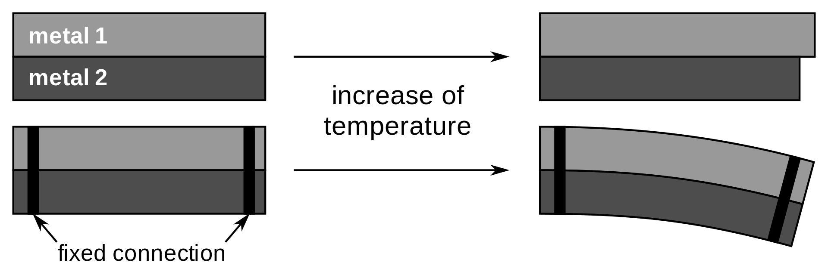
Background of sensors
Sensors existed much before days of electronics and computers. Those days they played a dual role of taking the measurement as well turning that into a action.
Bimetalic stirp used in tradtional iron boxes are a good example of mechanical sensor. This was heavily used in many equipment for temperature control

Slide 6
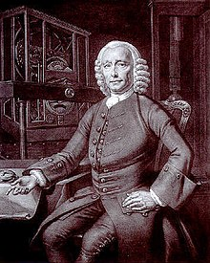
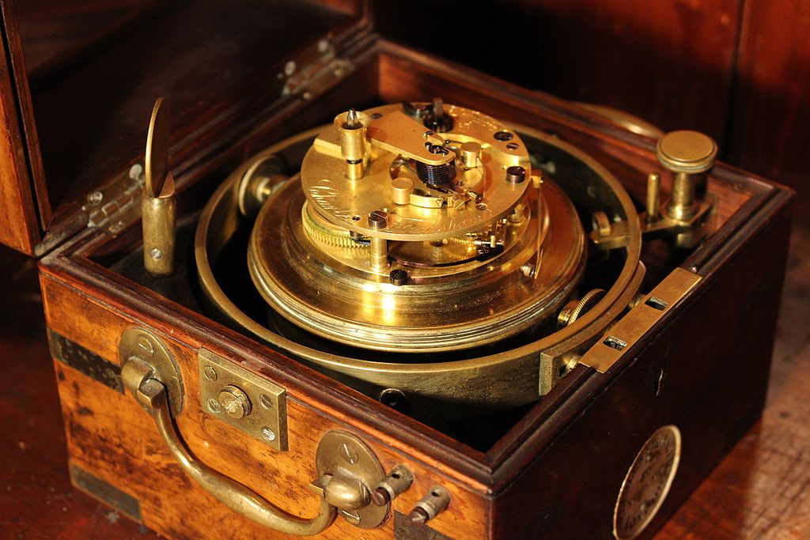
Bimetaloc strip was invented by… John Harrison, an eighteenth-century clockmaker who made it for his third marine chronometer (H3) of 1759 to compensate for temperature-induced changes in the balance spring.
Harrison's solution revolutionized navigation and greatly increased the safety of long-distance sea travel.

Slide 7
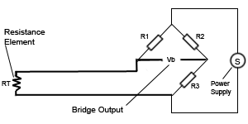
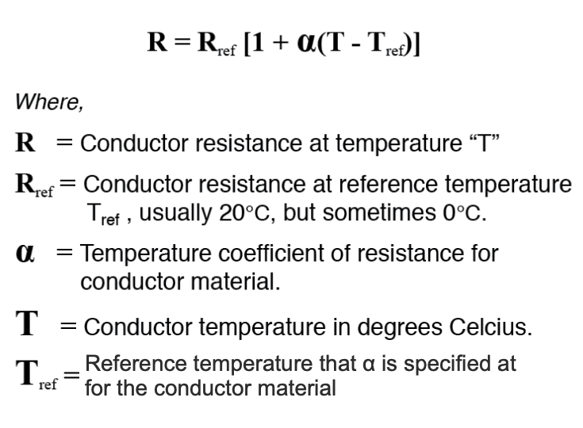
Can we build a sensor of our own ?
Yes it is possible to build sensors of your own
Many of the sensors which were used in industries where manually build. Semiconductor sensors which arrived lately has some advantages over the manually build one.
A simple temperature sensor can be build with a few meters of copper wire. Here the variation of electrical resistance in metal is used to measure temperature.
Resistance thermometers, are build using this kind of sensor. (RTD Resistance Temperature Detectors)

Slide 8
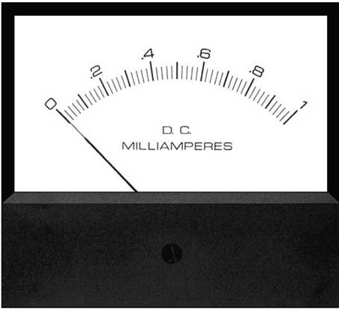

Another way to measure Temperature
Voltage Proporational to difference in Temperature
Metal Wire – A
Hot Junction
Cold Junction
Metal Wire – B

Slide 9
Comparison on RTD with Thermocouple
No | Advantages | Disadvantages
1 | The thermocouple is less expensive than RTD. | The stray voltage pick up is possible
2 | It has wide temperature ranges and good reproducibility, It has rugged construction | As output voltage is very small, it needs amplification.
3 | The temperature range is 270 to 2700 degree Celsius | The cold junction and lead compensation is essential.
4 | It does not required bridge circuit. | It shows non linearity.
5 | It has good accuracy.
6 | It has high speed of response.
7 | No self heating

Slide 10
To read more …
1.https://www.ti.com/lit/an/sbaa274/sbaa274.pdf?ts=1595152129802&ref_url=https%253A%252F%252ww
w.google.com%252F

Slide 11
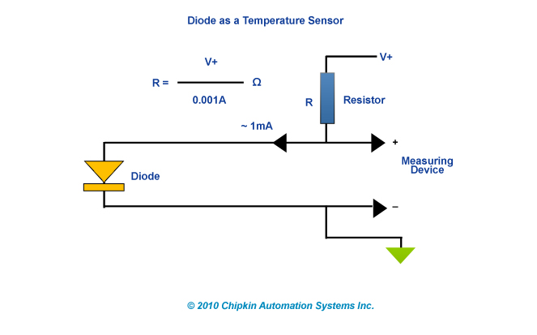
Diode as a temperature sensor

Slide 12
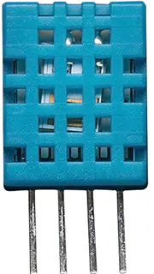
DHT-11 Temperature sensor
The DHT11 is a basic, digital temperature and humidity sensor. It uses a capacitive humidity sensor and a thermistor to measure the surrounding air, and gives out a digital signal on the data pin (no analog input pins needed). It is simple to use, but requires careful timing to grab data. The only real downside of this sensor is you can only get new data from it once every 2 seconds, so when using the library, sensor readings can be up to 2 seconds old.

Slide 13

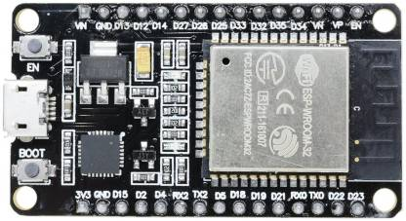

Power from a USB
Mobile charger

Slide 14
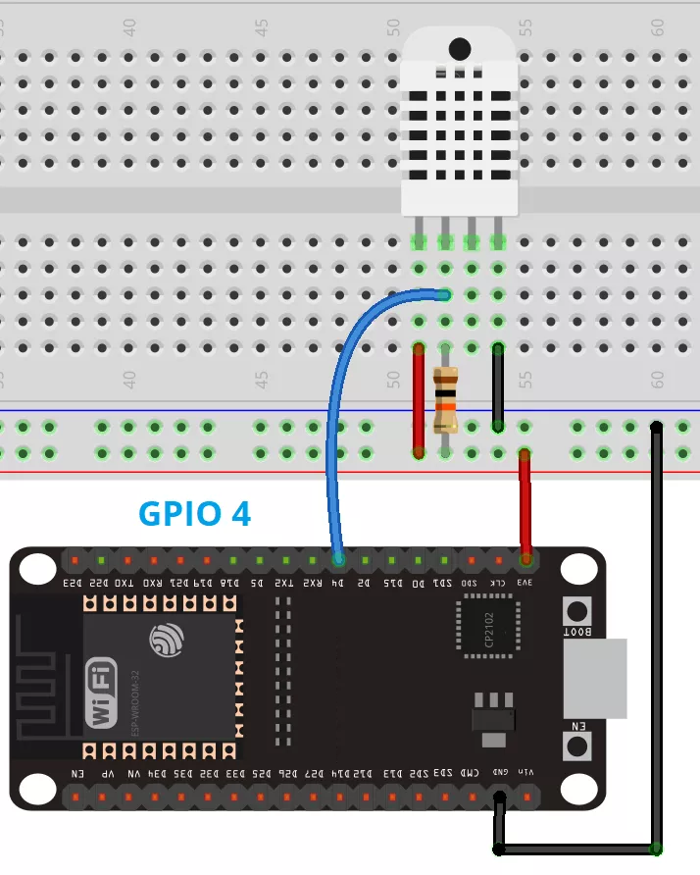

Slide 15
#include "DHT.h"
#define DHTPIN 4
#define DHTTYPE DHT11
DHT dht(DHTPIN, DHTTYPE);
void loop()
{
// Wait a few seconds between measurements.
delay(2000);
float h = dht.readHumidity();
float c = dht.readTemperature();
// Check if any reads failed and exit early (to try again).
if (isnan(h) || isnan(t) || isnan(f))
{
Serial.println(F("Failed to read from DHT sensor!"));
return;
}
float hic = dht.computeHeatIndex(t, h, false);
Serial.print(F("Humidity: "));
Serial.print(h);
Serial.print(c);
Serial.print(F("°C "));
Serial.print(F("°F Heat index: "));
Serial.print(hic);
Serial.print(F("°C "));
}

Slide 16
Infrared Thermometer
http://www.esp32learning.com/code/esp32-and-mlx90614-infrared-thermometer-example.php

Slide 17
What are sensor for IOT
Practically any sensor can be used for IOT application provided the sensor can give a Digital output. In case the sensor provides only an analog output. In which we need to provide a Digital to Analog convertor.

Slide 18
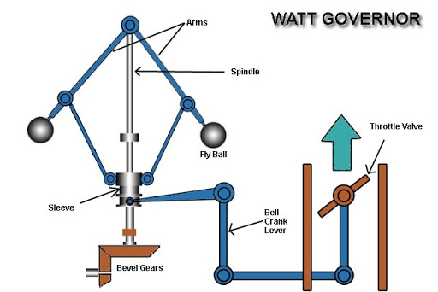
What cannot be used with IOT
When there
Was NO RPM sensors available This was the only option.

Slide 19
Nature of sensors
NO | Sensor Use
1 | Temperature and Humudity
2 | Water Turbidity sensor
3 | Air quality(Co2, methane, etc)
4 | Dust Sensor
5 | Current Sensor
6 | pH and TDS sensor
7 | Optical Sensor
8 | Magnetic field sensors / Hall effect sensors
9 | Vibration Sensor
10 | Electronic Gyroscope
NO | Sensor Use
11 | RPM Sensor
12 | Water Pressure Sensor
13 | Weight Sensor
14 | Proximity sensor
15 | Wind speed sensor
16 | GPS
17 | Heart Beat and SPO2 sensor
18 | Tilt sensor
19 | Gas leakage sensor
20 | Touch sensor

Slide 20
What are Actuators
An actuator is a component of a machine that is responsible for moving and controlling a mechanism or system, for example by opening a valve. In simple terms, it is a "mover".
Actuator
Energy/ Power Supply
Control Signal (from a computer)
Mechanical Force or an action

Slide 21
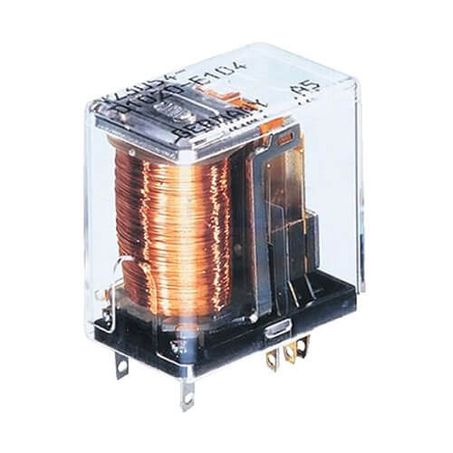
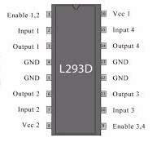
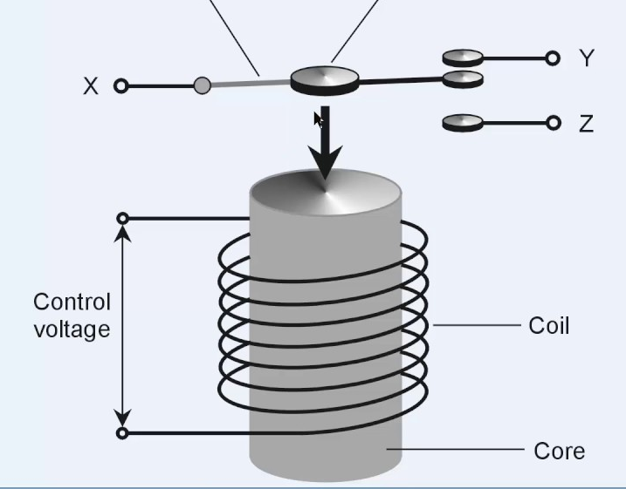
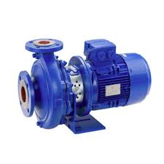
How does a very simple actuator works
Phase
Neutral

Slide 22
const int relay = 26;
void setup()
{
Serial.begin(115200);
pinMode(relay, OUTPUT);
}
void loop()
{
// Normally Open configuration, send LOW signal to let current flow
// (if you're usong Normally Closed configuration send HIGH signal)
digitalWrite(relay, LOW);
Serial.println("Current Flowing");
delay(5000);
// Normally Open configuration, send HIGH signal stop current flow
// (if you're usong Normally Closed configuration send LOW signal)
digitalWrite(relay, HIGH);
Serial.println("Current not Flowing");
delay(5000);
}

Slide 23
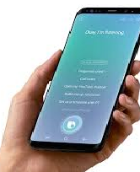
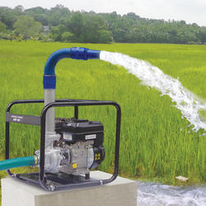
How do we make this as Iot Device in the field
Internet
Let us see how to control the pump set through internet

Slide 25
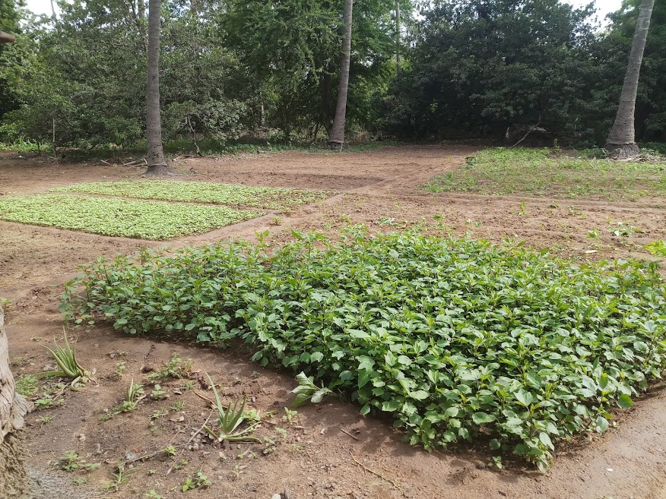
Dilemma of a modern day farmer

Slide 26
Introduction to Security in IoT

Slide 27
Why do we need security in IOT

