Slide 1
Internet of Things
Girish S Kumar
ISQUARED OT LABS (OPC)PVT ltd

Slide 2
What is internet of Things
Internet of Things definition? McKinsey short definition appears quite logic:
Internet of Things = “Sensors and actuators embedded in physical objects are linked through wired and wireless networks, often using the same Internet Protocol (IP) that connects the Internet.“
IoT has yet a wider reach as it also includes connections beyond the industrial context such as wearable devices on people.

Slide 3

How was this term “Things” coined
The term Internet of Things is more than four decade old.. The idea of connected devices had been around for more than four decades when internet was in experimental stage.
The term “Internet of Things” was coined by Kevin Ashton in 1999 during his work at Procter&Gamble. Ashton who was working in supply chain optimization, wanted to attract senior management’s attention to a new exciting technology called RFID. Because the internet was the hottest new trend in 1999 and because it somehow made sense, he called his presentation “Internet of Things”.

Slide 4
Listen to Kevin for few minutes
https://www.techrepublic.com/videos/share/how-the-term-internet-of-things-was-invented
The Internet of Things is not really when your app tells you that your toaster is ready with your toast. Right? We don't care about that. The Internet of Things means a whole range of different sensors that are somehow connected to the internet that are gathering information about the real world that can then be made useful in some way.

Slide 5
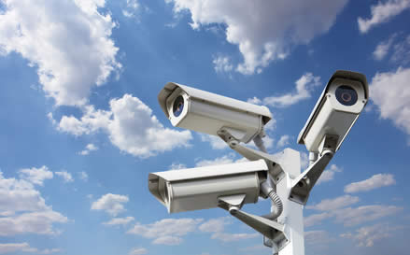
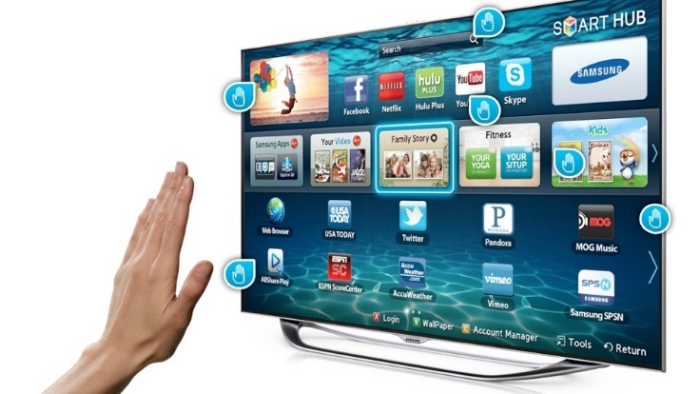
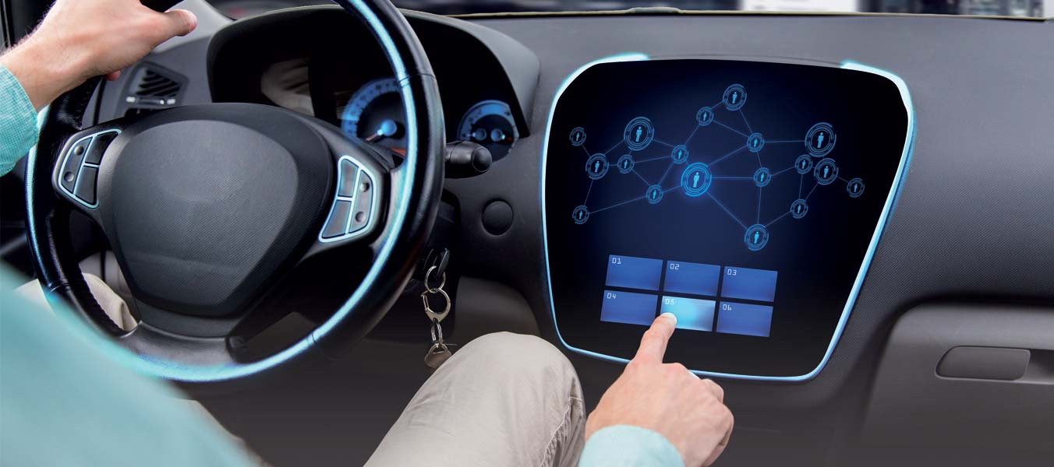
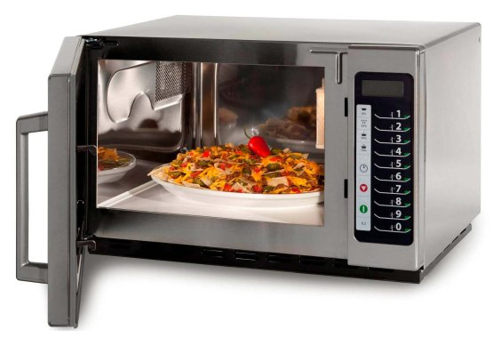

What are embedded computers
When a computer becomes a part of another large system or when computer becomes one of the components of a system we call it as:
Embedded Computer or Embedded system
Laptops, Desktop and servers are not embedded computers.
Computers fixed inside
Automobiles,
Microware oven,
Smart Watches,
Smart phones,
Robots,
Drones,
Smart TVs
Manufacturing Equipment
Washing Machines
Fridges
Digital Camera
Aeronautics

Slide 6
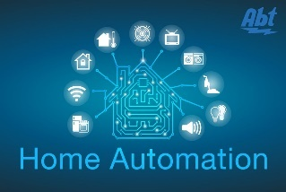
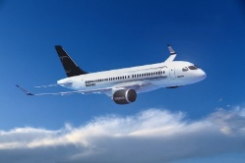


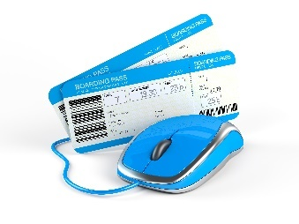
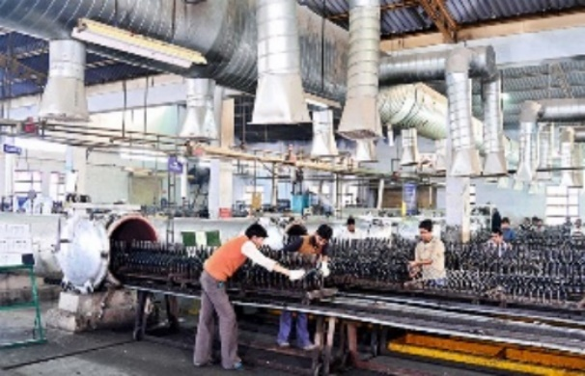

Applications of Iot
IoT devices
Internet Connected Devices
Home based devices
Hospitals &
health care unit
Space and Defence units
Manufacturing Units
Banks and Insurance Companies
Automobiles, Airlines & Aeronautics

Slide 7
Industrial Revolution
Industry 1.0
Around 1760, the First Industrial Revolution was the transition to new manufacturing processes using water and steam.
Industry 2.0
Around 1840, new technological systems were introduced, most notably superior electrical technology which allowed for even greater production and more sophisticated machines.
Industry 4.0
Industry 3.0
Around 1970 the Third Industrial Revolution involved the use of electronics and IT (Information Technology) to further automation in production. – Concept of automation entered industry
Industry 5.0
The Fourth industrial Revolution is the era of smart machines, storage systems and production facilities that can autonomously exchange information, trigger actions and control each other without human intervention.This exchange of information is made possible with the Industrial Internet of things (IIoT) as we know it today.
Industry 5.0 is the revolution in which man and machine reconcile and find ways to work together to improve the means and efficiency of production.

Slide 8

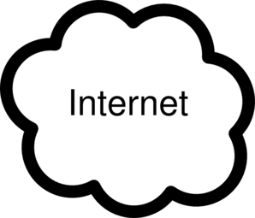
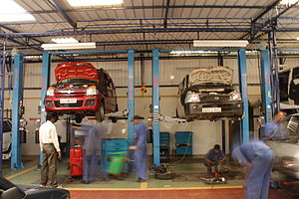
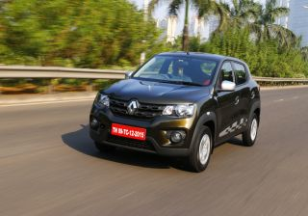
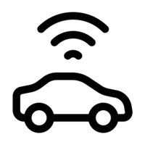
Iot in use (Car develops a fault)
GPS
Satellite
How about having a Uber, Swiggy or Zomata … equivalent for car workshops

Slide 9
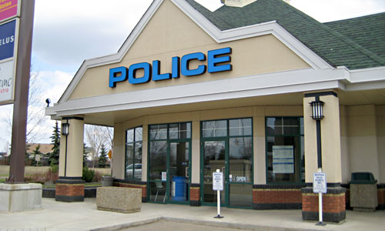

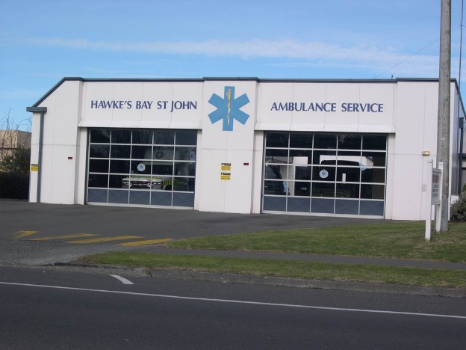
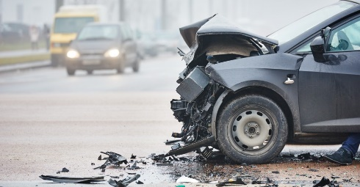

Iot in emergency

Slide 10
embedded computers and Iot
A Question for Discussion
What is the relationship between
Embeded Computers and IoT

Slide 11
History of Iot
1969: Arpanet
Beginnings of TCP/IP
1984: Domain Name System
1989: Tim Berners-Lee proposes the World Wide Web
1990: Considered the first IoT device, John Romkey created a toaster that could be turned on and off over the Internet
The Internet of Things term is coined by Kevin Ashton
1991: The first web page was created by Tim Berners-Lee
2000 LG announces it's first Internet refrigerator plans
2009: The Internet of Things was "Born"
https://www.postscapes.com/iot-history/

Slide 12
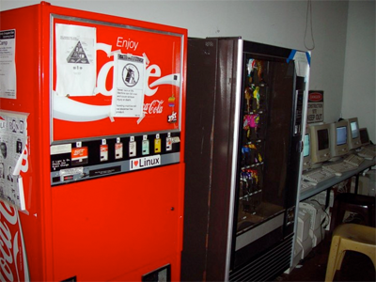
What was the first iot device
One of the first examples of an Internet of Things is from the early 1982s, and was a Coca Cola machine, located at the Carnegie Melon University. Local programmers would connect by Internet to the refrigerated appliance, and check to see if there was a drink available, and if it was cold, before making the trip.

Slide 13
Structure Of Internet

Slide 14
What is aN IP Address
IF we need to send/receive letters of parcels or make and receive phone calls we need we need an address. For parcels and letters we called it mailing address. For phones we call it Phone number or mobile number.
Very similarly for computers to exchange any kind of data they too need a number, similar to mobile number. That is called IP address. It appears in the form 10.30.45.69. Let us discuss how these address are formed.

Slide 15
Internet Protocol Address
Physical Address
Every N/w interface will have a physical address.
This is hardwired into the hardware at the time of manufacture and does not change with time.
IP Address
IP Address is a number which is 32 bit wide.
This is assigned by network administrative system and it can change with time or when the computer moves from one network to another.
This is like the engine/chassis number of an automobile.
This is very similar to the License plate (Registration number of an automobile). Changes every 15 years or when shift from one state to another.

Slide 16
Little more deep into IP address
Every house or building we build on land will two address
Physical address (Defined by Longitude and Latitude) (Cannot Change)
A street address, given by local municipality/corporation (Can change)
Physical address of the house will never change but, the street address can change with the street is renamed or building number assigned by Municipality changes.
Looking at address format we know how a letter/parcel send from a source reaches its destination. IP address also follow a very similar approach to Post office /courier delivery service.
IF you look at the street address of a person there will be following fields
Name: --------------------------
Building No/name: -------------------------
Street no/name: ----------------------------
Post Office no/name: ----------------------
District: ---------------------------------------
State: ----------------------------------------
Country:--------------------------------------

Slide 17
Country level PO
State level PO
District PO
District PO
District PO
State level PO
Area level PO
Area level PO
Area level PO
Delivery Boy-1
Delivery Boy -2
Delivery Boy-3

Slide 18
IP Address
In a similar way in Internet also delivery of packets happens in a hierarchical way.
It the logical address (IP Address) given by network helps for that.
It is not possible to address every computer using physical address. It is like addressing a letter using longitude or latitude. Or trying to track a vehicle using its engine number. When street address is used that problem is solved Exact the same thing happens with IP address. Too.
IP address is just a number which is 32 bit wide. That mean we can have 2 ^ 32 IP Address in the world.
Which means we can only have 4,29,49,67,296 IP address or only that many computers connected to internet. Today we have much more computers that this number connected to Internet. How does that happen
We will discuss this when we talk about NAT.

Slide 19

Hands ON – let us see what is the IP address and Physical address of your laptop
Open a command prompt or power shell on your windows computer
In case you are using Linux open terminal window
Now
C:> ipconfig (On Windows)
$ ifconfig (On Linux)
Open a command prompt or power shell on your windows computer
In case you are using Linux open terminal window
Now
C:> ipconfig /all (On Windows)
$ ifconfig (On Linux)

Slide 20
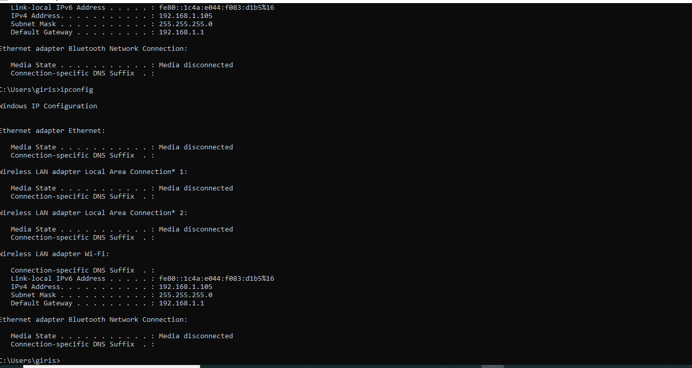

Slide 21
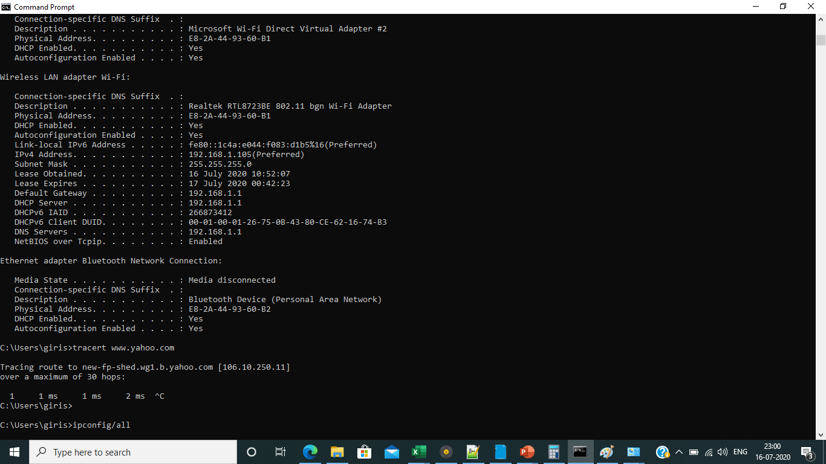

Slide 22
C:\Users\giris>ipconfig/all
Windows IP Configuration
Host Name . . . . . . . . . . . . : DESKTOP-BMPR2EC
Primary Dns Suffix . . . . . . . :
Node Type . . . . . . . . . . . . : Hybrid
IP Routing Enabled. . . . . . . . : No
WINS Proxy Enabled. . . . . . . . : No
Ethernet adapter Ethernet:
Media State . . . . . . . . . . . : Media disconnected
Connection-specific DNS Suffix . :
Description . . . . . . . . . . . : Realtek PCIe FE Family Controller
Physical Address. . . . . . . . . : 80-CE-62-16-74-B3
DHCP Enabled. . . . . . . . . . . : Yes
Autoconfiguration Enabled . . . . : Yes

Slide 23
Wireless LAN adapter Local Area Connection* 1:
Media State . . . . . . . . . . . : Media disconnected
Connection-specific DNS Suffix . :
Description . . . . . . . . . . . : Microsoft Wi-Fi Direct Virtual Adapter
Physical Address. . . . . . . . . : EA-2A-44-93-60-B1
DHCP Enabled. . . . . . . . . . . : Yes
Autoconfiguration Enabled . . . . : Yes
Wireless LAN adapter Local Area Connection* 2:
Media State . . . . . . . . . . . : Media disconnected
Connection-specific DNS Suffix . :
Description . . . . . . . . . . . : Microsoft Wi-Fi Direct Virtual Adapter #2
Physical Address. . . . . . . . . : E8-2A-44-93-60-B1
DHCP Enabled. . . . . . . . . . . : Yes
Autoconfiguration Enabled . . . . : Yes

Slide 24
Wireless LAN adapter Wi-Fi:
Connection-specific DNS Suffix . :
Description . . . . . . . . . . . : Realtek RTL8723BE 802.11 bgn Wi-Fi Adapter
Physical Address. . . . . . . . . : E8-2A-44-93-60-B1
DHCP Enabled. . . . . . . . . . . : Yes
Autoconfiguration Enabled . . . . : Yes
Link-local IPv6 Address . . . . . : fe80::1c4a:e044:f083:d1b5%16(Preferred)
IPv4 Address. . . . . . . . . . . : 192.168.1.105(Preferred)
Subnet Mask . . . . . . . . . . . : 255.255.255.0
Lease Obtained. . . . . . . . . . : 16 July 2020 10:52:07
Lease Expires . . . . . . . . . . : 17 July 2020 00:42:22
Default Gateway . . . . . . . . . : 192.168.1.1
DHCP Server . . . . . . . . . . . : 192.168.1.1
DHCPv6 IAID . . . . . . . . . . . : 266873412
DHCPv6 Client DUID. . . . . . . . : 00-01-00-01-26-75-0B-43-80-CE-62-16-74-B3
DNS Servers . . . . . . . . . . . : 192.168.1.1
NetBIOS over Tcpip. . . . . . . . : Enabled

Slide 25
Ethernet adapter Bluetooth Network Connection:
Media State . . . . . . . . . . . : Media disconnected
Connection-specific DNS Suffix . :
Description . . . . . . . . . . . : Bluetooth Device (Personal Area Network)
Physical Address. . . . . . . . . : E8-2A-44-93-60-B2
DHCP Enabled. . . . . . . . . . . : Yes
Autoconfiguration Enabled . . . . : Yes

Slide 26
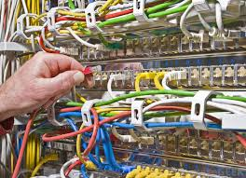
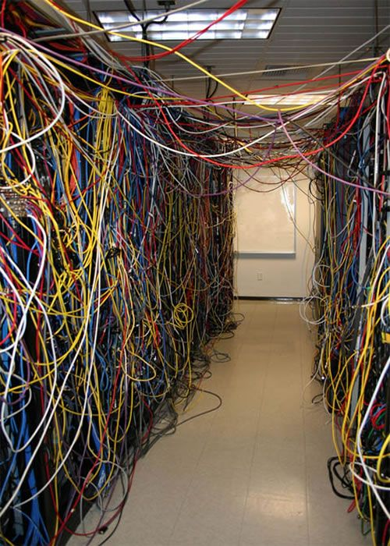
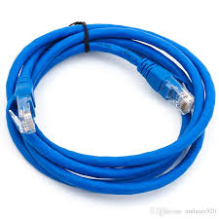
How are computer connected ?

Slide 27
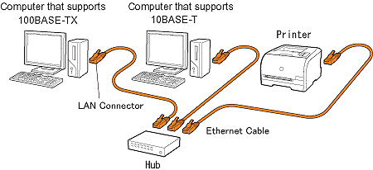
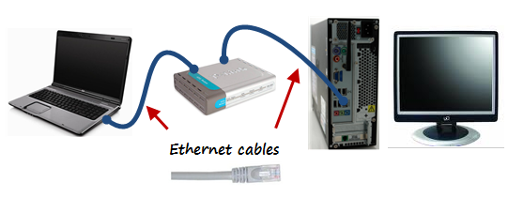

Slide 28
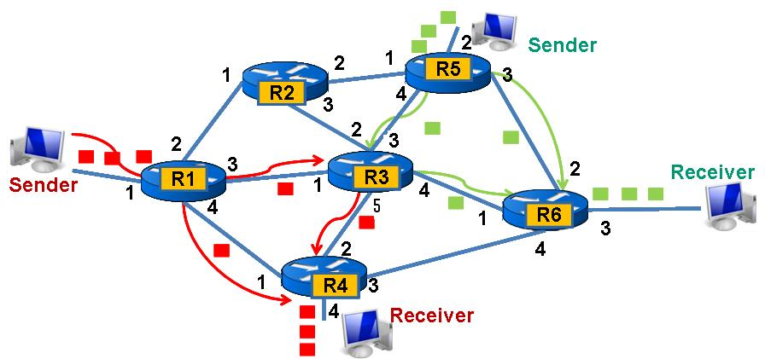
How are computer connected to communicate ?
Post office/courier office
Notes:
Post office model to be discussed before this

Slide 29
Let us do some hands ON
Let us see how your computer is connected to the network and how it communicate with other computers through packets.
Open a command prompt or power shell on your windows computer
In case you are using Linux open terminal window
Now
C:> ping www.yahoo.com
C:> tracert www.yahoo.com

Slide 30
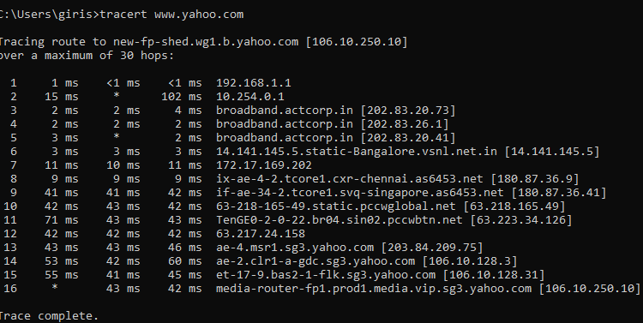
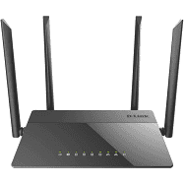
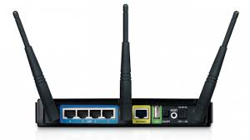
Route Taken by packets to reach yahoo.com
192.168.1.1
10.254.0.1
Home wifi Router

Slide 32
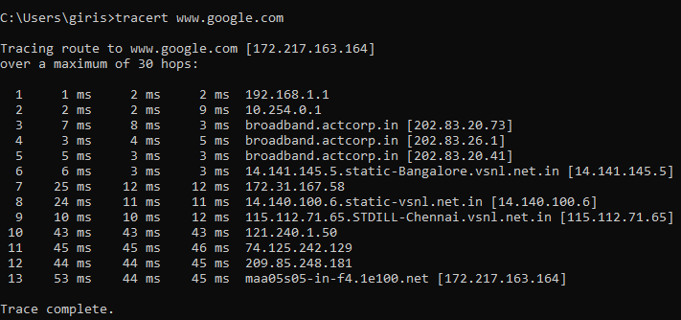
Route Taken by packets to reach google.com

Slide 33
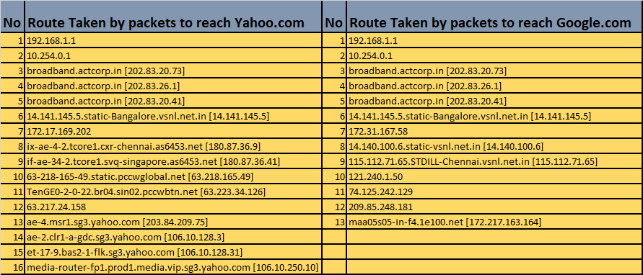

Slide 34
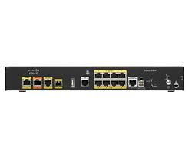
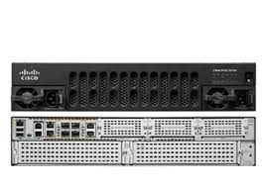

Slide 35
Exercise
1. Go to your command prompt and see what the path packets takes when you access your office/school or shopping portal.
2. Try finding this route to the same portal at different time – Does it change why ?
3.If there is change in route is that justified ?
4. Disconnect the external internet cable from our home router and do a traceroute again what do you see now ?
5. How can you make use of the traceroute command for debugging networks.

Slide 36
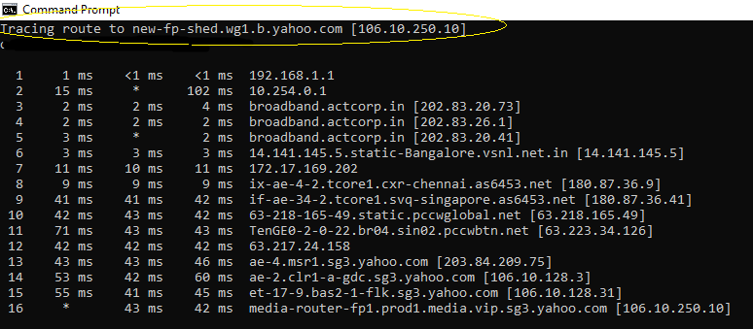
Domain Name

Slide 37
IP ADDRESS Vs names
IP Address are hard to remember but domain names are not.
Routers or switches do NOT understand the term domain name (Eg: www.google.com) they only understand IP address
Domain names are for humans where as IP address for Router and Switches

Slide 38
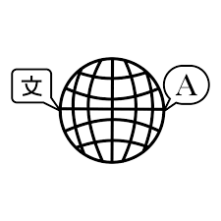
So we need a Translator
www.google.com
172.217.163.164
Translator
Domain Name Server maintains a table of IP address and corresponding domain names
A machine which run a program which does this translation is called Domain Name Server
(DNS Server)

Slide 39
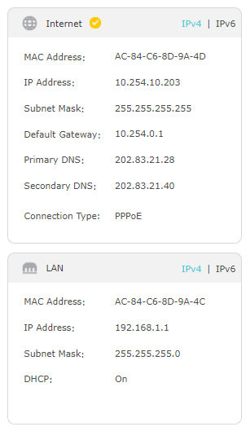

Slide 40
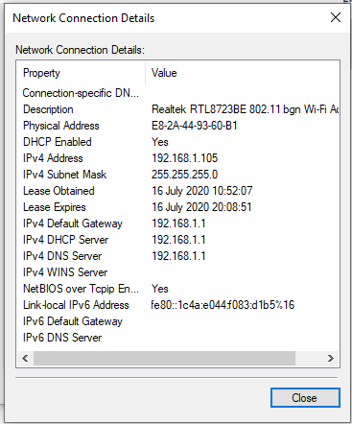

Slide 41
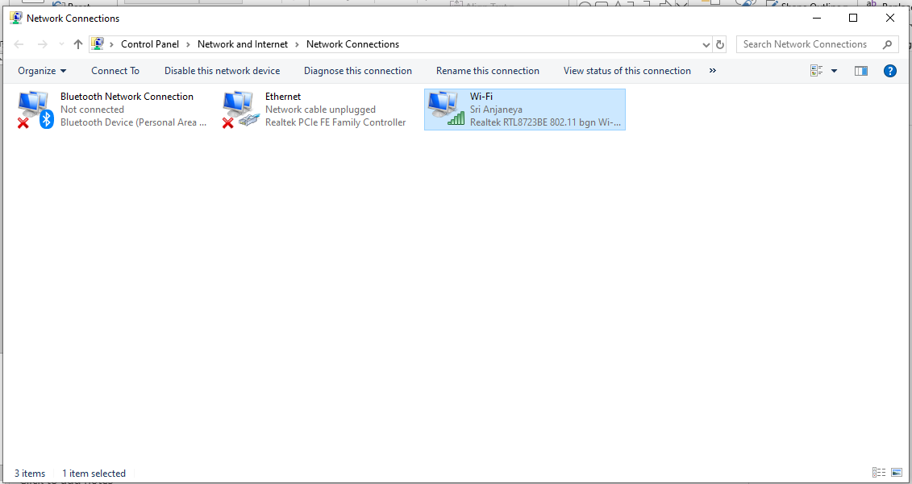
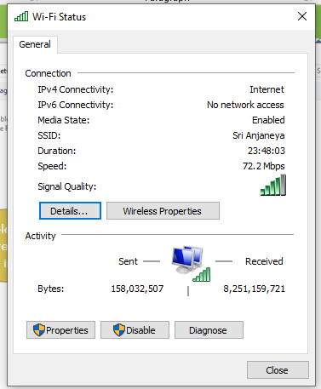
Double click here
Then press the details button in the popup

Slide 42
Exercise
1. Find out about the DNS Server Address configured in your router.
2. Find out the DNS Server Configured in your laptop/desktop
3. Find out the Public DNS Servers
4. How does DNS server receives data about the latest new domain names which are getting created and their corresponding IP address ?
5. Why do we need two DNS servers mentioned ? Primary and Secondary ?
6. What is the meaning of the term Default Gateway
7. Find out the default gateway of your laptop and home router.
8. Do google search for the key word “public dns servers” and find out what you get

Slide 43
Would like to learn hands on Computer networking ?
At the comfort of your home ?
With out investing on costly HARDWARE ?
There two options available for this.
GNS3
Cisco Packet Tracer
Packet Tracer is a network simulator has only limited real equipment features.
Where as GNS3 is a network emulator based on Dynamips and QEMU hardware simulator which uses the real binaries released by Cisco. It is more closer to real world network
The main limitation of GNS3 is the amount of ressources (CPU / memory) available on the PC for running the lab's emulated IOS images and virtual machines for clients & servers simulation.
GNS3 is open source and freely available for download. Runs on Windows and Linux
Google for “GNS3” you will find all the material for your setup a virtual networking lab,on your laptop

Slide 44
Lets do a bit of hands on with DNS
Lets write a simple python script to find the IP address of a computer using Domain name
import socket
hostName = "example.org"
ipAddress = socket.gethostbyname(hostName)
print("IP address of the host name {} is: {}".format(hostName, ipAddress))
C:\Users\giris\Documents\IotTraining\code>python dns.py
IP address of the host name example.org is: 93.184.216.34
C:\Users\giris\Documents\IotTraining\code>

