Slide 1
Internet of Things
Girish S Kumar
ISQUARED OT LABS (OPC)PVT ltd

Slide 2
What is internet of Things
Internet of Things definition? McKinsey short definition appears quite logic:
Internet of Things = “Sensors and actuators embedded in physical objects are linked through wired and wireless networks, often using the same Internet Protocol (IP) that connects the Internet.“
IoT has yet a wider reach as it also includes connections beyond the industrial context such as wearable devices on people.

Slide 3

How was this term “Things” coined
The term Internet of Things is more than four decade old.. The idea of connected devices had been around for more than four decades when internet was in experimental stage.
The term “Internet of Things” was coined by Kevin Ashton in 1999 during his work at Procter&Gamble. Ashton who was working in supply chain optimization, wanted to attract senior management’s attention to a new exciting technology called RFID. Because the internet was the hottest new trend in 1999 and because it somehow made sense, he called his presentation “Internet of Things”.

Slide 4
Listen to Kevin for few minutes
https://www.techrepublic.com/videos/share/how-the-term-internet-of-things-was-invented
The Internet of Things is not really when your app tells you that your toaster is ready with your toast. Right? We don't care about that. The Internet of Things means a whole range of different sensors/devices that are somehow connected to the internet that are gathering information about the real world that can then be made useful in some way.

Slide 5
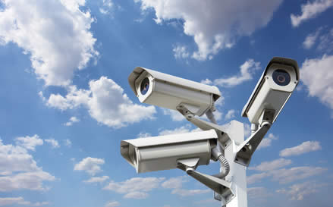
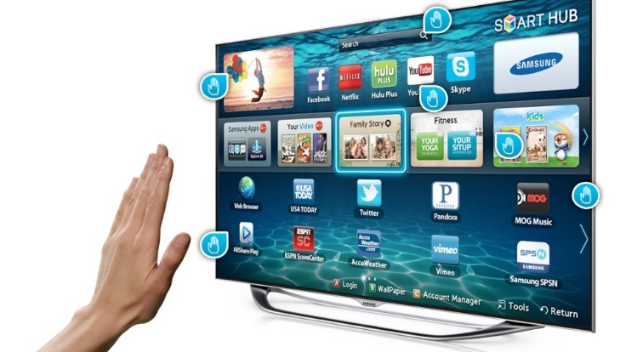
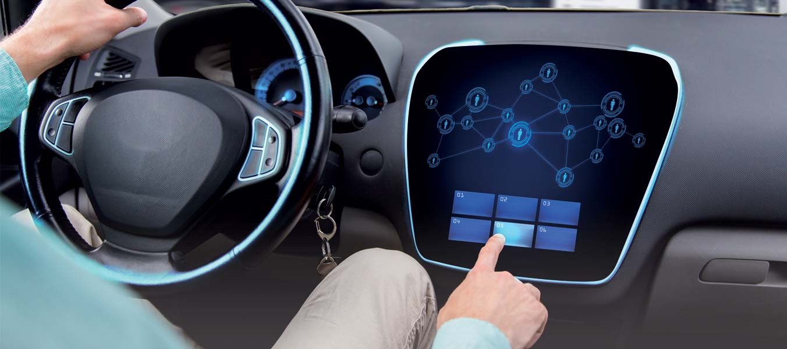
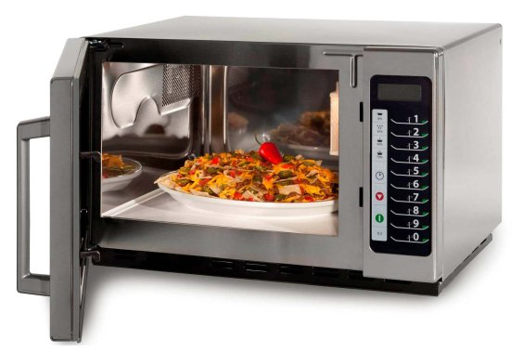

What are embedded computers
When a computer becomes a part of another large system or when computer becomes one of the components of a system we call it as:
Embedded Computer or Embedded system
Laptops, Desktop and servers are not embedded computers.
Computers fixed inside
Automobiles,
Microware oven,
Smart Watches,
Smart phones,
Robots,
Drones,
Smart TVs
Manufacturing Equipment
Washing Machines
Fridges
Digital Camera
Aeronautics

Slide 6
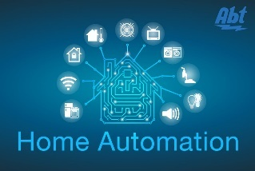


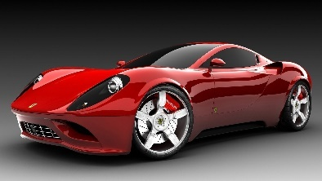
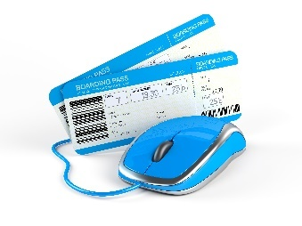
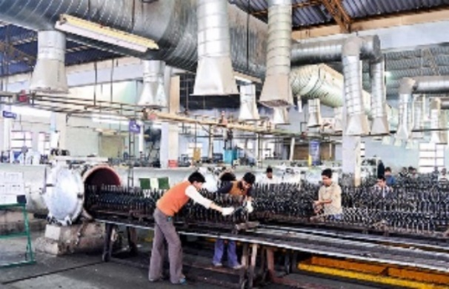

Applications of Iot
IoT devices
Internet Connected Devices
Home based devices
Hospitals &
health care unit
Space and Defence units
Manufacturing Units
Banks and Insurance Companies
Automobiles, Airlines & Aeronautics

Slide 7
Industrial Revolution
Industry 1.0
Around 1760, the First Industrial Revolution was the transition to new manufacturing processes using water and steam.
Industry 2.0
Around 1840, new technological systems were introduced, most notably superior electrical technology which allowed for even greater production and more sophisticated machines.
Industry 4.0
Industry 3.0
Around 1970 the Third Industrial Revolution involved the use of electronics and IT (Information Technology) to further automation in production. – Concept of automation entered industry
Industry 5.0
The Fourth industrial Revolution is the era of smart machines, storage systems and production facilities that can autonomously exchange information, trigger actions and control each other without human intervention.This exchange of information is made possible with the Industrial Internet of things (IIoT) as we know it today.
Industry 5.0 is the revolution in which man and machine reconcile and find ways to work together to improve the means and efficiency of production.

Slide 8


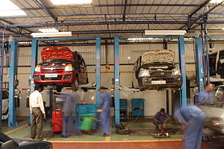
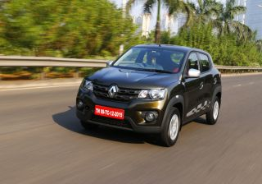
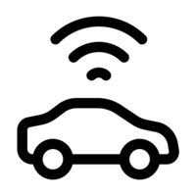
Iot in use (Car develops a fault)
GPS
Satellite
How about having a Uber, Swiggy or Zomata … equivalent for car workshops

Slide 9
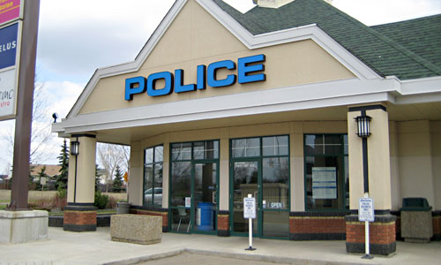


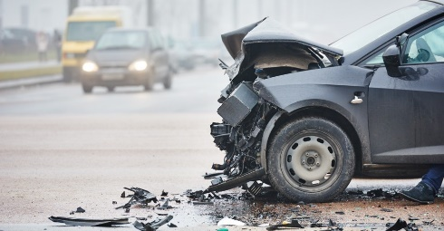

Iot in emergency

Slide 10
embedded computers and Iot
A Question for Discussion
What is the relationship between
Embeded Computers and IoT

Slide 11
History of Iot
1969: Arpanet
Beginnings of TCP/IP
1984: Domain Name System
1989: Tim Berners-Lee proposes the World Wide Web
1990: Considered the first IoT device, John Romkey created a toaster that could be turned on and off over the Internet
The Internet of Things term is coined by Kevin Ashton
1991: The first web page was created by Tim Berners-Lee
2000 LG announces it's first Internet refrigerator plans
2009: The Internet of Things was "Born"
https://www.postscapes.com/iot-history/

Slide 12
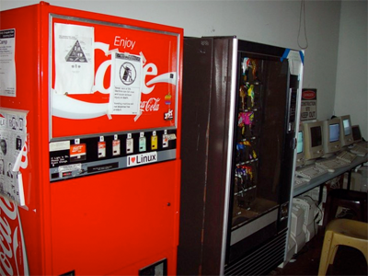
What was the first iot device
One of the first examples of an Internet of Things is from the early 1982s, and was a Coca Cola machine, located at the Carnegie Melon University. Local programmers would connect by Internet to the refrigerated appliance, and check to see if there was a drink available, and if it was cold, before making the trip.

