Slide 1
Cloud computing
Girish s Kumar

Slide 2
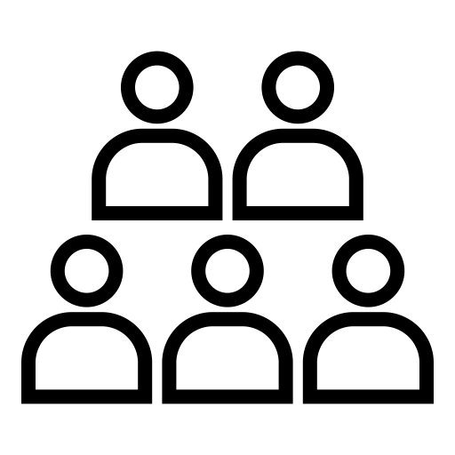

Problem: Computing resource on LEASE
Users who need computers on lease basis
An Entrepreneur, who comes out of a solution

Slide 3
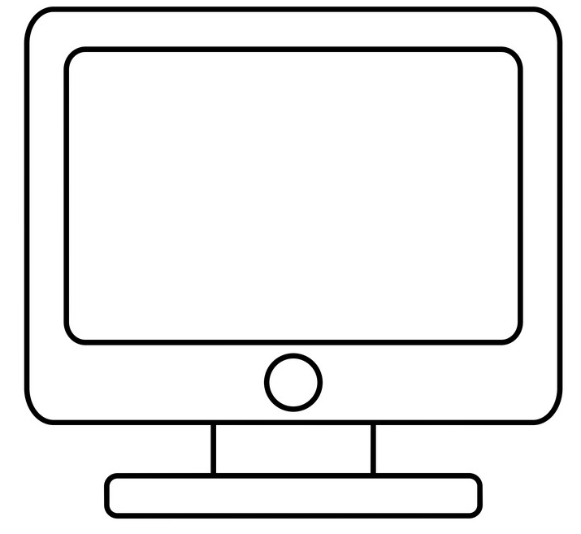
What the Entrepreneur did was…..
A room full of laptops /desktops available for use.
Any one can login to any of these laptops from a remote computer and work on it.
As these laptops/desktops are connected to internet anyone from any where from the login in and work on these.

Slide 4
There are few Challenges with this Model
Key board and Monitor attached to the laptop is not used
Each user will have different resource requirements (memory/CPU/Storage)
Some computers may be used from running memory (RAM) intensive programs where as some others may consume very little memory –resulting in un used RAM. Like this each user/program running on these a laptops/desktop are not used.
When using Isolated machines – usage or resources cannot optimized as they are distributed across various boxes.

Slide 5
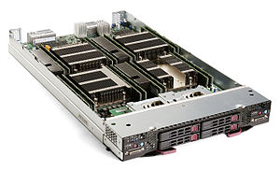
Solution for Problem :1
Blade Server Evolved
Remove the keyboard, mouse and display
Install Operating system
Connect the mother board to network through a cable
Power mother board from a UPS
A blade server is a stripped-down server computer with a modular design optimized to minimize the use of physical space and energy. Blade servers have many components removed to save space, minimize power consumption and other considerations, while still having all the functional components to be considered a computer.

Slide 6
SolutION for problem 2 & 3
RAM Central Pool
Storage Central Pool
CPU Central Pool
These machines can share it

Slide 7
Imagine of a computer where you can install and run multiple operating system ?
Each instance of the operating system behaves like a separate machine with a separate IP ?
Multiple machine on same hardware
That means we need another entity like a schedule to manage these sepearte instance of the OS.

Slide 8
Hypervisor
This entity or the software which let you boot your hardware with multiple operating system and then manage/schedule them is called Hypervisor.

Slide 9
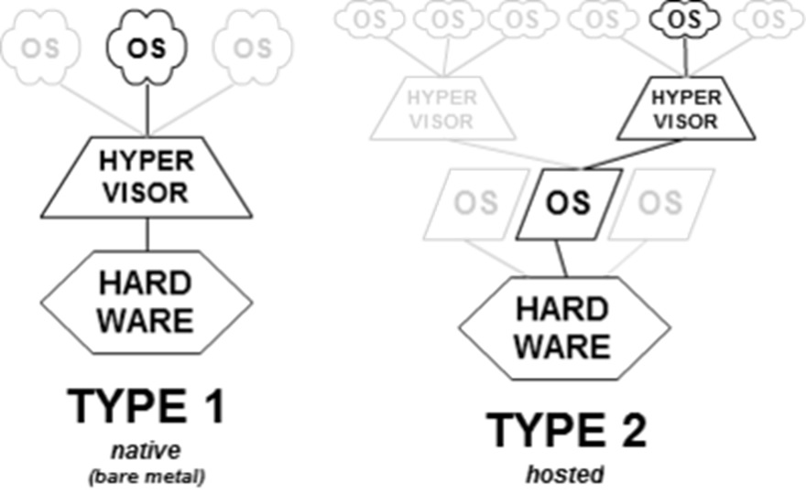

Slide 10
When you run multiple instance of the operating on the same mother board, it is possible for hypervisor to provide the support to share RAM. Storage, CPU across each instance of the OS.
Each of this instance behave like a OS, and each instance is called a Virtual machine.

Slide 11
Entrepreneur found this model very practical to implemented and economical
Resource sharing became very easy to implement.

Slide 12
Can we do Iot without cloud
You can do IoT without cloud,
Cloud is not mandatory for IoT
Such installation of IoT which does not use cloud are called On-Prem installations.

Slide 13
How Is cloud Computing related to Iot
This will be covered while we talk the case study

Slide 14
Development environment
Laptop/Desktop
Raspberry Pi
Amazon Light Sail
Linux Laptop
Programming Language Python/C
ESP32 Development Board

