Slide 1
Real Time Operating System
Girish S Kumar

Slide 2
Course Outline
Introduction to OS and real-time OS
Embedded HW/SW, basics of processor architecture, memory mgt and cache
Processes and threads, SMP, process states
Types of Schedulers, scheduler parameters and scheduler classifications
Scheduling algorithms, FCFS, SJF, RR and priority scheduling
Scheduling algorithms for periodic, aperiodic and sporadic tasks
Fixed and dynamic priority algorithms (RMS, DMS, EDF, LST), MLFQ
Inter-process communication (IPC) and Synchronizations
Semphores, mutex, Semaphores and spinlocks implementation in Linux
Priority inversion, Priority Inheritance and Ceiling protocols (PIP/PCP)
Message queues, pipes, shared memory, signals and events, Deadlocks
Device Drivers and Interrupts
POSIX standard and its role in RTOS
IoT requirements and design of RTOS for IoT systems

Slide 3
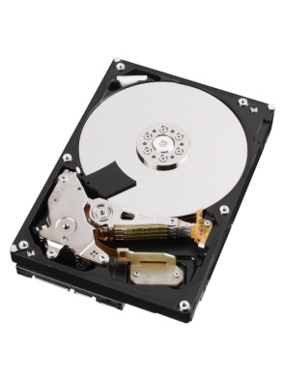


Primary Memory
(RAM)
Instruction
Data Address
Data
Secondary Memory
(Hard Disk)
CPU
Basic Computer Architecture

Slide 4
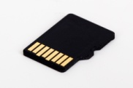
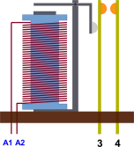
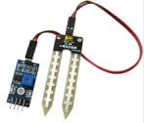



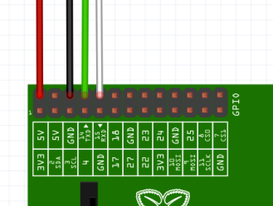


Primary Memory
(RAM)
Secondary Memory
Memory Card (16 GB, 32 GB etc)
Electromagnetic
Relay
Input
CPU
Touch
Screen
LCD (I/O)
Electric
Motor
Ports
Embedded Systems
Network Interface
4

Slide 5



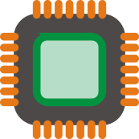
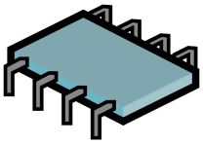
Computer without Operating System
Users
Applications
Software
CPU
Memory
I/O
Hardware

Slide 6
What was the motivation to build an Operating system
Operating System was not build over night to solve a problem instead it evolved to the solve the growing needs to computer industry
Computer can work with out Operating system even today we have computer which work with out OS. Still why an OS evolved ?
For Early day Computer without OS
S/w Developers need to know the H/W in details
They need to take care of everything from memory management, I/O, scheduling ….
Over time s/w developer found that there are lot of module they developed are common across may applications and they can be reused. So developed a layer with all these common modules between h/w and s/w applications, this made life very easy.
Over time this layer which interfaced between h/w and s/w underwent lot of reseach and evolved into a well defined called Operating System.

Slide 7
Evolution of Operating System
1971: Intel announces the microprocessor
1972: IBM comes out with VM: the Virtual Machine Operating System
1973: UNIX 4th Edition is published
1973: Ethernet
1974 The Personal Computer Age begins
1974: Gates and Allen wrote BASIC for the Altair
1976: Apple II
1981: IBM introduces the IBM PC
1983 Microsoft begins work on MS-Windows
1984 Apple Macintosh comes out
1990 Microsoft Windows 3.0 comes out
1991 GNU/Linux
1992 The first Windows virus comes out
1993 Windows NT
2007: iOS
2008: Android OS
1961: The dawn of minicomputers
1962 Compatible Time-Sharing System (CTSS) from MIT
1963 Burroughs Master Control Program (MCP) for the B5000 system
1964: IBM System/360
1960s: Disks become mainstream
1966: Minicomputers get cheaper, more powerful, and really useful
1967-1968: The mouse
1964 and onward: Multics
1969: The UNIX Time-Sharing System from Bell Telephone Laboratories

Slide 8
What is an Operating System
A underlying Computer program which basic hardware-management, software-scheduling and memory management, resource management etc.
It acts as an interface between the user and the computer hardware and controls the execution of all instructions (programs)
Users
Applications
Software
Operating System
CPU
Memory
I/O
Hardware

Slide 9
Functions of a Operating System
Service to applications
CPU Management
Memory Management
Management of attached devices.
File Management.
System performance handling.
Security.
Diagnostics & Error handling.
User Management (in Multi User system)

Slide 10
Operating System
Services to applications
Program Execution
Inter-process Communication
I/O operations

Slide 11
Types of Operating System
Batch operating system
Time Shared Operating System
Distributed Operating System
Real Time Operating System

Slide 12

What is a Real time System
Word Real means : Ability to process events from “Real Word” which is related to a real time clock
Those systems in which the correctness of the system depends not only on the logical result of computation, but also on the definite time limits within which the results are to be produced

Slide 13
Real Time Operating System
There are two types of real time Operating Systems
Hard Real Time
An OS where response time is very critical and it will
very short
Health monitoring devices
Air Craft Control
Weapons, Radar etc
Soft Real Time
An OS where response time is less critical
Multimedia devices
Home entertainment

Slide 14
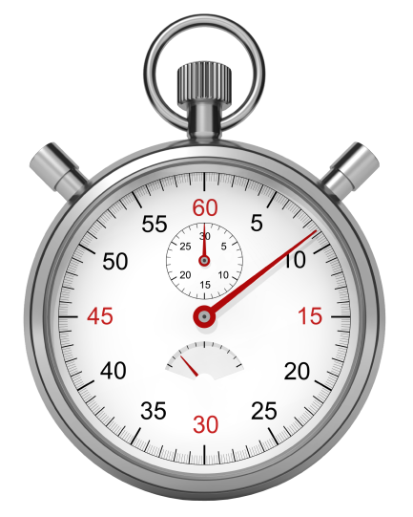
Realization of Real time system
General (Soft in most cases, but can be hard too)
Responds to real time events like
Stock market price which changes in less than sec
Online Train reservation system
Embedded (Usually hard real time)
Patient Monitoring applications
Industrial Plant control
Mobile phone base stations and towers
Weapons
Air Craft Control and Monitoring

Slide 15
QUIZ
In a Real time how small the response time can be ?
How do we fix the response time of a OS
What type of OS is Android ?

Slide 16
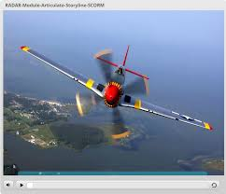
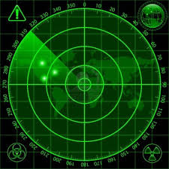
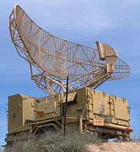
How does a Radar works

Slide 17
List of Real time Operating Systems
No | Name of OS
1 | Andriod
2 | Free RTOS
3 | Debian Linux
4 | Ubuntu
5 | Green Hills Software INTEGRITY
6 | VxWorks from Wind River
7 | QNX Neutrino
8 | Windows CE
9 | TI RTOS

Slide 18
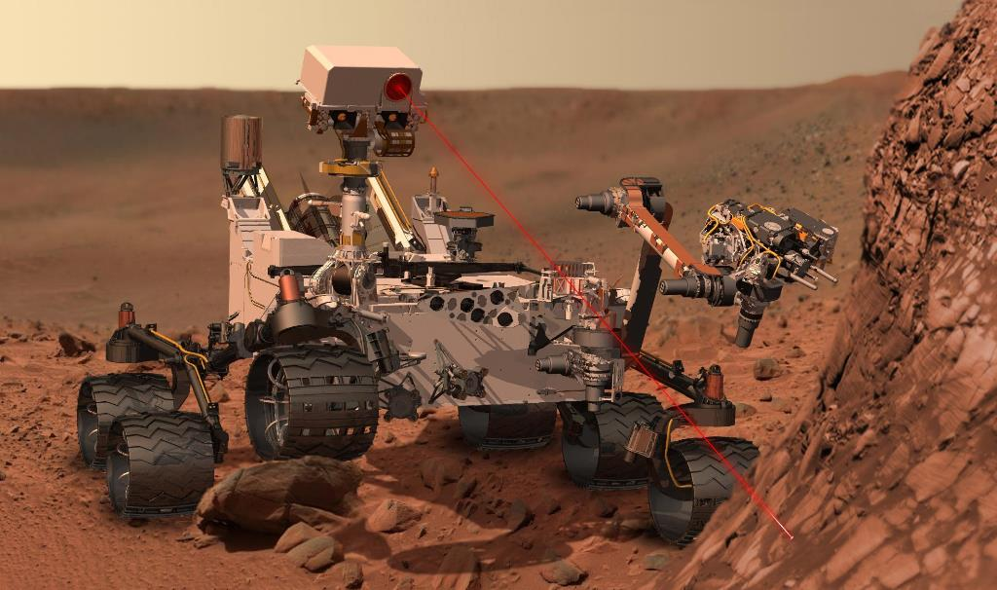
Mars Curiosity Facts
It's running 2.5 million lines of C on a RAD750 processor manufactured by BAE.
The underlying chipset is almost absurdly robust. Its specs may not seem like much at first but it is allowed to have one and only one "blue screen" every 15 years. Bear in mind, this is under bombardment from radiation that would kill a human many times over. In space, robustness wins out over speed. Of course, robustness like that comes at a cost. In this case, it's a cool $200,000 to $500,000.

Slide 19
Real time OS used for Mars Exploration by NASA
Rover (mission, organization, year) | CPUs | RAM | Flash | EEPROM | Operating system | CPU time available for the autonomy software
Sojourner Rover (Pathfinder, NASA, 1997)^{[1][2][3][4]} | 2 MHz^{[5]} Intel 80C85 | 512 KB | 176 KB | None | Custom cyclic executive | Not applicable to Cyclic Executives
Pathfinder Lander (NASA, 1997)^{[1]} (Base station for Sojourner rover) | 20 MHz MFC (IBM RAD6000 Precursor) | 128 MB | None | 6 MB | VxWorks^{[6]}(multitasking) | less than 75%
Spirit and Opportunity (Mars Exploration Rover (MER), NASA, 2004)^{[1]} | 20 MHz BAE RAD6000 | 128 MB | 256 MB | 3 MB | VxWorks (multitasking) | less than 75%
Curiosity (Mars Science Laboratory (MSL), NASA, 2011)^{[1][7][8]} | 200 MHz BAE RAD750 | 256 MB | 2 GB | 256 KB | VxWorks (multitasking) | less than 75%

Slide 20
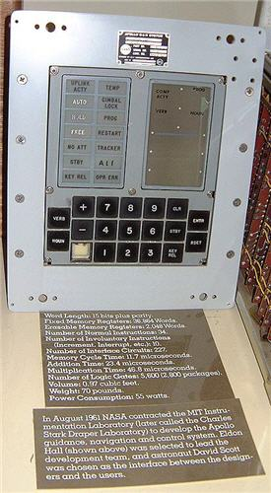
What was the OS used by Apollo -11
The so-called Apollo Guidance Computer (AGC) used a real time operating system,
which enabled astronauts to enter simple commands by typing in pairs of nouns and
verbs, to control the spacecraft. It was more basic than the electronics in modern
toasters that have computer controlled stop/start/defrost buttons.
It had approximately 64Kbyte of memory and operated at 0.043MHz.
The AGC was designed to be fault-tolerant and was able to run several sub programs in priority order. Each of these sub programs was given a time slot to use the computer's sparse resources.
Neil Armstrong asked Mission Control for clarification on the 1202 error. Jack Garman, a computer engineer at NASA, who worked on the Apollo Guidance Program Section, told mission control that the error could be ignored in this instance, which meant the mission could continue. Apollo 11 landed on moon a few seconds later.

Slide 21
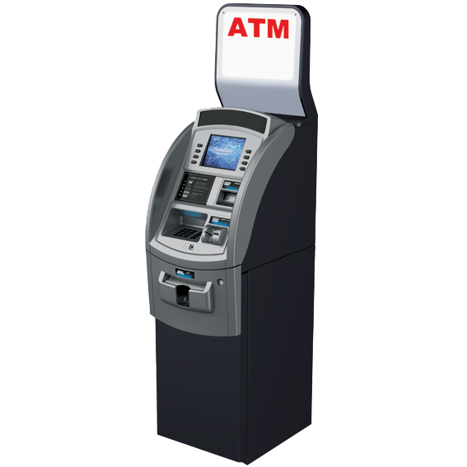
QUIZ
What type of OS is used in
Have you noticed it any time ?

Slide 22
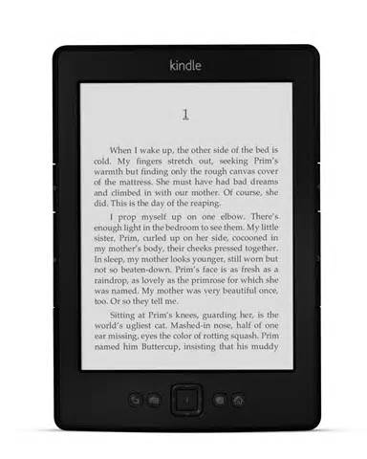
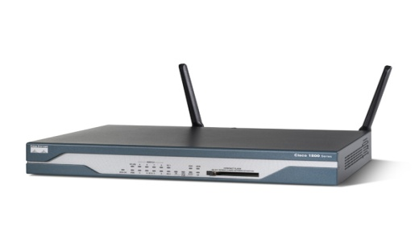
Example of Devices and OS
The Kindle Fire is a tablet computer developed by Amazon.com. Built with Quanta Computer, the Kindle Fire was first released in November 2011, featuring a color 7-inch multi-touch display with IPS technology and running a custom version of Google's Android operating system called Fire OS.
Cisco IOS (originally Internetwork Operating System) is a family of software used on most Cisco Systems routers and current Cisco network switches. (Earlier switches ran CatOS.) IOS is a package of routing, switching, internetworking and telecommunications functions integrated into a multitasking operating system. Although the IOS code base includes a cooperative multitasking kernel, most IOS features have been ported to other kernels such as QNX and Linux for use in Cisco products or simulators such as Cisco VIRL.

Slide 23
Components of OS

Slide 24
Layered Architecture of OS
Shell
Programs
File Management
Input Output
Memory Management
Kernel
Hardware Abstraction Layer (HAL)
Hardware
24

Slide 25
File Management
API
Input Output layer
Shell
Memory Management
Kernel
HW

Slide 26
Program execution
Loads a program into memory.
Executes the program.
Handles program's execution.
Provides a mechanism for process synchronization.
Provides a mechanism for process communication.
Provides a mechanism for deadlock handling.

Slide 27
What is a Process
A process is basically a program in execution. The execution of a process must progress in a sequential fashion.
 | Entity of a process
1 | Object Code- List of instructions for the CPU
2 | Data – Data that needs to be processed by instructions
3 | Resources – Memory, printer etc
4 | Status : New, Ready, Running Waiting, Terminated

Slide 28
A process has four sections
S.N. | Component & Description
1 | Stack The process Stack contains the temporary data such as method/function parameters, return address and local variables.
2 | Heap This is dynamically allocated memory to a process during its run time.
3 | Text This includes the current activity represented by the value of Program Counter and the contents of the processor's registers.
4 | Data This section contains the global and static variables.

Slide 29
How do we create a process
We use the C API
fork() API for this process in Linux
CreateProcess() on Windows

Slide 30
CPU Scheduling
CPU scheduling is a process which allows one process to use the CPU while the execution of another process is on hold(in waiting state) due to unavailability of any resource like I/O etc, thereby making full use of CPU. The aim of CPU scheduling is to make the system efficient, fast and fair.
First Come First Serve(FCFS) Scheduling
Shortest-Job-First(SJF) Scheduling
Priority Scheduling
Round Robin(RR) Scheduling
Multilevel Queue Scheduling

Slide 31
What is a thread ?
A concept created towards multiprocessing
Thread is an execution unit which consists of its own program counter, a stack, and a set of registers. Threads are popular way to improve application through parallelism.
The CPU switches rapidly back and forth among the threads giving illusion that the threads are running in parallel.
As each thread has its own independent resource for process execution, multiple processes can be executed in parallel by increasing number of threads.

Slide 32
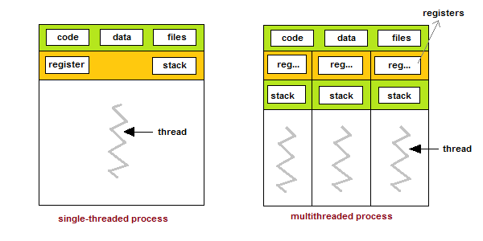
Relation between process and thread
As each thread has its own independent resource for process execution, multiple processes can be executed in parallel by increasing number of threads.

Slide 33
Types of Threads
Threads
Kernel threads are supported within the kernel of the OS itself. All modern OSs support kernel level threads, allowing the kernel to perform multiple simultaneous tasks and/or to service multiple kernel system calls simultaneously.
User threads, are above the kernel and without kernel support. These are the threads that application programmers use in their programs.

Slide 34
How do we create threads
Thread libraries provides programmers with API for creating and managing of threads.
Thread libraries may be implemented either in user space or in kernel space. The user space involves API functions implemented solely within user space, with no kernel support. The kernel space involves system calls, and requires a kernel with thread library support.
POSIX Pitheads, may be provided as either a user or kernel library, as an extension to the POSIX standard.
Win32 threads, are provided as a kernel-level library on Windows systems.
Java threads - Since Java generally runs on a Java Virtual Machine, the implementation of threads is based upon whatever OS and hardware the JVM is running on, i.e. either Pitheads or Win32 threads depending on the system

Slide 35
Inter Process Communication
Process need to exchange data for computing purpose for this most of the Operating systems has implemented the following methods
Signals
Pipe
Sockets
Message Queues
Semaphore
Shared Memory

Slide 36
Why do we create threads
Responsiveness
Resource sharing, hence allowing better utilization of resources.
Economy. Creating and managing threads becomes easier.
Scalability. One thread runs on one CPU. In Multithreaded processes, threads can be distributed over a series of processors to scale.
Context Switching is smooth. Context switching refers to the procedure followed by CPU to change from one task to another.

Slide 37
How does printf() and scanf() works
Shell
Programs
File Management
Input Output
Memory Management
Kernel
Hardware
Copyright Reserved - Do not reproduce
37
37

Slide 38
What is SMP
SMP (symmetric multiprocessing) is the processing of programs by multiple processors that share a common operating system and memory. In symmetric (or "tightly coupled") multiprocessing, the processors share memory and the I/O bus or data path. A single copy of the operating system is in charge of all the processors. SMP, also known as a "shared everything" system, does not usually exceed 16 processors.

Slide 39
Raspberry Pi
Find out what type of processor & OS is used in Raspberry Pi and the

