Slide 1
CMSIS-RTOS a Real Time Operating System

Slide 2
What is KEIL RTX
The Keil RTX is a royalty-free, deterministic Real-Time Operating System designed for ARM and Cortex-M devices. It allows you to create programs that simultaneously perform multiple functions and helps to create applications which are better structured and more easily maintained.

Slide 3
Features of KEIL RTX
Royalty-free, deterministic RTOS with source code
Flexible Scheduling: round-robin, pre-emptive, and collaborative
High-Speed real-time operation with low interrupt latency
Small footprint for resource constrained systems
Unlimited number of tasks each with 254 priority levels
Unlimited number of mailboxes, semaphores, mutex, and timers
Support for multithreading and thread-safe operation
Kernel aware debug support in MDK-ARM
Dialog-based setup using µVision Configuration Wizard
While it is certainly possible to create real-time programs without an RTOS (by executing one or more functions in a Super-loop), there are numerous scheduling, maintenance, and timing issues that an RTOS like the Keil RTX solves for you.

Slide 4
CMSIS-RTOS Keil RTX
CMSIS-RTOS RTX is a royalty-free, (new and improved version of KEIL RTX, )deterministic real-time operating system implementing the CMSIS-RTOS API, a generic RTOS interface for Cortex-M processor-based devices. Keil RTX version 4 implements CMSIS-RTOS v1, whereas Keil RTX 5 implements the latest CMSIS-RTOS v2 API
RTX manages the switching between the activities. Each activity gets a separate thread which executes a specific task and to simplify the program structure. CMSIS-RTOS RTX is scalable and additional threads can be added easily at a later time. Threads have a priority allowing faster execution of time-critical parts of a user application.
CMSIS-RTOS RTX offers services needed in many real-time applications, such as periodical activation of timer functions, memory management, and message exchange between threads with time limits.
The new CMSIS-RTOS API v2 addresses new requirements such as dynamic object creation, support for ARMv8-M, and full support of C++ run-time environments.

Slide 5
CMSIS-RTOS RTX kernel scheduling methods
Pre-emptive - each thread has a different priority and will run until a higher priority thread is ready to run. This is commonly used in interactive systems where a device may be in standby or background mode until some input is sent to it.
Round-Robin - each thread will run for a fixed period of CPU run-time (time slice). Data loggers/system monitors typically employ round-robin scheduling, to sample all sensors or data-sources in turn with no prioritization.
Co-operative - each thread will run until it is told to pass control to another thread or reaches a blocking OS call. Co-operative multi-tasking can be seen in applications that require a fixed order of execution.

Slide 6
Other features
Deterministic Behavior - Known behavior for time critical tasks.
CMSIS-RTOS RTX delivers fully deterministic behavior meaning that events and interrupts
are handled within a predefined time (deadline). Your application can rely on consistent
and known process timings.
Designed for Embedded Systems - Uses the minimum amount of system memory. CMSIS-RTOS RTX is specifically written for applications running on ARM Cortex-M based
MCUs. It runs quickly and requires only minimal MCU resources with a memory footprint
as small as 5KB (ROM).
Source Code - Useful for certification. The source code is included in all MDK editions. Use it if your product requires certification.

Slide 7
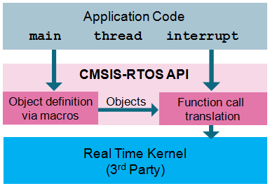
What is CMSIS RTOS API
The CMSIS-RTOS API is a generic RTOS interface for ARM Cortex-M processor-based devices.
CMSIS-RTOS provides a standardized API to access the OS
CMSIS-RTOS provides basic features that are required in many applications
The unified feature set of the CMSIS-RTOS API simplifies sharing of software components and reduces learning efforts.
Middleware components that use the CMSIS-RTOS API are RTOS agnostic. CMSIS-RTOS compliant middleware is easier to adapt.

Slide 8
Now it is time to understand a bit about the CPU and hardware of the computer on which this Real time Operating system is going to run Let us start with a bit or ARM Processor architecture as the computer is based on ARM processor

Slide 9
ARM Processor overview andCortex M4 (ARM Processor Arch slides Intro and Module-4)

Slide 10
Introduction to STM32F Microcontroller

Slide 11
STM32 is a family of 32-bit microcontroller integrated circuits by STMicroelectronics. The STM32 chips are classified as,
Cortex-M7, Cortex-M4F,
Cortex-M3, Cortex-M0+,
Cortex –M3 – Cortex- M4F
Internally, each microcontroller consists of the processor core, static RAM memory, flash memory, debugging interface, and various peripherals.
The STM32 F4-series is the first group of STM32 microcontrollers based on the ARM Cortex-M4F core. The F4-series is also the first STM32 series to have DSP and floating point instructions.

Slide 12
STMF32F407VGT6
Core:
ARM Cortex-M4F core at a clock rate of 84 / 168 / 180 MHz.
Memory:
Static RAM consists of up to 192 KB general purpose,
64 KB core coupled memory (CCM),
4 KB battery-backed,
80 bytes battery-backed with tamper-detection erase.
Flash consists of 512 / 1024 / 2048 KB general purpose,
30 KB system boot,
512 bytes one-time programmable (OTP),
16 option bytes.
Each chip has a factory-programmed 96-bit unique device identifier number.

Slide 13
NO | Feature | No | Feature
1 | Common peripherals are USB 2.0 OTG | 10 | 51 to 140 GPIOs,
2 | CAN 2.0B, SPI + two SPI or full-duplex | 11 | Sixteen DMA,
3 | I²S, three I²C, | 12 | improved real-time clock (RTC),
4 | four USART, | 13 | cyclic redundancy check (CRC) engine,
5 | two UART, SDIO for SD/MMC cards | 14 | random nmber generator (RNG) engine
6 | twelve 16-bit timers, two 32-bit timers | 15 | 8/16-bit external memory bus capabilities
7 | two watchdog timers | 16 | The STM32F4x7 models add ethernet MAC and camera interface.
8 | temperature sensor, | 17 | The STM32F41x/43x models add a cryptographic processor for DES / TDES / AES, and a hash processor for SHA-1 and MD5.
9 | 16 or 24 channels into three ADCs, two DACs, | 18 | , The STM32F4x9 models add a LCD-TFT controller.

Slide 14
STM32F4DISCOVERY board
In this section we will see how this CPU (Microcontroller) STMF32F407VGT6 is fixed on to a PCB and build a small on-board computer which can be used for developing Real time System

Slide 15
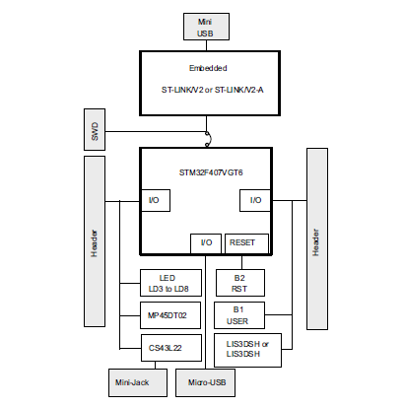
Interface
To laptop
To download
Binaries
General
Purpose
Input and
Output pins
Audio

Slide 16
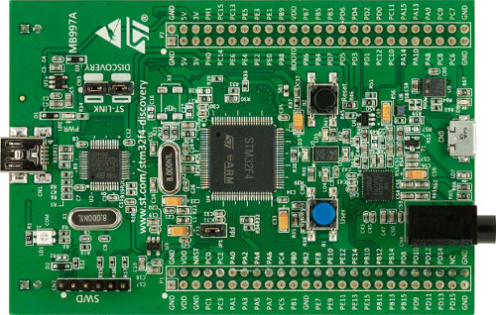
CS43L22

Slide 17
The STM32F4DISCOVERY offers the following features:
STM32F407VGT6 microcontroller featuring 32-bit ARM Cortex® -M4 with FPU core,
1-Mbyte Flash memory,
192-Kbyte RAM
On-board ST-LINK/V2 on STM32F4DISCOVERY or ST-LINK/V2-A
USB ST-LINK with re-enumeration capability and three different interfaces:
Virtual com port (with ST-LINK/V2-A only)
Mass storage (with ST-LINK/V2-A only)
Debug port
Board power supply:
Through USB bus
External power sources:3 V and 5 V
ST MEMS 3-axis accelerometer (LIS302DL or LIS3DSH )
ST MEMS audio sensor omni-directional digital microphone (MP45DT02 )
Audio DAC with integrated class D speaker driver (CS43L22)
Eight LEDs:
LD1 (red/green) for USB communication
LD2 (red) for 3.3 V power on
Four user LEDs, LD3 (orange), LD4 (green), LD5 (red) and LD6 (blue)
2 USB OTG LEDs LD7 (green) VBUS and LD8 (red) over-current
Two push buttons (user and reset)
USB OTG FS with micro-AB connector

Slide 18
CMSIS-RTOS API Structure
A typical CMSIS-RTOS API implementation interfaces to an existing Real-Time Kernel.
The CMSIS-RTOS API provides the following attributes and functionalities:
Function names, identifiers, and parameters are descriptive and easy to understand.
The functions are powerful and flexible which reduces the number of functions exposed to the
user.
Thread Management allows to define, create, and control threads.
Interrupt Service Routines (ISR) can call many CMSIS-RTOS functions. When a CMSIS-RTOS
function cannot be called from ISR context, it rejects the invocation. Three different thread
event types support communication between multiple threads and/or ISR:
Signals: are flags that may be used to signal specific conditions to a thread. Signals can be
modified in an ISR or set from other threads.
Message: is a 32-bit value that can be sent to a thread or an ISR. Messages are buffered in a
queue. The message type and queue size is defined in a descriptor.
Mail: is a fixed-size memory
block that can be sent to a thread or an ISR. Mails are buffered in a queue and memory
allocation is provided. The mail type and queue size is defined in a descriptor.

Slide 19
API Structure
Mutex Management and Semaphore Management are incorporated.
CPU time can be schedule with the following functionalities:
A timeout parameter is incorporated in many CMSIS-RTOS functions to avoid system
lockup. When a timeout is specified, the system waits until a resource is available or an
event occurs. While waiting, other threads are scheduled.
The osDelay function puts a thread into the state WAITING for a specified period of time.
The generic osWait function waits for events that are assigned to a thread.
The osThreadYield provides co-operative thread switching and passes execution to another
thread of the same priority.
The CMSIS-RTOS API is designed to optionally incorporate multi-processor systems and/or
access protection via the Cortex-M Memory Protection Unit (MPU).
In some RTOS implementations threads may execute on different processors and Mail
and Message queues can therefore reside in shard memory resources.

Slide 20
Functional Overview of CMSIS-RTOS
Kernel Information and Control
osKernelInitialize : Initialize the RTOS kernel.
osKernelStart : Start the RTOS kernel.
osKernelRunning : Query if the RTOS kernel is running.
osKernelSysTick $ : Get RTOS kernel system timer counter.
osKernelSysTickFrequency $ : RTOS kernel system timer frequency in Hz.
osKernelSysTickMicroSec $ : Convert microseconds value to RTOS kernel system timer value.
Thread Management
osThreadCreate : Start execution of a thread function.
osThreadTerminate : Stop execution of a thread function.
osThreadYield : Pass execution to next ready thread function.
osThreadGetId : Get the thread identifier to reference this thread.
osThreadSetPriority : Change the execution priority of a thread function. osThreadGetPriority : Obtain the current execution priority of a thread function.

Slide 21
Generic Wait Functions
osDelay : Wait for a specified time.
osWait $ : Wait for any event of the type Signal, Message, or Mail.
Timer Management $
osTimerCreate : Define attributes of the timer callback function.
osTimerStart : Start or restart the timer with a time value.
osTimerStop : Stop the timer.
osTimerDelete : Delete a timer.
Signal Management
osSignalSet : Set signal flags of a thread.
osSignalClear : Reset signal flags of a thread.
osSignalWait : Suspend execution until specific signal flags are set.
Mutex Management $
osMutexCreate : Define and initialize a mutex.
osMutexWait : Obtain a mutex or Wait until it becomes available.
osMutexRelease : Release a mutex.
osMutexDelete : Delete a mutex.
Semaphore Management
osSemaphoreCreate : Define and initialize a semaphore.
osSemaphoreWait : Obtain a semaphore token or Wait until it becomes available.
osSemaphoreRelease : Release a semaphore token.
osSemaphoreDelete : Delete a semaphore.

Slide 22
Memory Pool Management $
osPoolCreate : Define and initialize a fix-size memory pool.
osPoolAlloc : Allocate a memory block.
osPoolCAlloc : Allocate a memory block and zero-set this block.
osPoolFree : Return a memory block to the memory pool.
Message Queue Management $
osMessageCreate : Define and initialize a message queue.
osMessagePut : Put a message into a message queue.
osMessageGet : Get a message or suspend thread execution until message arrives.
Mail Queue Management $
osMailCreate : Define and initialize a mail queue with fix-size memory blocks.
osMailAlloc : Allocate a memory block.
osMailCAlloc : Allocate a memory block and zero-set this block.
osMailPut : Put a memory block into a mail queue.
osMailGet : Get a mail or suspend thread execution until mail arrives.
osMailFree : Return a memory block to the mail queue.

Slide 23
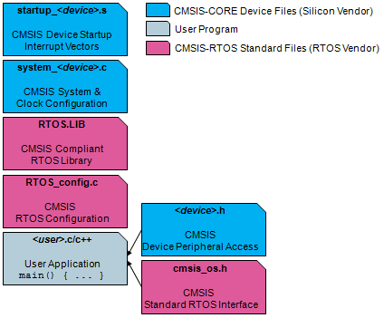
How to use a CMSIS RTOS Implement ation
CMSIS RTOS implementation is typically provided as a library. To add the RTOS functionality to an existing CMSIS-based application the RTOS library (and typically a configuration file) needs to be added. The available functionality of the RTOS library is defined in the file cmsis_os.h that is specific for each RTOS implementation.

Slide 24
Demo of CMSIS RTOS on Discovery Board from ST Microelectronics

Slide 25
CMSIS RTOS Kernel
The basic unit of execution on CMSIS is a thread,
The CMSIS RTOS consists of a
Scheduler
Memory Management service
Interrupt Handling support
Inter Thread communication
Time Management (CLOCK)
Inter Thread communication
Semaphores
Signals
Mutexes
Mailboxes
Message Queues

Slide 26
File Management
API
Input Output layer
Shell
Memory Management
Kernel
HW

Slide 27
CMSIS API
Inter Thread Communication
Interrupt Handling
Memory Management
Scheduler
HW

Slide 28
Scheduler
The RTOS itself consists of a scheduler which supports round-robin, pre-emptive and
co-operative multitasking of program threads

Slide 38
Assumptions behind modeling
Each process is totally self contained, that is not always the case
Example
a process may need a system resource, such as an I/O device or the bus, to complete its work. Scheduling the processes without considering the resources those processes require can cause priority inversion, in which a low-priority process blocks execution of a higher priority process by keeping hold of its resource.

Slide 39
Priority Inversion

Slide 40
Priority Inversion

