Slide 1
Virtual Machines

Slide 2
What is a Virtual Machine
A virtual machine is a software computer that, like a physical computer, runs an operating system and applications. The virtual machine is comprised of a set of specification and configuration files and is backed by the physical resources of a host.
Every virtual machine has virtual devices that provide the same functionality as physical hardware and have additional benefits in terms of portability, manageability, and security.
Specialized software, called a hypervisor, emulates a laptop’s or server's memory, hard disk , network and other hardware resources completely, enabling virtual machines to share the resources. The hypervisor can emulate multiple virtual hardware platforms that are isolated from each other, allowing virtual machines to run Linux and Windows Server operating systems on the same underlying physical host. Virtualization limits costs by reducing the need for physical hardware systems.

Slide 3
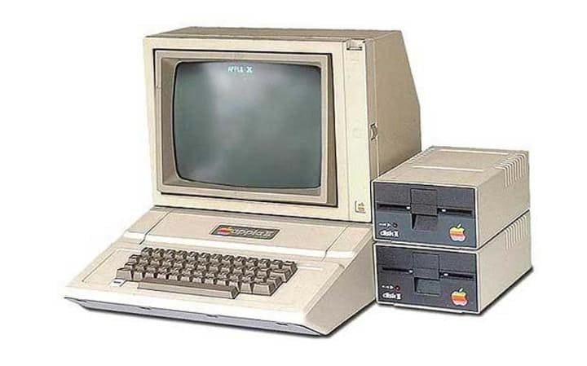
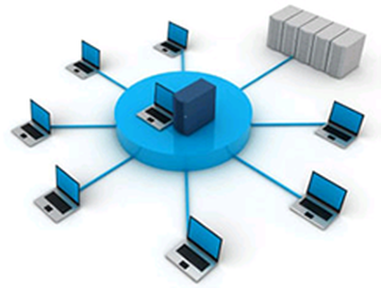
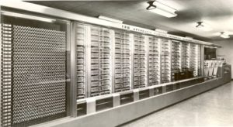
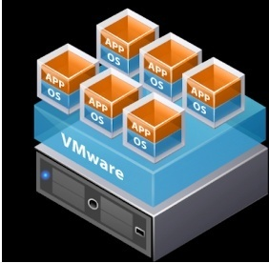
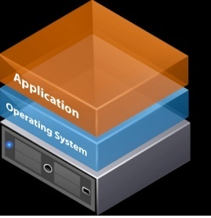

Slide 4
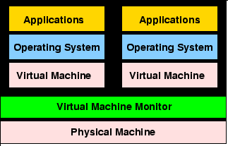

Slide 5
Virtual Machines
The concept of the virtual machine was invented by IBM as a method of time-sharing extremely expensive hardware . A `virtual machine'' is a fully protected and isolated copy of the underlying physical machine's hardware.
Each virtual machine user is given the illusion of having a dedicated physical machine. Software developers can also write and test programs without fear of crashing the physical machine and affecting the other users.
The result of a complete machine virtualization is the creation of a set of virtual computers that runs on a physical computer. Different operating systems, or separate instances of the same operating system, can run in each virtual machine. The operating systems that run in virtual machines are termed guest operating systems.
Virtual machines can also be easily migrated and replicated across machines to aid in service provisioning. Virtual machines can contain identical virtual hardware, even on hosts with different native hardware, making virtual machines freely portable between different physical machines.

Slide 6
Why Virtualization ?
Conventional system software manages hardware resources directly
OS manages the memory, CPU and I/O devices
Sharing of resource such as CPU, Memory, storage etc are only through OS
This means all users should use the same copy of OS
All users are vulnerable to attack from other users sharing the resource as the OS may have security gaps
All these problems are solved using Virtualization

Slide 7
What is Hypervisor
A hypervisor is a piece of software
which abstracts or isolates , operating systems and applications from the underlying computer hardware.
This abstraction allows :
The underlying machine hardware to independently operate one or more virtual machines as guests.
Multiple guest VMs to effectively share the system's physical compute resources, such as processor cycles, memory space, network bandwidth and so on. A hypervisor is sometimes also called a virtual machine monitor.

Slide 8
Types of Hypervisor
Type 1 hypervisors run directly on the system hardware. They are often referred to as a "native" or "bare metal" or "embedded" hypervisors in vendor literature.
Type 2 hypervisors run on a host operating system. When the virtualization movement first began to take off, Type 2 hypervisors were most popular. Administrators could buy the software and install it on a server they already had.
Application
Application
Application
Application
Linux
Windows
Linux
Windows
VM-1
VM2
VM-1
VM2
Bare metal Hypervisor
Type-2 Hypervisor
Hardware
Host Operating System
Hardware

Slide 9
Hypervisors widely used in Industry
No | Hypervisor | Comments
1 | VMware Workstation | robust hypervisor with some advanced features, such as record-and-replay and VM snapshot support. VMware Workstation retails for $189
2 | VMware Player | is a free virtualization hypervisor. This hypervisor technology can only run a single virtual machine (VM) and does not allow you to create VMs.
3 | VMware Server | A free, hosted virtualization hypervisor that’s very similar to VMware Workstation. However, VMware Server lacks some of the features
4 | Microsoft Virtual PC | The latest version of this hypervisor technology, Windows Virtual PC, only runs on Windows 7 and only supports running Windows operating systems on it. A common use case for Virtual PC is running legacy apps on a Windows 7
5 | Oracle VM Virtual Box | A mature virtualization hypervisor that’s suitable for many needs and use cases. Virtual Box hypervisor technology provides reasonable performance and features if you want to virtualize on a budget. Despite being a free, hosted product with a very small footprint, Virtual Box shares many features with VMware vSphere and Microsoft Hyper-V.
6 | Red Hat Enterprise Virtualization | Red Hat’s Kernel-based Virtual Machine (KVM) has qualities of both a hosted and a bare-metal virtualization hypervisor. KVM turns the Linux kernel itself into a hypervisor so VMs have direct access to the physical hardware.
7 | Citrix | XenServer is a comprehensive server virtualization platform with enterprise-class features built in to easily handle different workload types, mixed operating systems and storage or networking configurations.

Slide 10
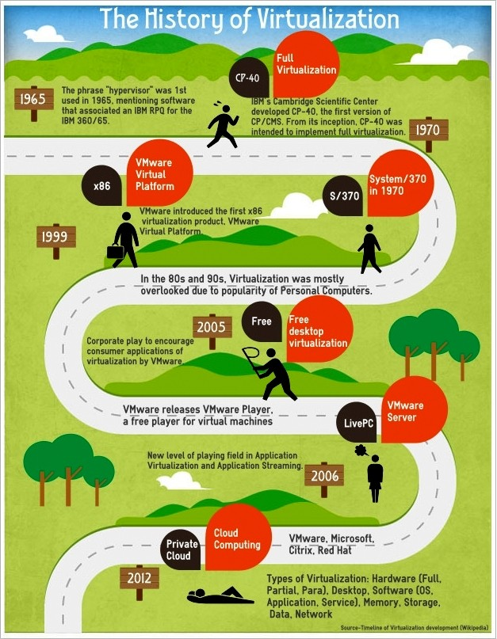
Jim Rymarczyk, who joined IBM as a programmer in the 1960s just as the mainframe giant was invented virtualization.

Slide 11
Components of a Virtual Machine
A virtual machine is a software computer that, like a physical computer, runs an operating system and applications.
Just like a normal computer a VM contains all the components in Virtualized form
Display,
Hard disk - know as virtual hard disk
One or more processors, - (vCPU)
RAM / memory, (vRAM)
CD/DVD drive,
Network adapter, (Virtual network adapter)
USB controller. (USB Controller mapped to one the USB drive on server)
Operating System, Application and software tools.
Operating system cannot distinguish between a Virtual machine and a Physical machine, nor can applications or other computers on a network.

Slide 12
Virtual CPU
A vCPU stands for virtual central processing unit. One or more vCPUs are assigned to every Virtual Machine (VM) within a cloud environment. Each vCPU is seen as a single physical CPU core by the VM’s operating system.
How many vCPU’s can I use on my Virtual Machine (VM)?
The number of vCPUs assigned to your server depends on the amount of load the VM will be under.
What is the equivalent of 1vCPU in physical CPU terms?
A general estimation is that 1 vCPU = 1 Physical CPU Core. However, this is not entirely correct, as the vCPU is made up of time slots across all available physical cores, so in general 1vCPU is actually more powerful than a single core, especially if the physical CPUs have 8 cores.
VMware is designed to allow each VM to use a certain proportion of a core’s clock time using complex sharing algorithms in its “CPU Scheduler”. With an entreprise-grade cloud, if there is not enough CPU resources to go around (e.g. in the unlikely occurrence that the VMs are running vCPUs at 100%), the VMs can be automatically migrated using DRS and vMotion onto another host server which has spare CPU resources.

Slide 13
Virtual Storage (SAN/NAS)
Virtual storage is the pooling of physical storage from multiple network storage devices into what appears to be a single storage device that is managed from a central console
There are two technologies use for creating Virtual storage using a pool of hard disks
Network Access Storage (NAS):Network-attached storage (NAS) is a type of dedicated file storage device that provides local-area network local area network (LAN) nodes with file-based shared storage through a standard Ethernet connection.
Storage Area Network (SAN): A Storage Area Network (SAN) is a specialized, high-speed network that provides block-level network access to storage.
When you set up a Virtual machine on a Laptop or Desktop, it is not mandatory to NAS or SAN always, we can use the regular hard disk as the storage of VM.

Slide 14
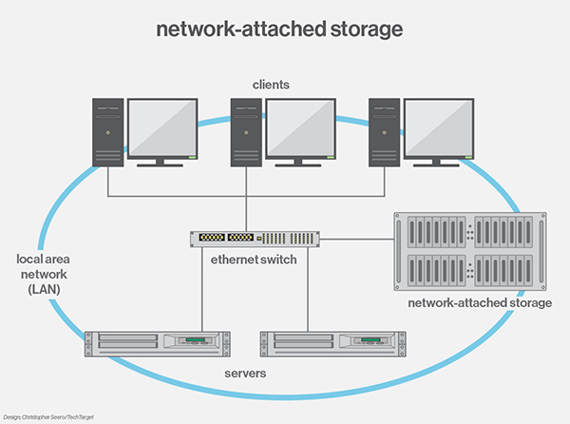
Network Access Storage (NAS):
A NAS device is a computer with an IP address, which do not have a keyboard or display. All configuration and management is done with a browser-based utility program. Each NAS is connected to a LAN as an independent network node.

Slide 15
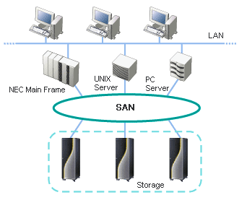
Storage Area Network (SAN)
A Storage Area Network (SAN) is a specialized, high-speed network that provides block-level network access to storage. SANs are typically composed of hosts, switches, storage elements, and storage devices that are interconnected using a variety of technologies, topologies, and protocols. SANs may also span multiple sites.
SANs are often used to:
Improve application availability (e.g., multiple data paths)
Enhance application performance (e.g., off-load storage functions, segregate networks, etc.)
Increase storage utilization and effectiveness (e.g., consolidate storage resources, provide tiered storage, etc.), and improve data protection and security.

Slide 16
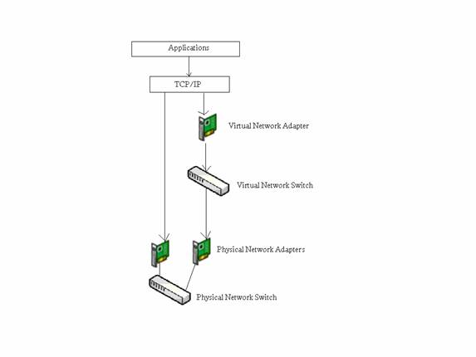
Virtual Network Adapter
A virtual network adapter is a piece of software (instead of a physical network adapter) that
allows a computer to connect to a network. A virtual network adapter can also be used to
connect all the computers on a local area network (LAN) to a larger network such as the
Internet or a collection of LANs.

Slide 17
Disaster Recovery
The technology fundamentally changes the way back-end system resources are accessed and utilized. With regard to DR, a virtualized environment lets users rapidly take snapshots of their servers, desktops and other components and store them on a storage area network (SAN) or other storage media.
These snapshots are part of the virtual environment, which can then be restored to another data center location that has been equipped with virtualization technology. In some cases, environments can be replicated so that no restore is necessary.
Hardware independence :Virtualization allows companies to transform physical servers into virtual machines, which reduces dependency on multiple physical resources.
Increase server portability. Virtual servers are much more portable than physical ones because they essentially become a set of files that companies can copy to tape, DVD, etc. and restore like any other file. In the event of a disaster, files can be loaded onto any server running a compatible hypervisor.

Slide 18
Nearly eliminate planned down time: Planned down time, including hardware maintenance, software updates, etc., typically constitutes 80 to 90 percent of all down time. Virtualization allows users to significantly reduce or eliminate this downtime.
While maintenance is performed on one physical server, employees/users/students can continue to work on their virtual servers that are running elsewhere in the resource pool
Test rapidly and keep it current: Virtualization allows users to take snapshots of their production environments and store them on a storage area network (SAN) or other device/media.
Create virtual desktops: By Configuring an appropriate remote connection to a recovery site, companies can manage virtual desktops from a central data center, and employees can load and access their desktops, as well as the recovery site, from any physical machine.

Slide 19
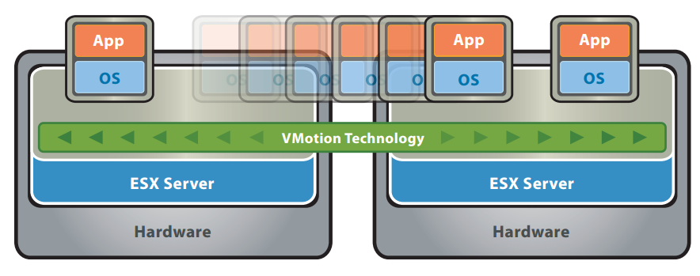
vMotion
vMotion is a term introduced by VMWare, which means Live migration of a virtual machine from one physical server to another

Slide 20
Live migration of a virtual machine from one physical server to another is done with by three underlying technologies.
First, the entire state of a virtual machine is encapsulated by a set of files stored on shared storage such as Fibre Channel or iSCSI Storage Area Network (SAN) or Network Attached Storage (NAS).
VMware’s clustered Virtual Machine File System (VMFS) allows multiple installations of ESX Server to access the same virtual machine files concurrently. Second, the active memory and precise execution state of the virtual machine is rapidly transferred over a high speed network,
Third, the networks being used by the virtual machine are also virtualized by the underlying ESX Server, ensuring that even after the migration, the virtual machine network identity and network connections are preserved. VMotion manages the virtual MAC address as part of the process.

Slide 21
Virtual Machine for Real time applications

Slide 22
Cisco Conferencing server
Cisco Telepresence Server is software that is installed servers within a company network using which users can do audio/video conference, and do content sharing in Real Time from any mobile, desktop, or room system, anywhere. People can meet the way they want—in –one-to-one discussions; in personal, always-on meeting rooms; or in scheduled meetings. Telepresence Servers uses, SIP for call establishment and RTP for media.
Nature of Calls | Cisco Meeting Server 1000*
HD Calls | 96
SD Calls | 192
Audio calls | 3000
http://www.cisco.com/c/dam/en/us/td/docs/voice_ip_comm/uc_system/virtualization/virtualization-cisco-meeting-server.html

Slide 23
Cisco Conferencing server VM Requirements
Component | VM Configuration Requirements
 | vCPU | vRAM | vDISK | vNIC
Call Bridge VM | 4+ (1 vCPU per 1.25 HD ports) | 4+ GB (1 per physical core) | 1 X 100GB | 1
Edge VM | 4 to 8 | 4 to 8GB | 1 X 100GB | 1
Database VM | 8 | 8 GB | 1 X 100GB | 1
Recording VM | min 4, max 32 | 0.5GB per vcpu | 1 X 100GB | 1
Streaming VM | min 4, max 32 | 1GB per vCPU | 1 X 100GB | 1

Slide 24
Real Time JAVA
With the development of Embedded systems and IoT there is lot of demand for machine independent programming, - Write Once and run any where kind of computer programs.
Portability of computers at binary level has become an a need,
a quick development platform where the developer need not have to worry about Garbage collection, and pointers was another requirements .
JAVA meets this requirement. Programming in Java is safer and more reliable by avoiding common coding errors, such as dereferencing stale pointers and trampling memory.
One limitation of traditional JAVA is , it is not developed with real time computing in mind, however it was developed to cater to the needs to data processing, graphics and mobile app development which does not have precise timing requirements.
Such a need was identified long back and JAVA community has come out with specification for a JAVA targeted for Real Time environment.
https://jcp.org/en/jsr/detail?id=1

Slide 25
Real Time JAVA
Specs for Real Time JAVA can be found at http://download.oracle.com/otndocs/jcp/realtime-1.0.2-mrel-spec-oth-JSpec/
Various implementation of Real JAVA compiler and run time environment has come out from companies to support this specification.
Real time JAVA Virtual Machine (Run Time environment) Supports
Feature | Comments
Periodic Scheduling
Priority Based scheduling
Sporadic Task Scheduling | Random task with a fixed dead line
Aperiodic Task Scheduling | Random task No fixed dead line
Importance parameters | additional scheduling metric that may be used by some priority-based scheduling algorithms during overload conditions to differentiate execution order among threads of the same priority
Real Time Threads | Schedulable using the above techniques
Memory Management | Real Time Garbage collector
Process Synchronization
Clocks and Timer | High resolution timers and clocks

Slide 26
Real-Time Java for Internet of Things (IoT), by PTC
PTC Perc Ultra is a Real Time JAVA virtual machine and tool set created for demanding embedded and real-time systems.
The PTC Perc product line offers Ahead-of-Time (AOT) and Just-in-Time (JIT) compilation, remote debug support, deterministic garbage collection, standard graphics and extended commercial RTOS support.
The PTC Perc Ultra Virtual Machine supports
Deterministic Garbage Collection Technology
Virtual Machine solution for multi-core, multi-processor systems
SMP specific Features
Runs multiple Java threads concurrently across all available CPUs/Cores
Supports setting the affinity of CPUs/Cores
New, multi-threaded Garbage Collector
GC is incremental, pre-emptible by higher priority Java threads
Real time response latency of <1ms on x86 1.6GHz+
Support for Linux®/x86, Linux/PPC, and Linux/ARM SMP kernels and popular
multi-core capable RTOS

Slide 27
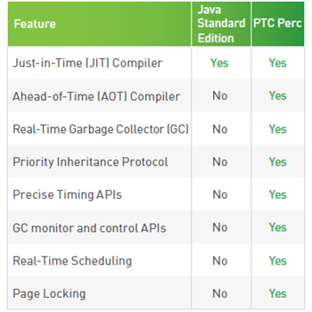
Comparison of PERC with Java Standard Edition

Slide 28
PTC Perc
PTC Perc supports Just-in-Time (JIT) compilation of Java byte codes to native code but adds an Ahead-ofTime (AOT) compiler that allows developers to precompile their applications and Java libraries to native code and link them into the PTC Perc Virtual Machine just like a C/C++ toolchain. This avoids unpredictable Just In Time delays
PTC Perc uses a patented real-time garbage collection algorithm that allows high priority threads to interrupt GC activity at any time to perform time-critical tasks.
PTC Perc implements the Priority Inheritance Protocol when threads contend for shared locks, thereby preventing the priority inversions that can occur in traditional Java SE.
Additional Timing APIs in PTC Perc permit developers to schedule jitter-free periodic tasks, sleeps, or waits.
The PTC Perc VM lets the user set the priority and timing parameters of the garbage collector to control when it runs and how much CPU time it is allowed to consume in relation to Java threads. On SMP processors, multiple GC worker threads run concurrently with Java threads and the user can assign which cores are to be used for GC, thus reserving cores only for Java.

Slide 29
PTC Perc
PTC Perc allows the user to set real-time scheduling policies in Linux to avoid preemption by other processes. The real-time priorities supersede all normal threads.
And the PTC Perc VM can be configured to lock all memory pages into physical RAM rather than wait for page faults to occur. These features and others make PTC Perc a robust, real-time Java solution.

Slide 30
References
http://www.ptc.com/developer-tools/perc
http://www.oracle.com/technetwork/articles/java/nilsen-realtime-pt1-2264405.html
http://download.oracle.com/otndocs/jcp/realtime-1.0.2-mrel-spec-oth-JSpec/

Slide 31


Virtual Machines and cloud computing
A cloud is built up of numerous physical machines (the hardware). Each of these machines then run multiple virtual machines, which is what are presented to the end-users.
Virtual machines are only limited in the way that their specifications cannot exceed that of their host (the underlying physical machine).

Slide 32
Real time applications on Cloud
Today’s public cloud is not yet ready for deliver the real time performance which is comparable to an embedded system, - This is just due to various factors like network delay and other factors of cloud.
However today’s cloud based system can provide close or near to real time experience were dead line is of the order of seconds not milliseconds
Google maps which display the position of your car in real time is a good example
Many of the Video streaming sites are based on cloud computing
Search engines

Slide 33
Future of Real Time System
Embedded Real time system (Mainly for Hard Real time for mission critical applications)
Host based Real time Systems (For both Hard and soft real time – But not mission critical)
Web Based Real time System - (WEB RTC for web based real time apps)
Cloud Based Real time system – Soft real time system which needs scalability
Machine independent Real time system based on JAVA – (For IoT applications which needs timing accuracy of the order of millisecs)

