Slide 1
Memory Management

Slide 2
Memory Technologies
Static RAM (SRAM)
Memory cell is implemented using six-transistor circuit, stores a bit.
Data is erased only when powered off
Much faster
Expensive , compared to other technologies like DRAM
Immune to electrical disturbances
Used in Cache Memories
Dynamic RAM (SRAM)
Much slower, implementation, uses capacitors and transistors.
Needs Periodic Refresh (every 100ms)
Less Expensive than SRAM
Not immune to electrical disturbances
Used in Main Memories

Slide 3
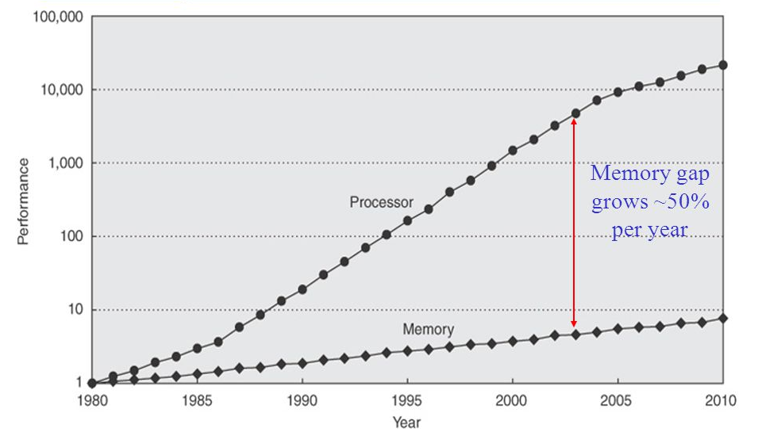
CPU-DRAM Performance Gap
Intel and ARM are coming out with faster and faster CPU every year, faster the CPU means, the memory access time need to catch up with that, otherwise the CPU cannot perform at the expected speeds. However the memory technologies are not moving at the same speed that of CPU, hence there is performance gap between the CPU performance and memory access time

Slide 4
How do Solve this problem of memory Gap (Memory Wall)

Slide 5
What do you do when you are Hungry
Option | Action | Latency | Associated Cost/Effort
1 | Refrigerator or food cupboard | One minute | Faster, but need to maintain the needed food and electricity charges. Choice depends on commonly used items
2 | Go to Local Food Shop | 20-30 Minutes | Takes time and effort to go travel to shop, cost efficient than option-1 Choice wider, but limited to what is there is Food shop.
3 | Go to Market buy ingredients and cook | Hours | Most of cost efficient option but needs effort and advance planning. Choice is very wide, you can have anything. Not the best option when you are Hungry.
This is exactly done solve the gap between memory speed and CPU speed.

Slide 6
Memory Hierarchy
Goals
To create an illusion of “fast and large” main memory
As fast as a small SRAM-based memory
As large (and cheap) as DRAM-based memory
To provide CPU with necessary data and instructions as quickly as possible
Frequently Used Data is kept in a small memory called Cache which is SRAM based
When CPU finds its data in cache, we call it “Cache Hit”
When CPU does not finds its data in cache, we call it “Cache Miss”
Cache hit rate = No of Cache Hits/No of time Cache is accessed
Avg. mem. access lat. (AMAL) = cache hit time + (1 – cache hit rate) * miss penalty
Cache helps reduce bandwidth pressure on memory bus

Slide 7

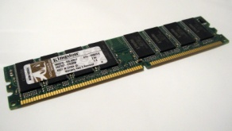
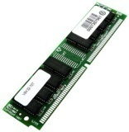
Cache Operations
&A[0]
Get A[0]
Data
Data

Slide 8
Read & Write Cache Operation
CPU Cache Operations
Main Memory Cache Operations
CPU: Read request
Cache: hit: provide data
Cache: miss, talk to main memory, hold CPU until data arrives; fill cache (if needed, kick out old data); provide data •
CPU: Write request
Cache: hit, update data Cache: miss, put data in a buffer (pretend data is written); let CPU proceed
Cache: Read request Memory: provide data •Cache: Write request Memory: update memory

Slide 9
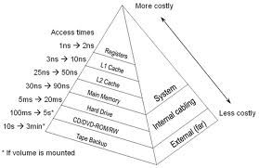
Memory Hierarchy
On-Chip
On-Chip or off-chip

Slide 10
Principle of locality
• Temporal locality If the location A is accessed now, it’ll be accessed again soon
• Spatial locality If the location A is accessed now, the location nearby (e.g., A+1) will be accessed soon

Slide 11
Which block to keep in cache and which block not to keep
Goal: minimize total Cache misses
Trivial in a direct-mapped cache
N choices in N-way associative cache
What is the block that need to be kept in cache
MRU (most remotely used) is considered optimal
This is an oracle scheme – we do not know the future
Which is the block that need to be replaced
LRU (least recently used) – look at the past to predict the future
FIFO (first in first out) – honor the new ones
Random – don’t remember anything
Cost-based – what is the cost (e.g., latency) of bringing this block again?

Slide 12
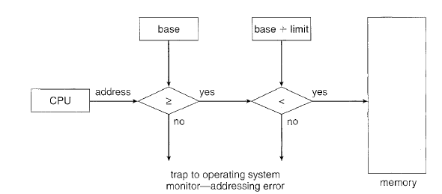
Memory protection
In a Multi-programming environment
There will be multiple process running, each process has a address range of 4GB (typical)
We need to make sure that memory area allocated to each process remains private to itself and no other process access it
Some kind of virtual fence need to created to protect memory spaces.
This is done using two registers called the base and limit registers for every process
Each address generated is validated against this number before accessing memory
This feature is usually implemented in Hardware, for better efficiency.

Slide 13
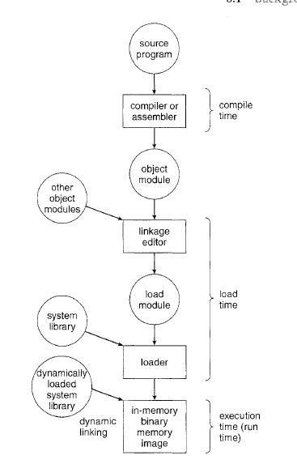
Address Binding
Address in computer program stored in disk does not always maps to real or “Physical address”, instead it will be symbolic links. Which are over written by real address during
Load time or Run Time
In some OS this is done during compile time, in such a case the executable will contain physical address

Slide 14
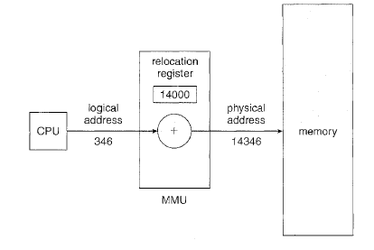
Logical versus Physical Address Space
An address generated by the CPU is commonly referred to as a Logical address
whereas an address seen by the memory unit-that is, the one loaded into memory address register of the memory-is commonly referred to as a Physical address
The run-time mapping from virtual to physical addresses is done by a hardware device called the We can choose from many different methods to accomplish such mapping,

