Slide 1
Memory Management

Slide 2
Memory Technologies
Static RAM (SRAM)
Memory cell is implemented using six-transistor circuit, stores a bit.
Data is erased only when powered off
Much faster
Expensive , compared to other technologies like DRAM
Immune to electrical disturbances
Used in Cache Memories
Dynamic RAM (SRAM)
Much slower, implementation, uses capacitors and transistors.
Needs Periodic Refresh (every 100ms)
Less Expensive than SRAM
Not immune to electrical disturbances
Used in Main Memories

Slide 3
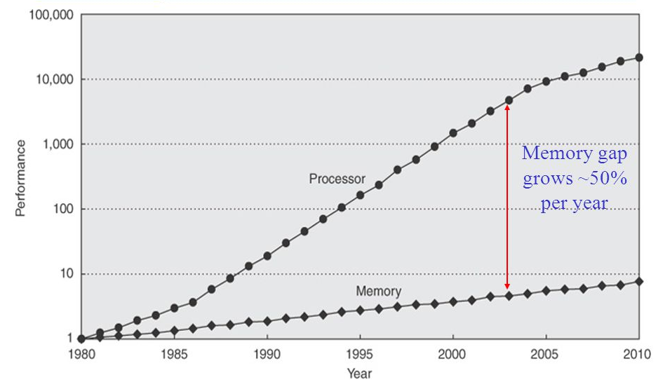
CPU-DRAM Performance Gap
Intel and ARM are coming out with faster and faster CPU every year, faster the CPU means, the memory access time need to catch up with that, otherwise the CPU cannot perform at the expected speeds. However the memory technologies are not moving at the same speed that of CPU, hence there is performance gap between the CPU performance and memory access time

Slide 4
How do Solve this problem of memory Gap (Memory Wall)

Slide 5
What do you do when you are Hungry
Option | Action | Latency | Associated Cost/Effort
1 | Refrigerator or food cupboard | One minute | Faster, but need to maintain the needed food and electricity charges. Choice depends on commonly used items
2 | Go to Local Food Shop | 20-30 Minutes | Takes time and effort to go travel to shop, cost efficient than option-1 Choice wider, but limited to what is there is Food shop.
3 | Go to Market buy ingredients and cook | Hours | Most of cost efficient option but needs effort and advance planning. Choice is very wide, you can have anything. Not the best option when you are Hungry.
This is exactly done solve the gap between memory speed and CPU speed.

Slide 6
Memory Hierarchy
Goals
To create an illusion of “fast and large” main memory
As fast as a small SRAM-based memory
As large (and cheap) as DRAM-based memory
To provide CPU with necessary data and instructions as quickly as possible
Frequently Used Data is kept in a small memory called Cache which is SRAM based
When CPU finds its data in cache, we call it “Cache Hit”
When CPU does not finds its data in cache, we call it “Cache Miss”
Cache hit rate = No of Cache Hits/No of time Cache is accessed
Avg. mem. access lat. (AMAL) = cache hit time + (1 – cache hit rate) * miss penalty
Cache helps reduce bandwidth pressure on memory bus

Slide 7

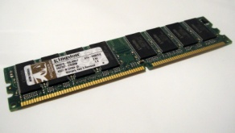
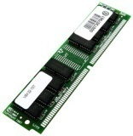
Cache Operations
&A[0]
Get A[0]
Data
Data

Slide 8
Read & Write Cache Operation
CPU Cache Operations
Main Memory Cache Operations
CPU: Read request
Cache: hit: provide data
Cache: miss, talk to main memory, hold CPU until data arrives; fill cache (if needed, kick out old data); provide data •
CPU: Write request
Cache: hit, update data Cache: miss, put data in a buffer (pretend data is written); let CPU proceed
Cache: Read request Memory: provide data •Cache: Write request Memory: update memory

Slide 9
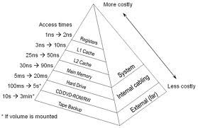
Memory Hierarchy
On-Chip
L1 cache holds cache lines retrieved from the L2 cache memory.
On-Chip or off-chip
L2 cache holds cache lines retrieved from main memory.

Slide 10
Principle of locality
• Temporal locality If the location A is accessed now, it’ll be accessed again soon
• Spatial locality If the location A is accessed now, the location nearby (e.g., A+1) will be accessed soon

Slide 11
Which block to keep in cache and which block not to keep
Goal: minimize total Cache misses
Trivial in a direct-mapped cache
N choices in N-way associative cache
What is the block that need to be kept in cache
MRU (most remotely used) is considered optimal
This is an oracle scheme – we do not know the future
Which is the block that need to be replaced
LRU (least recently used) – look at the past to predict the future
FIFO (first in first out) – honor the new ones
Random – don’t remember anything
Cost-based – what is the cost (e.g., latency) of bringing this block again?

Slide 12
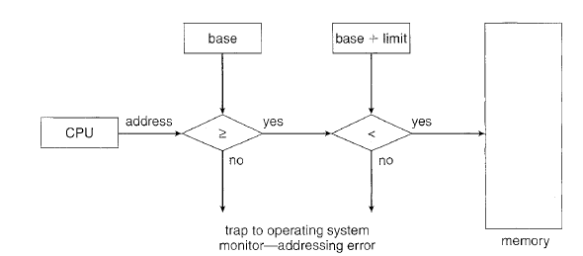
Memory protection
In a Multi-programming environment
There will be multiple process running, each process has a address range of 4GB (typical)
We need to make sure that memory area allocated to each process remains private to itself and no other process access it
Some kind of virtual fence need to created to protect memory spaces.
This is done using two registers called the base and limit registers for every process
Each address generated is validated against this number before accessing memory
This feature is usually implemented in Hardware, for better efficiency.

Slide 13
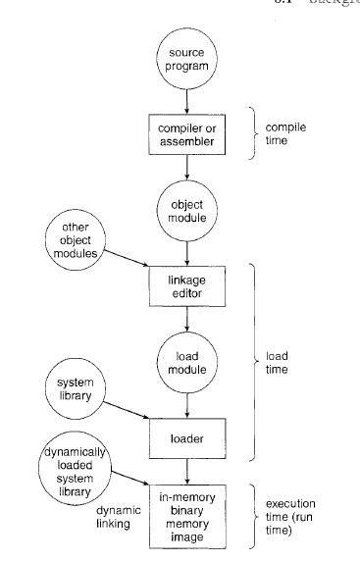
Address Binding
Address in computer program stored in disk does not always maps to real or “Physical address”, instead it will be symbolic links. Which are over written by real address during
Load time or Run Time
In some OS this is done during compile time, in such a case the executable will contain physical address

Slide 14
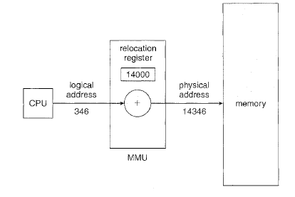
Logical versus Physical Address Space
An address generated by the CPU is commonly referred to as a Logical address whereas an address seen by the memory unit-that is, the one loaded into memory address register of the memory-is commonly referred to as a Physical address
The run-time mapping from virtual to physical addresses is done by a hardware device called the We can choose from many different methods to accomplish such mapping,
The user program never sees the real physical addresses. The user program generates only logical addresses
and thinks that the process runs in locations 0 to max address
The concept of a logical address space that is bound to a separate physical
address space is central to proper memory management.

Slide 15
Dynamic Loading
In reality there is no need to load the entire program from Disk/secondary storage to the main memory. Only the needed portion has to be loaded into the memory. This way we can get better memory utilization.
The advantage of this approach is the unused portion of the program is never loaded into the memory. Whenever a routine is called and the code corresponding to it is not there in the memory, it is loaded by OS and executed (What happens to real time experience ?)
The main program is loaded into memory and is executed. When a routine needs to call another routine, the calling routine first checks to see whether the other routine has been loaded. If it has not, the re-locatable linking loader is called to load the desired routine into memory and to update the program's address tables to reflect this change. Then control is passed to the newly loaded routine.
Almost all the OS supports this feature, however it is up to the programmer to implement this feature to the program to get better memory utilization.
Microsoft Windows has API to load DLL into the memory before calling a routine.

Slide 16
#include <stdlib.h>
#include <stdio.h>
#include <dlfcn.h>
int main(int argc, char **argv)
{
void *handle;
double (*cosine)(double); /* Function pointer */
char *error;
handle = dlopen ("/lib/libm.so.6", RTLD_LAZY);
if (!handle)
{
fputs (dlerror(), stderr);
exit(1);
}
cosine = dlsym(handle, "cos");
if ((error = dlerror()) != NULL)
{
fputs(error, stderr);
exit(1);
}
printf ("%f\n", (*cosine)(2.0));
dlclose(handle);
}

Slide 17
The dlopen function opens a library and prepares it for use.
void * dlopen(const char *filename, int flag);
If filename begins with ``/'' (i.e., it's an absolute path), dlopen() will just try to use it (it won't search for a library). Otherwise, dlopen() will search for the library in the following order:
1. A colon-separated list of directories in the user's LD_LIBRARY_PATH environment variable.
2. The list of libraries specified in /etc/ld.so.cache (which is generated from /etc/ld.so.conf).
3. /lib, followed by /usr/lib. Note the order here; this is the reverse of the order used by the old a.out loader.
In dlopen(), the value of flag must be either RTLD_LAZY, meaning ``resolve undefined symbols as code from the dynamic library is executed'', or RTLD_NOW, meaning ``resolve all undefined symbols before dlopen() returns and fail if this cannot be done''.
The main routine for using a DL library is dlsym() which looks up the value of a symbol in a given (opened) library. This function is defined as: void * dlsym(void *handle, char *symbol);the handle is the value returned from dlopen,

Slide 18
Contiguous Memory Allocation
Main Memory
Resident part of OS
The operating system is loaded into the low part of the memory (low address) this is because the interrupt vectors need to be in lower part
Memory for User apps
Many user processes to reside in memory at the same
time. We need to consider how to allocate available memory to the processes that are in the input queue waiting to be brought into memory.
In. contiguous memory allocation, each process is contained in a single
contiguous section of memory.

Slide 19
Memory Allocation
A simple method for allocating memory is to divide memory into several fixed-sized regions called partition. Each partition will contain exactly one process. Thus, the degree of multiprogramming is bound by the number of partitions.
the operating system keeps a table indicating which parts of memory are available and which are occupied. Initially, all memory is available for user processes and is considered one large block of available memory a hole. Eventually as you will see, memory contains a set of holes of various sizes.
As processes enter the system, they are put into an input queue. The operating system takes into account the memory requirements of each process and the amount of available memory space in determining which processes are allocated memory. When a process is allocated space, it is loaded into memory, and it can then compete for CPU time. When a process terminates, it releases its memory which the operating system may then fill with another process from the input queue.
First Fit (Fit into the first one which is large enough) , Best Fit (Find the best fit hole) Worst file (find the largest)

Slide 20
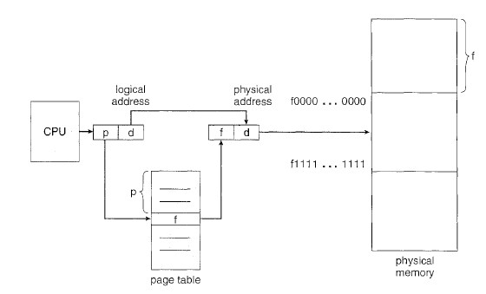
Paging
Paging is a memory-management scheme that permits the physical address space a process to be noncontiguous. Paging avoids external fragmentation and the need for compaction.
The basic method for implementing paging involves breaking physical memory into fixed-sized blocks called frames and breaking logical memory into blocks of the same size called When a process is to be executed, its pages are loaded into any available memory frames from their source (a file system or the backing store).
Every address generated the CPU is divided into two parts: a page number (p) and a page offset (d) . The page number is used as an index into a The page table contains the base address of each page in physical memory. This base address is combined with the page offset to define the physical memory address that is sent to the memory unit.

Slide 21
Segmentation
An important aspect of paging is the separation of the user's view of memory from the actual physical memory. As we have already seen, the user's view of memory is not the
same as the actual physical memory. The user's view is mapped onto physical
memory. This mapping allows differentiation between logical memory and
physical memory.
Consider how a program fits into the memory from a user perspective
Subroutine
stack
Main program
User Library

Slide 22
Segmentation is a memory-management scheme that supports this user view of memory. A logical address space is a collection of segments. Each segment has a name and a length. The addresses specify both the segment name and the offset within the segment. The user therefore specifies each address by two quantities: a segment name and an offset.
Segments are numbered and are referred to by a segment number , rather than by a segment name.
Thus, a logical address consists of a two tuple:
<segment-number, offset>.
When as user program is compiled, and the compiler automatically constructs segments reflecting the input program.
A C compiler might create separate segments for the following:
The code
Global variables
The heap, from which memory is allocated
The stacks used by each thread
The standard C library
Libraries that are linked in during compile time might be assigned separate segments. The loader would take all these segments and assign them segment numbers.

Slide 23
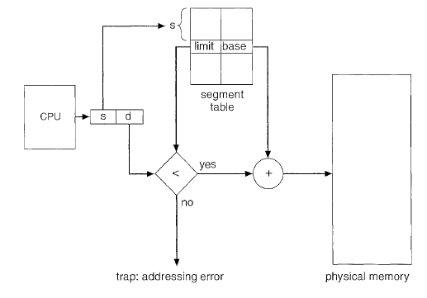
How does segmentation works
A logical address consists of two parts: a segment number, s, and an offset into that segment, d.
The segment number is used as an index to the segment table. The offset d of
the logical address must be between 0 and the segment limit. (If not it is an error)
When an offset is in the valid range it is added to the segment base to produce the address
in physical memory of the desired byte. The segment table is thus essentially an array of base-limit register pairs.

Slide 24
Case study of segmentation and paging in Pentium

Slide 25
http://www.osinfoblog.com/post/137/segmentation-with-paging:-the-intel-pentium/

