Slide 1
Real Time systems Categories

Slide 2
How do real time system gets inputs and how they respond
Periodic
Inputs from
Sensors
(Push)
Real Time System
Output
Periodic
Polling of sensors
(Pull)
Async I/P
Real Time systems can be categorized by the way inputs are processed

Slide 3
Categories of Real Time System
Purely Cyclic
Task executes periodically
Resource Requirement does not change across cycles
Mostly Cyclic
Task are executed periodically
System responds to Some Asynchronous events too
Asynchronous somewhat predictable
System responds to both periodic and asynchronous events
Duration between two consecutive task vary significantly
Asynchronous Unpredictable
System mainly responds to asynchronous event
System are more complex
More periodic
And predictable
More Async
Less predictable

Slide 4
Real Time systems from Implementation perspective

Slide 5
Real Time System
(implementation)
Time Driven
Reactive
Dead Line based

Slide 6
Time Driven
Periodic
Hard real-time, periodic/cyclic and predictable
Task oriented
Pre-defined instances of task execution with fixed intervals
Schedule oriented
Schedule is computed off-line for all the tasks in the system
No interruptions to the running of tasks are entertained
Simpler system with fixed number of tasks in them
Which job to run at each instance is predefined
All the tasks are assured of its time slice (CPU)

Slide 7
Reactive
Async
Real-time, asynchronous and unpredictable
Event Driven
Largely event-driven
Complex
Regulated by timing constraints
Embedded systems with multitude of inputs/sensors, which are complex in design
Interacts intensively and continuously with the environment through stimulus-response behavior
Any action taken by the system is triggered by inputs or timing related system requirements

Slide 8
Dead Line Driven
Async
Hard real-time,
Event Driven
event-driven
Dead Line Oriented
Regulated by strict timing constraints resulting in complex design
Each task in the system has deadlines specified, which need to be met for a correct functioning of the system
Asynchronous and predictable

Slide 9
Difference between GPOS and RTOS
No | General Purpose OS | Real Time OS
1 | Support Multiuser Environment | Does not support multiusers only a single user is supported
2 | Supports Virtual memory model | Does not support Virtual memory – only support a flat memory model
3 | Non scalable | Non scalable
4 | High interrupt latency | Low interrupt latency
5 | Not sensitive to time | Sensitive to time
6 | OS kernel is not preemptive | Kernel opreations are preemptive. It means low priority task will be pre-empted even if its executing any system call.

Slide 10
Components of OS

Slide 11


Layered Architecture of OS
Shell
Programs
File Management
Input Output
Memory Management
Kernel
Hardware Abstraction Layer (HAL)
Hardware
11

Slide 12
File Management
API
Input Output layer
Shell
Memory Management
Kernel
HW

Slide 13
Program execution
Loads a program into memory.
Executes the program.
Handles program's execution.
Provides a mechanism for process synchronization.
Provides a mechanism for process communication.
Provides a mechanism for deadlock handling.

Slide 14
What is a Process
A process is basically a program in execution. The execution of a process must progress in a sequential fashion.
 | Entity of a process
1 | Object Code- List of instructions for the CPU
2 | Data – Data that needs to be processed by instructions
3 | Resources – Memory, printer etc
4 | Status : New, Ready, Running Waiting, Terminated

Slide 15
A process has four sections
S.N. | Component & Description
1 | Stack The process Stack contains the temporary data such as method/function parameters, return address and local variables.
2 | Heap This is dynamically allocated memory to a process during its run time.
3 | Text This includes the current activity represented by the value of Program Counter and the contents of the processor's registers.
4 | Data This section contains the global and static variables.

Slide 16
How do we create a process
We use the C-API
fork() API for this process in Linux
CreateProcess() on Windows
Live Example of creating process in Linux

Slide 17
Fork()
The fork() function is used to create a new process by duplicating the existing process from which it is called. The existing process from which this function is called becomes the parent process and the newly created process becomes the child process. As already stated that child is a duplicate copy of the parent but there are some exceptions to it.
Fork() has an interesting behavior while returning to the calling method. If the fork() function is successful then it returns twice. Once it returns in the child process with return value ‘0’ and then it returns in the parent process with child’s PID as return value. This behavior is because of the fact that once the fork is called, child process is created and since the child process shares the text segment with parent process and continues execution from the next statement in the same text segment so fork returns twice (once in parent and once in child).

Slide 18
#include <unistd.h>
#include <sys/types.h>
#include <errno.h>
#include <stdio.h>
#include <sys/wait.h>
#include <stdlib.h>
int var_glb; /* A global variable*/
int main(void)
{
pid_t childPID;
int var_lcl = 0;
childPID = fork();
if(childPID >= 0) // fork was successful
{
if(childPID == 0) // child process
{
var_lcl++;
var_glb++;
printf("\n Child Process :: var_lcl = [%d], var_glb[%d]\n",
var_lcl, var_glb);
}

Slide 19
else //Parent process
{
var_lcl = 10;
var_glb = 20;
printf("\n Parent process :: var_lcl = [%d], var_glb[%d]\n", var_lcl, var_glb);
}
}
else // fork failed
{
printf("\n Fork failed, quitting!!!!!!\n");
return 1;
}
return 0;
}

Slide 20
CPU Scheduling
CPU scheduling is a process which allows one process to use the CPU while the execution of another process is on hold(in waiting state) due to unavailability of any resource like I/O etc, thereby making full use of CPU. The aim of CPU scheduling is to make the system efficient, fast and fair.
First Come First Serve(FCFS) Scheduling
Shortest-Job-First(SJF) Scheduling
Priority Scheduling
Round Robin(RR) Scheduling
Multilevel Queue Scheduling

Slide 21
First Come First Serve(FCFS) Scheduling
Jobs are executed on first come, first serve basis.
Easy to understand and implement.
Poor in performance as average wait time is high.
Quick Reference : Queue in a super Market
Shortest-Job-First(SJF) Scheduling
Best approach to minimize waiting time.
Actual time taken by the process is already known to processor.
A perfect implementation of this method is not difficult
Priority Scheduling
Priority is assigned for each process.
Process with highest priority is executed first and so on.
Processes with same priority are executed in FCFS manner.
Priority can be decided based on memory requirements, time requirements or any other resource requirement.

Slide 22
Round Robin(RR) Scheduling
A fixed time is allotted to each process, called quantum, for execution.
Once a process is executed for given time period that process is preempted and other process executes for given time period.
Context switching is used to save states of preemptive processes.
Round Robin(RR) Scheduling
A fixed time is allotted to each process, called quantum, for execution.
Once a process is executed for given time period that process is preempted and other process executes for given time period.
Context switching is used to save states of preemptive processes.
Multilevel Queue Scheduling
Multiple queues are maintained for processes.
Each queue can have its own scheduling algorithms.
Priorities are assigned to each queue.

Slide 23
Introduction to Parallel computing

Slide 24
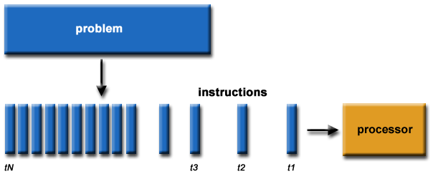
Serial Computing
A problem is broken into a discrete series of instructions
Instructions are executed sequentially one after another
Executed on a single processor
Only one instruction may execute at any moment in time

Slide 25
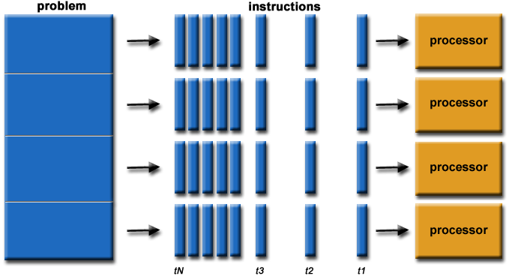
Parallel Computing
In the simplest sense, parallel computing is the simultaneous use of multiple compute resources to solve a computational problem:
A problem is broken into discrete parts that can be solved concurrently
Each part is further broken down to a series of instructions
Instructions from each part execute simultaneously on different processors
An overall control/coordination mechanism is employed

Slide 26
What is a thread ?
A concept created towards multiprocessing
In the threads model of parallel programming, a single "heavy weight" process can have multiple "light weight", concurrent execution paths.
Thread is an execution unit which consists of its own program counter, a stack, and a set of registers. Threads are popular way to improve application through parallelism.
The CPU switches rapidly back and forth among the threads giving illusion that the threads are running in parallel.
As each thread has its own independent resource for process execution, multiple processes can be executed in parallel by increasing number of threads.

Slide 27
The main program a.out is scheduled to run by the native operating system. a.out loads and acquires all of the necessary system and user resources to run. This is the "heavy weight" process.
a.out performs some serial work, and then creates a number of tasks (threads) that can be scheduled and run by the operating system concurrently.
Each thread has local data, but also, shares the entire resources of a.out. This saves the overhead associated with replicating a program's resources for each thread ("light weight"). Each thread also benefits from a global memory view because it shares the memory space of a.out.
A thread's work may best be described as a subroutine within the main program. Any thread can execute any subroutine at the same time as other threads.
Threads communicate with each other through global memory (updating address locations). This requires synchronization constructs to ensure that more than one thread is not updating the same global address at any time.
Threads can come and go, but a.out remains present to provide the necessary shared resources until the application has completed.

Slide 28
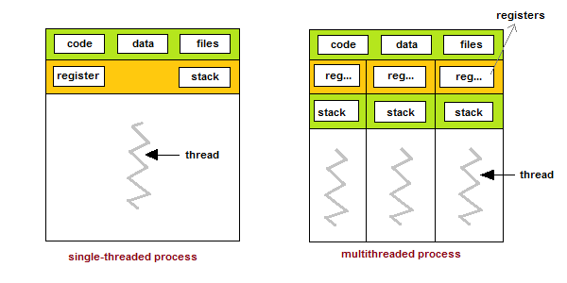
Relation between process and thread
As each thread has its own independent resource for process execution, multiple processes can be executed in parallel by increasing number of threads.

Slide 29
Difference Between threads and processes
Processes do not share their address space while threads executing under same process share the address space.
From the above point its clear that processes execute independent of each other and the synchronization between processes is taken care by kernel only while on the other hand the thread synchronization has to be taken care by the process under which the threads are executing
Context switching between threads is fast as compared to context switching between processes
The interaction between two processes is achieved only through the standard inter process communication while threads executing under the same process can communicate easily as they share most of the resources like memory, text segment etc

Slide 30
Types of Threads
Threads
Kernel threads are supported within the kernel of the OS itself. All modern OSs support kernel level threads, allowing the kernel to perform multiple simultaneous tasks and/or to service multiple kernel system calls simultaneously.
User threads, are above the kernel and without kernel support. These are the threads that application programmers use in their programs.

Slide 31
How do we create threads
Thread libraries provides programmers with API for creating and managing of threads.
Thread libraries may be implemented either in user space or in kernel space. The user space involves API functions implemented solely within user space, with no kernel support. The kernel space involves system calls, and requires a kernel with thread library support.
POSIX Pitheads, may be provided as either a user or kernel library, as an extension to the POSIX standard.
Win32 threads, are provided as a kernel-level library on Windows systems.
Java threads - Since Java generally runs on a Java Virtual Machine, the implementation of threads is based upon whatever OS and hardware the JVM is running on, i.e. either Pitheads or Win32 threads depending on the system

Slide 32
#include <stdio.h>
#include <pthread.h>
#include <semaphore.h>
#include <stdlib.h>
char n[1024];
sem_t len;
void * read1()
{
while(1)
{
printf("\nThread-1:Enter a string\n");
scanf("%s",n);
printf("\n");
sem_post(&len);
}
}
void * write1()
{
while(1)
{
sem_wait(&len);
printf("\nThread-2:The string entered is :");
printf("==== %s\n",n);
}
}

Slide 33
int main()
{
int status;
pthread_t tr, tw;
char *ptr ;
const int x = 100;
ptr = (char*) malloc(100);
printf("Address of pointer variable is %x ", &ptr);
printf("Address on heap is %x ", ptr);
printf("Address on const is %x ", &x);
printf("Address on global is %x ", &len);
pthread_create(&tr,NULL,read1,NULL);
pthread_create(&tw,NULL,write1,NULL);
printf("Pthread value = %d\n", tr);
printf("Pthread value = %d\n", tw);
pthread_join(tr,NULL);
pthread_join(tw,NULL);
}

Slide 34
Why do we create threads
Responsiveness
Resource sharing, hence allowing better utilization of resources.
Economy. Creating and managing threads becomes easier.
Scalability. One thread runs on one CPU. In Multithreaded processes, threads can be distributed over a series of processors to scale.
Context Switching is smooth. Context switching refers to the procedure followed by CPU to change from one task to another.

Slide 35
How Linux handles threads and process scheduling
A process consists of a number of threads sharing the same address space.
Kernel threads under Linux are implemented as processes that share resources.
The scheduler does not differentiate between a thread and a process
There is only one scheduler ( which is the process scheduler ) that schedules the "threads" ( which are actually processes that share the same resources )
Each thread has it's own stack and running execution state (registers etc.) just like "normal" processes. A context switch between two threads that belong to the same process just means that the switch might be a bit faster due to shared memory that may be still in the cache.
To avoid simultaneous access of the same memory, the threaded program me has to use mutexes or locks - the scheduler does not help in this case.

Slide 36
What is SMP
SMP (symmetric multiprocessing) is the processing of programs by multiple processors that share a common operating system and memory. In symmetric (or "tightly coupled") multiprocessing, the processors share memory and the I/O bus or data path. A single copy of the operating system is in charge of all the processors. SMP, also known as a "shared everything" system, does not usually exceed 16 processors.

Slide 37
How does printf() and scanf() works
Shell
Programs
File Management
Input Output
Memory Management
Kernel
Hardware
Copyright Reserved - Do not reproduce
37
37

Slide 38
Raspberry Pi
Find out what type of processor & OS is used in Raspberry Pi and the

Slide 39
Inter Process Communication
Process need to exchange data for computing purpose for this most of the Operating systems has implemented the following methods
Signals
Pipe
Sockets
Message Queues
Semaphore
Shared Memory

Slide 40
Notes

Slide 41
How Linux handles threads and process scheduling
The Linux kernel scheduler is actually scheduling tasks, and these are either threads or (single-threaded) processes.
A process is a set of threads sharing the same address space.
Threads on Linux are kernel threads (in the sense of being managed by the kernel, which also creates its own threads), created by the Linux specific clone syscall (which can also be used to create processes on Linux). The pthread_create() function is probably built (on Linux) above clone inside NPTL and Gnu Libc (which integrated NPTL on Linux).
Kernel threads under Linux are implemented as processes that share resources. The scheduler does not differentiate between a thread and a process
There is only one scheduler ( which is the process scheduler ) that schedules the "threads" ( which are actually processes that share the same resources )
Each thread has it's own stack and running execution state (registers etc.) just like "normal" processes. A context switch between two threads that belong to the same process just means that the switch might be a bit faster due to shared memory that may be still in the cache. To avoid simultaneous access of the same memory, the threaded program me has to use mutexes or locks - the scheduler does not help in this case.
http://stackoverflow.com/questions/8463741/how-linux-handles-threads-and-process-scheduling

