Slide 1
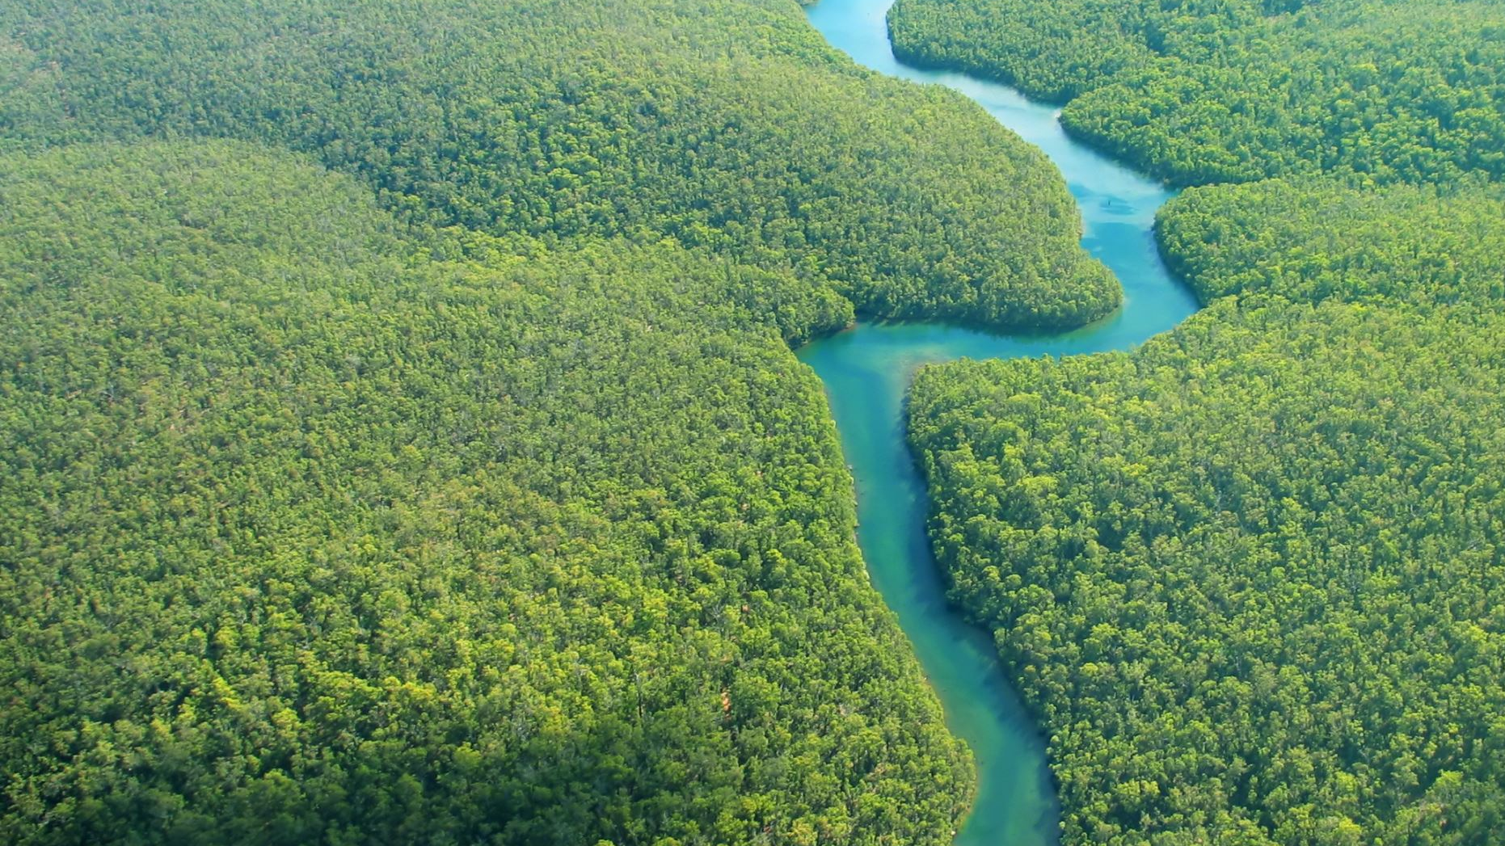
Our Water Body
How do we restore our Water body in Riviera
Girish S Kumar

Slide 2
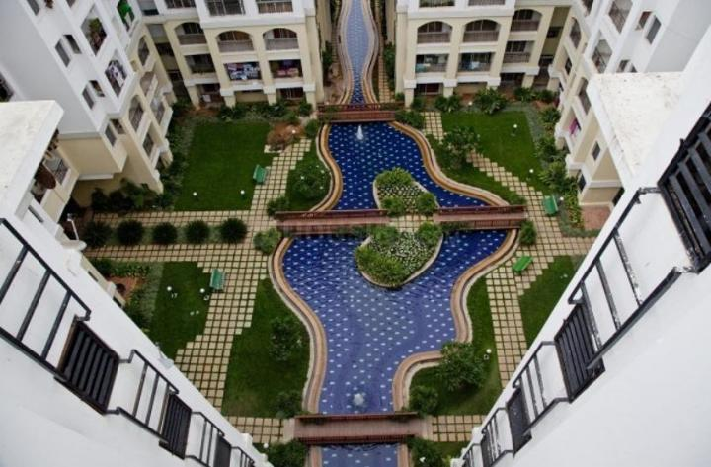
Objectives
Restoration of our water body with full of water.
Environmentally safe water body
Maintain a hygienic and a clean water body
Compliance with BWSSB and Govt agencies
Work with limited budgets
Ensure water availability round the year

Slide 3
1. Leakage in water body towards basement – Solved 2. Source of clean & affordable water. (Not Solved)
Challenges

Slide 4
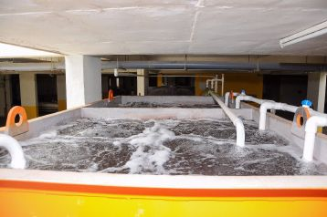
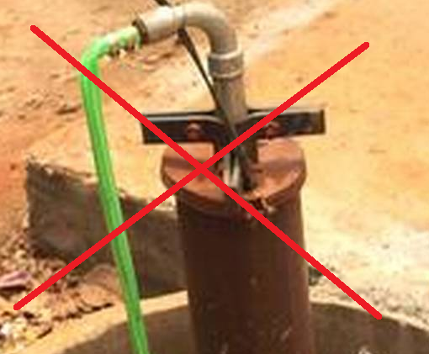
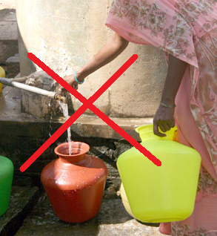
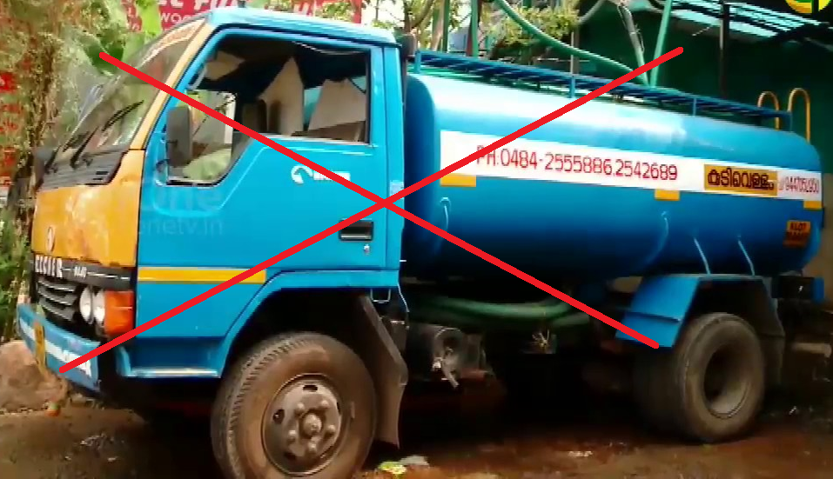
Challenges with water
Cauvery water is costly and should not be used for non potable usages due to compliance issues
Borewell water – Not dependable
Tanker Lorries – Costly (not advised)
STP water which is easily available (comes with some challenges)
Rain water (Not available round year, Bangalore don’t have any more rain forests)

Slide 5
What happens if we fill STP water into water body today ?

Slide 6
Practically it is safe to use STP water in water body, nothing will happen. –But we have to take care of few issues for long run
It Way Safer and better than Tanker Water

Slide 7
Challenges with STP water
 | Challenges with STP | Comments from Residents
1 | Blackish water in flushes | Residents do have a mental block towards using it.. Shhh… don’t even go near STP water that is dirty… don’t even talk to me about it.
2 | Nitrates and phosphates | Presence of these will results in green algae growth in the water body which spoils the look and may damage the tiles.
3 | Water from toilet sewage is treated and reused | How can we use such a water in our water body Spread across our campus, Can this can results in some kind of medical issue in the long run.
4 | Can we really use STP for such purpose will the chemical present in STP water, spoil our water body ? | I really don’t know… better we use BWSSB as it is 100% safe … cant we use it even if it is costly ? (Comments I head heard from knowledgeable residents)

Slide 8
We have solutions
 | Challenges with STP | Solution
1 | Blackish water in flushes | Root cause identified and solved
2 | Nitrates and phosphates | Quantity is so low when compared to limits, the small quantity which is present can easily be removed using chemical methods
3 | Water from toilet sewage is treated and reused | Our water test reports indicates that the harmful microbes are way below the limits specified by WHO and Govt of India. In addition we can take added precautions. Bit of microbes are needed every where to strengthen our immunity.
4 | Can we really use STP for such purpose will spoil our water body ? | Share the test report with residents. Also ensure we keep our final tank and pipes clean so that we always get crystal clear STP water, this will erase this feeling from the minds of old residents.

Slide 9
Lets explore the Solutions

Slide 10
What do we do for blackish water?
Root Cause
During the 24 hours of sewage treatment. Some very few organic or inorganic particles escape from the reactor and makes it way out. Significant of them will be caught in settling tank, and rest in the two filtering units
Still a very small amount of fine microscopic blackish (organic or inorganic) particles makes its way to the final tank and settle down.
During pumping out process they make their way into pipes where they stick for a long time and comes out in our flushes as blackish water.
The blackish water is caused by extremely fine particles which has escaped the treatment.

Slide 11
Solution for blackish water
 | Solution | Status
1 | Fix aerators (diffusers) in all the settling tanks and final tank | Fixed and functional
2 | Periodic cleaning of final Tank | Schedule in place and followed
3 | Periodic cleaning of STP water distribution pipes to remove blackish water particles that are sticking inside | Schedule in place and followed
4 | More frequent cleaning (back wash ) of filters | Schedule in place and followed
5 | Checking the turbidity levels of STP water and taking actions | To be implemented
6 | Keeping the final tank full most of the time so that the particles are always in the lower layers. | To be Implemented
7 | Adding an additional filtration stage (pressure filter (Sand) before sending water to Water Body) | To be Implemented

Slide 12
Nitrates and Phosphates (Nutrients for Algae formation)
These are the only two salts present in STP Water which makes it unsuitable for human consumption (differentiates it from fresh water)
Water testing reports indicates that they are present only in very small quantities as our input is only residential sewage and 90% of it is just used fresh water from bathroom, kitchens.
Out of which formation of algae is mostly caused by Phosphates. We can easily remove phosphates by adding small amounts metallic reagents (aluminium sulphate, sodium aluminate, ferric chloride, ferric sulphate, ferrous sulphate, and ferrous chloride.)
This method is suited when phosphorus concentration is below one milli gram per Litre. Water test report of our STP water shows this parameter is way below this limit
How much to metallic reagents to be added: Very little, Can be sprinkled or mixed with water and added into water body.

Slide 13
Further Steps to prevent algae formation
Chlorination of water through chlorination unit. – This is mandatory to prevent any kind of algae or mosquito breeding. We already have this mechanism in place
A sample of STP water kept openly in the sun, did not show any algae formation for two weeks. Slight formation of algae was observed after 14 days.
Replacement of water in water body once a week is advised because of the above observation.
Constant circulation and operation of fountains are advised to provide additional aeration.
Frequent filtration during circulation & Chlorination will prevent any further algae which got introduced into the water during its exposure to nature. (Inoculum of algae can come through birds sipping water from water body, their beaks do carry many micro organisms)
Algae formation can happen even with Cavery water

Slide 14
Health /Medical issues with STP water.
STP water is free of any kind of harmful chemicals, since the treatment is due purely using biological methods, only chemical used for it is Air bubbles.
Nitrates and phosphates does not cause any health issues unless it is consumed, and their concentration is very less.
Only factor in STP water that cause health issue is ColiForm a form of bacteria which is commonly found in animal/human faces. However this is present in very small quantities in River water and other natural water bodies. Human immune system is capable of killing this provided their concentration is really low. As per KSPCB the STP water is safe for non potable uses provided the ColiForm concertation is below 100 units per 100 ml of sample. In our Case this is less than one unit per 100 ml. Which is way below the limits set by KSPCB/WHO. Hence usage of STP water cannot cause any health issues or epidemics. This is a time tested fact.
Additional Chlorination ensures bacteria growth is arrested in case the water gets contaminated by birds or other animals. (like rats/squirrels/bats etc).

Slide 15
Will STP water cause any kind of damage to water body ?
It is very unlikely STP water can cause damage to water body or tiles. We have been using STP water for that last 12 years and none of the GI pipes which we use are corroded because of STP water.
Since water body has white cement used in tiles, there is chance it can get corroded over time if STP water is acid
For this purpose we track the pH level of STP water daily and it is always remain very close to 7 , which indicates it is neither acidic or alkaline to cause any kind of corrosion.

Slide 16
Let us not call it STP any more, instead call it Water Recycling Plant. Instead of STP water we will says “Treated water” or recycled water
Paradigm shift

Slide 17
Implementation Plan Expenses Challenges

Slide 18
Phase One (Prototype)

Slide 19
To start with we will identify a small independent portion of water body which has good exposure to sun light and wind. (Club House area can be candidate)

Slide 20
Fill in with STP water and deposit a fixed amount of metal reagent (Aluminum Sulphate) to prevent algae We will NOT do filtering now, as we do not have provision for it today. Instead take STP water from the top, when the final tank is full.

Slide 21
Visually observe water and measure, the turbidity of water periodically using sensor or turbidity measuring jar.

Slide 22
1. Check for the formation of algae 2. Any other issues like black color deposits etc 3. Replace water every week. 4. Repeat this for four weeks

Slide 23
Observation Log Template
No | Date | Time | Algae found (Y/N) | Black Particles found (Y/N) | Odor (Y/N) | Turbidity (Actual values from sensor) | pH | Other Observation/ Comments
1
2
3
4
5
6
7

Slide 24
Phase -2
Upon satisfactory completion of
Phase-1 we can move to phase-2

Slide 25
How much water we need
Calculations
Total Length | 250 meter
Width | 3 meters
Height | 50 cm | Current Water level
Cross section area | 3 X 0.5 = 1.5 sq meters
Volume of water | 250 X 1.5 = 375 Cubic meters
Volume in Liters | 375 X 1000 = 3,75,000 Liters | 1000 liters makes on Cubic meter
True water holding capacity | Approx. 1.50,000 Liters | More that 50% is not used. It is not rectangle shaped.
We need a small water filtering unit that can filter 1.5 Lakhs liters in a day or two, so that water body can be filled within that time.

Slide 26
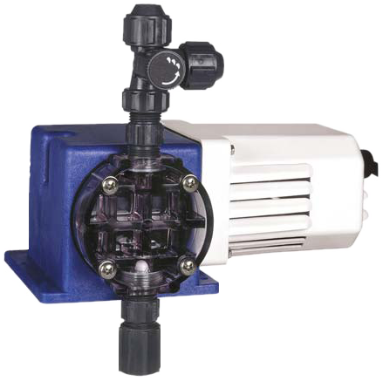
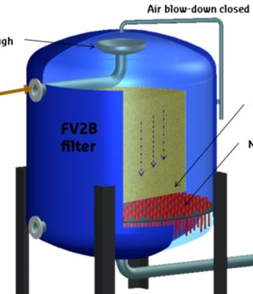
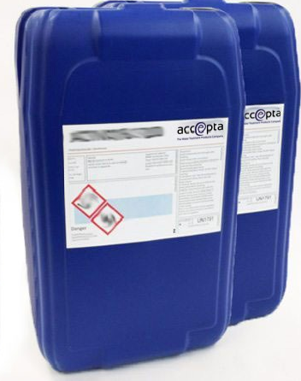
Implementation
Existing STP water Distribution line
T Connector
To Water body
Secondary Chlorination unit
Pressure Sand Filter
Chlorine Tank

Slide 27
Capital Investment
 |  | Comments
Pressure Filter System
Chlorine Pump
Pipes
Replumbing of Water body
Installation Expenses & Labour
Turbidity and pH Sensors |  | One set in Water body and another one in testing STP water samples.

Slide 28
Operational Overhead
Chlorine
Aluminum Sulphate
Back washing of filter
Power for Running Pressure filter
Maintenance of Pressure filter

