Slide 1
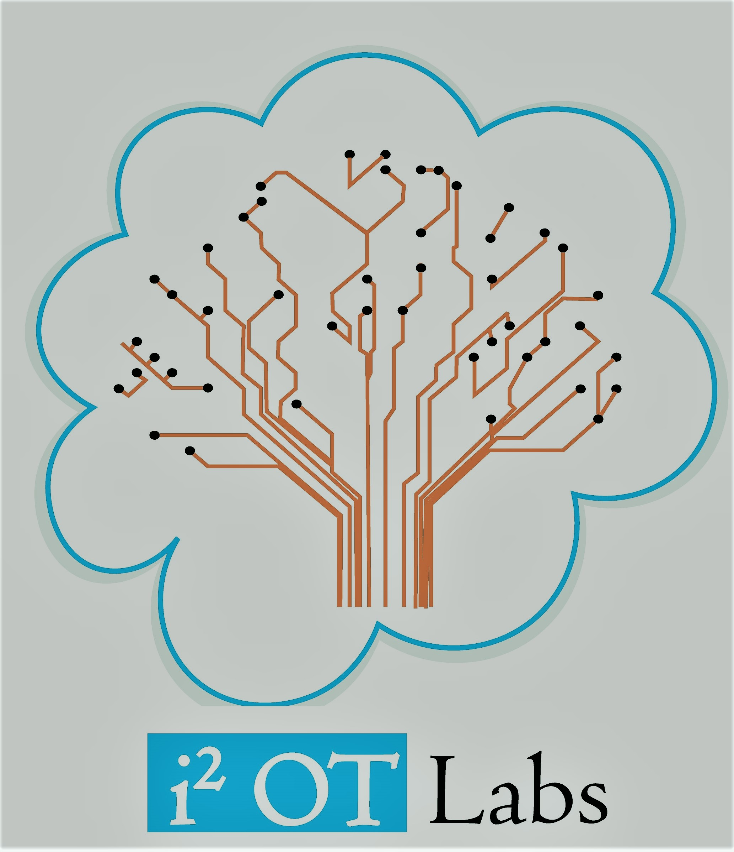
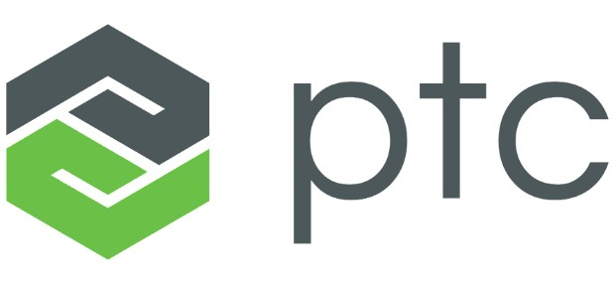
Case Studies on Thingworx
Partner
Girish S Kumar
I-Squared OT Labs (OPC) Pvt Ltd

Slide 2
How does Thingworx brings value to business as IoT platform
All the “bricks and mortar” need to build a IoT solution is readily available . No need to start from scratch
Enables Rapid application development and deployment
Reduce Development Life Cycle from months to weeks with less man power.
Man power with basic programming knowledge can do the development there by enabling more focus on the real problem in hand than of fixing programming and logical errors.
Easy to develop front end, GUI and web interfaces. (Drag and drop kind)
Enables Continuous development and deployment.
Fairly large set of ready to use components to interface with a wide range of environments like, embedded computers, cloud, internet sensors and actuators.
In-build security features which prevents hackers from getting in the environment.

Slide 3
Case Studies

Slide 4

ThingWorx delivers business transformation to Sysmex Corporation®
Case Study

Slide 5
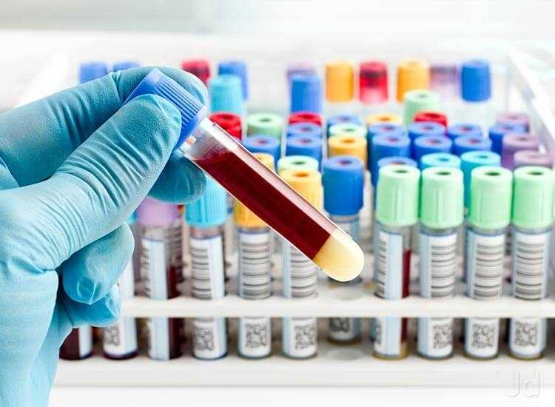

Sysmex Corporation is a global manufacturer of medical diagnostics equipments with large installation base over 168 countries.
These equipments are deployed in diagnostic laboratories , Hospitals and health care facilities
Nature of equipments
Hematology,
Hemostasis,
Urinalysis,
Clinical chemistry,
Immunoassay system,
Life science.
https://www.sysmex.com

Slide 6
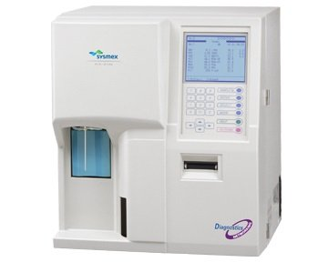
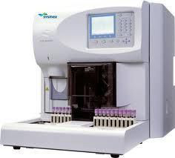
Nature of the Problem
Symex Remote
Monitoring system
To improve instrument uptime and service efficiency Symex, implemented a remote monitoring of their equipments deployed at various customer bases.
Remote monitoring helped Symex to collect data about the machine and take proactive steps to prevent down time
Database
Internet
As the volume of data increased there was more value in the data. But existing technology infrastructure, the company
was unable to turn its connected product data into meaningful
business value

Slide 7
Solution
This is exactly where Thingworx was brought in to solve the problem in hand
Database
Thingworx
Server
Internet
Provided connectivity to remote equipments smoothly over internet.
Provided Cyber Security
Audit Capabilities
Able to integrate with existing enterprise system – CRM etc

Slide 8
Results
Direct, real-time instrument connection for delivering next- generation service and support
Rapid problem resolution through enhanced collaboration and better use of remote and systems data
Allowed Sysmex to put its energy into value added applications that utilize the remote instrument data.
Ability to rapidly build value-added applications
Within the first few months, Sysmex was able to build its first application using ThingWorx, and its business has progressed.
Reference:
https://www.ptc.com/-/media/Files/PDFs/IoT/sysmex_thingworx-delivers-business-transformation.pdf?la=en&hash=7C4D181C115C95DFCBB4B286ACA895F4194425B9

Slide 9
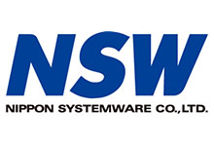
NIPPON SYSTEMWARE CO., LTD. (NSW) ® Builds IoT Solutions for Customers 10x Faster Using ThingWorx Industrial Innovation Platform

Slide 10
NSW is company focused on providing analytics to their customers based on the equipment data,
They anticipates data will be the biggest business generator in the IoT/M2M era.
Large customer based with government offices, insurance organizations and large electronics companies.
Helps their customers to create new business value by enabling them to more effectively gather, analyse and utilize big data
For Smart Cities, NSW improves the health of infrastructure through ongoing monitoring and maintenance.
For manufacturing customers, NSW provides remote monitoring and predictive analytics to help proactively fix issues before they arise.

Slide 11
The Problem
Needs a Platform which will
Enable to develop and implement solutions quickly at lower cost
Collect data from various source
Provide Analytics
Have the ability to customize solutions based on each customer’s unique needs.
Platform should be cloud-based M2M

Slide 12
Solution
Using the ThingWorx platform – specifically ThingWorx Foundation, Analytics and Studio – NSW created Taomi, their own cloud-based IoT platform.
Toami provides three types of solution models:
A custom model with customer-specific applications
A rebranded OEM model for telecommunications companies (such as Toami for Docomo, a solution created for NTT Docomo)
A vertically-integrated software-as-a-service (SaaS) solution that combines sensors and devices as well as applications built on Toami.
NSW customers have used Taomi to create SaaS implementations that manage temperature and humidity, water reservoir levels, restroom occupancy and other sensor-oriented apps.

Slide 13
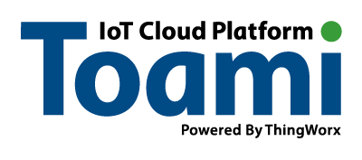
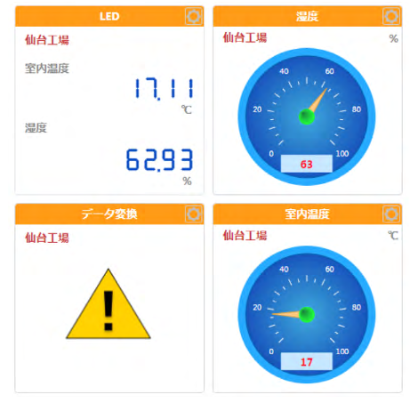
Results
With ThingWorx, NSW developed solutions roughly 10 times faster than they could when building from scratch and can now offer them globally.
Easily update and fine-tune each solution to support a variety of change requests from their customers.
Easily gather data from connected devices and provide predictive analytics and maintenance services for their customers, especially those with critical applications such as manufacturing or medical equipment.
The platform also serves as an engineering training tool, allowing NSW new hires to quickly and efficiently learn how to develop solutions using a common application development environment.
Reference: https://www.ptc.com/-/media/Files/PDFs/Case-Studies/NSW_Case-Study.pdf?la=en&hash=A33E8E58C321C6E01A2A4C76F58BC9A212BECEDF

Slide 14

ThingWorx helps Embedded
Energy Technology monitor
real-time energy savings

Slide 15
Embedded Energy Technology main mission is to save energy and prove it.
EET has developed special insulator called SmartJacket that insulates and monitors steam system components.
The SmartJacket integrates wireless sensors with highly efficient insulation, capturing and reporting true energy savings while tracking real-time component health and overall system function.

Slide 16
Problem
A lot of large buildings, campuses, hospitals etc. all have giant industrial steam systems, and the amount of energy that goes through them is massive. The steam systems are used not only for heating buildings in cold areas, but also for cooling them via heat exchangers in hot areas
All Steam pipes are insulated to prevent energy from radiating outside.
As insulation is critical for energy saving, the company developed a special product called SmartJacket that can be removed during repair work and installed back. This made the repair work of steam pipe and other component easy.
However the company was constantly asked a question by customer to give a empirical measurement on how much energy is saved by the use of the SmartJacket
This prompted engineers to developed a sensor that could be mounted along with the insulation to measure how much heat is being retained and provide insight into whether
or not the component is functioning as intended.

Slide 17
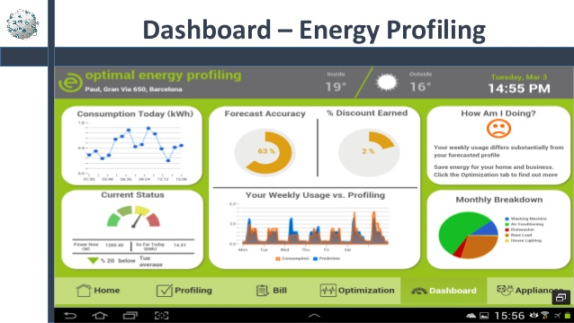
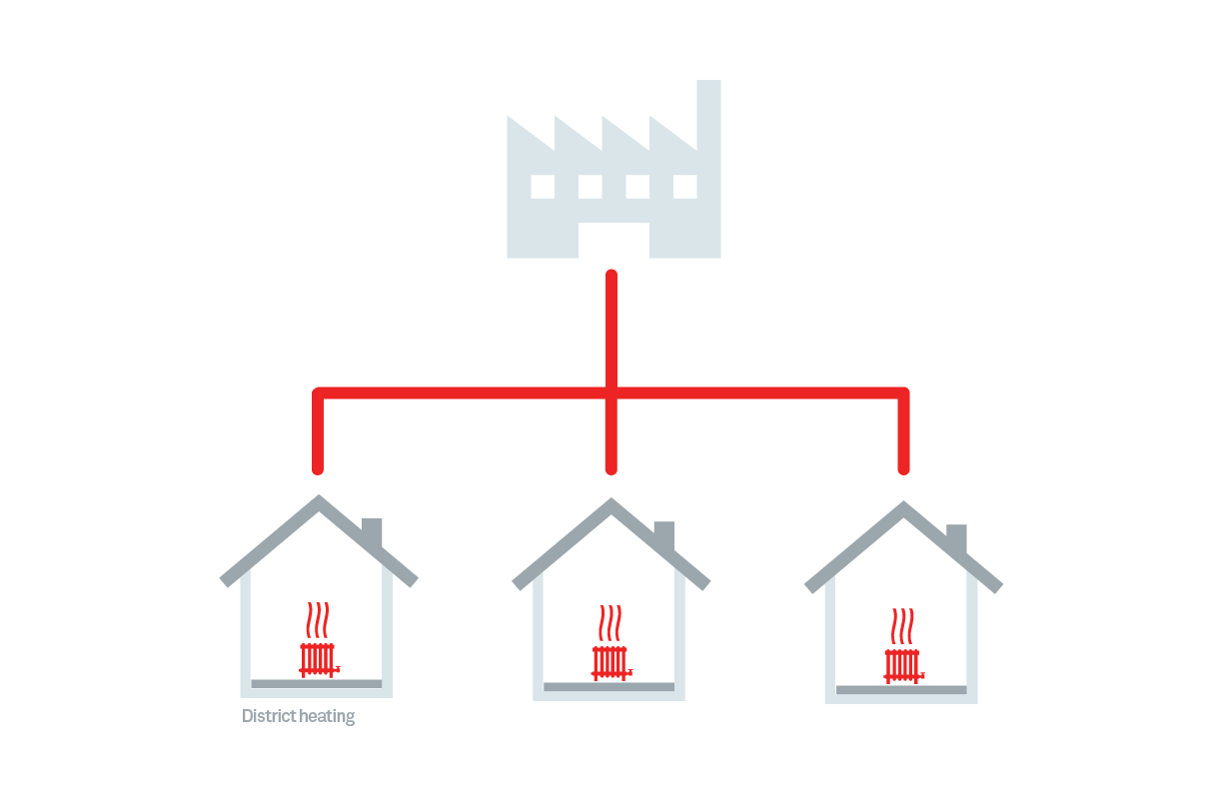
Server
Internet
Each sensor measures 4 key temperatures: the inside jacket temperature, the outer jacket (touch) temperature, the ambient Room or steam vault temperature, and the component temperature
These readings provide a complete picture of what is happening inside the component, and are displayed in a Web Portal that analyzes and presents the data in a concise format.
With large number customer and grow demands, developing an in house solution will need few developer and an year.
Embedded System
Sensor

Slide 18
Solution & Results
In fact, the work that was planned to create the new platform was scoped to be done by three developers, but due to the ease of use of the platform, Embedded Energy Technology only needed to have one developer, “and that cost saving helped to justify the purchase of ThingWorx” . “We also see efficiencies with the backend work that we have to do such as updating gateway software, or commissioning new sensors. With ThingWorx, these can now be automated rather than engaging someone to run scripts on each system
This is exactly where Thingworx was identified as solution
Ref: https://www.ptc.com/-/media/Files/PDFs/IoT/embedded-energy-technology_monitoring-real-time-energy-savings.pdf?la=en&hash=73F9FC98844E820CD0C043F06BFA91B0FFAA4CDF
Philip .J. Johns
CEO of EET

Slide 19

ThingWorx delivers business differentiation to Vantron

Slide 20
Vantron Technology is a leading provider of low-power embedded system and software solutions to OEM/ODM customers.
Vantron also provides assistance in application software development, tailoring its embedded systems based on customers’ requirements, and turn- key manufacturing services.

Slide 21
Problem
Vantron customers from various industries such as
Healthcare,
Heavy equipment,
Vehicle tracking
Telematics
Needs customized solutions.
Rapid application development
Customers looking for interconnectivity more and more through the cloud so that they could access and interact with their equipment remotely.
Vantron’ s customers use a range of operating systems on their embedded systems, from Linux and Windows to Android

Slide 22
Solution
Thingworx support a wide range of embedded systems, from Linux and Windows to Android
Rapid application development possible
Brand recognition, the robustness, and the available partner ecosystem all had an important role to play in selecting the ThingWorx platform” says Easen Ho,

Slide 23
Results
The rapid application development capabilities of ThingWorx enabled Vantron’s engineers to add connectivity and completing the ThingWorx integration within 2-3 weeks.
Having intelligently connected systems and devices provides Vantron with a
differentiated offering. - an industry-standard way for customers to have their devices easily
connected with minimal effort.

