Slide 1

Computer Networks: Session 4
INAE Faculty Mentorship Program
Tarun Mangla
Assistant Professor,
Department of Computer Science & Engineering,
IIT Delhi
Notes:
Today I'll talk about our work rethinking how we design speed tests. Speed tests are everywhere — billions are run every year by consumers, operators, regulators, researchers. But despite all that usage, the tools haven't kept up with what stakeholders actually need. I'll argue we should move beyond one-shot bandwidth numbers toward lightweight, diagnostic, longitudinal measurement.

Slide 2
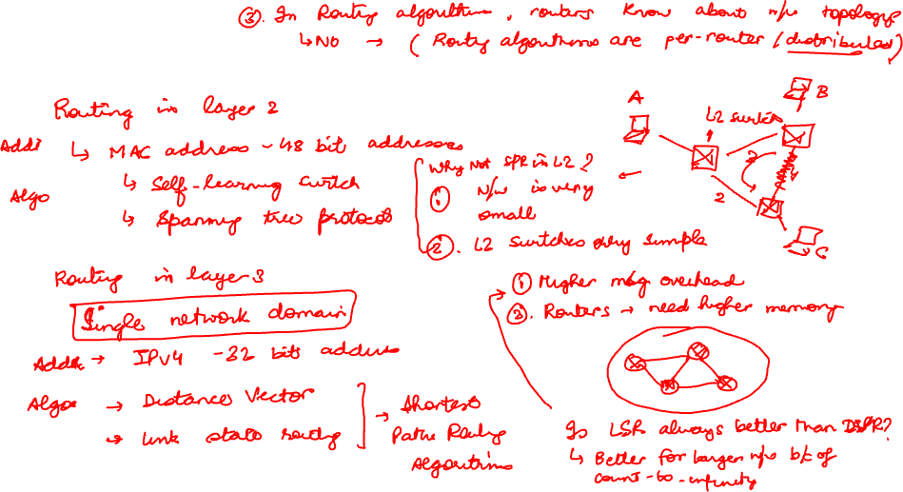
Routing Recap

Slide 3

Today’s Session: Routing
How to route data across networks?
Building a centralized control plane?

Slide 4



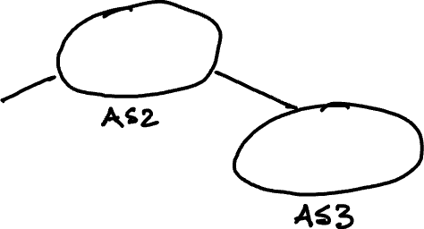



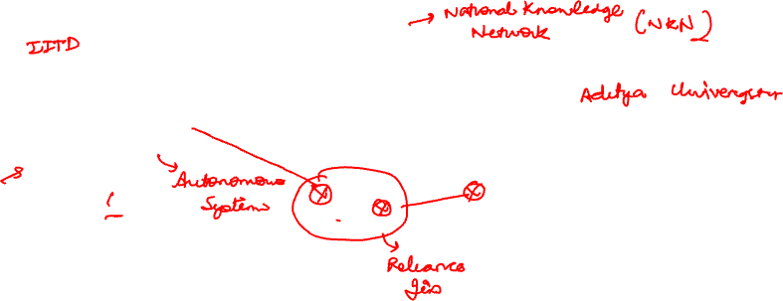


Inter-domain routing
How does Internet route packet from x to y?
What you need:
Common addressing scheme
Common routing protocol

Slide 5
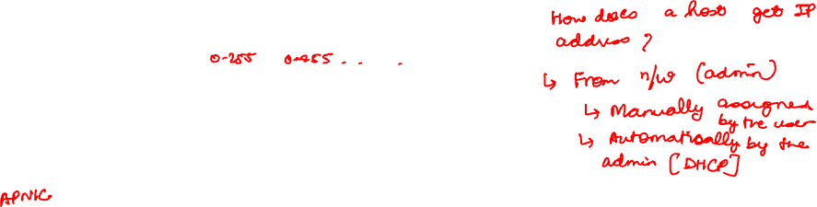
Internet addressing or IP address
IP address: 32-bit identifier associated with each host or router interface
dotted-decimal IP address notation:
How does an AS obtain IP address?
Need a coordinating agency
Internet Assigned Numbers Authority (IANA) and Internet Corporation for Assigned Names and Numbers (ICANN)
103.27.10.1 = 01100111 00011011 00001010 00000001
103
27
10
1
Notes:
-

Slide 6


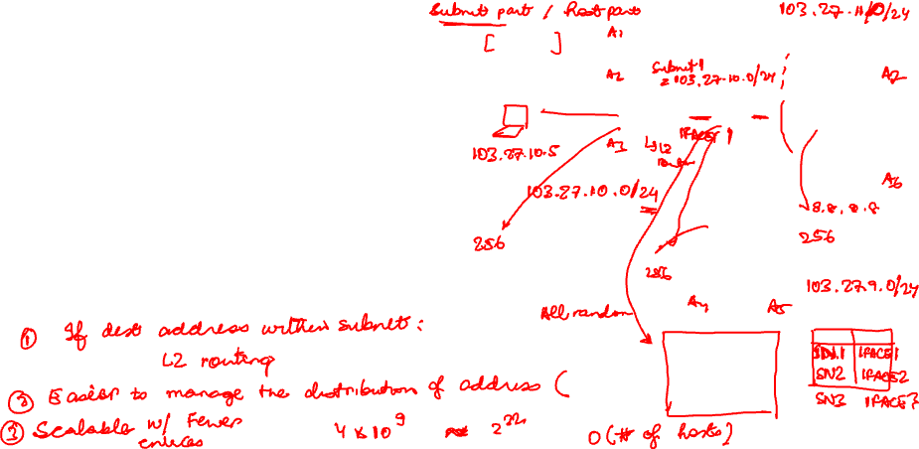
IP addresses are hierarchical
IP addresses have a hierarchical structure:
subnet part: all devices in the same subnet share the same high-order bits
host part: remaining low-order bits, unique within the subnet
Why is it useful?
103.27.10.4
103.27.11.2
103.27.10.2
103.27.10.1
103.27.11.1
103.27.10.3
103.27.9.3
103.27.11.3
103.27.9.1
103.27.9.2
Notes:
Few observations
Each router interface has one IP address.
Router entry can be 223.1.2.2 /
Can we do better?
Subnet mask . Either write it as 255.255.255.0 or 103.27.10.0/24

Slide 7

Question: How many Subnets?
223.1.1.2
subnet 223.1.1/24
where are the subnets?
what are the /24 subnet addresses?
how many subnets?
223.1.1.1
223.1.1.4
223.1.1.3
223.1.9.2
223.1.7.0
subnet 223.1.7/24
subnet 223.1.9/24
223.1.9.1
223.1.7.1
223.1.8.1
223.1.8.0
subnet 223.1.2/24
223.1.2.6
subnet 223.1.8/24
223.1.3.27
subnet 223.1.3/24
223.1.2.1
223.1.2.2
223.1.3.1
223.1.3.2

Slide 8
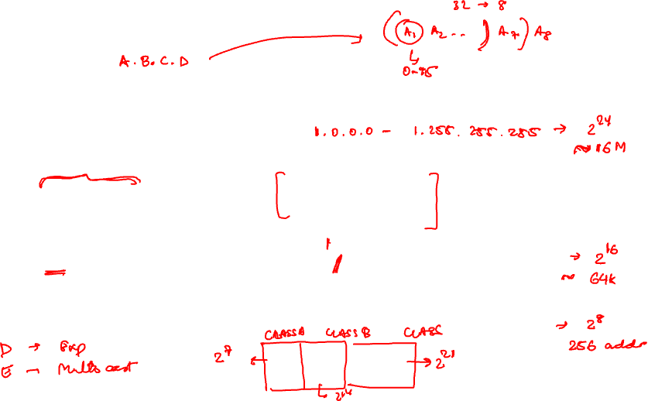
Why 4 dotted representation of IP addresses?
In the beginning, IP addresses were divided into 5 categories, called classful addressing
Classes: A, B, C, D, and E
Advantages: Hierarchical routing
Notes:
Class

Slide 9
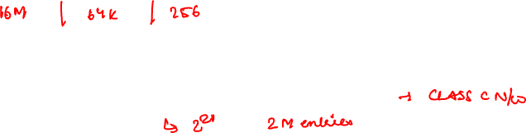
Limitations of Classful Addressing
Wastage of IP address space due to fixed class sizes
Large routing tables increase router overhead
Inflexible — only three class sizes (A, B, C) available
Accelerated exhaustion of the IPv4 address space

Slide 10
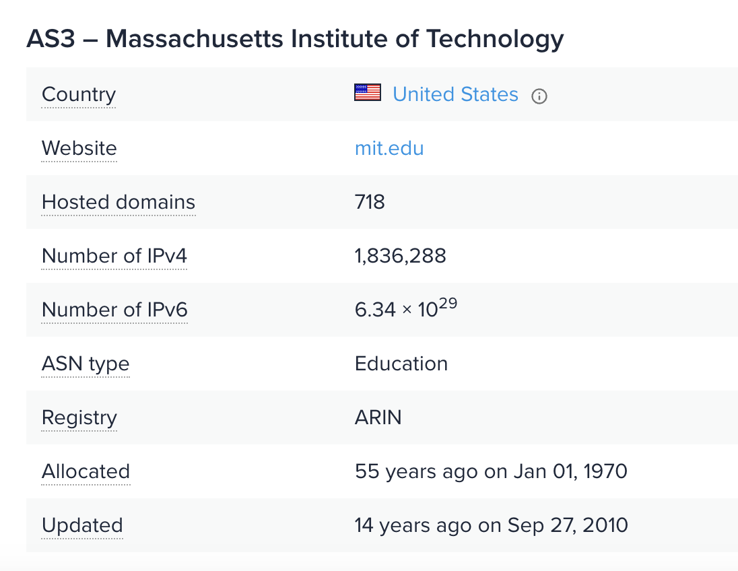
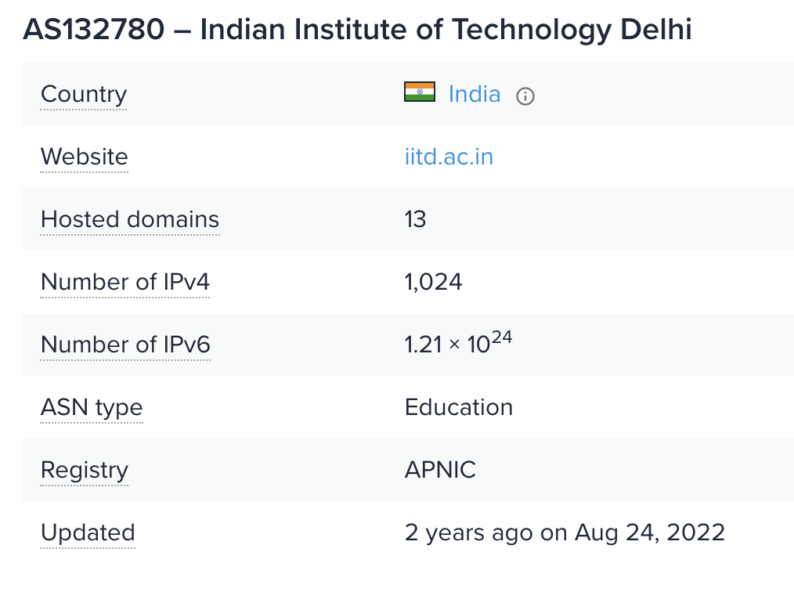
Example: IP Addresses of two AS

Slide 11
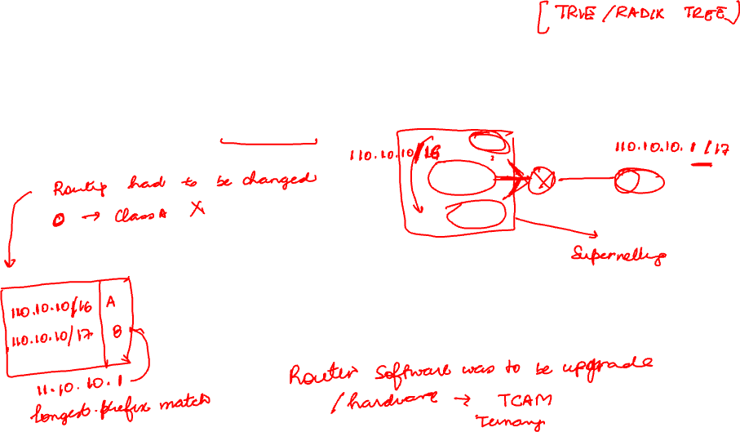
CIDR: Classless InterDomain Routing (pronounced “cider”)
subnet portion of address of arbitrary length
address format: a.b.c.d/x, where x is # bits in subnet portion of address
subnet
part
host
part
11001000 00010111 00010000 00000000
200.23.16.0/23

Slide 12
Inter-AS routing
How does Internet route packet from x to y?
What are the requirements for inter-AS routing?
Common addressing scheme
Common routing protocol

Slide 13

Internet inter-AS routing
2b
AS 1
AS 3
2a
2c
1b
3b
2d
1a
1c
3a
3c
AS 2
1d
3d
Can we use link-state or distance-vector?
scale: millions of destinations/routers
autonomy: ASes don’t want to expose internal topology
policy: each AS wants to control how traffic is routed through it
BGP (Border Gateway Protocol): the de facto inter-domain routing protocol
Notes:
Since an inter-AS routing protocol involves coordination among multiple ASs, communicating ASs must run the same inter-AS routing protocol. In fact, in the Internet, all ASs run the same inter-AS routing protocol, called the Border Gateway Protocol, more commonly known as BGP

Slide 14
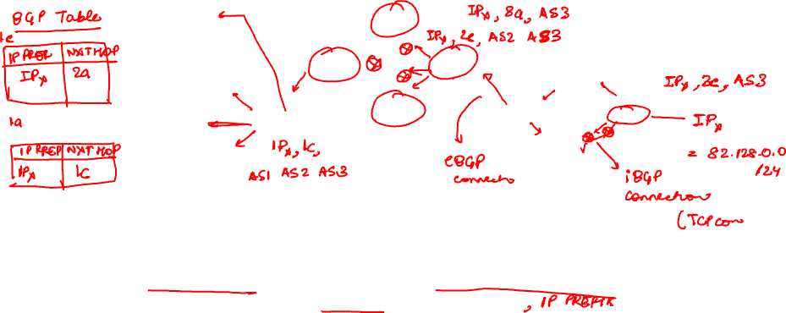
What is Border Gateway Protocol (BGP)
2b
AS 1
AS 3
2a
2c
1b
3b
2d
1a
1c
3a
3c
AS 2
1d
3d
Each AS has one or more speakers that advertise BGP routes
BGP routers communicate via TCP for reliable delivery
Advertisements are of the form: If you send packets to me, I can send them to 82.128.0.0/9 through the path AS4123, AS1045, AS9
Two important attributes: AS-PATH and NEXT-HOP
path vector protocol

Slide 15
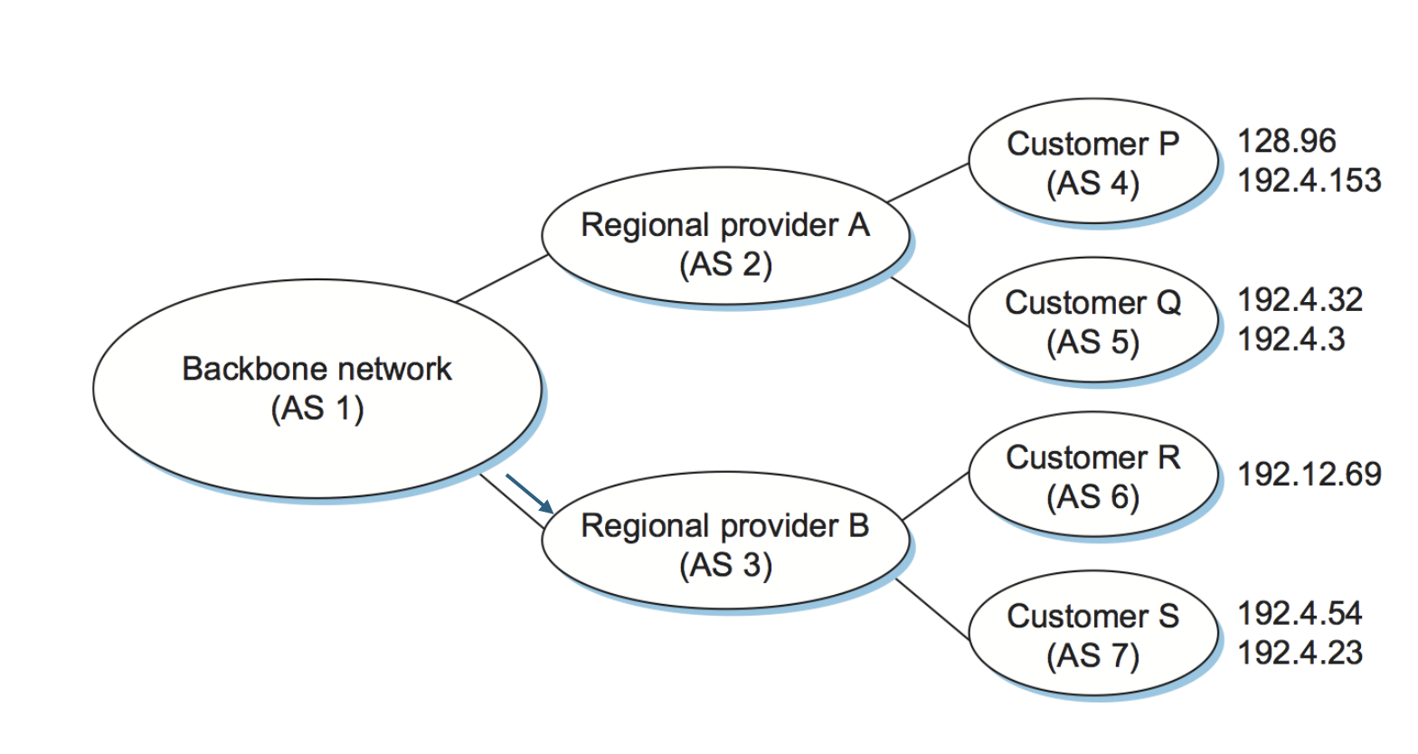
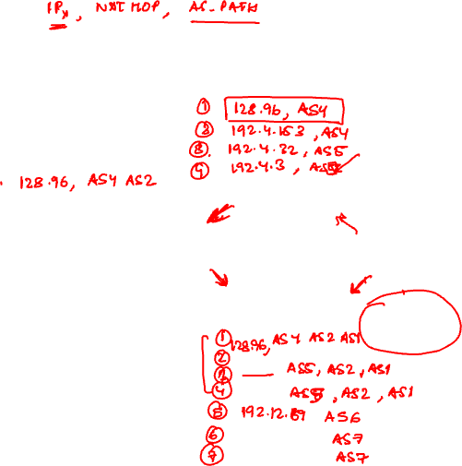
BGP Example
ASes advertise routes to each other
An AS may have received multiple advertisements to the same IP address
Once it has picked a route, it starts sending packets over that route and advertises the others and withdraws previous routes if any
To a given AS B, AS A will advertise only one route to any prefix X. Exception is if the ASes are connected via multiple routers, in which case it can send one advertisement per connection point

Slide 16
BGP Example
ASes advertise routes to each other
An AS may have received multiple advertisements to the same IP address
Once it has picked a route, it starts sending packets over that route and advertises the others and withdraws previous routes if any
To a given AS B, AS A will advertise only one route to any prefix X. Exception is if the ASes are connected via multiple routers, in which case it can send one advertisement per connection point

Slide 17
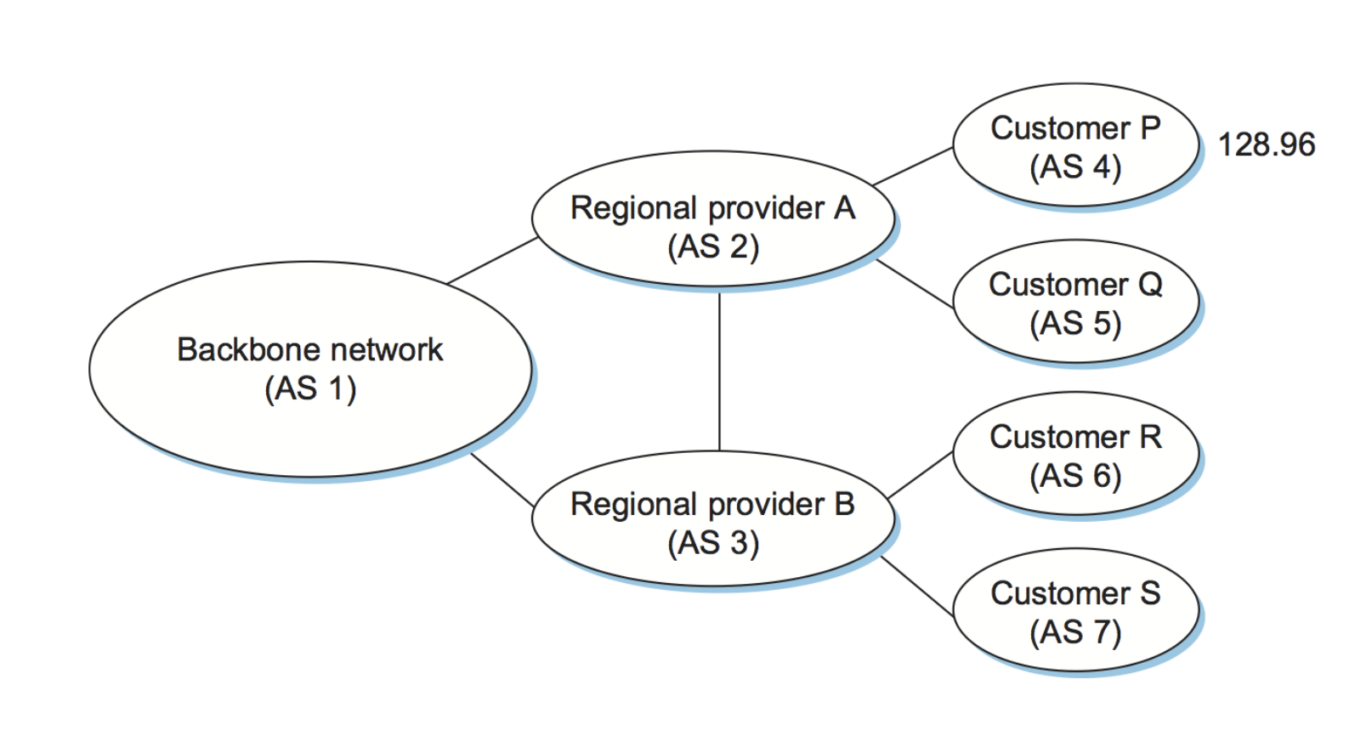
BGP Example: What if there is a loop in the network?

Slide 18
BGP path advertisement: multiple paths
AS 3
3b
AS 1
1b
AS3,X
3a
3c
1a
1c
AS 2
3d
X
2b
1d
AS3, X
AS2,AS3,X
2a
2c
2d
gateway router may learn about multiple paths to destination:
AS1 gateway router 1c learns path AS2,AS3,X from 2a
AS1 gateway router 1c learns path AS3,X from 3a
How does AS1 decide which is the best path?

Slide 19
Inter-AS Routing: Policies
No transit traffic through certain ASes
Never put China on a route starting from Ministry of Defence
Do not use Singapore to get from India to Maldives
Traffic starting or ending at Google should not transit through Microsoft
Don’t share information about this peering link to other routers
Set local preference on BGP routes

Slide 20
What happens if local pref is the same?
AS 3
3b
AS 1
1b
3a
3c
1a
1c
AS 2
3d
X
2b
112
1d
AS3,X
AS1,AS3,X
2a
2c
201
263
2d
2d learns (via iBGP) it can route to X via 2a or 2c
Shortest AS path length
hot potato routing: choose local gateway that has least intra-domain cost (e.g., 2d chooses 2a, even though more AS hops to X): don’t worry about inter-domain cost!

Slide 21
BGP route selection rules
Router may learn about more than one route to destination AS, selects route based on:
local preference value attribute: policy decision
shortest AS-PATH
closest NEXT-HOP router: hot potato routing
additional criteria

Slide 22
BGP: achieving policy via selective advertisements
ISP only wants to route traffic to/from its customer networks (does not want to carry transit traffic between other ISPs – a typical “real world” policy)
A advertises path Aw to B and to C
B chooses not to advertise BAw to C!
B gets no “revenue” for routing CBAw, since none of C, A, w are B’s customers
C does not learn about CBAw path
C will route CAw (not using B) to get to w

Slide 23
Policy via Selective Advertisements

Slide 24
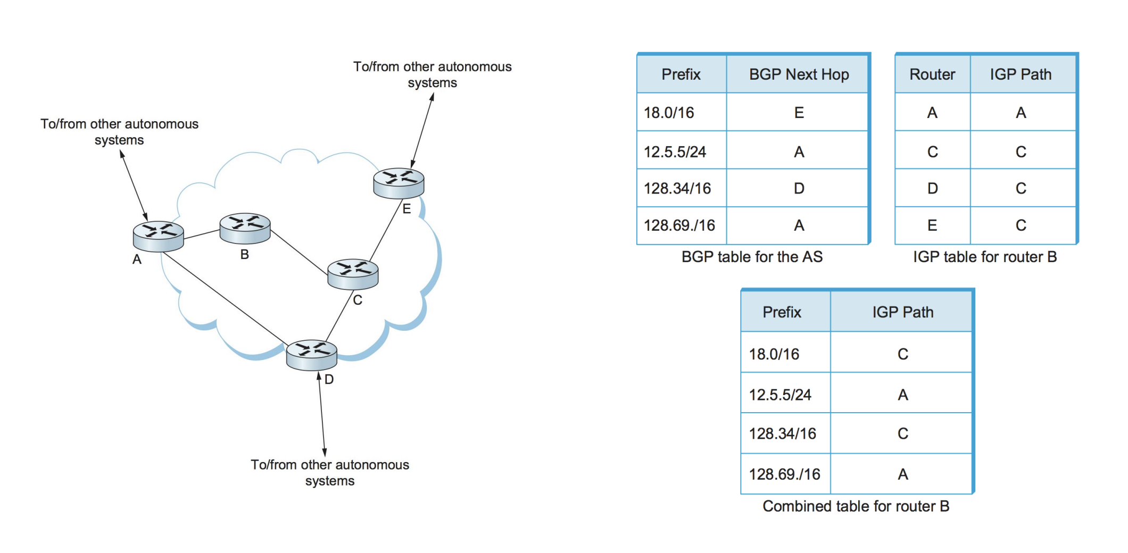
Connecting Intra- and Inter-domain Routing

Slide 25
Recap
Looked at three kinds of routing protocols: L2 routing, intra-domain routing, and inter-domain routing
All are distributed algorithms — running independently on each router
Advantages: generally resilient and scalable
However, there are also limitations …

Slide 26
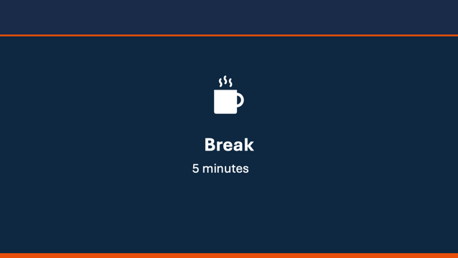

Slide 27

Traffic engineering: difficult with traditional routing
5
3
v
w
5
2
u
2
1
z
3
1
2
x
y
1
Q: what if network operator wants u-to-z traffic to flow along uvwz, rather than uxyz?
A: need to re-define link weights so traffic routing algorithm computes routes accordingly (or need a new routing algorithm)!
Indirect control: Changing weights instead of paths

Slide 28
Traffic engineering: difficult with traditional routing
5
3
v
w
5
2
u
2
1
z
3
1
2
x
y
1
Q: what if network operator wants to split u-to-z traffic along uvwz and uxyz (load balancing)?
A: can’t do it (or need a new routing algorithm)
Lack of flexibility!

Slide 29
Traditional Router: Per-router distributed control plane
Limitation: Traffic management is challenging with a distributed control plane
routing, management
control plane (software)
routing
processor
forwarding data plane
high-speed
switching
fabric
router input ports
router output ports

Slide 30



Idea of Software Defined Networks

Slide 31
(Logically) Centralized Controller
Controller Platform

Slide 32
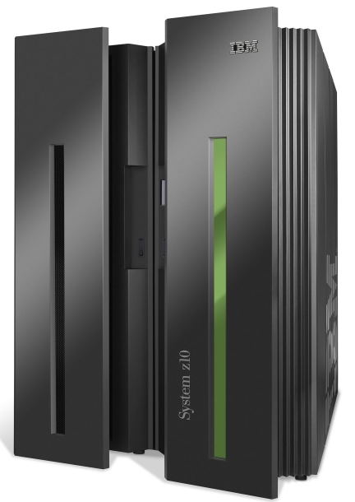
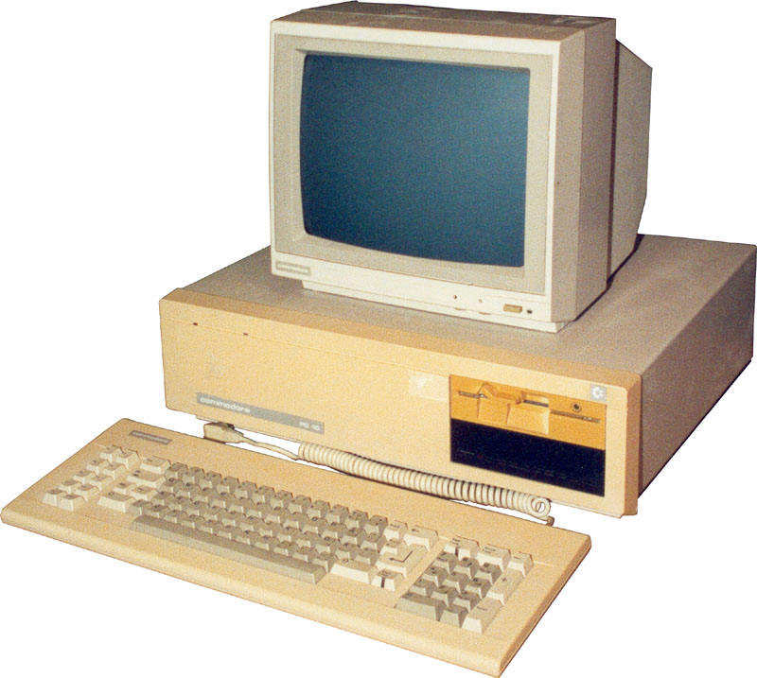
A Helpful Analogy: Computer Systems (From Nick McKeown’s talk “Making SDN Work” at the Open Networking Summit, April 2012)
App
App
App
App
App
App
App
App
App
App
App
Specialized
Applications
Open Interface
Specialized
Operating
System
Windows
(OS)
Linux
Mac
OS
or
or
Specialized
Hardware
Open Interface
Microprocessor
Vertically integrated
Closed, proprietary
Slow innovation
Small industry
Horizontal
Open interfaces
Rapid innovation
Huge industry

Slide 33
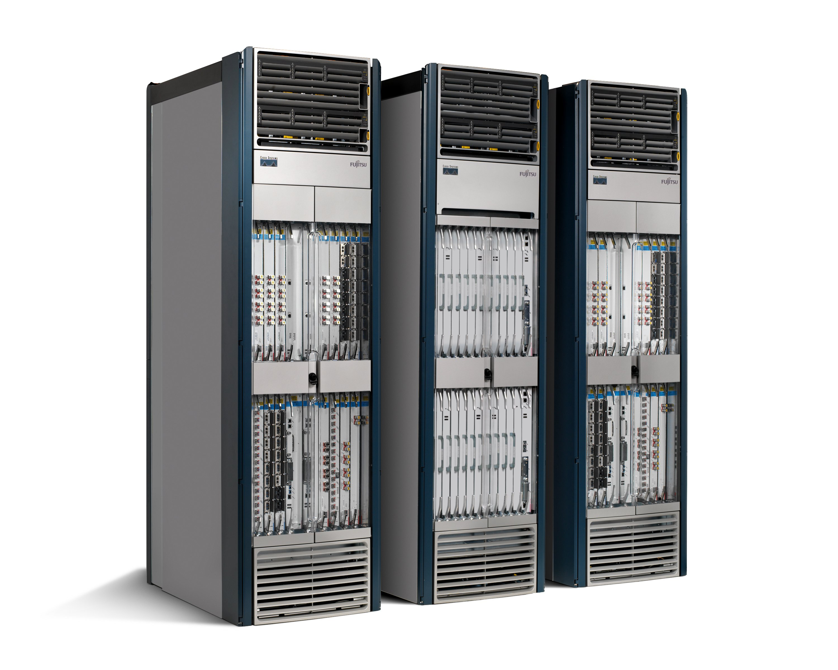
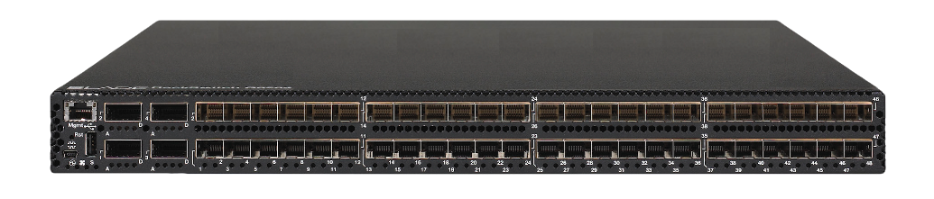
Network Elements
App
App
App
App
App
App
App
App
App
App
App
Specialized
Features
Open Interface
Control
Plane
Control
Plane
Control
Plane
or
or
Specialized
Control
Plane
Open Interface
Specialized
Hardware
Merchant
Switching Chips
Vertically integrated
Closed, proprietary
Slow innovation
Horizontal
Open interfaces
Rapid innovation
How does such a software-defined network look?
Notes:
Broadcom, Intel

Slide 34
Software-defined Network Architecture

Slide 35

OpenFlow: An SDN Architecture Example
OpenFlow API
API used to specify generalized forwarding actions
Three classes of OpenFlow messages:
controller-to-switch
asynchronous (switch to controller)
symmetric (misc.)
OpenFlow Controller

Slide 36
OpenFlow API
flow: defined by header field values (in link-, network-, transport-layer fields)
generalized forwarding: simple packet-handling rules
match: pattern values in packet header fields
actions: for matched packet: drop, forward, modify, matched packet or send matched packet to controller
priority: disambiguate overlapping patterns
counters: #bytes and #packets
Flow table
Router’s flow table define router’s match+action rules
match
action

Slide 37
OpenFlow API
Match
Action
Stats
Packet + byte counters
Forward packet to port(s)
Drop packet
Modify fields in header(s)
Encapsulate and forward to controller
Header fields to match:
Ingress Port
Src MAC
Dst MAC
Eth Type
VLAN
ID
VLAN
Pri
IP Src
IP Dst
IP Proto
IP
ToS
TCP/UDP Src Port
TCP/UDP Dst Port
Link layer
Network layer
Transport layer

Slide 38
OpenFlow: examples
Destination-based forwarding:
Switch
Port
MAC
src
MAC
dst
Eth
type
VLAN
ID
VLAN
Pri
IP
Src
IP
Dst
IP
Prot
IP
ToS
TCP
s-port
TCP
d-port
Action
*
*
*
*
*
*
*
51.6.0.8
*
*
*
*
port6
IP datagrams destined to IP address 51.6.0.8 should be forwarded to router output port 6
Firewall:
Switch
Port
MAC
src
MAC
dst
Eth
type
VLAN
ID
VLAN
Pri
IP
Src
IP
Dst
IP
Prot
IP
ToS
TCP
s-port
TCP
d-port
Action
*
*
*
*
*
*
*
*
*
*
*
22
drop
Block (do not forward) all datagrams destined to TCP port 22 (ssh port #)
Switch
Port
MAC
src
MAC
dst
Eth
type
VLAN
ID
VLAN
Pri
IP
Src
IP
Dst
IP
Prot
IP
ToS
TCP
s-port
TCP
d-port
Action
*
*
*
*
*
*
128.119.1.1
*
*
*
*
*
drop
Block (do not forward) all datagrams sent by host 128.119.1.1

Slide 39
OpenFlow: controller-to-switch messages
Key controller-to-switch messages
features: controller queries switch features, switch replies
configure: controller queries/sets switch configuration parameters
modify-state: add, delete, modify flow entries in the OpenFlow tables
packet-out: controller can send this packet out of specific switch port
OpenFlow Controller

Slide 40
OpenFlow: switch-to-controller messages
Key switch-to-controller messages
packet-in: transfer packet (and its control) to controller. See packet-out message from controller
flow-removed: flow table entry deleted at switch
port status: inform controller of a change on a port.
OpenFlow Controller

