Slide 1

Computer Networks: Session 3
INAE Faculty Mentorship Program
Tarun Mangla
Assistant Professor,
Department of Computer Science & Engineering,
IIT Delhi
Notes:
Today I'll talk about our work rethinking how we design speed tests. Speed tests are everywhere — billions are run every year by consumers, operators, regulators, researchers. But despite all that usage, the tools haven't kept up with what stakeholders actually need. I'll argue we should move beyond one-shot bandwidth numbers toward lightweight, diagnostic, longitudinal measurement.

Slide 2

Recap
Overview of the Internet
Architecture, performance metrics, socket programming, switched networks, decentralization, packet-switching
Pedagogy
Bottom-up vs top-down
In-class exercises, quizzes
Building from first principles
Design trade-offs and not “facts”
message
M
application
transport
network
link
physical
segment
H_{t}
M
H_{t}
datagram
H_{n}
H_{t}
H_{n}
M
frame
H_{l}
H_{n}
H_{t}
M
link
physical
switch
destination
H_{n}
H_{t}
M
network
link
physical
M
application
transport
network
link
physical
H_{l}
H_{n}
H_{t}
M
H_{n}
H_{t}
M
H_{t}
M
H_{n}
H_{t}
M
router
H_{l}
H_{n}
H_{t}
M

Slide 3
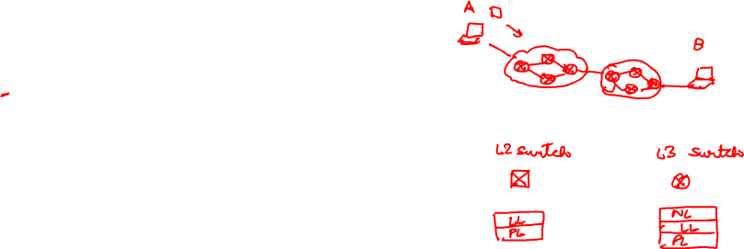
Today’s Session: Routing
How to route data?
within an L2-switched network (l2 routing)
within a single network (intra-domain routing)
across networks (inter-domain routing)

Slide 4
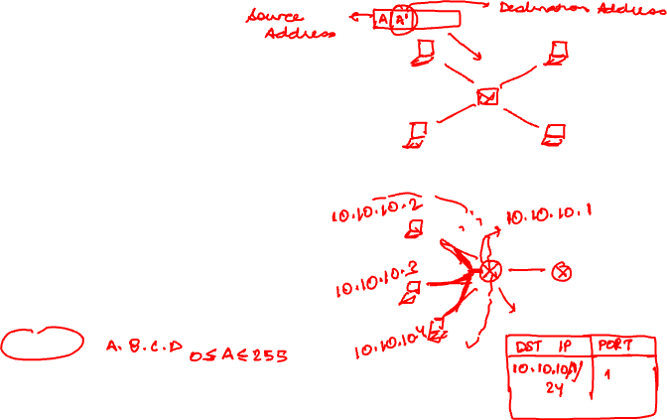
What is the first thing needed for routing?
Address: identifier for the host machines
Routing is destination-lookup based
Internet has two types of addresses
MAC addresses: used in the link layer
IP addresses: used in the network layer
MAC address:
Completely “flat” 48-bit number
For example: 00:40:05:1c:0e:9f
IP address
Hierarchical 32-bit number for IPv4
For example: 8.8.8.8
Each subnetwork has a prefix

Slide 5
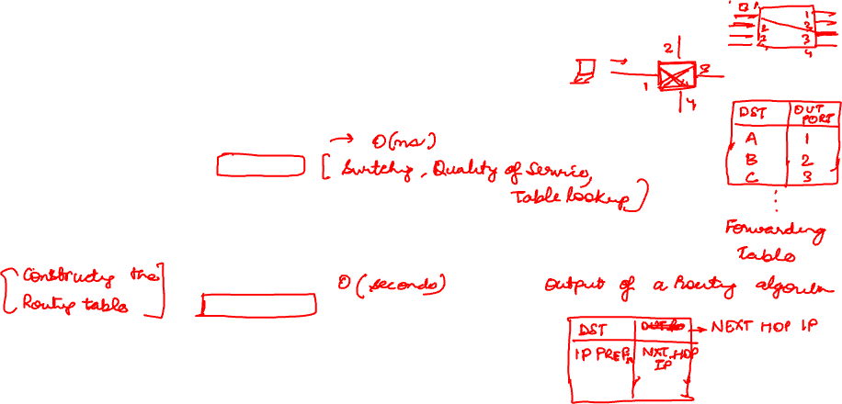
Routing and Forwarding
Each switch has multiple physical ports
Packet comes to an input port
Forwarded to an output port based on the destination
Two key functions
Forwarding
(data plane)
Move a frame from an input port to the appropriate output port
Uses a forwarding table: destination address → output port
Routing
(control plane)
Determine the forwarding table using routing algorithms
Network-wide, cooperative process (seconds–minutes)

Slide 6


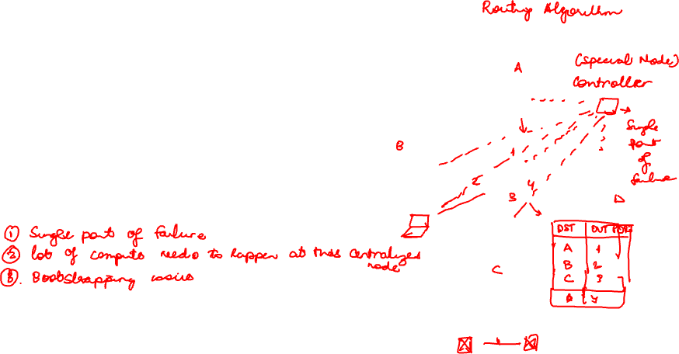



L2 Routing
Option 1: Using static tables added by network administrator
Difficult to support dynamic addition of nodes (end-hosts and switches)
Option 2: Using a centralized node
Method: Each switch registers with the node and the node computes the forwarding table
Option 3: Distributed algorithms
Each switch constructs the routing table independently
Messages are exchanges for sharing information about neighbors/hosts

Slide 7

Routing algorithm: Self-learning Switch
Source: A
switch learns which hosts can be reached through which interfaces
Dest: A’
A A’
A
C’
B
when frame received, switch “learns” location of sender: incoming LAN segment
1
2
6
3
5
4
records sender/location pair in switch table
B’
C
A’
Switch table
(initially empty)
MAC addr interface TTL
A
1
60

Slide 8
Self-learning switch
Source: A
switch learns which hosts can be reached through which interfaces
Dest: A’
A A’
A
C’
B
1
2
6
A A’
A A’
A A’
A A’
A A’
3
5
4
B’
C
frame destination, A’, location unknown:
A’ A
A’
flood
MAC addr interface TTL
destination A location known:
A
1
60
switch table
(initially empty)
selectively send
on just one link
A’
4
60

Slide 9
L2 Routing: Self-learning Switch
when frame received at switch:
1. record incoming link, MAC address of sending host
2. index switch table using MAC destination address
3. if entry found for destination then {
if destination on segment from which frame arrived then drop frame
else forward frame on interface indicated by entry
}
else flood /* forward on all interfaces except arriving interface */

Slide 10


Interconnecting switches
self-learning switches can be connected together:
S₄
1
3
S₁
2
S₃
A
1
S₂
1
F
1
3
2
3
D
2
3
2
I
B
C
E
G
H
Self learning! (works exactly the same as in single-switch case!)
Q: show switch tables and packet forwarding in S₁, S₂, S₃, S₄

Slide 11
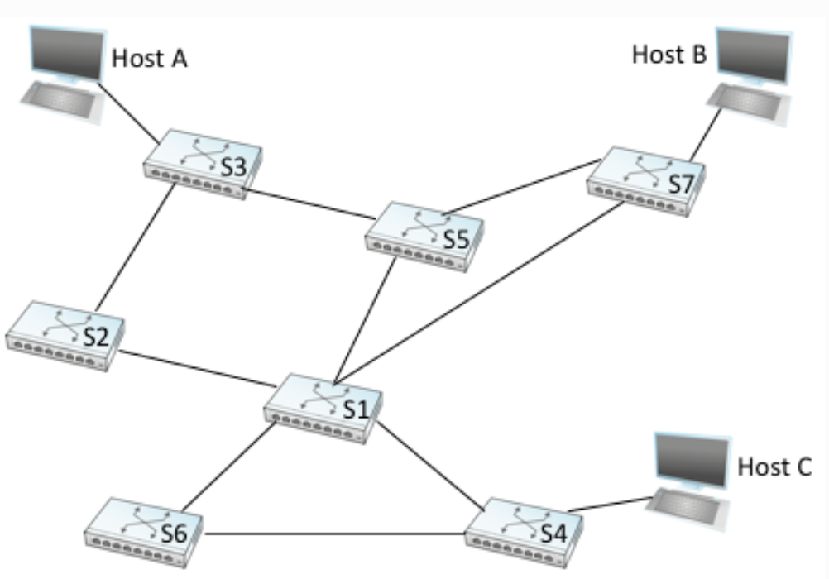
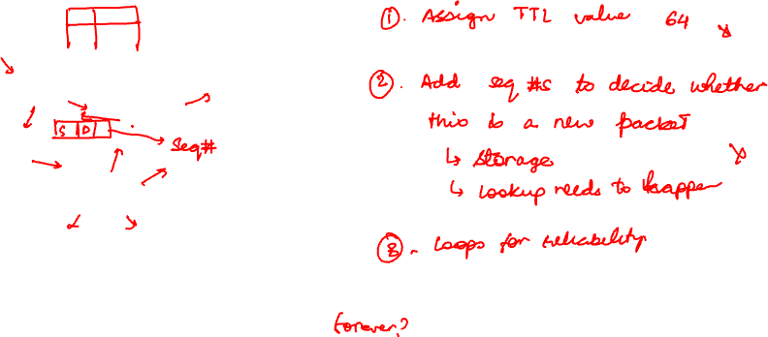
What happens in case of a loop?
When host A sends a packet to B, the packets will circulate forever inside the network on all the switches because they forward it indefinitely
How do we prevent packets from looping?

Slide 12
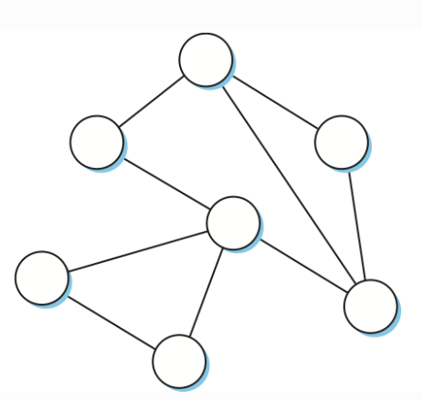
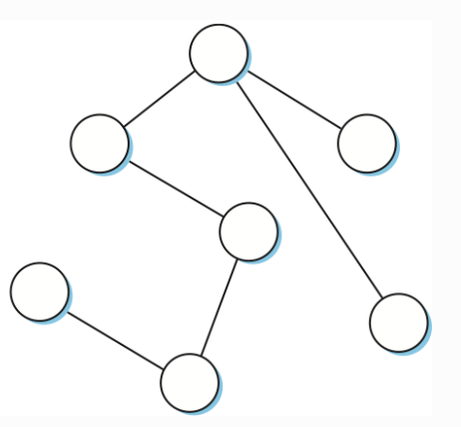
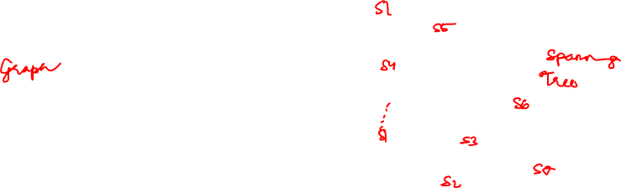
Break the Loop (Logically)
Idea: All nodes should be connected but there should be no cycles
Spanning tree: subgraph that covers all vertices but contains no cycles
Switches will only forward on ports lying on the spanning tree
How to create the spanning tree?
Requirement: distributed algorithm
Challenge: How to create the same spanning tree in a distributed manner

Slide 13

Distributed Spanning Tree Algorithm: Key Idea
All switches pick a common “root” switch — whichever has the lowest Ethernet address (assumes unique addresses)
All other switches select the shortest path to that root switch; any links not on the shortest path of at least one switch are removed
Tie-break: pick the hop with the lower MAC address
If information is stale, timeout so that if a link fails a different tree is chosen

Slide 14
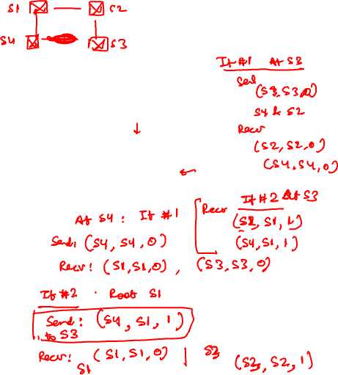
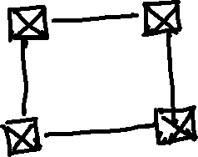
STP (Details)
Initially, each switch thinks it is the root
Tell its neighbors that I have a path to the root (me) with 0 hops
When receives message from a smaller switch ID, stop generating own configuration messages

Slide 15
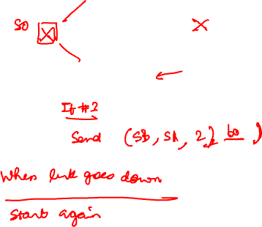
STP (Details)
Initially, each switch thinks it is the root
Tell its neighbors that I have a path to the root (me) with 0 hops
When receives message from a smaller switch ID, stop generating own configuration messages
If someone else is the root
Keep track of the shortest path to X that anyone has advertised
Tell all my neighbors except the one with better path about this shortest path to X
If someone else advertises a path to X that is shorter than mine, update my idea of a shortest path. Re-advertise

Slide 16
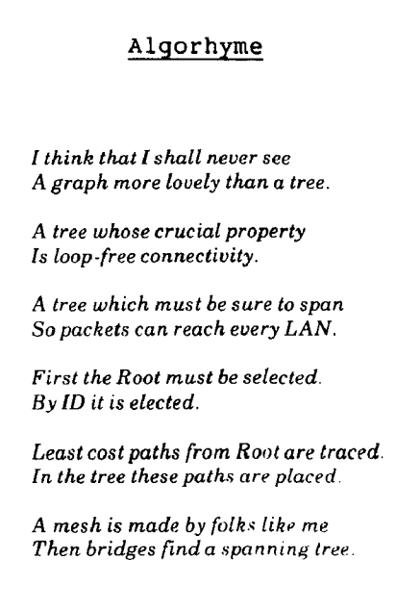
Spanning Tree Protocol
Fun fact: Invented by Radia Perlman from Digital Equipment Corporation (DEC)

Slide 17
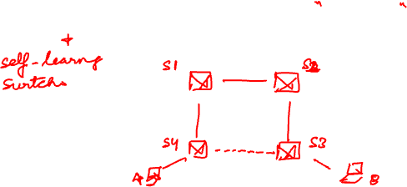
Question: Spanning Tree Algorithm and Performance
Does the spanning tree algorithm find optimal path?

Slide 18
Break
5 minutes

Slide 19
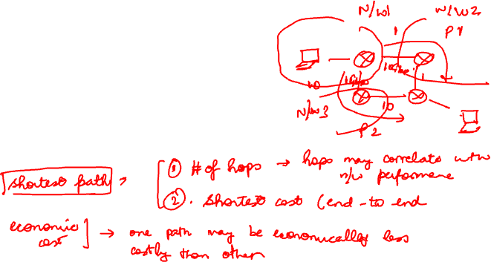
Performance of Spanning Tree Protocol
The spanning tree protocol + flooding-based routing is designed to support extremely simple forwarding switches.
It does not focus on performance at all
Can we design better routing algorithms?
What do we mean by “better”?

Slide 20

Two Types of Routing
Routing domain: An internetwork where all the routers are under the same administrative control (e.g., university campus or an ISP)
Intra-domain routing: routing packets within a domain
Simpler routing policy under one administrative domain
Shorter or faster paths → better routes
Inter-domain routing: routing packets across multiple domains
E.g., across IITD and NKN network
Involve complex policies driven by economics

Slide 21
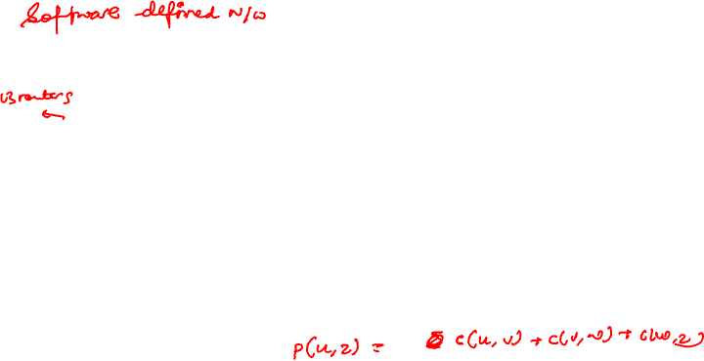
Intra-domain Routing: Graph Abstraction
c_{a,b}: cost of direct link connecting a and b
e.g., c_{w,z} = 5, c_{u,z} = ∞
cost defined by network operator: could always be 1, or inversely related to bandwidth, or inversely related to congestion
5
v
3
w
2
5
u
2
1
z
3
1
2
x
y
1
Routing is to find the lowest-cost path between any two nodes
Cost of a path == Sum of the costs of all the edges that make up the path
graph: G = (N,E)
N: set of routers = { u, v, w, x, y, z }
E: set of links ={ (u,v), (u,x), (v,x), (v,w), (x,w), (x,y), (w,y), (w,z), (y,z) }
How to determine shortest path from one node to all other nodes in a graph?

Slide 22
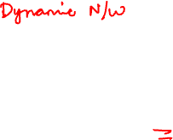
Why not use static routing?
One might calculate all shortest paths and load them into routers
Problems:
Alternatives: dynamic and/or distributed protocol
Distance vector
Link state

Slide 23
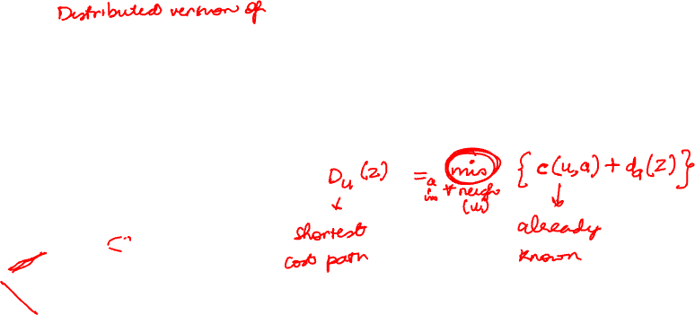
Distance vector algorithm
Based on Bellman-Ford (BF) equation (dynamic programming):
Suppose that u’s neighboring nodes, x,v,w, know that for destination z:
D_{v}(z) = 5
D_{w}(z) = 3
5
v
3
w
2
5
u
2
1
z
3
1
2
x
y
1
D_{x}(z) = 3

Slide 24
Distance vector algorithm
key idea:
Every T seconds, each router sends its own distance vector estimate to neighbors
when x receives new DV estimate from any neighbor, it updates its own DV using BF equation:
D_{x}(y) ← min_{v}{c_{x,v} + D_{v}(y)} for each node y ∊ N
under minor, natural conditions, the estimate D_{x}(y) converge to the actual least cost d_{x}(y)

Slide 25



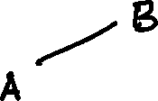
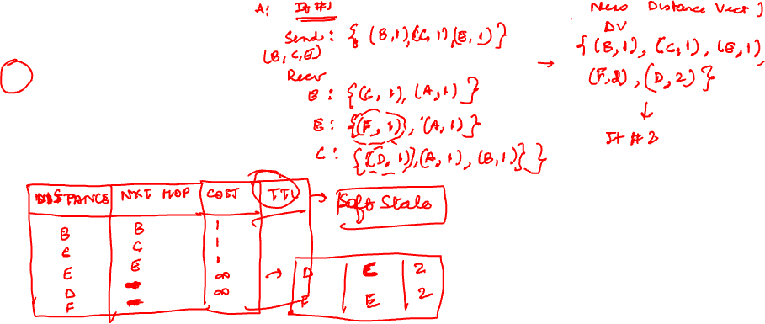

Distance vector: Example

Slide 26
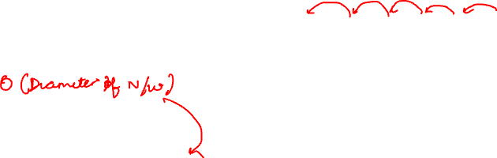
Good News Travels Fast, Bad News Travels Slow!
Assume a new node F comes up in the network
How long does it take for the A to update their routing table?
In general, good news spreads at rate of one hop per exchange
What is the maximum time it can take?
What happens in case of link failure?

Slide 27

Count-to-infinity Problem
A
B
C
A-B link DOWN → B cannot directly reach A
✕
cost=1
cost=1
Node B — Routing Table
Node C — Routing Table
Round 0: Initial (before failure)
Round 0: Initial (before failure)
Dest
Cost
Next
Dest
Cost
Next
B
0
—
B
1
B
A
1
A
A
2
B
Round 1: A-B link down — B detects
Round 1: A-B link down — B detects
Dest
Cost
Next
Dest
Cost
Next
B
0
—
B
1
B
A
∞
—
A
2
B
Round 2: C advertises → B updates
Round 2: C advertises → B updates
Dest
Cost
Next
Dest
Cost
Next
B
0
—
B
1
B
A
3
C
A
2
B
Round 3: B advertises → C updates
Round 3: B advertises → C updates
Dest
Cost
Next
Dest
Cost
Next
B
0
—
B
1
B
A
3
C
A
4
B
Round 4: C advertises → B updates
Round 4: C advertises → B updates
Dest
Cost
Next
Dest
Cost
Next
B
0
—
B
1
B
A
5
C
A
4
B
Round 5: B advertises → C updates
Round 5: B advertises → C updates
A
∞
—
A
∞
—
Each round cost(A) grows by 1 (B: 1→∞→3→5→∞, C: 2→2→4→6→∞) — neither node learns the link is truly broken

Slide 28
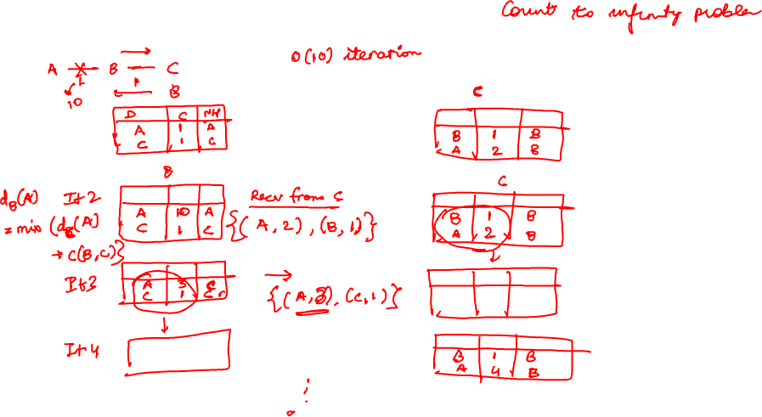

Slide 29

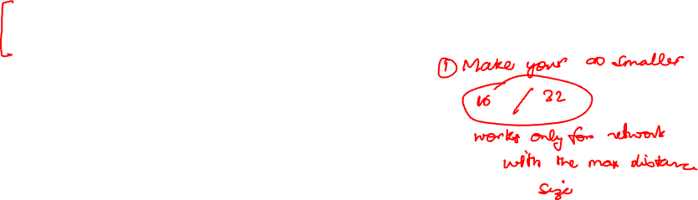

How to Handle Count to Infinity Problem?
Split horizon
Don’t announce the route back to the next hop
Does it always work?

Slide 30
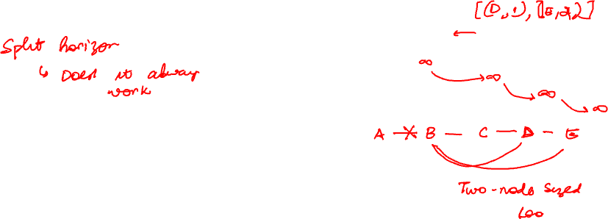
How to Handle Count to Infinity Problem?
Split horizon
Don’t announce the route back to the next hop
Does it always work?

Slide 31
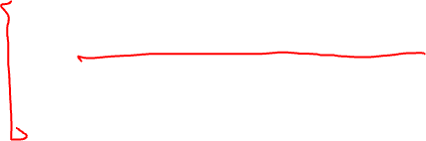
How to Handle Count to Infinity Problem?
Split horizon
Don’t announce the route back to the next hop
Make infinity smaller
Routing Information Protocol (RIP): Based on hop count
Used a maximum length of 15
Limitation: Doesn’t work for cases when actual path length is greater than 15

Slide 32
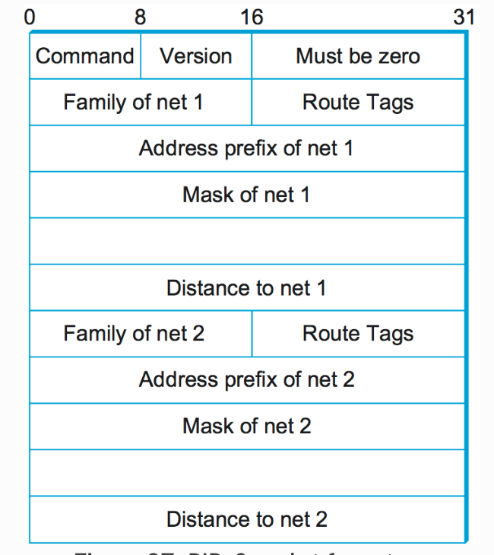
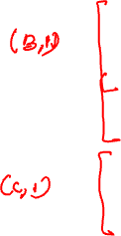
RIP Message Format
RIPv2 Protocol Message Format

Slide 33
Distance Vector: Summary
Building a routing table by distributing vector of distances to neighbors
Completely distributed and based only on knowledge of immediate neighbors
Simpler computation, small update message size
Slow convergence
Count to infinity problem and limited network diameter
Used in small-sized networks (E.g., LAN or private wide-area networks)

Slide 34
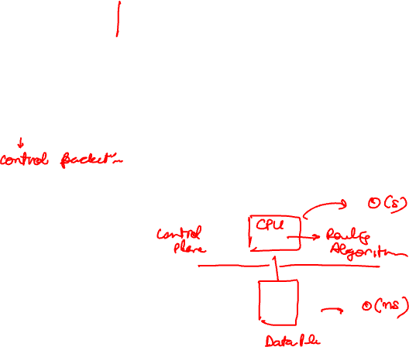
Link State Routing Algorithm
Each node knows the entire network topology including link costs:
accomplished via “link state broadcast”
all nodes have same info
Link state broadcast:
(x, {list of neighbors, cost}, seq #, TTL)
reliable broadcast using acknowledgements
Once a node has the entire topology:
Use Dijkstra’s algorithm to find the shortest path

Slide 35
Reliable Flooding
Goal: Ensure every node have most recent LSP from each node
Forward LSP to all nodes but one that sent it
Send an acknowledgment back to the sending node
Retransmit the LSP if an acknowledgment is not received within a certain time frame
Generate new LSP periodically; increment SEQNO. This helps routers compare updates to determine the newer one
Start SEQNO at 0 when reboot (this creates a host of issues we’ll ignore)
Discard old LSPs after a timeout (e.g. 1 hour)

Slide 36
Dijkstra’s link-state routing algorithm
1 Initialization:
2 N' = {u} /* compute least cost path from u to all other nodes */
3 for all nodes v
4 if v adjacent to u /* u initially knows direct-path-cost only to direct neighbors */
5 then D(v) = c_{u,v} /* but may not be minimum cost! */
6 else D(v) = ∞
7
8 Loop
9
10
11
12
13
14
15 until all nodes in N'
find w not in N' such that D(w) is a minimum
add w to N'
update D(v) for all v adjacent to w and not in N' :
D(v) = min ( D(v), D(w) + c_{w,v} )
/* new least-path-cost to v is either old least-cost-path to v or known
least-cost-path to w plus direct-cost from w to v */

Slide 37
Dijkstra’s algorithm: an example
v
w
x
y
z
Step
0
1
2
3
4
5
N'
D(v),p(v)
D(w),p(w)
D(x),p(x)
D(y),p(y)
D(z),p(z)
D(w),p(w)
5,u
4,x
3,y
3,y
5
v
3
w
2
5
u
2
1
z
3
1
2
x
y
1
Two popular link state routing protocols: Intermediate System to Intermediate System (IS-IS), Open Shortest Path First (OSPF)

Slide 38
Takeaways
L2: learn MACs, flood the unknown, spanning tree breaks loops — no shortest path.
L3 routing: a distributed shortest-path computation over the router graph.
Distance vector: know only neighbors. Cheap, but slow convergence and count-to-infinity.
Link state: flood the topology, run Dijkstra locally. Fast and loop-free, more overhead.
Trade-off: local vs. global knowledge — RIP/EIGRP vs. OSPF/IS-IS.
Distributed protocols at the heart of routing

Slide 39
Common Misconceptions Among Students

