Slide 1

Computer Networks: Session 1
INAE Faculty Mentorship Program
Tarun Mangla
Assistant Professor,
Department of Computer Science & Engineering,
IIT Delhi
Notes:
Today I'll talk about our work rethinking how we design speed tests. Speed tests are everywhere — billions are run every year by consumers, operators, regulators, researchers. But despite all that usage, the tools haven't kept up with what stakeholders actually need. I'll argue we should move beyond one-shot bandwidth numbers toward lightweight, diagnostic, longitudinal measurement.

Slide 2
Program Expectations
This is not a course on networks. It is a course on teaching networks — we will use networks content as the material to do that
The program runs through case studies and discussion, not lectures-at-you
Request: Everyone contributes
Will be more fun
If you have a question, others likely do too

Slide 3
Pre-survey Results
Results link

Slide 4
Key decisions in teaching a networks course
Learning objectives
Course content
Pedagogy

Slide 5
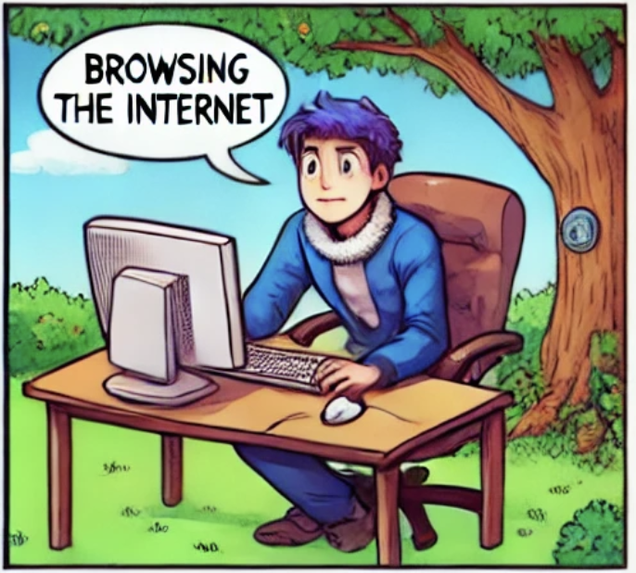
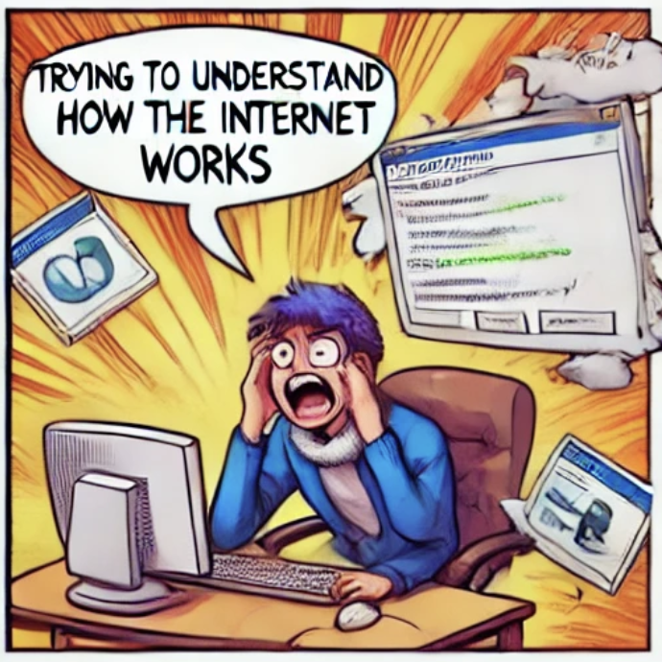
Learning Objectives
Question: What learning objectives do you currently have for your CN course?
What learning objectives should mean: what a student can do at the end — not just “know about”
Example learning objectives:
Understand what is “under the hood” of the Internet
Understand why the Internet was designed this way
Develop custom networked applications and services

Slide 6
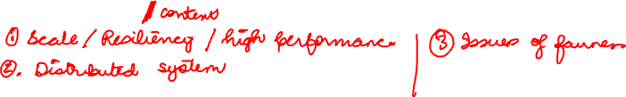
Course Content
Question: how do you decide what goes into the course?
Do you face a dilemma about how much to cover, especially as the field has advanced?
One way to think about it: which concepts are genuinely unique to networking — concepts, not artifacts
Unique to networking: resource allocation in a shared medium with no central control, addressing vs naming
Not unique — an artifact: memorizing the fields of the TCP header, or the exact CLI of a particular tool
Other concepts?

Slide 7
Pedagogy: Things to keep in mind
Teach the why, not just the what or how
Have students arrive at design principles, not be handed them
Frame ideas as tradeoffs, not facts
Pair concepts with concept-revealing labs
Analogies: postal system, traffic, day-to-day stuff
Historical anecdotes: make design feel contingent, not inevitable

Slide 8
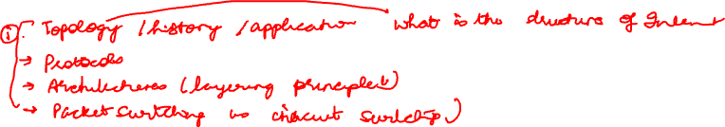
Today’s Module: How to introduce Computer Networks
Option 1: Define what it is upfront
Option 2: Building network from first principles

Slide 9
Why this course matters
Internet underpins nearly every system you'll build or rely on
Teaches how to design for billions of users across untrusted parties
Core principles, such as layering, decentralization, robustness, apply to every large-scale system
A rare design that has lasted decades while still evolving
Intuitions transfer to distributed systems, cloud, security, and AI

Slide 10
Where does this course fit in broader CS?
The three parts of computer science
Theory
Focuses on the fundamental limits of computation and knowledge. What problems can computers solve in principle, and how efficiently? What does it mean to prove something?
Artificial intelligence
Asks how computers can perceive, reason, and act in the real world — thinking in terms of uncertainty and approximation, grounded in rigorous models and experimental evidence.
Computer Systems (this course)
Examines how to build real-world systems that actually work. How do hardware and software interact? What are the tradeoffs in performance, reliability, and scalability?

Slide 11



Popular applications on the Internet
What do these apps have in common?
Connectivity. In principle, the network just needs to transfer bytes — but be flexible enough to meet each app's different needs.
WWW, streaming, real-time communication, massive distributed compute

Slide 12
Network design requirements
A network that supports:
Common services via well-defined abstractions
Scalable connectivity
Cost-efficient resource sharing
Resilience to failures
Extensibility for new apps and technologies
How do you build such a network?

Slide 13
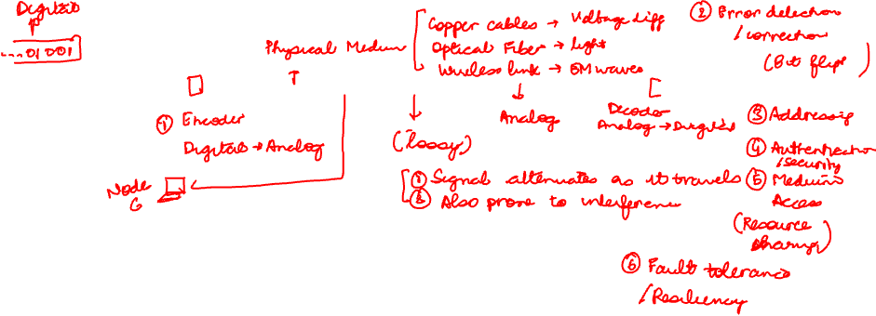
How do you build a simple network?
Node A
Node B
Core task: convert digital bits to/from an analog signal across a physical medium
Caveat: signals are lossy — attenuation, noise, interference

Slide 14
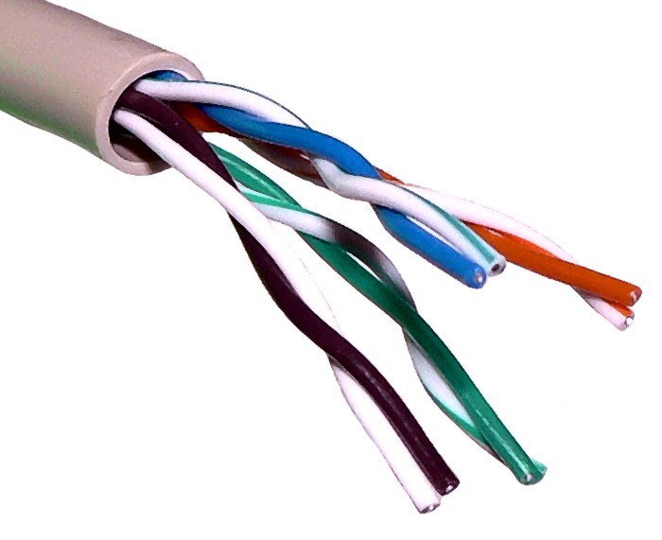
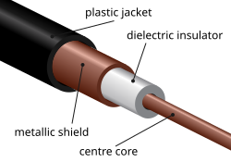
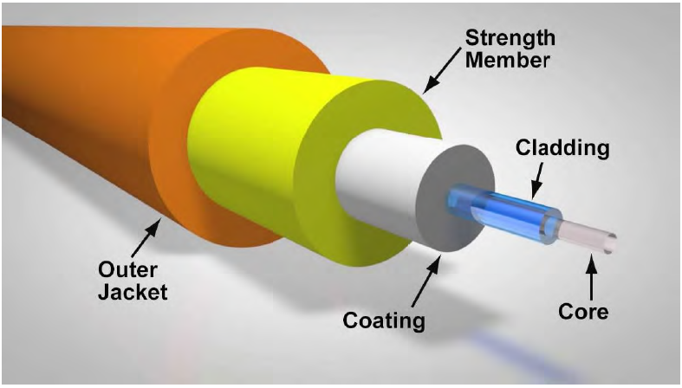
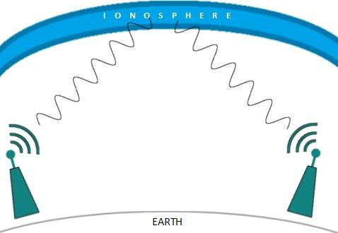
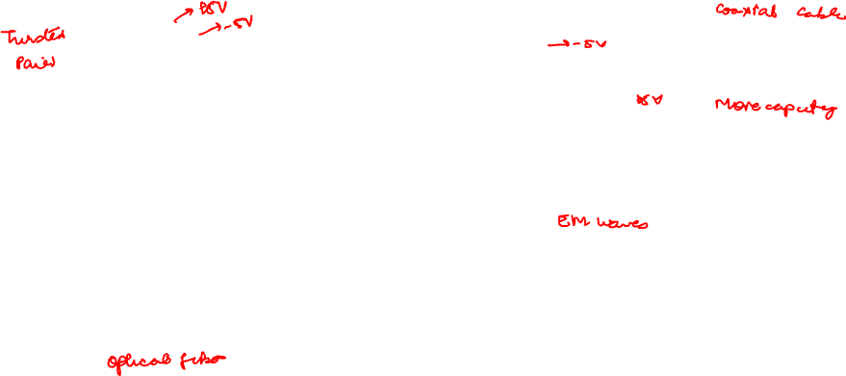
Types of Physical Medium

Slide 15
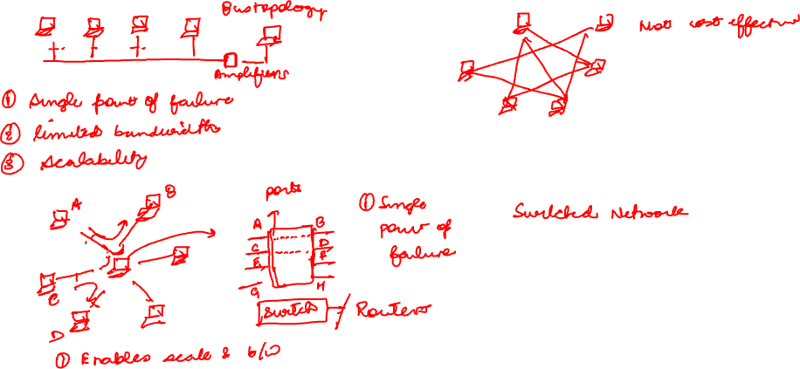
How do we build a network of n (n > 2) computers?

Slide 16
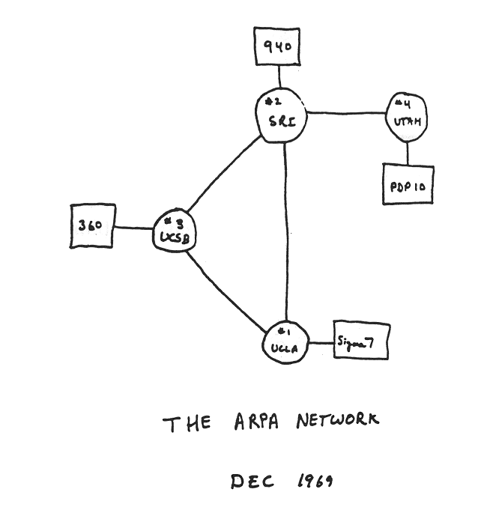
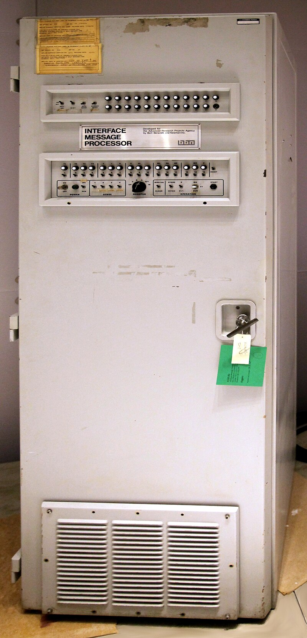
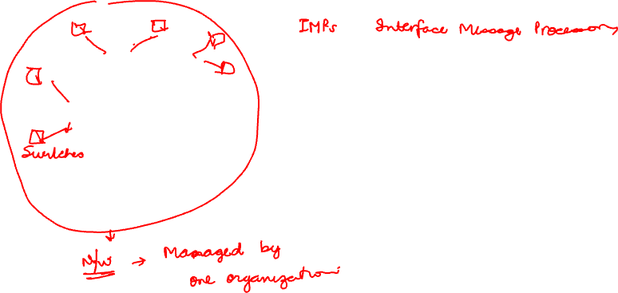
The first computer network (ARPANET)
Key takeaway: A switched device (router/switch) is what makes scaling possible

Slide 17
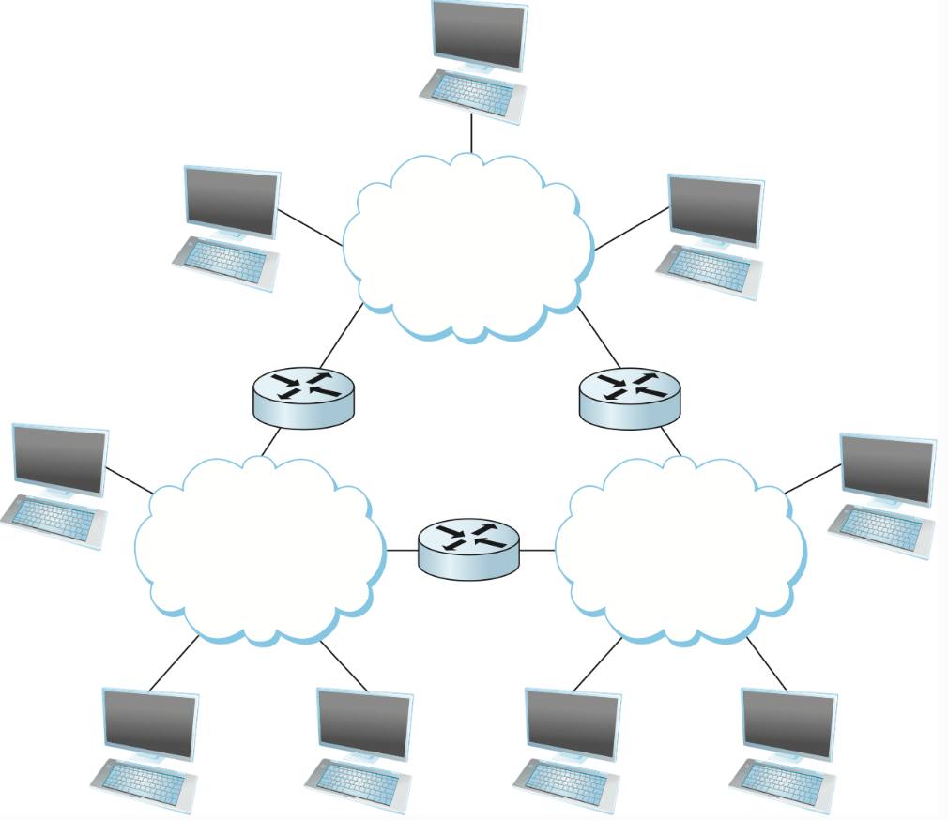
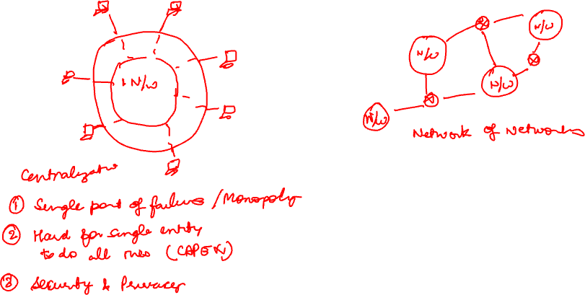
How do we connect a billion machines over the globe?

Slide 18
















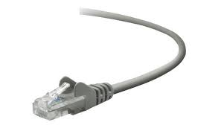
The Internet: a network of networks
Billions of connected computing devices:
hosts = end systems
running network apps at Internet’s “edge”
mobile network
national or global ISP
Packet switches: forward packets (chunks of data)
routers, switches
local or regional ISP
Internet
Communication links
fiber, copper, radio, satellite
transmission rate: bandwidth
home network
content
provider
network
datacenter
network
Networks
collection of devices, routers, links: managed by an organization
enterprise
network
Notes:
What do I mean by Internet. It is a public network that anyone can connect to. It consists of

Slide 19
Break
5 minutes

Slide 20
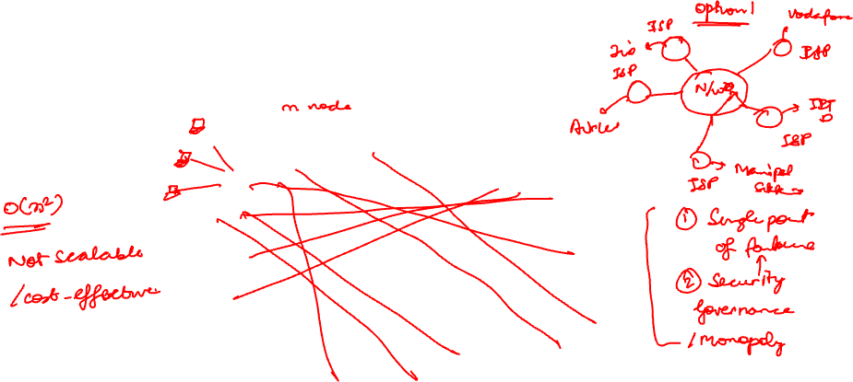
Structure of the Internet
Given millions of access networks, how do we connect them?
Evolution driven by economics and national policies
…
access
net
…
access
net
access
net
access
net
access
net
access
net
access
net
…
…
access
net
access
net
access
net
access
net
access
net
…
access
net
access
net
access
net
access
net
…

Slide 21
Structure of the Internet
Given millions of access networks, how to connect them?
Option: connect each access ISP to one global transit ISP?
Customer and provider ISPs have economic agreement.
…
access
net
…
access
net
access
net
access
net
access
net
access
net
access
net
…
global ISP
…
access
net
access
net
access
net
access
net
access
net
…
access
net
access
net
access
net
access
net
…

Slide 22
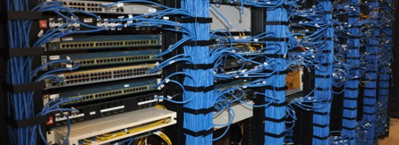
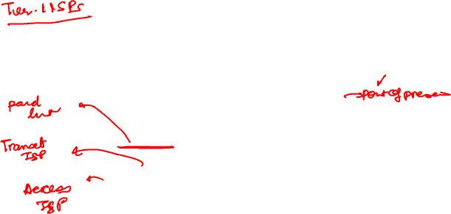
Internet structure: a “network of networks”
But if one global ISP is viable business, there will be competitors …. who will want to be connected
Internet exchange point
…
…
access
net
access
net
access
net
access
net
access
net
IXP
access
net
access
net
ISP A
…
…
access
net
IXP
ISP B
access
net
ISP C
access
net
access
net
peering link
access
net
access
net
…
access
net
access
net
…
access
net

Slide 23

Internet structure: a “network of networks”
… and regional networks may arise to connect access nets to ISPs
…
…
access
net
access
net
access
net
access
net
access
net
IXP
access
net
access
net
ISP A
…
…
access
net
IXP
ISP B
access
net
ISP C
access
net
access
net
access
net
regional ISP
access
net
…
access
net
access
net
…
access
net

Slide 24
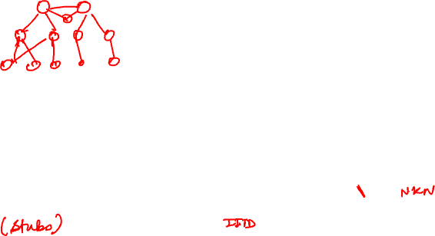
3-tier Internet Architecture
Tier-1 ISP
Global reach; doesn't pay for transit
E.g., TATA Communications, AT&T
Tier-2 ISP
Customer to some, provider/peer to others
Tier-3 ISP
Acts only as customer (no downstream networks)
access
net
access
net
access
net
access
net
access
net
IXP
access
net
access
net
ISP A
…
…
access
net
IXP
ISP B
access
net
ISP C
access
net
access
net
access
net
regional ISP
…
access
net
access
net
access
net
access
net
…
Is it that neat?

Slide 25
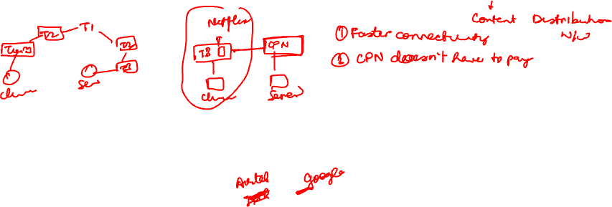
Internet structure: a “network of networks”
Content provider networks (e.g., Google, Microsoft, Akamai) may run their own network..
But why?
This has led to flattening of the Internet
…
access
net
…
access
net
access
net
access
net
access
net
IXP
access
net
access
net
ISP A
…
…
Content provider network
access
net
IXP
ISP B
access
net
ISP C
access
net
access
net
access
net
regional ISP
…
access
net
access
net
access
net
access
net
…

Slide 26

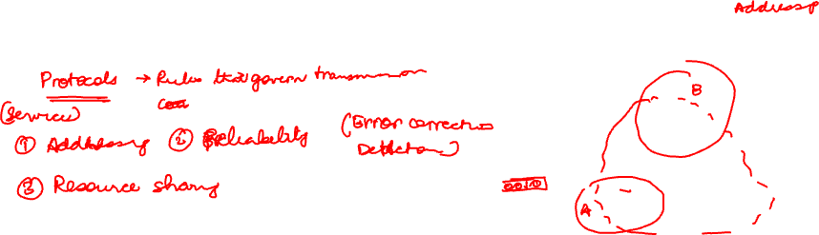
How to send data over the Internet?
Now that we know how the Internet is structured — what does it actually take to send data across it?
What functions need to be implemented?
Can everyone implement these functions as they feel?

Slide 27



What’s a network protocol?
Hi
Network protocols:
Rules for:
… specific messages sent
… specific actions taken when message received, or other events
… similar to human protocols but designed for machines
Hi
Got the
time?
2:00
Protocols define the format, order of messages sent and received among network entities, and actions taken on message transmission, receipt
TCP connection
request
TCP connection
response
Request For Comments (RFCs) specifying the protocols
Standardization bodies: IETF, IAB etc.
GET http://www.google.com
<file>
time

Slide 28
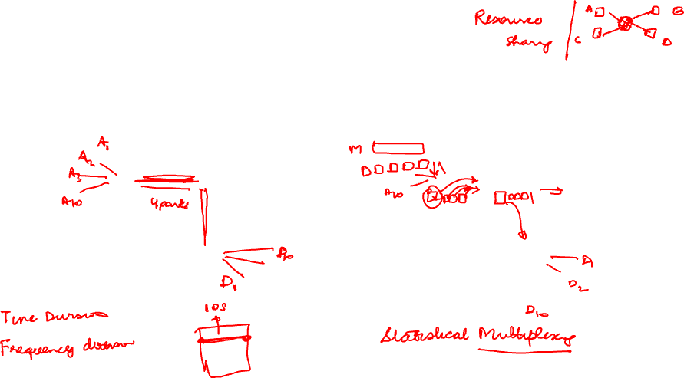
How to share the common network across hosts?
Circuit Switching
Packet Switching
End-end resources allocated to, reserved for“call” between source and destination
Divide the data into packets of size L bits, each packet is transmitted at link bandwidth​
Store and forward approach
Which option did the Internet choose?

Slide 29
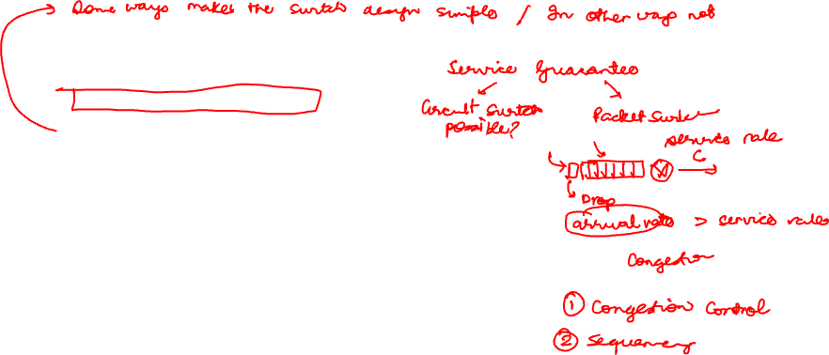
Packet-switching versus circuit switching
Internet uses packet switching
Great for “bursty” data – sometimes has data to send, but at other times not
Efficient resource sharing (why?)
Simpler*, no call setup unlike circuit switching
however, does not provide any performance guarantee, best-effort delivery
excessive congestion possible: packet delay and loss due to buffer overflow
need to implement reliable data transfer, in-order delivery, congestion control
Implication on router design

Slide 30
Takeaways
Switched networks enable scaling
lets many nodes share infrastructure without dedicated circuits
Internet = network of independently operated networks (ISPs)
easy to scale, resilient, pragmatic concerns of governance
Internet structure
started with a three-tier ISP hierarchy
giving way to a flatter topology driven by CDNs and IXPs
Packet switching
enables efficient resource sharing when data is bursty
leads to best-effort delivery and shapes router design

Slide 31

What is the official unit of energy?

Slide 32

In a packet-switched network w/ each link having a bandwidth 100 kbps. What is the end-to-end transmission delay for sending 1 kbit data?

Slide 33
Which statement is NOT true for packet switching.

Slide 34
Congestion control needs to be implemented in a circuit-switched network

Slide 35
And the winner is... 🥁

Slide 36
How to think about Internet architecture?
Common Network Services
Data transmission (encoding, decoding)
Reliability
Addressing/routing
Rate control
..
Network structure
Is there a way to reason about the Internet architecture or how to place these network services?

Slide 37
Power of abstraction

