Slide 1

Computer Networks: Session 2
INAE Faculty Mentorship Program
Tarun Mangla
Assistant Professor,
Department of Computer Science & Engineering,
IIT Delhi
Notes:
Today I'll talk about our work rethinking how we design speed tests. Speed tests are everywhere — billions are run every year by consumers, operators, regulators, researchers. But despite all that usage, the tools haven't kept up with what stakeholders actually need. I'll argue we should move beyond one-shot bandwidth numbers toward lightweight, diagnostic, longitudinal measurement.

Slide 2
Session Expectations
Not a course on networks — a course on teaching networks
Case studies and discussion, not lectures
Everyone contributes
More fun
Your question is probably someone else's too

Slide 3
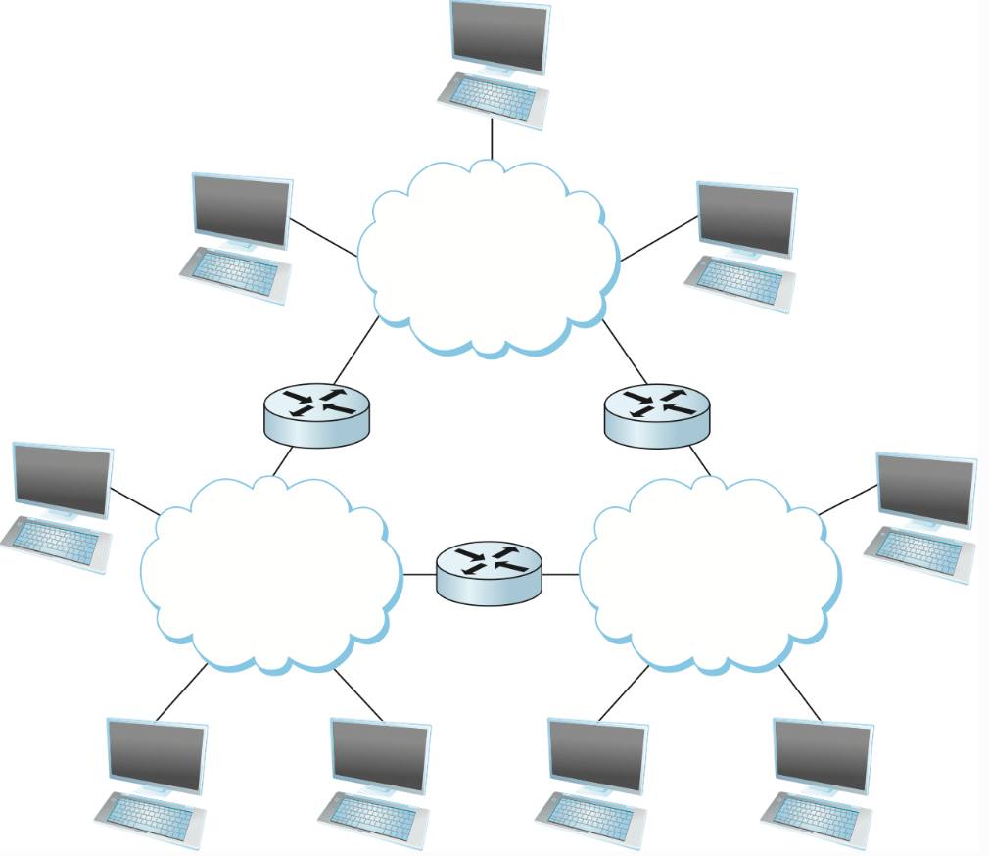
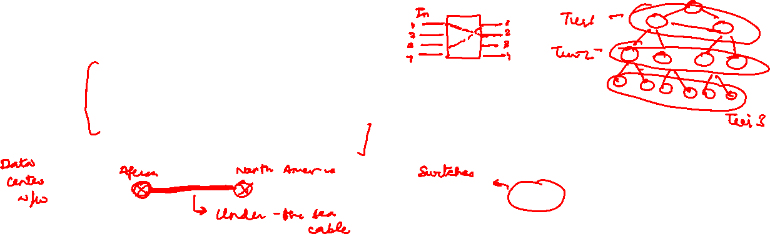
Recap
Overview of the Internet
switched networks, decentralization for scale and resiliency, 3-tiered Internet structure, packet switching vs circuit switching
Pedagogy
Design from first principles
Focusing on the why and design trade-offs

Slide 4

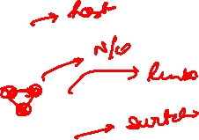
Today’s session: How to design and implement Internet?
Common Network Services
Data transmission (encoding, decoding)
Reliability
Addressing/routing
Congestion control
In-order delivery
..
Network structure
Given this long list of services and components, thinking about the architecture might be one way to go about it.

Slide 5
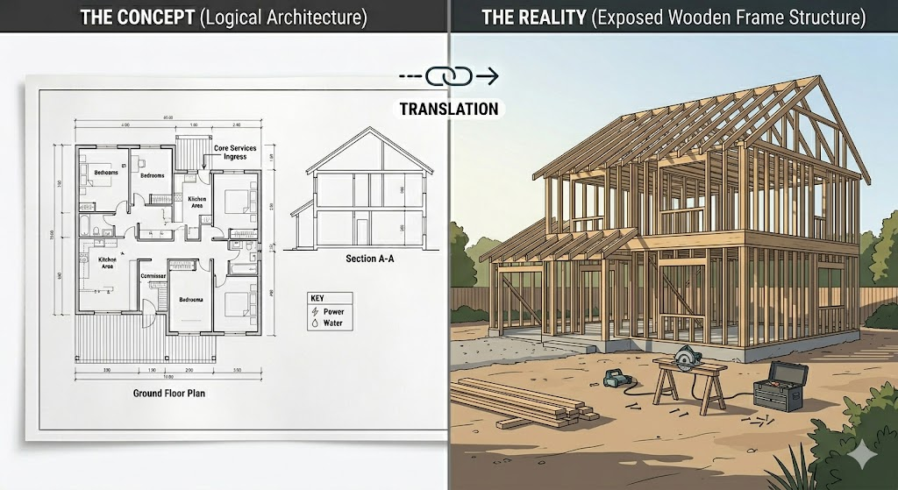
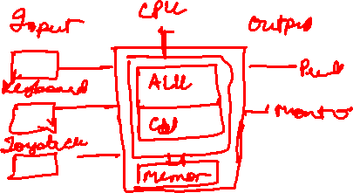
What do we mean by architecture and why is it needed?
Architecture = a working model of a system
Descriptive: captures the current system
Prescriptive: guides how it evolves over time
Why it matters
Separates what a module does from how it does it
Enables modules to evolve independently
In a systems context
Specify the modules that make up the system
Specify the interfaces between those modules
Notes:
Analogy: architecture of a house
Specifies functional components (rooms, layout)
Specifies interfaces (doors, connections)
Does not specify materials or finishes

Slide 6
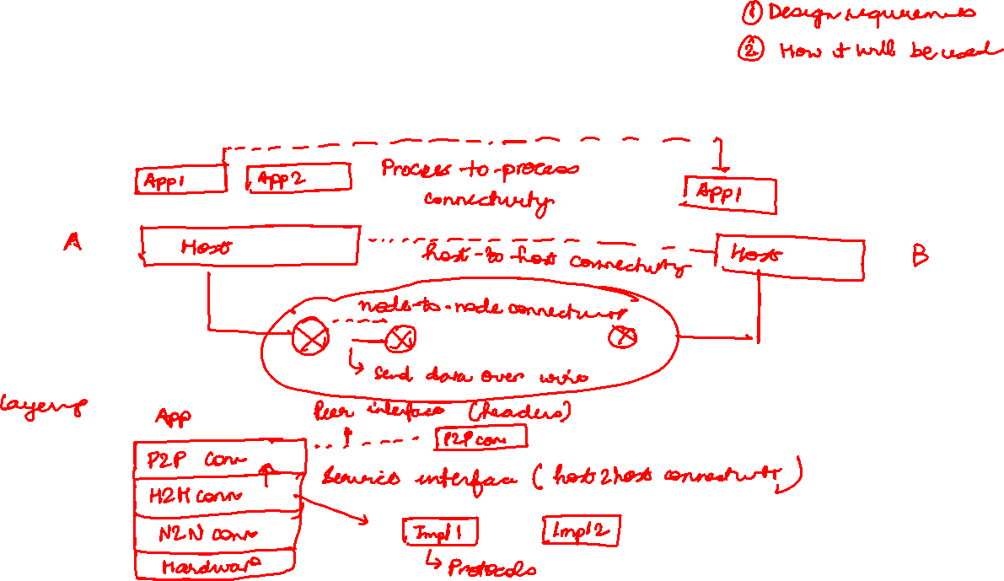
How do we reason about Internet architecture?

Slide 7
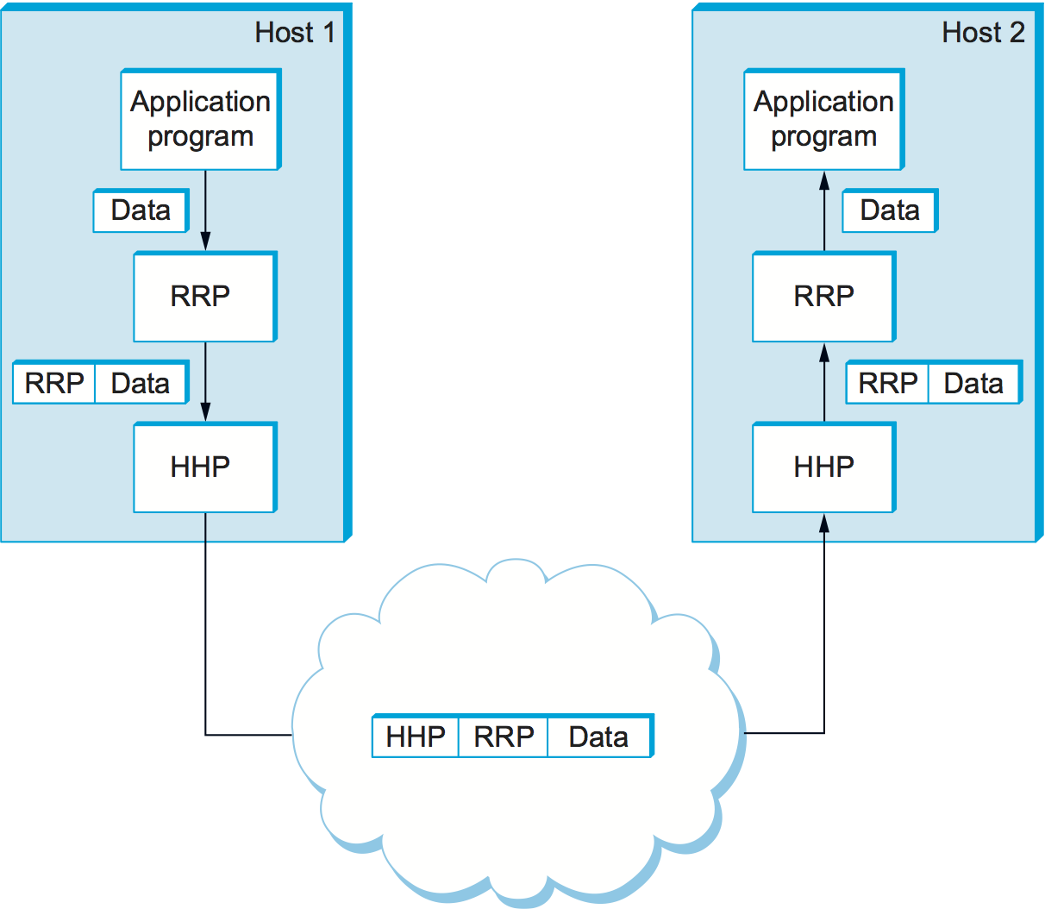
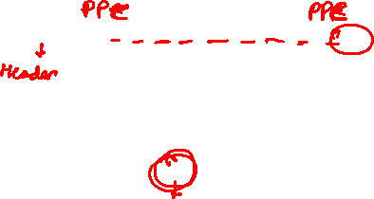
Implementing layers through encapsulation
Every layer adds its own headers to the data. On the other end, every layer removes its headers

Slide 8

Today’s Internet Architecture
application: supporting network applications
transport: process-process data transfer
network: routing of datagrams from source to destination
link: data transfer between neighboring network elements
physical: bits “on the wire”
application
application
transport
transport
network
network
link
link
physical
physical

Slide 9

Different protocols in each layer
application: supporting network applications
HTTP, IMAP, SMTP, DNS, FTP
transport: process-process data transfer
TCP, UDP
network: routing of datagrams from source to destination
IP, routing protocols
link: data transfer between neighboring network elements
Ethernet, 802.11 (WiFi), PPP
physical: bits “on the wire”
application
application
transport
transport
network
network
link
link
physical
physical

Slide 10

Layering and encapsulation
application
transport
network
link
physical
M
application
transport
network
link
physical
Application exchanges messages to implement some application service using services of transport layer
H_{t}
M
Transport-layer protocol transfers M (e.g., reliably) from one process to another, using services of network layer
transport-layer protocol encapsulates application-layer message, M, with transport layer-layer header H_{t} to create a transport-layer segment
H_{t} used by transport layer protocol to implement its service
source
destination

Slide 11
Services, Layering and Encapsulation
application
transport
network
link
physical
M
application
transport
network
link
physical
H_{t}
M
Transport-layer protocol transfers M (e.g., reliably) from one process to another, using services of network layer
H_{n}
H_{t}
M
Network-layer protocol transfers transport-layer segment [H_{t} | M] from one host to another, using link layer services
network-layer protocol encapsulates transport-layer segment [H_{t} | M] with network layer-layer header H_{n} to create a network-layer datagram
H_{n} used by network layer protocol to implement its service
source
destination

Slide 12
Services, Layering and Encapsulation
H_{n}
H_{t}
M
application
transport
network
link
physical
M
application
transport
network
link
physical
H_{t}
M
H_{n}
H_{t}
M
Network-layer protocol transfers transport-layer segment [H_{t} | M] from one host to another, using link layer services
H_{l}
H_{n}
H_{t}
M
Link-layer protocol transfers datagram [H_{n}| [H_{t} |M] from host to neighboring host, using network-layer services
link-layer protocol encapsulates network datagram [H_{n}| [H_{t} |M], with link-layer header H_{l} to create a link-layer frame
source
destination

Slide 13




Services, Layering and Encapsulation
application
transport
network
link
physical
application
transport
network
link
physical
message
M
M
segment
H_{t}
M
H_{t}
M
datagram
H_{n}
H_{t}
M
H_{n}
H_{t}
M
frame
H_{l}
H_{n}
H_{t}
M
H_{l}
H_{n}
H_{t}
M
source
destination

Slide 14

End-to-end overview of Internet Architecture
source
message
M
application
transport
network
link
physical
segment
H_{t}
M
H_{t}
datagram
H_{n}
H_{t}
H_{n}
M
frame
H_{l}
H_{n}
H_{t}
M
link
physical
switch
destination
H_{n}
H_{t}
M
network
link
physical
M
application
transport
network
link
physical
H_{l}
H_{n}
H_{t}
M
H_{n}
H_{t}
M
H_{t}
M
H_{n}
H_{t}
M
H_{l}
H_{n}
H_{t}
M
router
Not all nodes will implement all the layers.

Slide 15
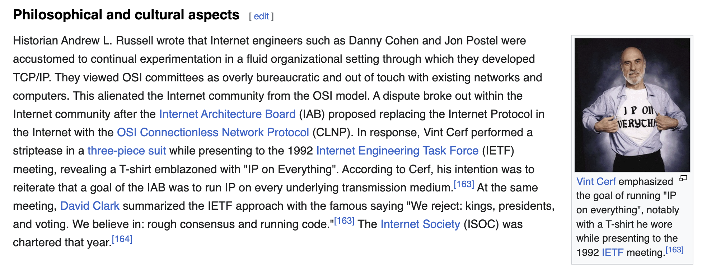
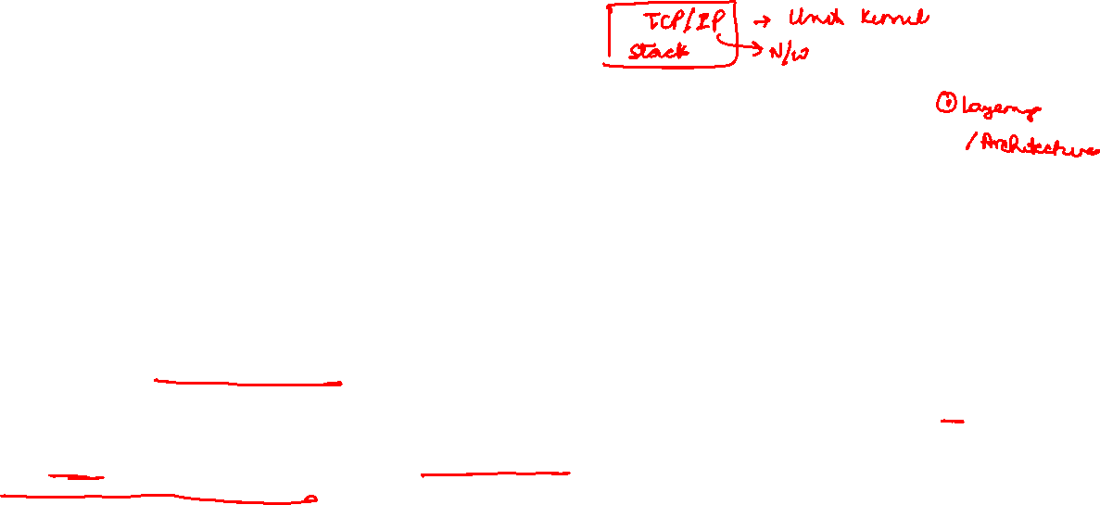
An alternative Internet Architecture
OSI/ISO reference model
Two layers not found in Internet protocol stack!
presentation: allow apps to interpret data (encryption, compression, conventions)
session: synchronization, checkpointing, recovery of data exchange
application
presentation
session
transport
network
link
physical
NEVER ADOPTED
The seven layer OSI/ISO
reference model
Design and implementation are not a linear process.
OSI 7-layer model was proposed but never saw the light of day — TCP/IP won in practice.

Slide 16
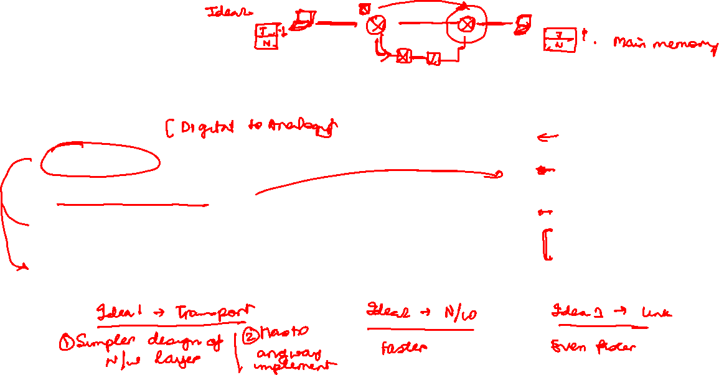
Where to implement network functions?
Common Network Services
Data transmission (encoding, decoding)
Reliability
Addressing/routing
Congestion control
In-order delivery
..
application
application
transport
transport
network
network
link
link
physical
physical

Slide 17





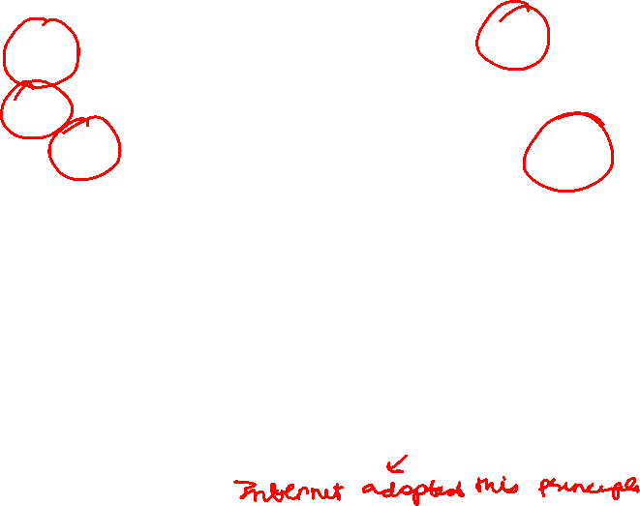




Where to Implement Network Services?
Two different paradigms
In-network support
Network with rich functionality that covers most requirements
Complex switch design
For example, switches implement reliability
End-system support only
As little functionality as possible in the network
Most functionality at the end points
Dumb network, intelligent end-points

Slide 18

Dumb Network, Intelligent End-hosts: End-to-end principle
Need end-to-end correctness anyways
Not everyone needs it
Diminishing returns from in-network functionality
Cost-effective
Not everyone has it
All networks are not capable of providing functionalities
Flexibility of implementation
Easier to change the end-hosts than all the switches in the network
Any limitations?

Slide 19
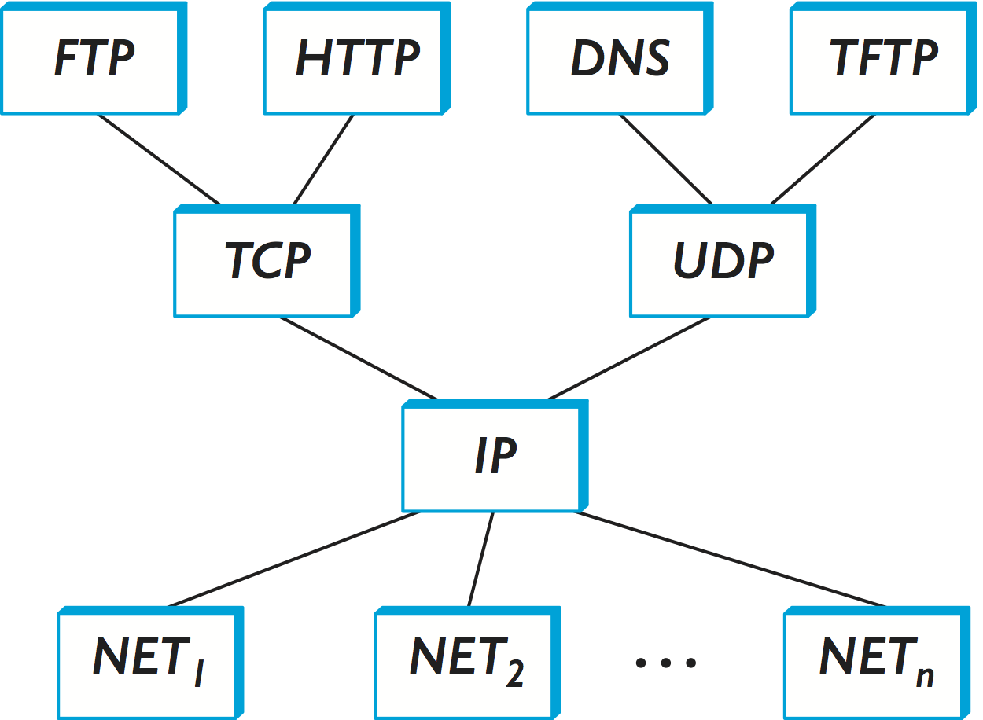
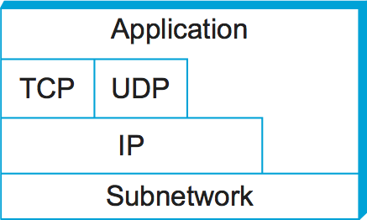
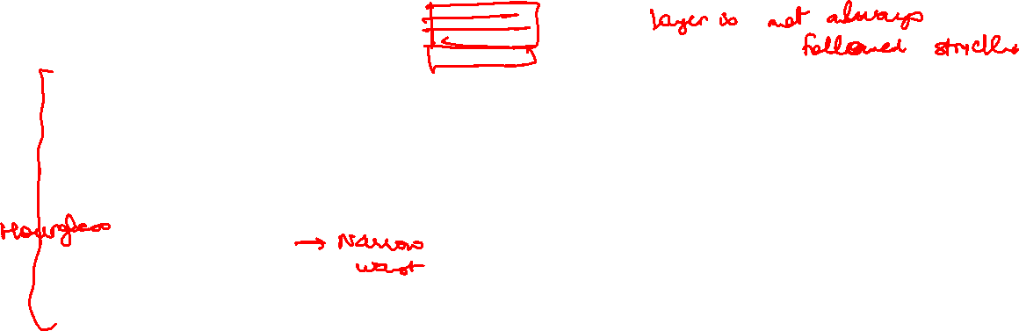
Internet Protocol Graph
The internet protocol suite forms an hourglass: many applications (FTP, HTTP, DNS, TFTP) ride on TCP or UDP, which both narrow to a single waist — IP — that runs over any underlying network (NET₁…NETₙ). The right-hand stack shows the same idea as layers: Application → TCP/UDP → IP → Subnetwork.

Slide 20
Summary
# 1: Layering, a useful construct, to organize Internet architecture
Allows different implementations to inter-operate with each other
Internet uses a 5-layered architecture, called IP stack
Encapsulation used for adding layer information
#2: End-to-end principle
Move all intelligence to the end hosts
Makes the design of network simpler
End hosts are easier to change compared to changing the entire network

Slide 21
Break
5 minutes

Slide 22
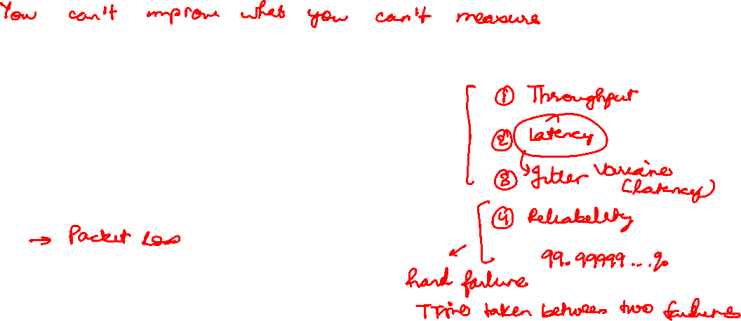
How do we measure the performance of a network?​
Why should we measure network?
What are the different metrics that characterize network performance?
Latency
Throughput
Loss

Slide 23
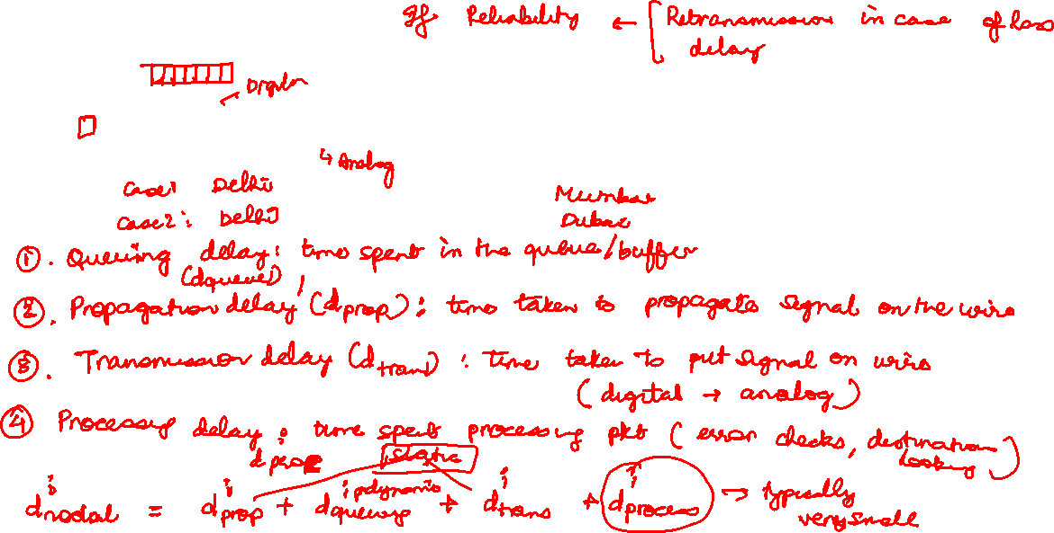
Sources of packet delay
A
B
Notes:
d_{proc}: nodal processing
check bit errors
determine output link
typically < microsecs
d_{queue}: queueing delay
time waiting at output link for transmission
depends on congestion level of router
d_{prop}: propagation delay:
time taken for the signal to reach its destination
d: length of physical link
s: propagation speed (~2x10⁸ m/sec)
d_{prop} = d/s
d_{trans}: transmission delay:
time taken to transmit the packet from host to the link
L: packet length (bits)
R: link transmission rate (bps)
d_{trans} = L/R

Slide 24

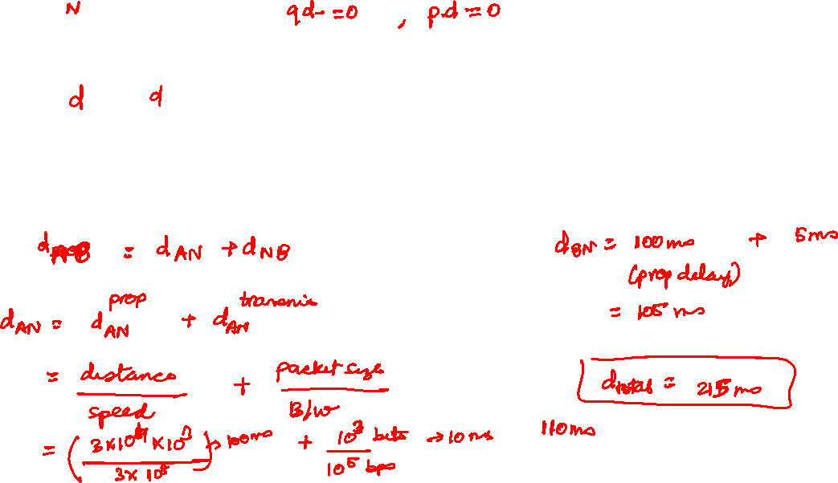





Problem
d = 30,000 km Packet size = 1,000 bits Signal speed = 3 × 10⁸ m/s
Q: How long does it take to send a packet from A to B?

Slide 25

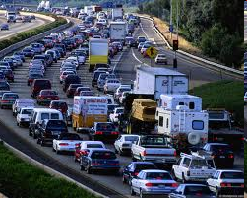
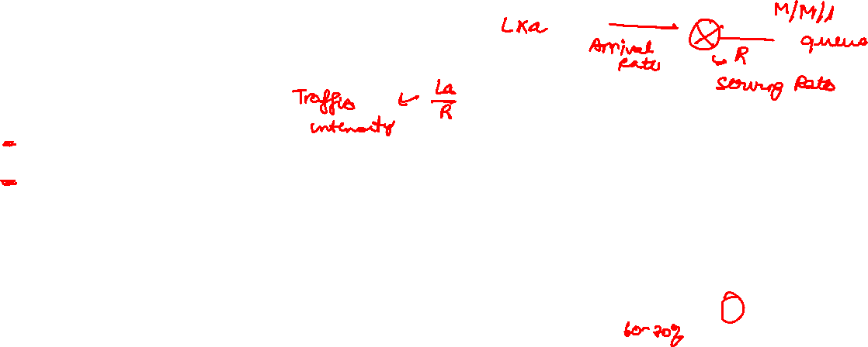
Packet queueing delay (revisited)
a: average packet arrival rate
L: packet length (bits)
R: link bandwidth (bit transmission rate)
average queueing delay
L
a
.
:
arrival rate of bits
“traffic
intensity”
R
service rate of bits
traffic intensity = La/R
1
La/R ~ 0: avg. queueing delay small
La/R -> 1: avg. queueing delay large
La/R > 1: more “work” arriving is more than can be serviced - average delay infinite!
La/R ~ 0
La/R -> 1

Slide 26




End-to-end delay
What is end-to-end delay?

Slide 27
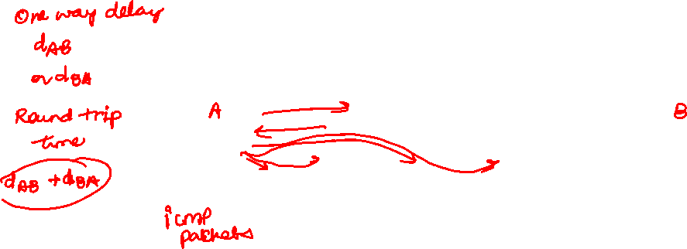
How do you measure delay on network?
Ping: provides delay measurement from source to a destination
traceroute program: provides delay measurement from source to router along end-end Internet path towards destination. For all i:
sends three packets that will reach router i on path towards destination (with time-to-live field value of i)
router i will return packets to sender
sender measures time interval between transmission and reply
3 probes
3 probes
3 probes

Slide 28
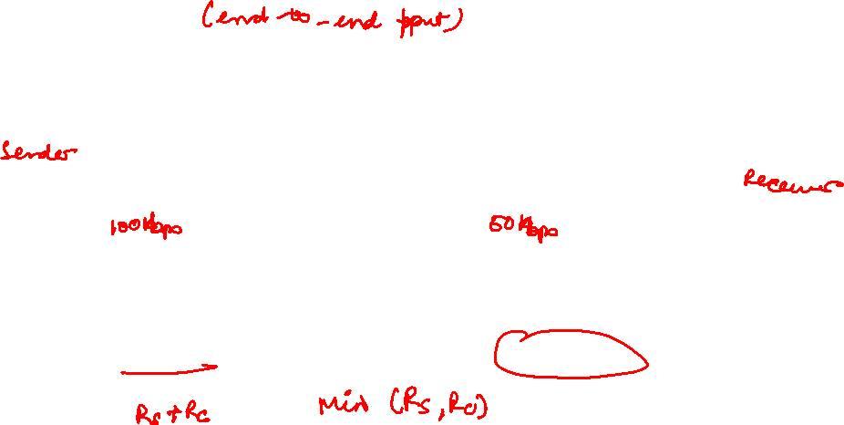
Throughput
throughput: rate (bits/time unit) at which bits are being sent from sender to receiver
instantaneous: rate at given point in time
average: rate over longer period of time
link capacity
R_{s} bits/sec
link capacity
R_{c} bits/sec
pipe that can carry
fluid at rate
(R_{s} bits/sec)
pipe that can carry
fluid at rate
(R_{c} bits/sec)
server sends bits
(fluid) into pipe
server, with
file of F bits
to send to client

Slide 29

Throughput: network scenario
per-connection end-end throughput: min(R_{c},R_{s},R/10)
in practice: R_{c} or R_{s} is often bottleneck
R_{s}
R_{s}
R_{s}
R
R_{c}
R_{c}
R_{c}
10 connections (fairly) share backbone bottleneck link R bits/sec

Slide 30
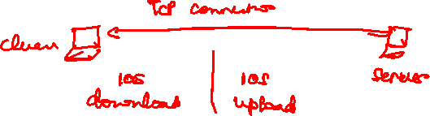
How do you measure end-to-end throughput on network?
Various speed test tools (e.g., ookla speedtest, mlab ndt7, iperf)
How does a speedtest work?
Let’s take a speedtest

Slide 31
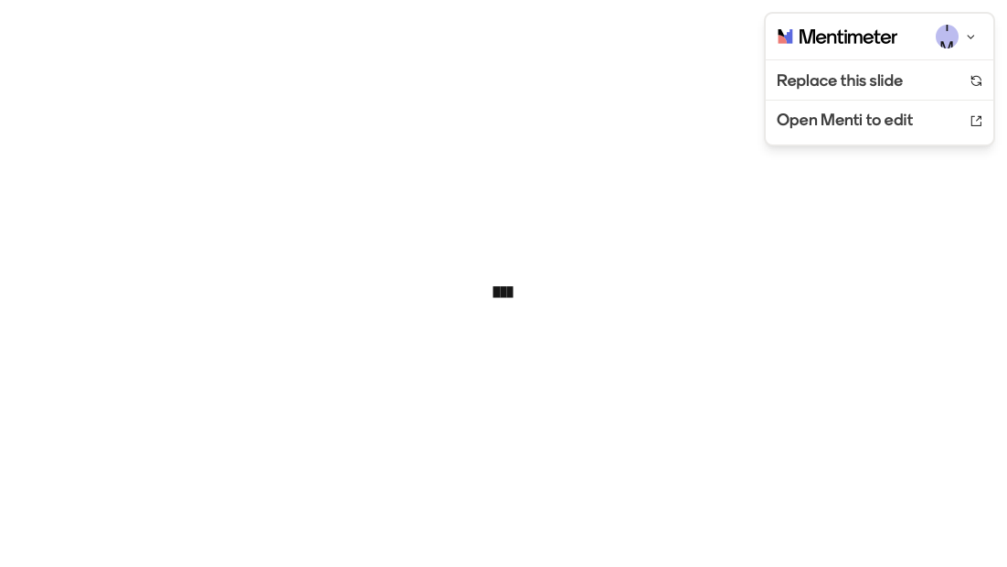
What is the official unit of energy?

Slide 32


In a packet-switched network w/ each link having a bandwidth 100 kbps. What is the end-to-end transmission delay for sending 1 kbit data?

Slide 33

Which statement is NOT true for packet switching.

Slide 34

Congestion control needs to be implemented in a circuit-switched network

Slide 35
And the winner is... 🥁

Slide 36
How to teach rest of networking?
Bottom-Up
Physical → Application (Tanenbaum)
Pros
Mirrors how networks were engineered
Builds deep appreciation for L1/MAC fundamentals
Cons
Dry start; weak motivation
Apps and "why" come too late
Top-Down
Application → Physical (Kurose & Ross)
Pros
Grounded in apps students use daily
Socket programming early builds confidence
Cons
Lower layers feel like "magic"
Physical-layer topics get rushed
application
application
transport
transport
network
network
link
link
physical
physical

Slide 37
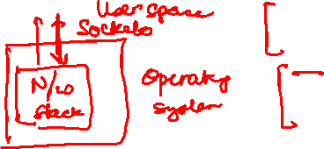
Writing a networked application
socket: software endpoint where a process sends and receives data over the network
socket analogous to door
sending process shoves message out door
sending process relies on transport infrastructure on other side of door to deliver message to socket at receiving process
two sockets involved: one on each side
application
socket
application
controlled by
app developer
process
process
transport
transport
network
network
controlled
by OS
link
Internet
link
physical
physical

Slide 38
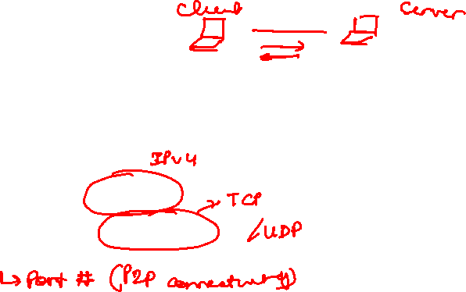
Socket Program
● ● Server (TCP)
import socket
s = socket.socket(socket.AF_INET,
socket.SOCK_STREAM)
s.bind(('', 12000))
s.listen(1)
# wait for a client
conn, addr = s.accept()
data = conn.recv(1024).decode()
reply = data.upper()
conn.send(reply.encode())
conn.close()
● ● Client (TCP)
import socket
s = socket.socket(socket.AF_INET,
socket.SOCK_STREAM)
s.connect(('localhost', 12000))
# send a line to the server
msg = input('Enter message: ')
s.send(msg.encode())
reply = s.recv(1024).decode()
print('From server:', reply)
s.close()

Slide 39
Key Takeaways
The internet is built on layering and the end-to-end principle
Protocols define services; layers hide complexity from those above
Keep the network simple; put intelligence at the endpoints
Performance has a few core knobs
Bandwidth, latency, jitter, loss — different apps care about different ones
Top-down vs bottom-up are teaching choices, not truths
Pick the order that gets students to “why” fastest
Sockets are where the abstractions meet code
Tutorial will work through socket programming hands-on
Next session: addressing and routing

