Slide 1
INTERFACING AN AI CHATBOT WITH THE COLLEGE WEBSITE

Slide 2
Objective
The concept of chatbots has not been a new in this technological growing society. Our project acutely deals with an important section of this growing entity, focusing the usage of the chatbots in the field of education, especially higher education. The current model of the project is made to handle the queries of the students regarding their department or college. The model deals on a real time basis with the students clearing the rings of doubts in minds of students over the whole college procedure. When the website has lot of sections, it is difficult for the student to access what they exactly want. It is not practically feasible for the institutes to fix up a real time assistant to pass the information . This is where our chat bot comes to the aid. It is designed to meticulously help students discover the institutes which they desire to go. The bot works on the real time data provided by the institutes itself to increase reliability and increasing transparency for students.

Slide 3
Problem Identification and problem statement contd.
The system will have two types of users. First type of the user will be the Admin, who will handle the entire system, and the other type of the user will be Students. There will be two types of students, registered ones and unregistered ones. The registered users will have to log in using the User ID and Password provided to them and after successfully logging in, student can ask his queries. The unregistered users will have to first register themselves in the system by filling up the simple registration form. Then after successful registration, the student can ask his queries.
To access this system, user needs to have a web services enabled device. The system proposed system will be a web based system. So the entire project will be hosted on a cloud platform. The users can access this system from any place and at any time. The response time to the queries of the user will depend upon the internet speed of the user. If user has a decent internet connection, he/she will get the answers to his/her queries in the usual time. The usual reply time will be around 3-5 seconds as the process involves fetching the keywords from the user’s query, searching it in the knowledge database and then showing the output. This process will take some time, which is estimated to be 4 seconds approximately. If the user has a bad internet connection, it will take some more time for him to get the output. But even in the worst case, the response time will not exceed 15 seconds.

Slide 4
Methodology
Working with UI
Chatbot needs an UI to interact with human. This is the basic need for it. Our UI is designed with HTML, CSS and JavaScript
HTML & CSS is for frontend and JavaScript is for backend.
We use dialog flow api in the backend to train our algorithm which filters certain keywords from the user queries and search in the database based on the keywords and display the answer for the user query.

Slide 5
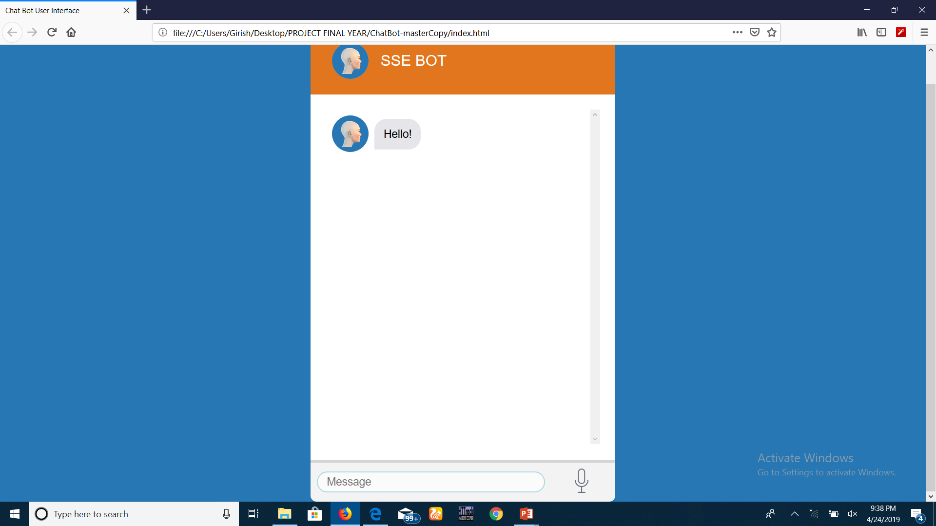
Methodology contd.
This is how the UI of chatbot looks like.

Slide 6

Methodology contd
Dialogflow API
Here we are using Dialogflow API to train the chatbot.
Dialogflow (Previously known as API.AI) is where the magic happens. It works on natural language processing and backed by Machine Learning . At Dialogflow the whole ‘conversation’ take place. Dialogflow is backed by Google and runs on Google infrastructure, which means you can scale to millions of users. The process a Dialogflow agent follows from invocation to fulfillment is similar to someone answering a question, with some liberties taken of course.

Slide 7
Methodology contd.
Why Dialogflow?
On any platform — Dialogflow support more than 20+ platforms from Google home to Twitter
Across devices — Dialogflow supports all the devices from wearables , to phones to devices.
Around the world — Dialogflow supports more than 14+ languages worldwide & more support is coming.
Glossary
1.agent
2. intent [ conversation starter ]
3. entity [ variables ]
4. fulfilment [ Custom code ]
5. context
6. Platform Integration

Slide 8
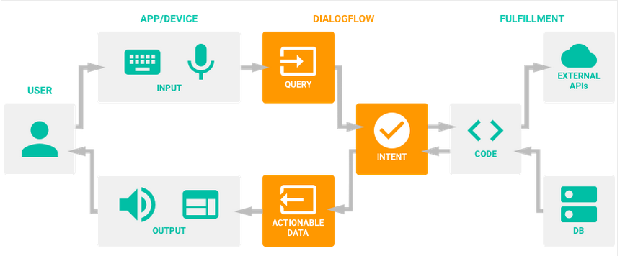
Methodology contd.

Slide 9
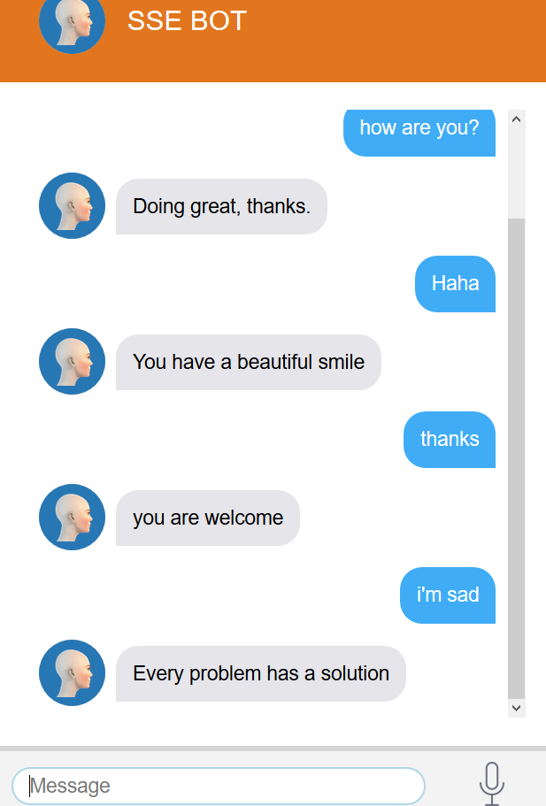
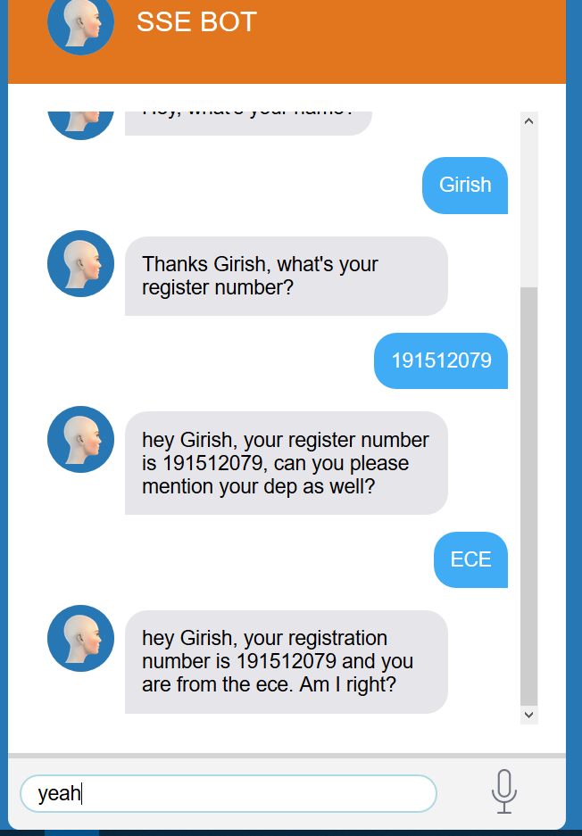
Results

Slide 10
Thank you

