Slide 1
Introduction to Performance Testing
Presenter: Sachin Kulkarni

Slide 2
Agenda
What is Performance Testing
Limitations of Manual Performance Testing
Why Performance Test?
Performance Engineer Skills
Performance Related Testing
Types of Performance Testing
Performance Testing Tools
Performance Testing Engagement Form
Questions and Contact Information

Slide 3
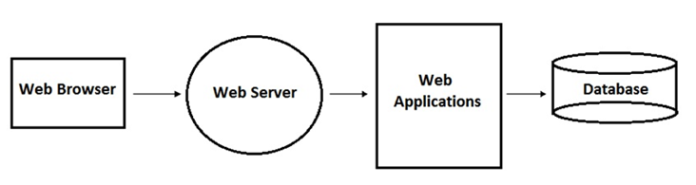
What is Performance Testing?
One of the definition is testing an application under defined or heavy loads, such as testing of a web site under a range of loads to determine the Response time or at what point the system's response time degrades or fails.
A Simple Web Application Architecture

Slide 4
Limitations of Manual Performance Testing:
Traditional or manual testing methods offer only a partial solution to load testing.
Following are the drawbacks of Traditional Manual Performance Testing:
It is expensive, requiring large amounts of both personnel and machinery.
It is complicated, especially coordinating and synchronizing multiple testers.
It involves high degree of organization, especially to record and analyze the results meaningfully.
Repeatability of the manual tests is limited.

Slide 5
Example Manual Performance Testing
Real Users
HTTP
N e t w o r k
HTTP
HTTP
DB Server
HTTP
App Server
HTTP
Web Server
App Server
HTTP

Slide 6
Why Performance Testing
Speed - Does the application respond quickly enough for the users?
Scalability – Will the application handle the expected user load and beyond?
Stability – Is the application stable under expected and unexpected user loads?
Throughput – Amount of requests that the application is able to process in a time unit.
Confidence – Are you sure that users will have a positive experience on go-live day?

Slide 7
Speed
User Expectations
Experience
Usage
System Constrains
Hardware
Network
Software
Cost
Speed can be expensive

Slide 8
Scalability
How many users….
before it gets “slow”?
before it stops working?
will it sustain?
do I expect today?
do I expect before the next upgrade?
How much data can it hold?
Database capacity
Back-up Server capacity
Data growth rates

Slide 9
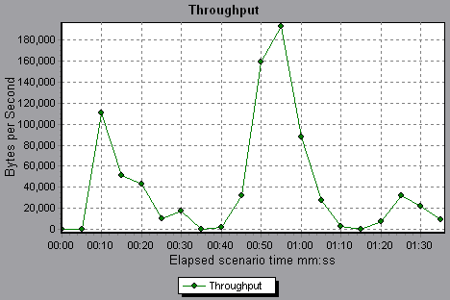
Stability
What happens if…
there are more users than we expect?
all the users do the same thing?
a user gets disconnected?
the web server goes down?
we get too many orders for the same thing?
Throughput
Represents the amount of data that the Vusers received from the server at any given second, measured in B/K/M/G bps.

Slide 10

Confidence
If you know what the performance is…
you can assess risk.
you can make informed decisions.
you can plan for the future.
you can sleep the night before go-live day.
The peace of mind that it will work on go-live day
alone justifies the cost of performance
testing.

Slide 11
Performance Engineer Skills
Functional Testing
Programming and Architecture
Networking and Protocols
Business Analysis
Databases and Validation
Planning
Systems and Hardware Administration
Results Analysis and Root cause
Reporting and Suggestion

Slide 12
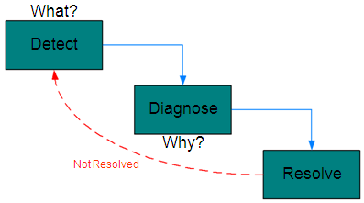
Performance Related Testing
Performance Validation
Performance Testing
Performance Engineering

Slide 13
Performance Validation
“Performance validation is the process by which software is tested with the intent of determining if the software meets pre-existing performance requirements.”
Primarily used for…
Determining SLA compliance.
Response Time
Threshold Limit for Resource utilization (CPU, Memory etc.)
Validating subsequent builds/releases.

Slide 14
Performance Testing
“Performance testing is the process by which software is tested to determine the current system performance. This process aims to gather information about current performance, but places no value judgments on the findings.”
Primarily used for…
determining capacity of existing systems.
creating benchmarks for future systems.
evaluating degradation with various loads and/or configurations.

Slide 15
Performance Engineering
“Performance engineering is the process by which software is tested and tuned with the intent of realizing the required performance. This process aims to optimize the most important application performance, user experience.”
Primarily used for…
new systems with pre-determined requirements.
extending the capacity of old systems.
“fixing” systems that are not meeting requirements/SLAs.

Slide 16
Types of Performance Testing
Load Test: Expected load
Stress Test: Exceed the expected load (try to find the crash point)
Long Test/ Endurance Test: Expected load for long duration (identify memory leaks)
Spike Test: Maximum utilization (peak load/utilization)

Slide 17



Tools
Proprietary
HP – Loadrunner
IBM – Rational Performance Tester
Borland – SilkPerformer
Free
JMeter
OpenSTA
WebLoad
Customized
Do yourself ☺

Slide 18
Performance Testing
Tools

Slide 19

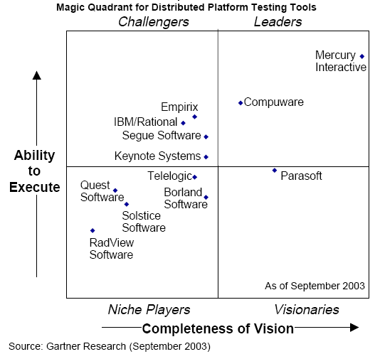
Performance Test Tools

Slide 20
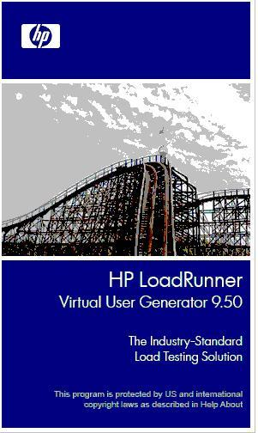
About LoadRunner
LoadRunner is a load test tool that predicts system behavior and performance.
LoadRunner exercises an entire application infrastructure by emulating workload as if it was generated by the real clients or users.
LoadRunner can track and record transaction response times and system resource statistics during a test run. Results can be used for in-depth analysis and suggestion.

Slide 21
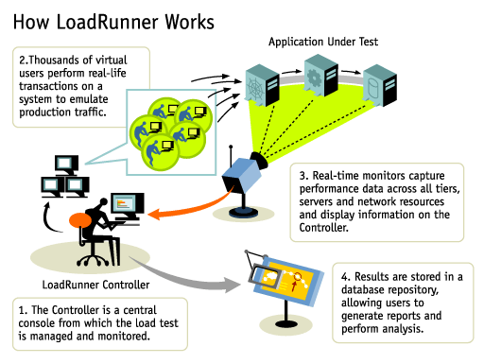
How LoadRunner Works

Slide 22


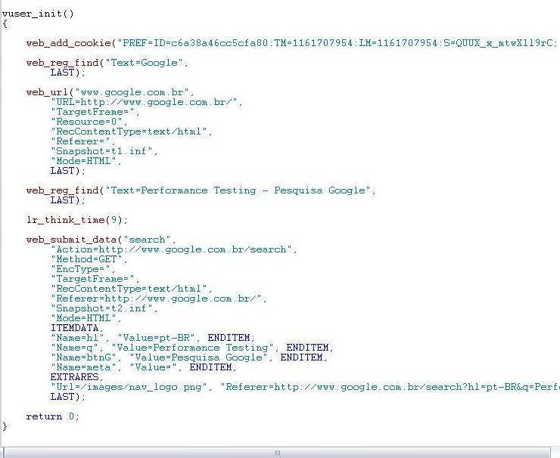
How LoadRunner Works Scripts Recording
Request
Web
Server
Application
Server
Database
Server
Response
VUGen

Slide 23
Execution Using Automated Tools
Virtual Users
N e t w o r k
HTTP
HTTP
DB Server
App Server
Web Server
App Server

Slide 24
LoadRunner Components
Mercury Virtual User Generator
Records the user actions into a C++ script
Deals with Dynamic values - Correlation
Deals with variable data - Parameterization
Mercury LoadRunner Controller
Creates the business Scenarios
Controls Test Execution
Collects infrastructure metrics
Mercury LoadRunner Analysis
Supports the results analysis
Creates charts and reports

Slide 25



Performance Testing Lifecycle LoadRunner Solution
Tune System Based on Analysis
Plan
Load Test
Test
Design
Record
Scripts
Create
Scenario
Run
Scenario
Analyze
Results

Slide 26
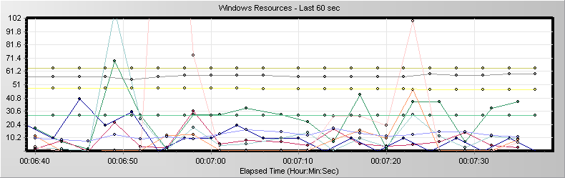
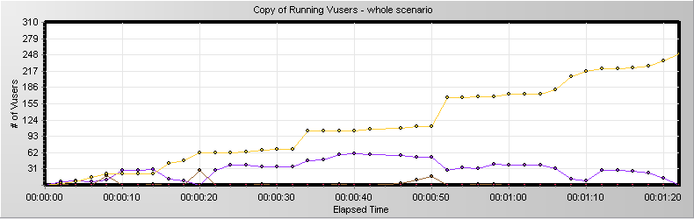
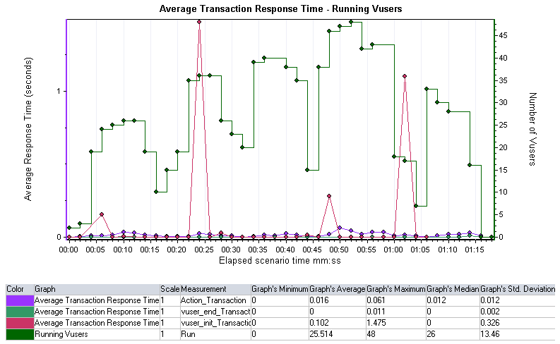
Monitoring the Resources
Servers Resources
Monitoring
VUsers Monitoring
Transactions Response Times
and graphics combination

Slide 27
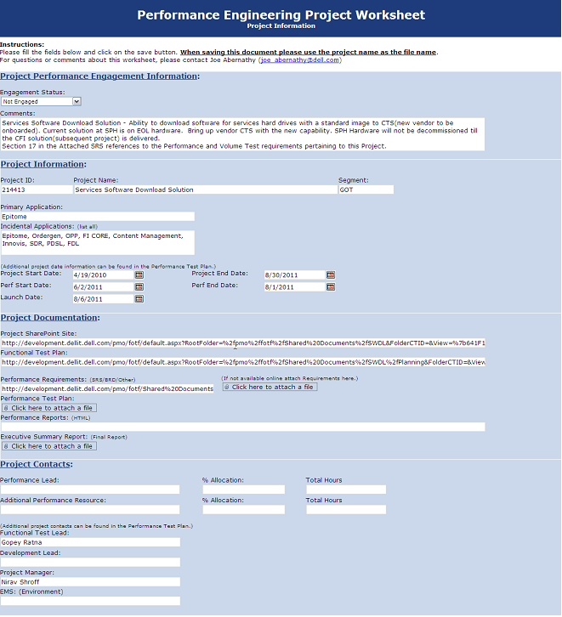
Performance Testing Engagement Form

Slide 28

Questions and Contact Information
Sachin Kulkarni
Email:
Sachin_Kulkarni1@dell.com

