Slide 1
HireFlow AI - Job Application Tracker
AI-Based Full Stack Project
Team Members: Surajit, Vikram, Suman, Vivek, Vikash, Utkarsh, Zoya

Slide 2
Project Introduction
HireFlow AI is an AI-powered job application tracking system.
It helps users manage job applications, track statuses, and analyze resumes.
Frontend: Streamlit
Backend: Flask
Database: SQLite

Slide 3
Key Features
• User Login & Signup
• Add Job Applications
• Track Job Status
• AI Resume Analyzer
• Streamlit Frontend
• Flask Backend API
• SQLite Database

Slide 4
Technology Stack
Programming Language: Python
Frontend: Streamlit
Backend: Flask
Database: SQLite
Libraries: Pandas, hashlib, requests, OpenAI

Slide 5
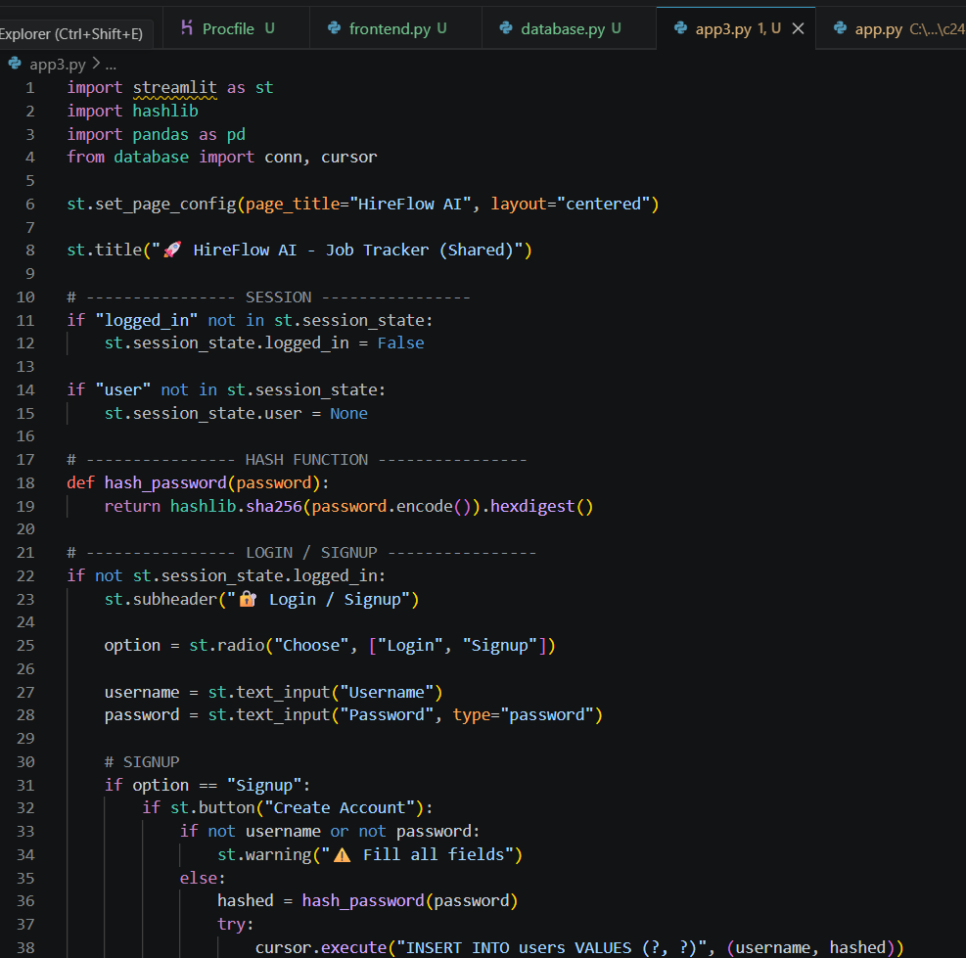
Project Code Screenshot

Slide 6
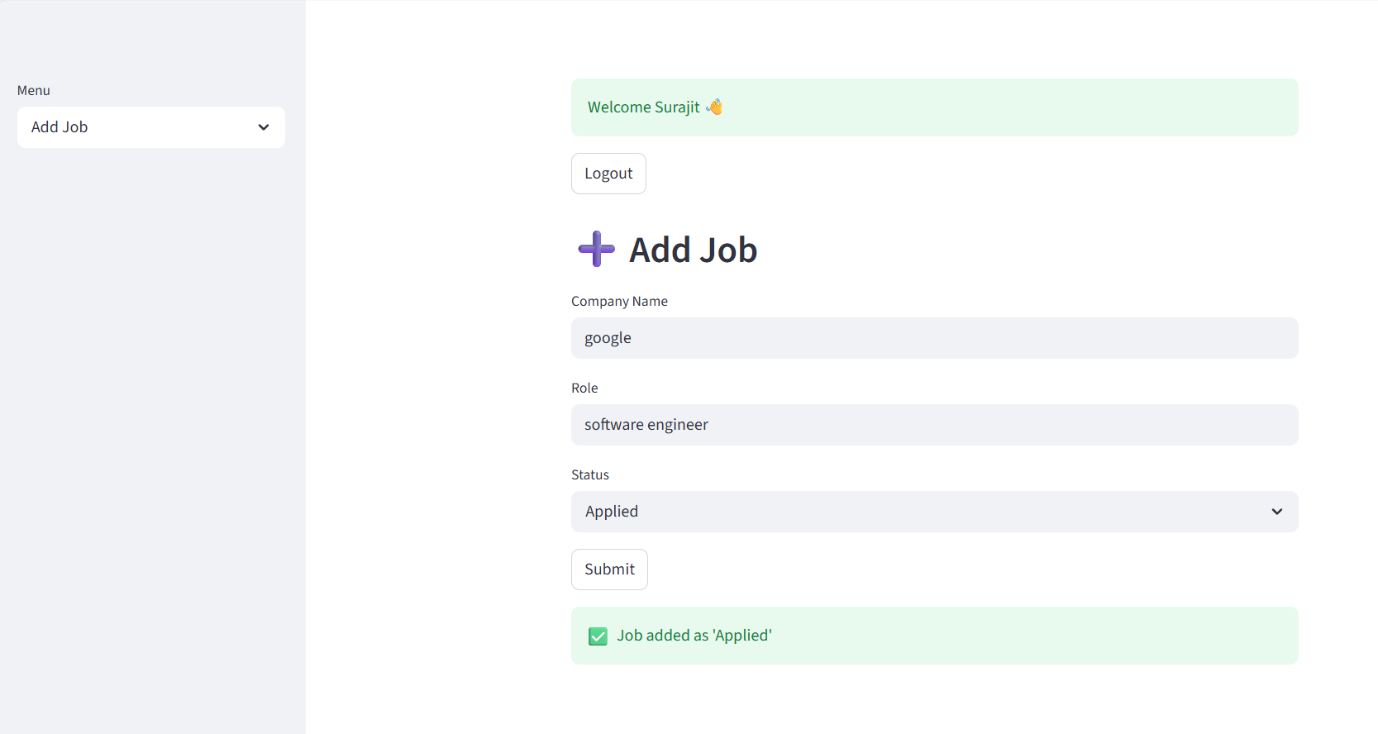
Project UI Screenshot

Slide 7
Project Workflow
1. User logs into the system
2. Add new job application
3. Store data in SQLite database
4. View and manage applications
5. AI analyzes resume and provides suggestions

Slide 8
Conclusion
HireFlow AI simplifies the job application process.
The project demonstrates full-stack development using Python.
It combines AI features with practical application tracking.

