Slide 1

Go, change the world
RV College of
Engineering
Computer Communication
Networks
TOPIC:IMPLEMENTATION OF SMART GARAGE SYSTEM USING CISCO PACKET TRACER SIMULATOR
BILLE GIRITEJA 1RV17EC029
Dept. of ECE, RVCE, Bengaluru

Slide 2
INTRODUCTION
Internet of Things is a burgeoning field in the world of technology
It helps ease life for a person by means of internetworking physical devices, automotive, home appliances and other items embedded with electronics, software, sensors and actuators
Smart garage is one such device that helps ease the access of the garage doors in domestic use.

Slide 3
INTRODUCTION
Smart garage system controls its objects such as windows , doors, lights, and also few gas detectors, alarm using micro-controller or computer technology
Smart garage help you to access your doors with the help of a computable device such as smart phones or tablets connected to a network, and access by means of secured pins to authorize the access
In this project we are implementing smart garage system with IOT and we will show the implementation of smart garage system using Cisco Packet Tracer

Slide 4
LITERATURE SURVEY
Sl No | Author | Journal/ Conference | Date published | Inference
1 | B S Sanjay | "Design and Implementation of Smart Garage- an IoT Perspective”-ICECDS-2017 | July 2017 | In this paper the author discussed about the security of the garage by installing smart lock system which can be operated manually and also using mobile server or any cloud server
2 | Md. Wahidur Rahman | International Journal of Innovative Science and Research Technology Volume 3, Issue 8 | August 2018 | In this paper the author discussed about efficient implementation of smart garage system using minimum cost and introduced the controlling of electrical components and also tracking the location of vehicle using android application
3 | ElakyaR,Juhi Seth, Pola Ashritha, R Namith | “International Journal of Engineering and Advanced Technology (IJEAT)” Volume 9 issue 5” | October 2019 | In this paper the author discussed about efficient and smart way to automate the management of the parking system that allocates an efficient parking space using internet of things technology

Slide 5
MOTIVATION
This automation helps us to reduce the temperature in the garage by opening the doors and windows when the CO2 emmissons reaches greater than the threshold .
As all are IoT devices ,they can interact with one another based on the conditions defined by the owner
We can view the garage using the IP camera that is installed in the garage which reduces human effort of constant checking in the garage
Scheduling the lights to turn on/off based on schedule reduces the human effort as well reduces the power consumption
Building a garage system which is smart and secure both at the same time will make our life’s easier as these days human’s are thinking smart rather than working hard ,hence we are motivated to implement the same using packet tracer

Slide 6
METHODOLOGY
To Implement Smart Garage System , we will be using cisco packet tracer ,which includes different smart objects used for Garage automation such as smart door, smart window, smart door, smart light , smart sensors, fire sprinkler ,and different sensors are included.
To control these smart objects and sensors, microcontroller (MCU) and IoT server are used.
To connect every smart object in the garage we use fast-ethernet cables and connect them through a switch which is connected to server and pc
Different Types of conditions are written on to the smart objects based on the user requirement to control the garage and security is assured to user by implementing the pin lock system in the mobile for automating uses

Slide 7
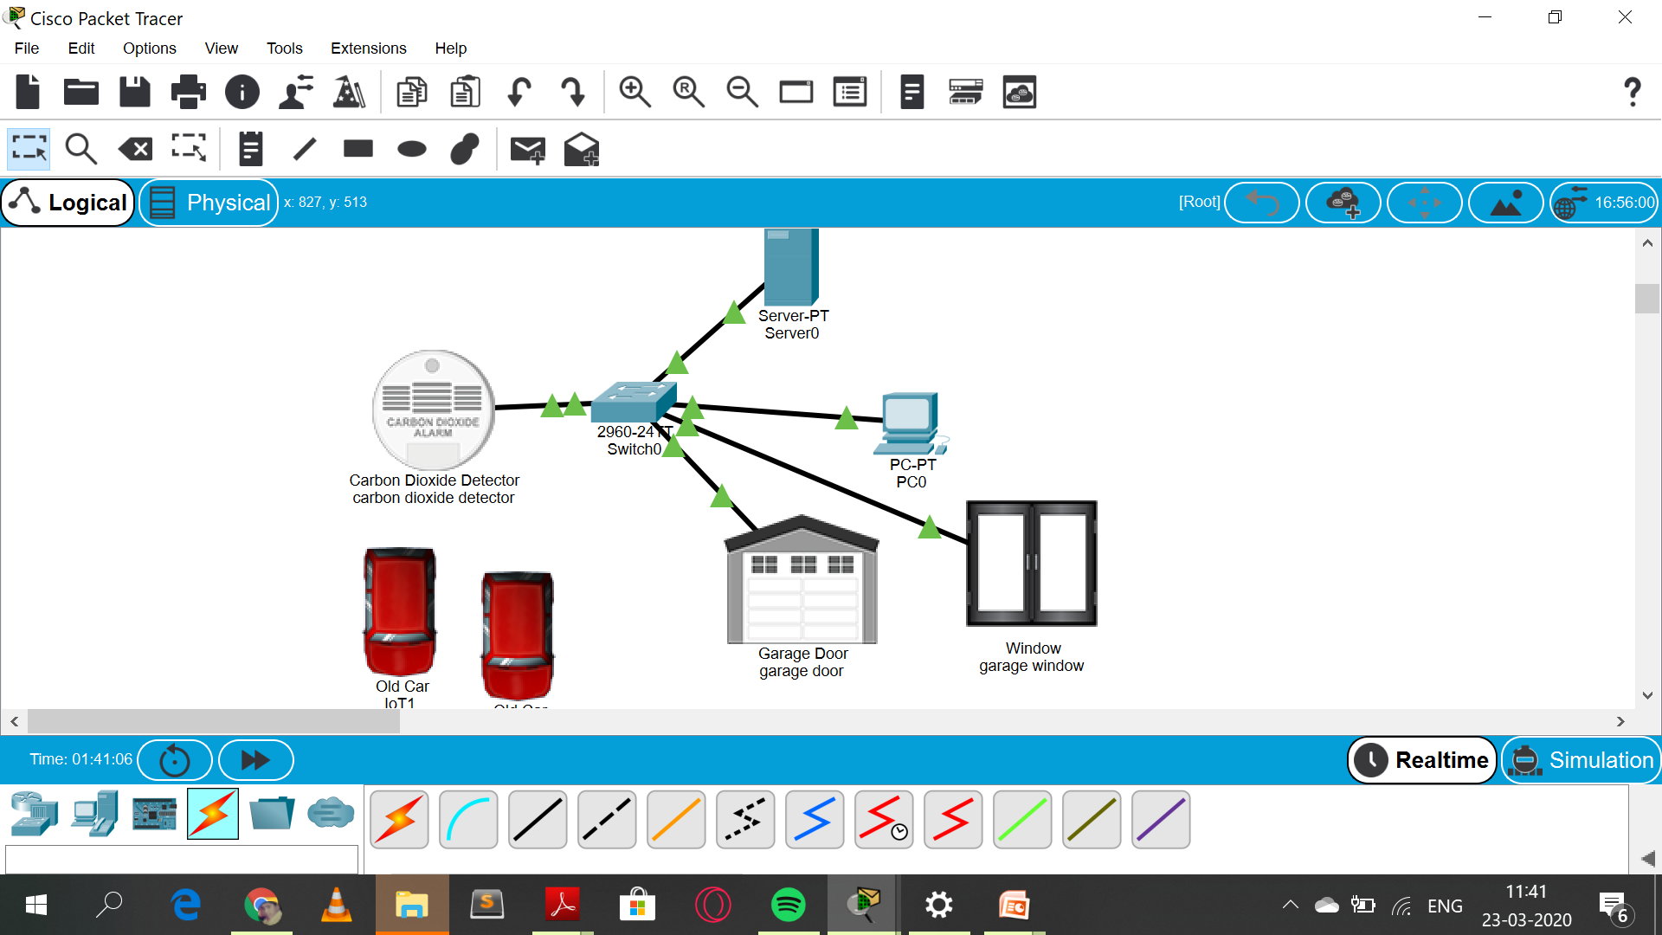
METHODOLOGY
This is the implementation that we have done for phase -1 which shows the smart objects are connected to the sever and PC using Ethernet cable and wireless medium to manage smart device local and remotely.
Before accesing the smart objects we have to connect them to the garage gateway
After registering smart devices to garage gateway all devices are accessed through web by authorized user

Slide 8
EXPECTED RESULTS
Opening of window and door when CO2 emmissions are greater than threshold value set by the user
Activating the ceiling sprinkler when the temperature and smoke level increase..
Automated the alarm when there is any problem related to fire .
Secured Authentications for IoT users by giving them username and password to control the smart objects

Slide 9
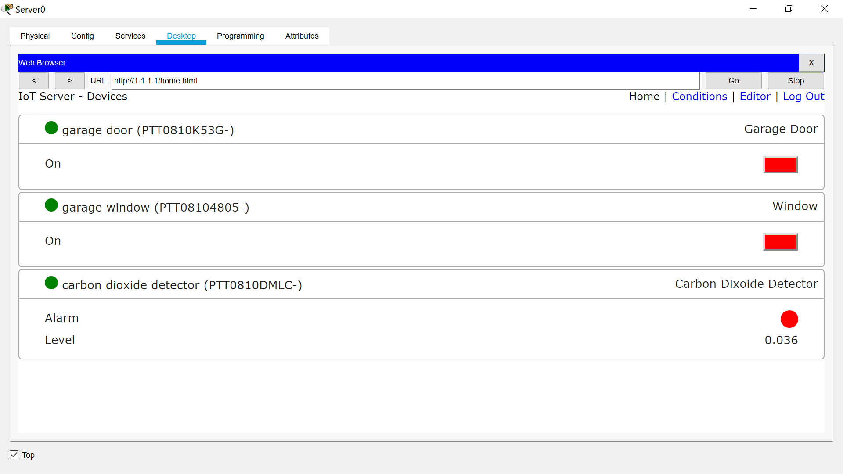
EXPECTED RESULTS

Slide 10
THANK YOU

