Slide 1
the hell that is…
TECHNICAL INTERVIEWS…

Slide 2
Sam Rhynas
Software Engineer 20+ years
Head of Operations
Stochastic Solutions
Girl Geek Scotland Leadership Team
PyData Meetup Organiser

Slide 3
Software Engineer
Senior Software Engineer
QA Manager
Release Manager
Operations Manager
Director of Operations
Head of Operations

Slide 4
Customer Support
Agony Aunt
Technical Author
Data Governance
Data StoryTeller
Project Manager
Software Engineer
Scrum Master
Gardener
Mentor
Sports & Social Organiser
QC
Negotiator
Data Scientist
UX design
Software Trainer
Test Manager
Unix Sys Admin
Dogsbody
People Manager
Installation Engineer
Facilitator
QA
Product Owner
Team Lead
DevOps
Operations
Account Manager
Mentor
Client Liason
Knitter
Client Management

Slide 5
What is
a
technical interview?

Slide 6




In your own space
Notes:
Alone & discuss details in next stage interview
Paired remotely
Monitored, perhaps Google docs or Collabedit
Using an online tool
Your examples of work eg in GitHub

Slide 7


In the office
Notes:
Assigned task then left alone to do it, then discuss
Paired, might be write code, might be observe other code, look at existing, refactor, bug spot, speed & efficiency
Review some code
Technical presentation
Whiteboard many small challenges

Slide 8
ASK!

Slide 9
PRACTISE! PRACTISE! PRACTISE!
Codewars.com
Hackerrank
Pramp
Gainlo
Alg.expert
Notes:
Writing on a board in front of folk is hard the first few times
Writing code on one…in an interview environment…is event harder!
PRACTISE! PRACTISE! PRACTISE!

Slide 10
Topics to consider…
Data Structures
Arrays
Lists
Stack
queue
Algorithms
Sort
search
Complexity
Optimisation
Speed
Memory
Notes:
Use of 3rd party libs
Coding style

Slide 11
Communicate
Clear
Simple
Analytical
Brief
Interesting
Aware
Think
Ask

Slide 12
If it’s going wrong…
Keep calm
Take a moment
Talk
Bounce Ideas
Notes:
Acknowledge awareness of an error
Suggest things you’d change ‘next time’
Highlight what you might do in ‘real life’
Accept critique

Slide 13
If it’s already gone wrong…
Fail graciously!
“That’s what I meant”
“No, you’re not right because…”
“Ah, ok, I see now how that might be a good way to approach it”
“Oh, I didn’t know that, thanks for explaining”
“OK, I must go and read more about that, thank you
Notes:
Acknowledge awareness of an error
Suggest things you’d change ‘next time’
Highlight what you might do in ‘real life’
Accept critique

Slide 14
What makes you stand out ?
Coding
is only part of what
makes you a
good software engineer

Slide 15
What makes you stand out ?
TESTING
METHODOLOGIES
USABILITY
SECURITY
PRIVACY
LEGAL
GOVERNANCE
DOCS
ETHICS

Slide 16
Have you any questions…
Ask the techies
tech questions…
Notes:
Don’t waste the opportunity
Reference any nontech questions if you are unsure on how to cover them

Slide 17
Have you any questions…
Test framework
what do you use
Continuous builds
what tools are they implement in
How long does it take to build & deploy
How do you manage your bugs?
What roles do you have in your project/agile teams?
Do you use open source tools/purchased tools/combo?
Notes:
Turn the list of “what makes you stand out” on it’s head
Ask questions about how THEY do those things

Slide 18

Follow Up

Slide 19

Follow Up

Slide 20
Follow Up
ASK
PERSONAL RETROSPECTIVE
LEARN
ASK A 3rd PARTY

Slide 21
Takeaways
ASK QUESTIONS BEFOREHAND
PRACTISE
KEEP CALM
COMMUNICATE
FAIL GRACIOUSLY
FOLLOW UP
LEARN
ENJOY THE NEW JOB!

Slide 22
If all else fails, it
might make a good blog post…

Slide 23
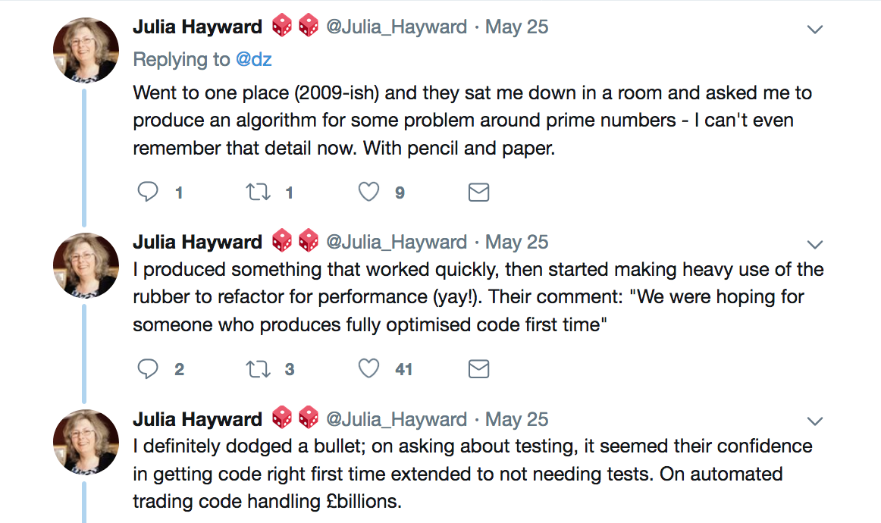

Slide 24
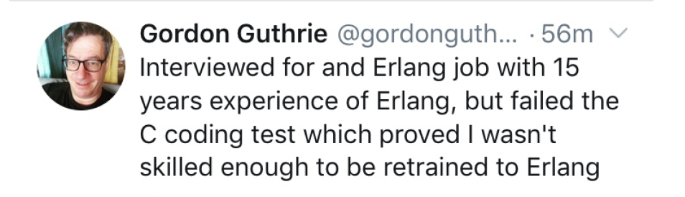

Slide 25
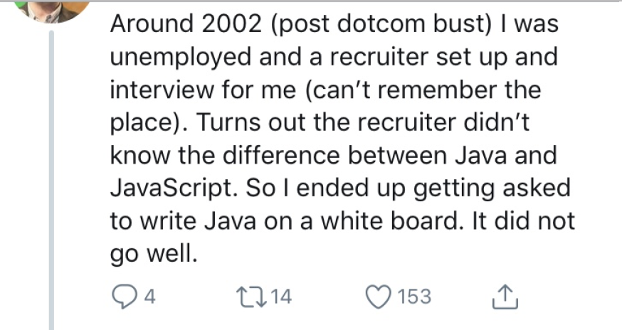
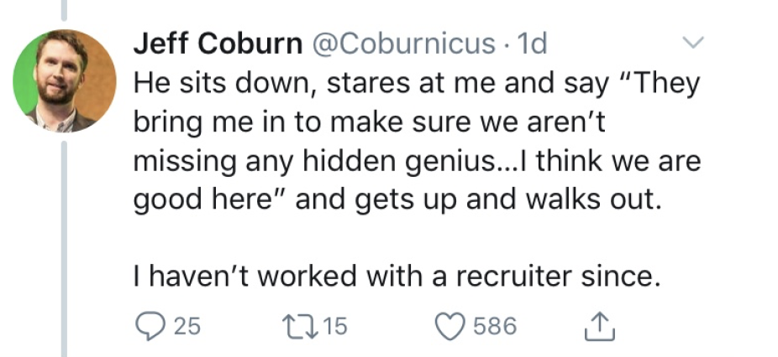
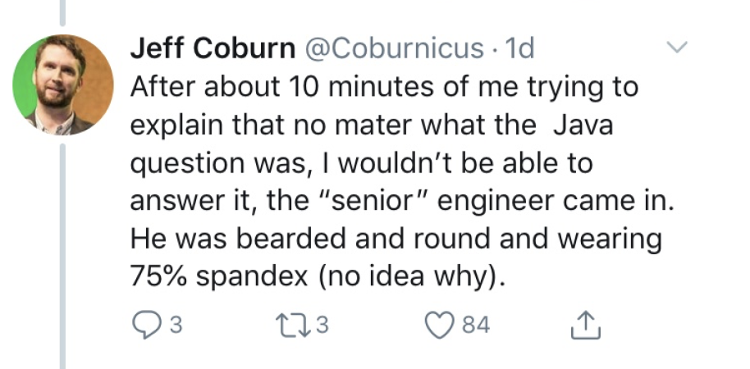

Slide 26
Sam Rhynas
@lilacpatsy
Stochastic Solutions
@StochasticSolns
Girl Geek Scotland
@GirlGeekScotland
PyData Edinburgh
@PyDataEdinburgh

Slide 27
