Slide 1
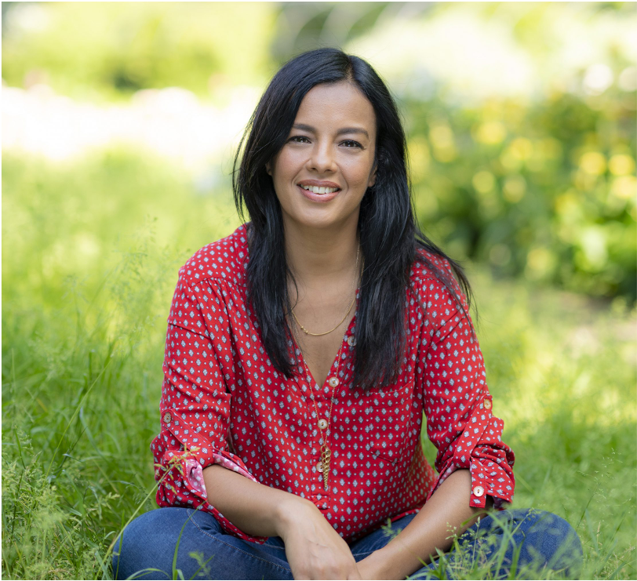

Green Challenge
Partnership Invitation

Slide 2

















Together for Good: Green Challenge
Together TV is the broadcaster inspiring positive change.
We believe that great content can create impact and change.
Our TV channel reaches 27m UK homes and we reach tens of millions via our digital channels
This summer 50k people went on our Sunflower Challenge journey.
This autumn we are inviting 100k people on our Green Challenge to help the planet though growing and eating more sustainably.
We will be posting 100k basil seed kits to homes across the UK, and creating a six-week growing and cooking journey.
We use a combination of national marketing, TV series, digital content, and free, themed experiences to motivate people to build new habits.
As COP26 approaches we are seeking partners whose groups would like to pre-register to take part in the Challenge. We would love it if you could:
Join the Green Challenge
Promote it to your networks
Support the Challenge online
For more information, please contact Francesca Aita, Together TV’s Head of Marketing on francesca@togethertv.com
Our Media Partners

Slide 3
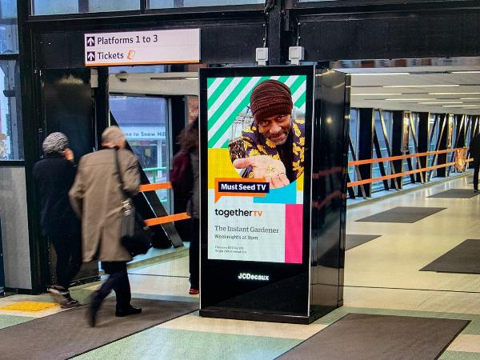
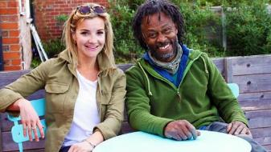
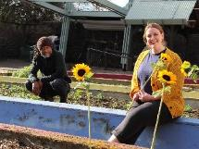
Together for Good: Sunflower Challenge
Above The Line marketing
Our BBC Creative-devised national ATL campaign featured Charlie Dimmock and Danny Clarke.
It reached millions through 450+ DOOH screens, print ads in 5 national newspapers, TV spots and social media advertising campaigns.
New TV series
We broadcast new series of Garden Rescue and The Instant Gardener on Together TV, reaching millions and driving thousands of sign-ups via content-specific Calls To Action
With 20k pre-registrations ahead of launch we smashed our 10k target on day 1 so bought more seed kits to increase our total to 50k
Sunflower Challenge Journey
Once seed kits are received, people go on guided journeys through weekly emails, SMS, website resources, Sunflower Challenge videos, wellbeing check-ins, galleries and online community.
Tens of thousands of people now growing and sharing sunflowers!

Slide 4



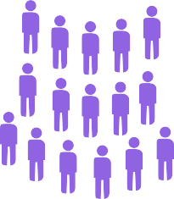






Our TV audiences
Available in 27m UK homes
15m annual TV viewers
4m monthly TV viewers
Our digital audiences
40m global Facebook reach
530k Facebook followers
2.7m YouTube video views
YouTube views up 217%
+217%

Slide 5

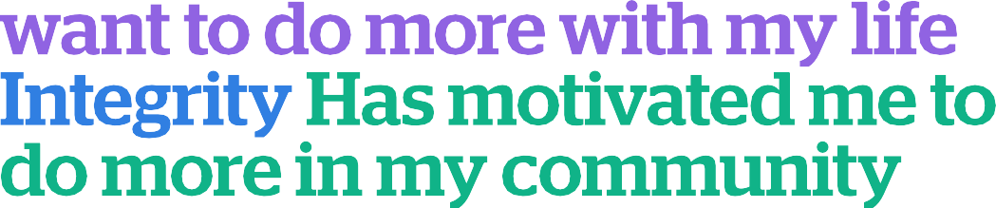
Together TV’s impact
3 million viewers say that we make them want to do more in their life
2.5 million viewers say that we motivate them to do more in their local community
Source: Opinium Oct. 2020, data set 2,000 individuals in UK
The Good Cook has given me much more confidence in the kitchen
After watching Trashed, I’m teaching my children to be conscious about their plastic use
Together TV is a true public service channel
Mike, Blackpool
Hema, Leicester
Brian, Facebook

Slide 6
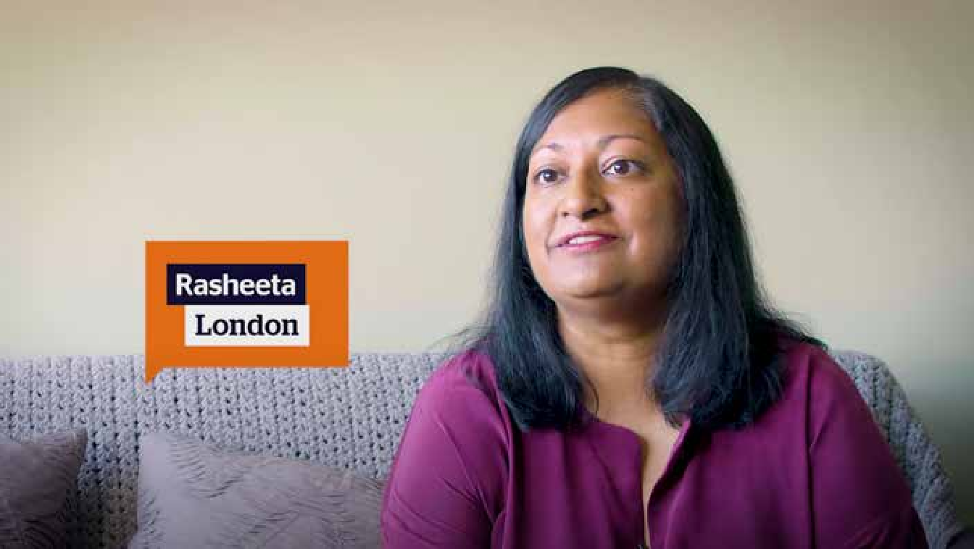
We Are Together TV
Get in touch
We Are Together TV
Click to play on YouTube
If you would like your staff, customers, beneficiaries to take part in our Green Challenge and our wider work, please get in touch with Francesca.
Francesca Aita
Head of Marketing
francesca@togethertv.com
Freeview 82
Sky 170
Virgin Media 269
Freesat 164
The Community Channel operating as Together TV is a charitable Community Benefit Society registered with the FCA (RS007400).
Designed by Patrick Miller

