Slide 2
Part 1 – Fetch the data
Data Set Name | Number of records
Portugal | 607
United_kingdom | 607
Hong_kong | 607
Eire | 607
Spain | 607
France | 607
Singapore | 456
Norway | 577
Germany | 607
Netherlands | 607
All | 607
Part-1.py script reads and transform data from json file into data frame which will be used during traning and prediction
Range of date:
From 2017-11-29 to 2019-05-31

Slide 3
Part 1 – Fetch the data
Country | Total revenue
EIRE | 104589.400
France | 38985.420
Germany | 45651.261
Hong Kong | 14393.130
Netherlands | 12296.780
Norway | 38326.120
Portugal | 13327.210
Singapore | 12945.460
Spain | 15393.360
United Kingdom | 3343551.644
the table shows the sum of revenues for three years for each country
it should be noted that the revenues in the UK are several times higher than revenues in other countries

Slide 4
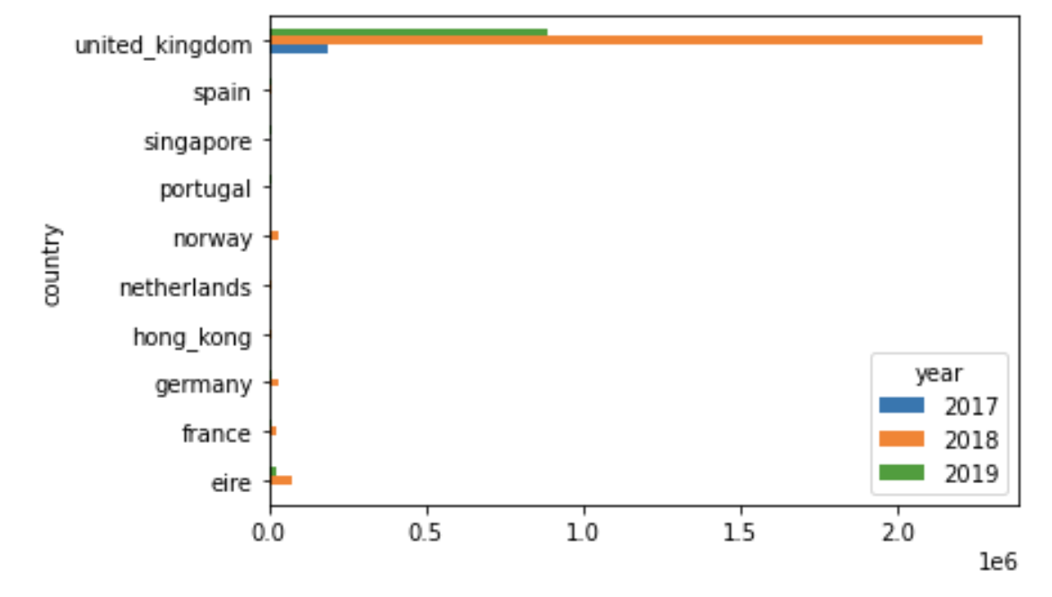
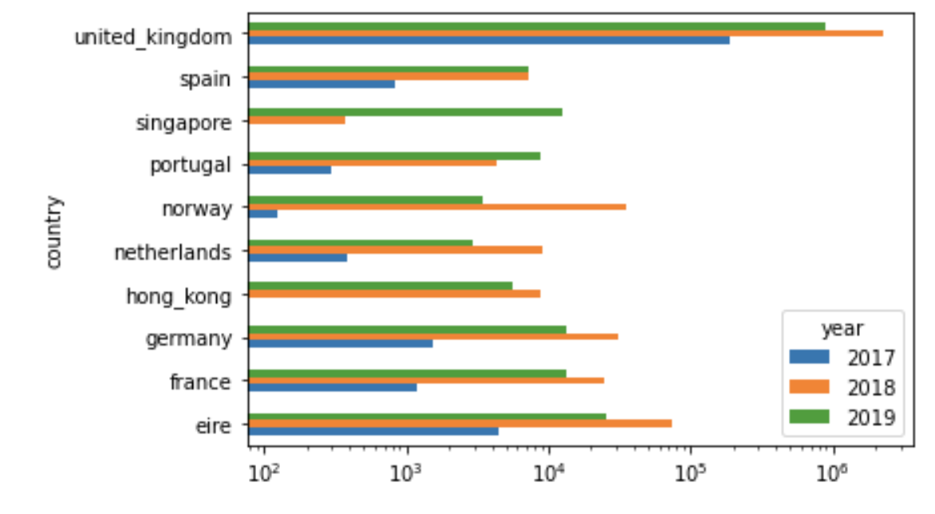
Part 1 – Fetch the data compare revenues in countries
(*) Logarythm scale

Slide 5
Part 2 – Create prediction model
Part-2.py script using Random Forest Regresion model for all data sets
Models was trained for following data set:
EIRE,
Spain,
Germany,
Netherlands,
France,
Portugal,
United Kingdom,
Hong Kong,
Singapore,
Norway
and for combined data sets.

Slide 6
Part 2.2 – Compare different models
Seleced model | Data Set Name
Ada Boosting | Portugal
Random Forest | United_kingdom
Random Forest | Hong_kong
Random Forest | Eire
Random Forest | Spain
Random Forest | France
Ada Boosting | Singapore
Random Forest | Norway
Random Forest | Germany
Random Forest | Netherlands
Random Forest | All
Part-2.2.py script using four methods to create prediction model:
SGD Regressor
Random Forest Regressor
Gradient Boosting Regressor
Ada Boost Regressor
Algorithm selected optimal model with minimal Mean Squared Error

Slide 7
Part 2.2 – learning curves for All data

Slide 8
Part 2.2 – learning curves for EIRE data

Slide 9
Part 2.2 – learning curves for France data

Slide 10
Part 2.2 – learning curves for German data

Slide 11
Part 2.2 – learning curves for Hong Kong data

Slide 12
Part 2.2 – learning curves for Netherlands data

Slide 13
Part 2.2 – learning curves for Norway data

Slide 14
Part 2.2 – learning curves for Portugal data

Slide 15
Part 2.2 – learning curves for Singapore data

Slide 16
Part 2.2 – learning curves for Spain data

Slide 17
Part 2.2 – learning curves for United Kingdom data

