Slide 1
rmi

Slide 2
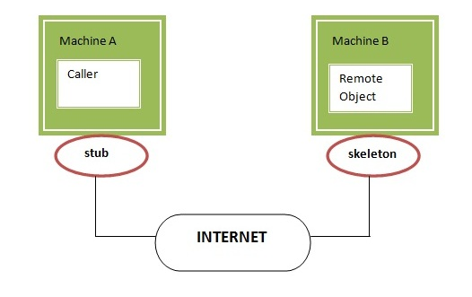

Slide 3
stub
skeleton
It initiates a connection with remote Virtual Machine (JVM),
It writes and transmits (marshals) the parameters to the remote Virtual Machine (JVM),
It waits for the result
It reads (unmarshals) the return value or exception, and
It finally, returns the value to the caller.
It reads the parameter for the remote method
It invokes the method on the actual remote object, and
It writes and transmits (marshals) the result to the caller.

Slide 4
//defining remote interface
import java.rmi.*;
public interface HelloWorld extends Remote{
public String display() throws RemoteException;
public int add(int x, int y) throws RemoteException;
}

Slide 5
//client program
import java.rmi.*;
import java.net.*;
public class HelloClient
{
public static void main(String args[]) {
try{
String host ="localhost";
HelloWorld remobject =(HelloWorld)Naming.lookup("rmi://"+host+"/HelloWorld");
System.out.println(remobject.display());
System.out.println(remobject.add(2,3));
}
catch(RemoteException re)
{
re.printStackTrace();
}
catch(NotBoundException nbe)
{
nbe.printStackTrace();
}
catch(MalformedURLException mfe)
{
mfe.printStackTrace();
}
}
}

Slide 6
//implementing remote interface
import java.rmi.*;
import java.rmi.server.UnicastRemoteObject;
public class HelloImp extends UnicastRemoteObject implements HelloWorld
{
public HelloImp() throws RemoteException{}
public String display() throws RemoteException
{
return "Hello world from sever";
}
public int add(int a, int b) throws RemoteException
{
return a+b;
}
}

Slide 7
//server program
import java.rmi.*;
import java.net.*;
public class HelloServer
{
public static void main(String args[]) {
try{
HelloImp localobject = new HelloImp();
Naming.rebind("rmi:///HelloWorld",localobject);
}
catch(RemoteException re)
{
re.printStackTrace();
}
catch(MalformedURLException mfe)
{
mfe.printStackTrace();
}
}
}

Slide 8
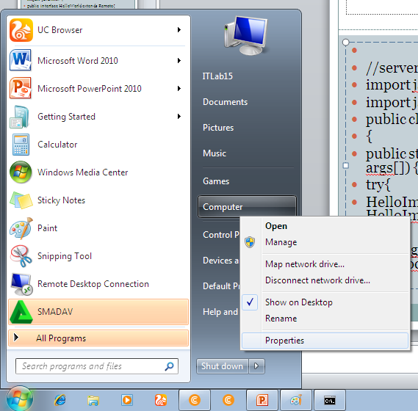

Slide 9
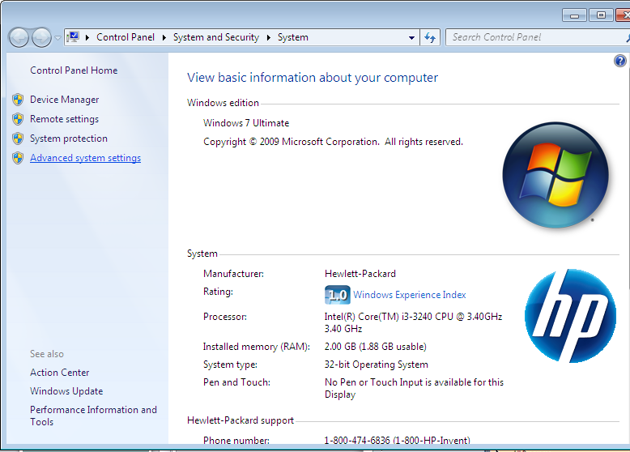

Slide 10
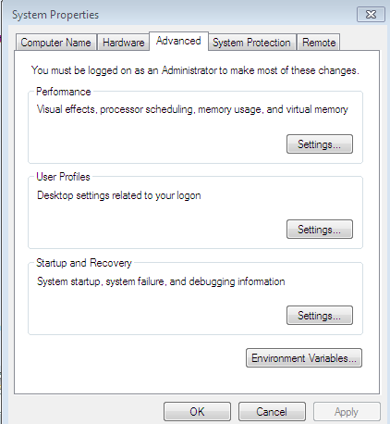

Slide 11
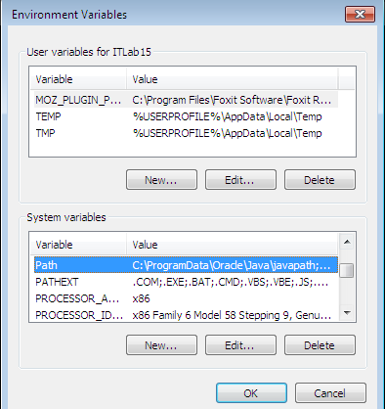

Slide 13
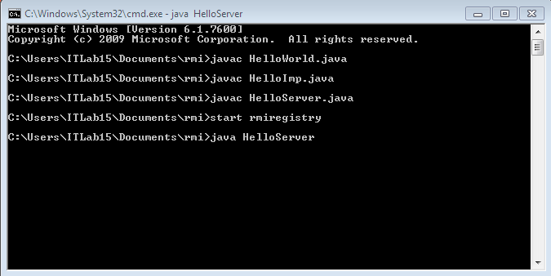

Slide 14
