Slide 1
Distributed systems
Consistency and replication

Slide 2
Outline
Introduction
Consistency
Replication
Objectives
By the end of this lesson
You will be able to
Define what consistency mean
Explain how to achieve consistency
Define what replication mean and
How to replicate nodes

Slide 3
Consistency is the agreement between multiple nodes in a DS to achieve a certain value.
Strong consistency : the data in all nodes is the same at any time. The value of key1 in node A and node B is the same. If it is updated update in all nodes
Week consistency : there is no guaranty that all nodes have the same data at any time.

Slide 4
Why replication?
To enhance reliability
If one replica is unavailable or crashes, use other
Protects against corrupted data
To improve performance
Scale with size of the DS (replicated web server)
Scale in geographically DS

Slide 5
Problems in replication?
Consistency : all replicas may not have the same data
Conflicting operations
Read-write conflict : a read operation and a write operation act concurrently
Write-write conflict : two concurrent write operation

Slide 6
Consistency models
Data-Centric
Client-Centric

Slide 7
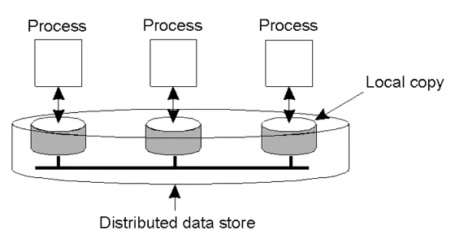
Data-Centric consistency model
A contract between the data storage and process in which the data store precisely what the result of read and write operations are in the present of concurrency.

Slide 8
Data-Centric consistency model
Strict consistency : any read on a data item ‘X’ return a value corresponding to the most recent write on X
P1 w(x) a
P2 | R(x)a
P1 w(x) a
P2 R(x) NIL | R(x)a

Slide 9
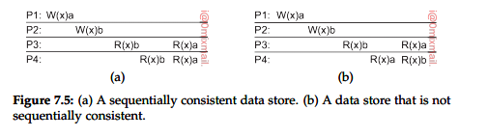
Data-Centric consistency model
Sequence consistency : if the execution sequence is the same then the result should be some sequence.

Slide 10
Data-Centric consistency model
Causal consistency : write read write among all processes
P1 | W(x)a | W(x)c
P2 | R(x)a W(x)b | R(x)c R(x)b
P3 | R(x)a | R(x)b R(x)c
P4 | R(x)a

Slide 11
Data-Centric consistency model
Causal consistency : write read write among all processes
W W R
a a b a → b order should be maintained
P1 | W(x)a | W(x)c
P2 | R(x)a W(x)b | R(x)c R(x)b
P3 | R(x)a | R(x)b R(x)c
P4 | R(x)a

Slide 12
Data-Centric consistency model
FIFO consistency : some causal but under it that process if WRW then check under WW order
P1 | W(x)a
P2 | R(x)a W(x)b | W(x)c
P3 | R(x)b | R(x)a R(x)c
P4 | R(x)a

Slide 13
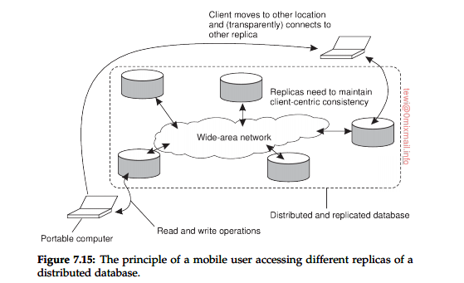
Client-Centric consistency model
Client-Centric consistency : aims at providing a system wide view of data store
The view we see in term of a client side

Slide 14
Client-Centric consistency model
Eventually consistency : in the system that tolerance high degree of inconsistency, if no update takes place for a long time all replicas will be gradually and eventually become consistent.
Monotonic read consistency : a data store is said to provide monotonic read consistency if a process read the value of data items any successive read operation on x by that process will always return the same value/ more recent value.
Monotonic write consistency : a data store is said to provide monotonic write consistency if a write operation by a process on a data item x completed before any successive write operation on x by the same process.

Slide 15
Client-Centric consistency model
Read your write consistency: a data store is said to provide read-your-write consistency if the effect of a write operation by a process on data item x will always be a successive read operation on x by the same process(write-read) ➔login
Write follow read consistency
A data store is said to provide write follow read consistency if a process has write operation on data item a following a previous read operation on x then it is guaranteed to take place on the same order a more recent value of x that was read. (read –write) ➔review

Slide 16
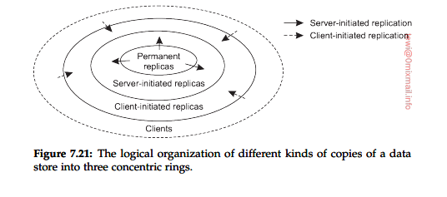
Replica mangment
Data replication : is a process of storing data in more than one place/node
This process is useful in improving the availability of data
Replication help in increasing of availability and fault tolerance in DS
Replica placement : it is basically states about where the server should be placed and how many number of replica are to be created
To identify location : calculate the distance between assumed server and calculate average

Slide 17
Consistency protocol
Remote write protocol
Local write protocol
1
4
W
R
2
W
R
R
3
W
W
R

Slide 18
?

